Slide 1
SAMSA
13 June 2023

Slide 2
SAMSA
13 June 2023

Slide 3
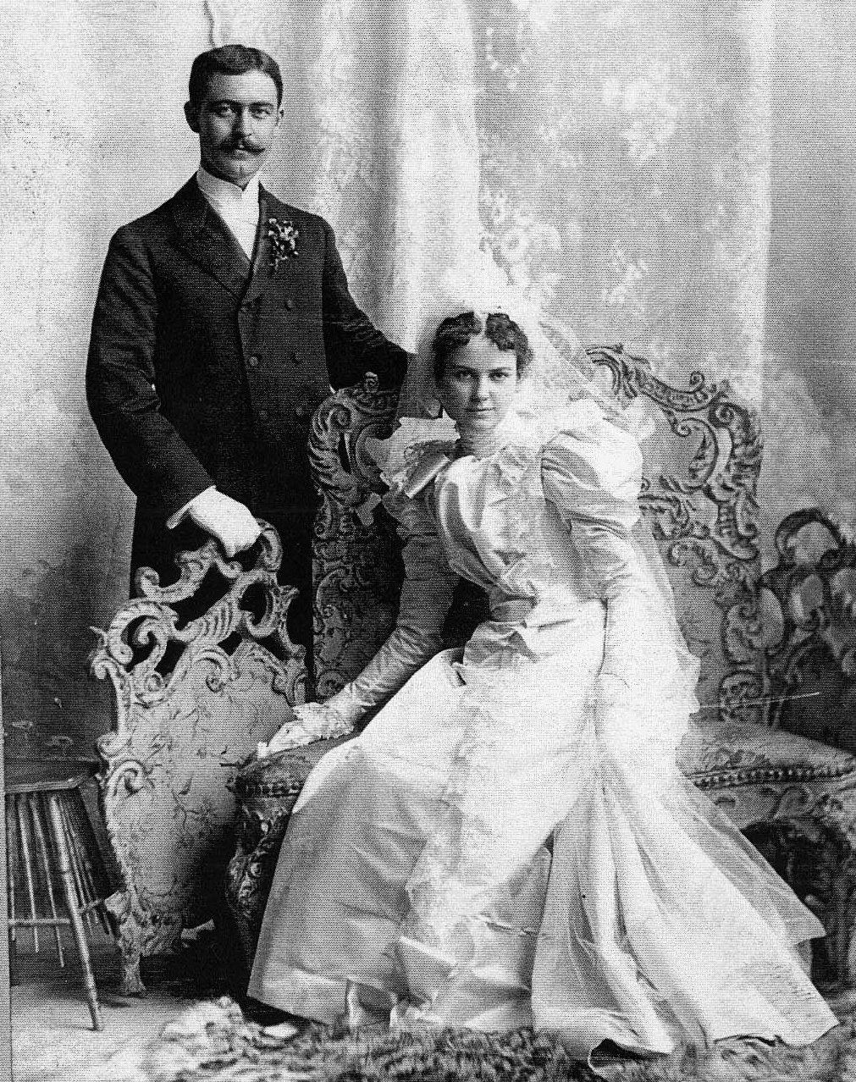
Time…
George Martin Berger & Rose “Nellie” Trefzger 1871 born 1897 married 1953 died Photo: 1897

Slide 4
Time…
Andrew Joseph Hill & Mary Lynne Gasaway 1963 born 1988 married Photo: 1988

Slide 5
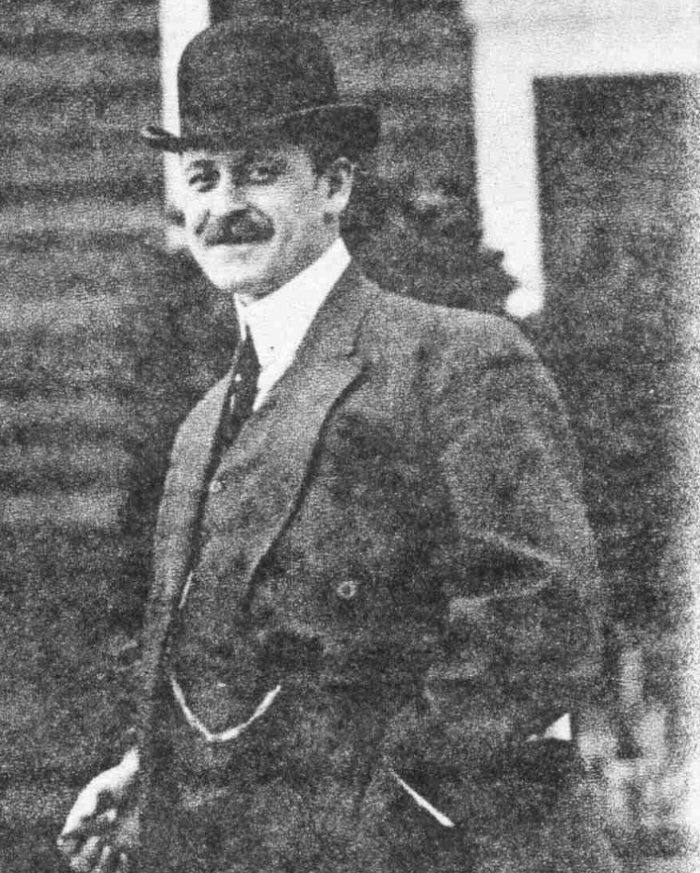
Time…
George Martin Berger 1871 born 1897 married 1953 died Photo: 1910

Slide 6
Time…
Andrew Joseph Hill 1963 born 1988 married Photo: 1983

Slide 7
Time…
George Martin Berger & Rose “Nellie” Trefzger 1871 born 1897 married 1953 died Photo: 1897

Slide 8
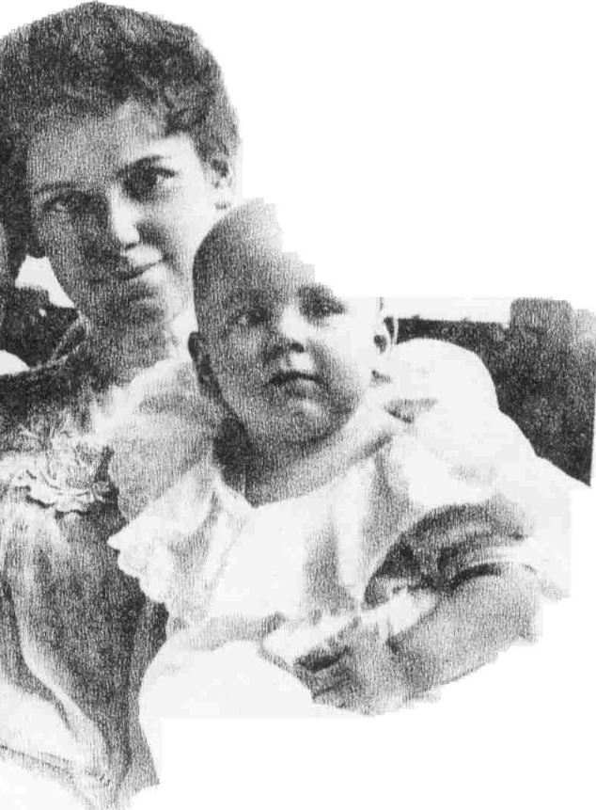
Time…
Adele Petronella Berger Colvin 1911 born 1934 married 2001 died Photo: 1912

Slide 9
Time…
Adele Petronella Berger Colvin 1911 born 1934 married 2001 died Photo: 1912

Slide 10
Time…
Adele Petronella Berger Colvin 1911 born 1934 married 2001 died Photo: 1930

Slide 11
Time…
Adele Petronella Berger Colvin 1911 born 1934 married 2001 died Has 5 children, Lives to 90

Slide 12
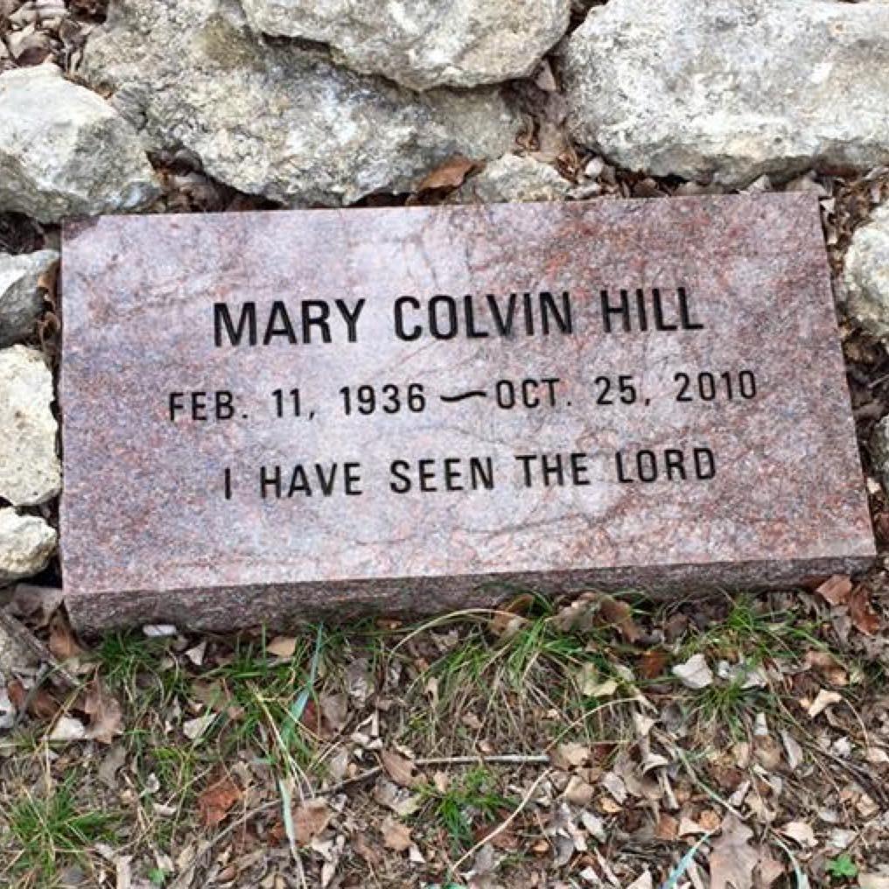
Time…
Mary Colvin Hill 1936 born 1959 married 2010 died Has 8 children, Lives to 74

Slide 13
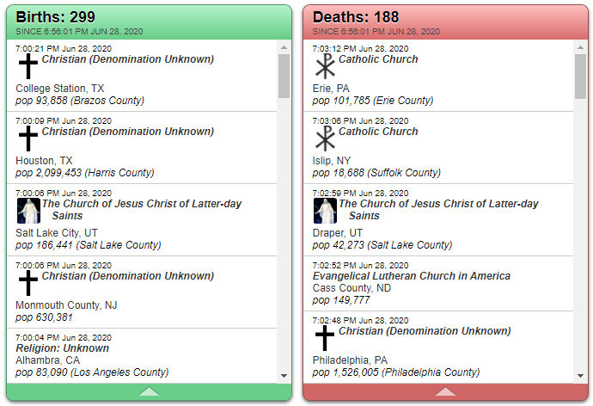
Time…

Slide 14
Time…

Slide 15
Time…
Kane Tanaka (田中カ子, 2 January 1903 – 19 April 2022) was a Japanese supercentenarian who died at the age of 119 years, 107 days (the world’s longest lived person).

Slide 16
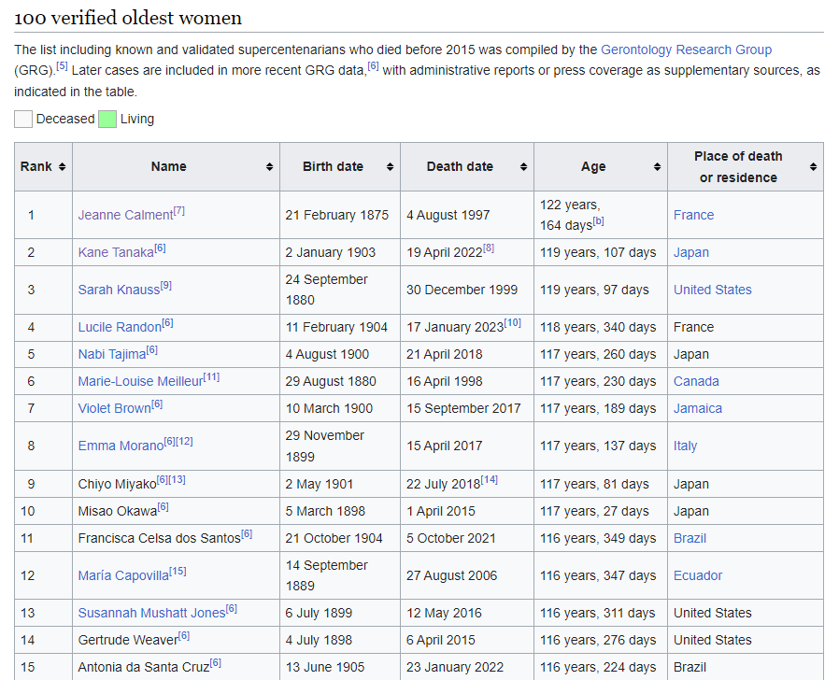
Time…
Kane Tanaka (田中カ子, Tanaka Kane, 2 January 1903 – 19 April 2022) was a Japanese supercentenarian who died at the age of 119 years, 107 days (the world’s longest lived person).

Slide 17
Time…
Emma Martina Luigia Morano (29 November 1899 – 15 April 2017) was an Italian supercentenarian who, before her death at the age of 117 years and 137 days, was the world's oldest living person whose age had been verified, and the last living person to have been verified as being born in the 1800s.

Slide 18
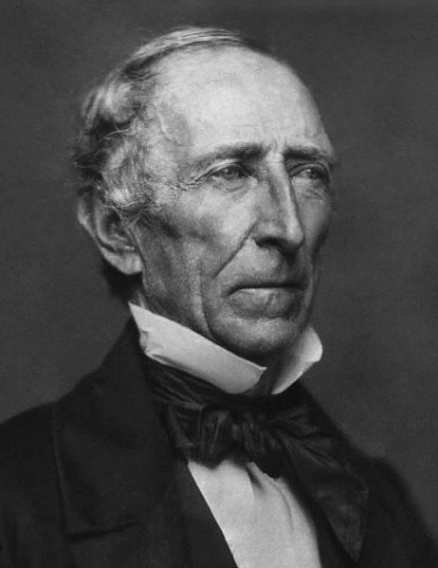
Time…
President John Tyler was born in 1790, one year after George Washington was sworn in as president.
He was the 10th President of the United States, serving from 1841-1845 and signing the Annexation of Texas.

Slide 19
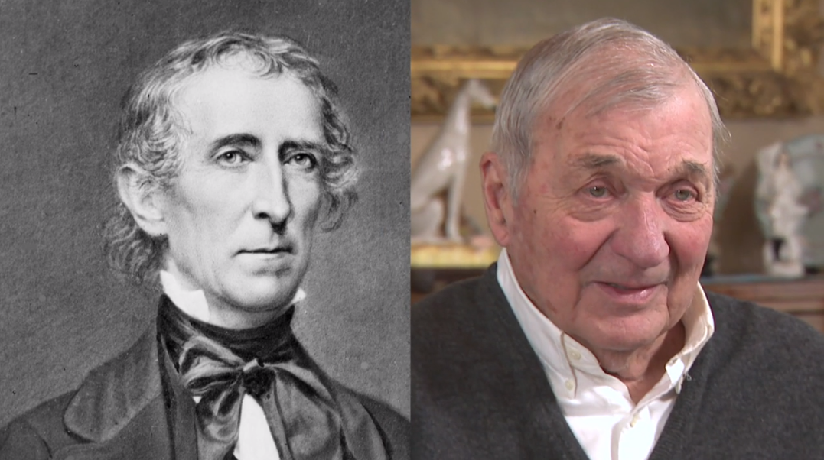
Time…
President Tyler has a living grandson, Harrison Ruffin Tyler, who was born on 09 November 1928
(age 94).

Slide 20
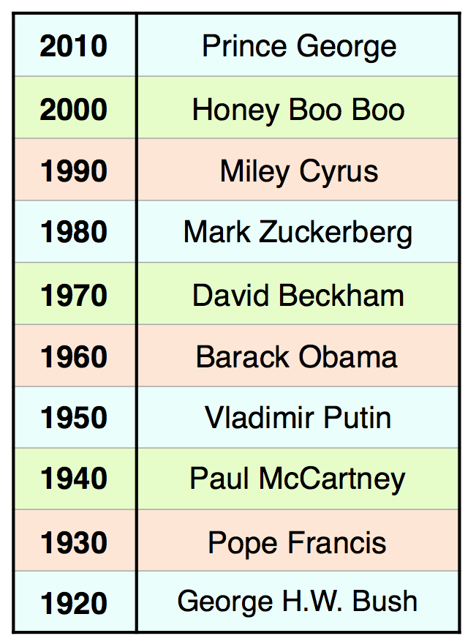
Time…
These are the decades in which these individuals were born:

Slide 21
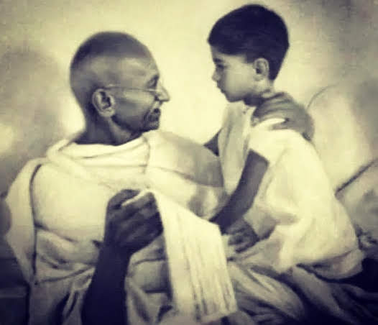
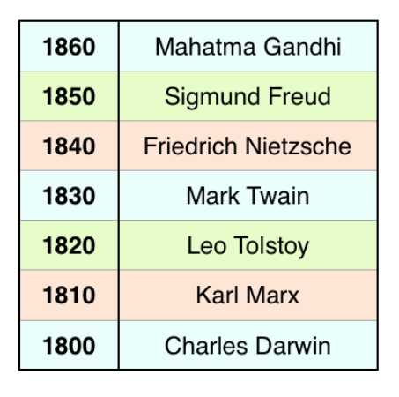
Time…

Slide 22
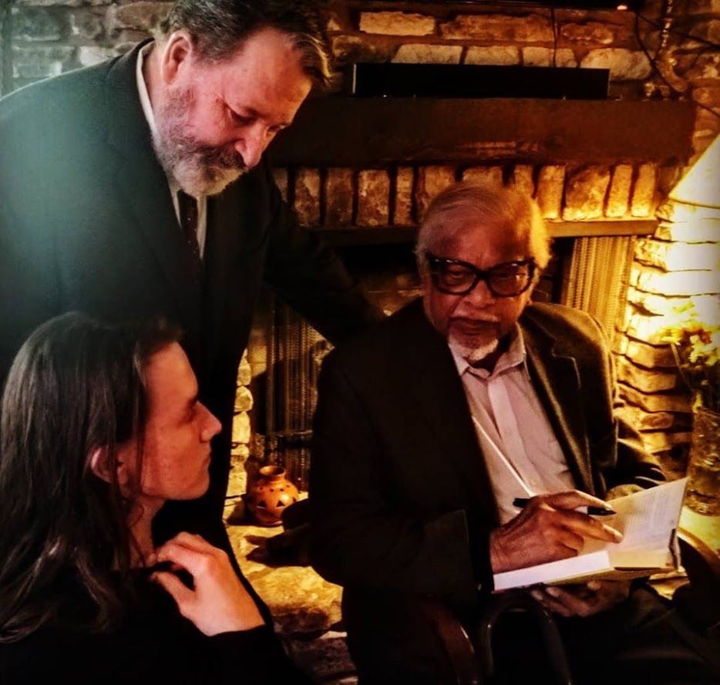
Time…

Slide 23
Time…

Slide 24
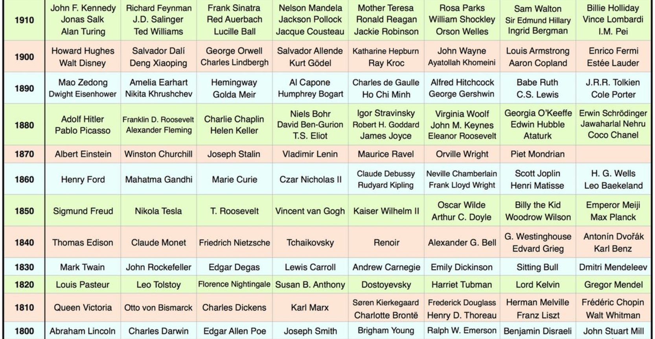
Time…

Slide 25
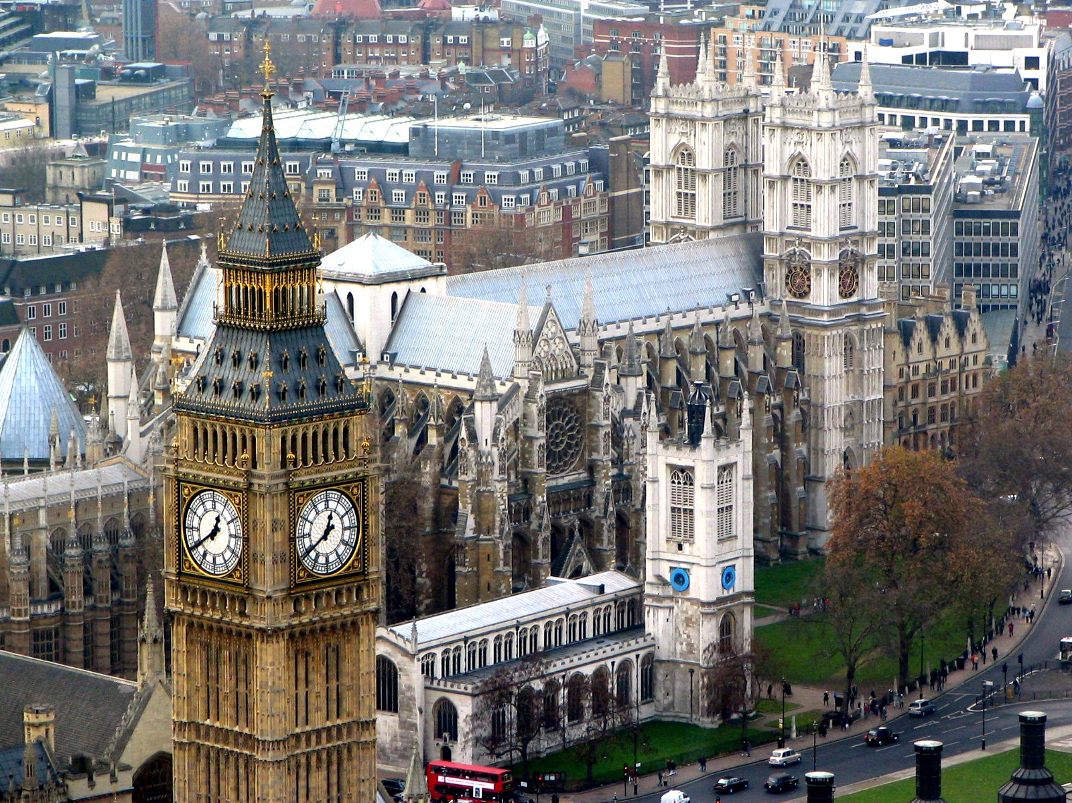
What does this say about the concept of law?

Slide 26
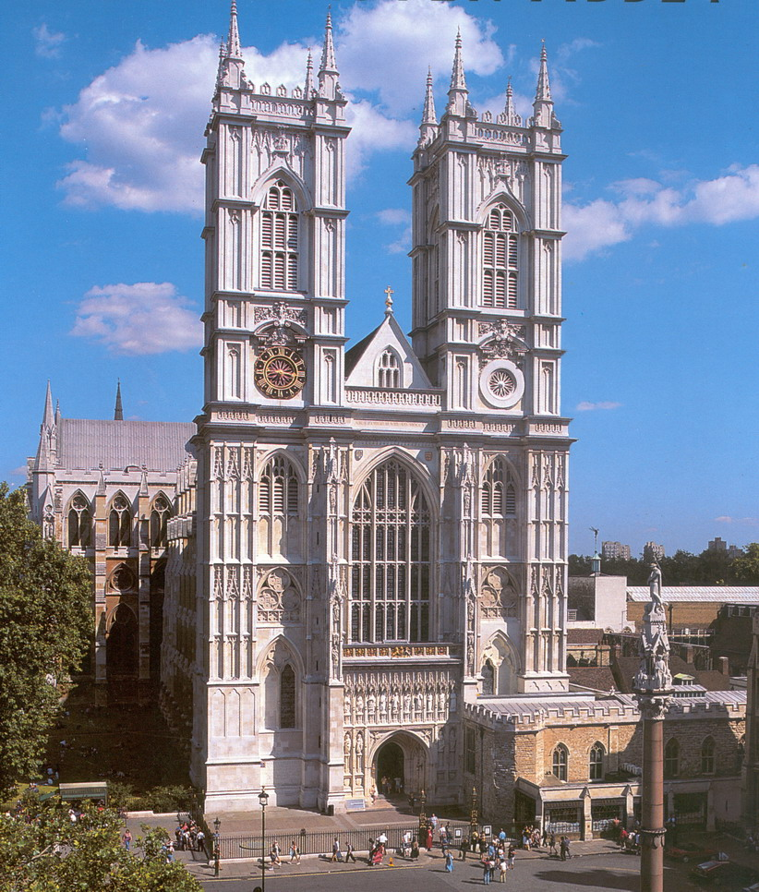

Slide 27
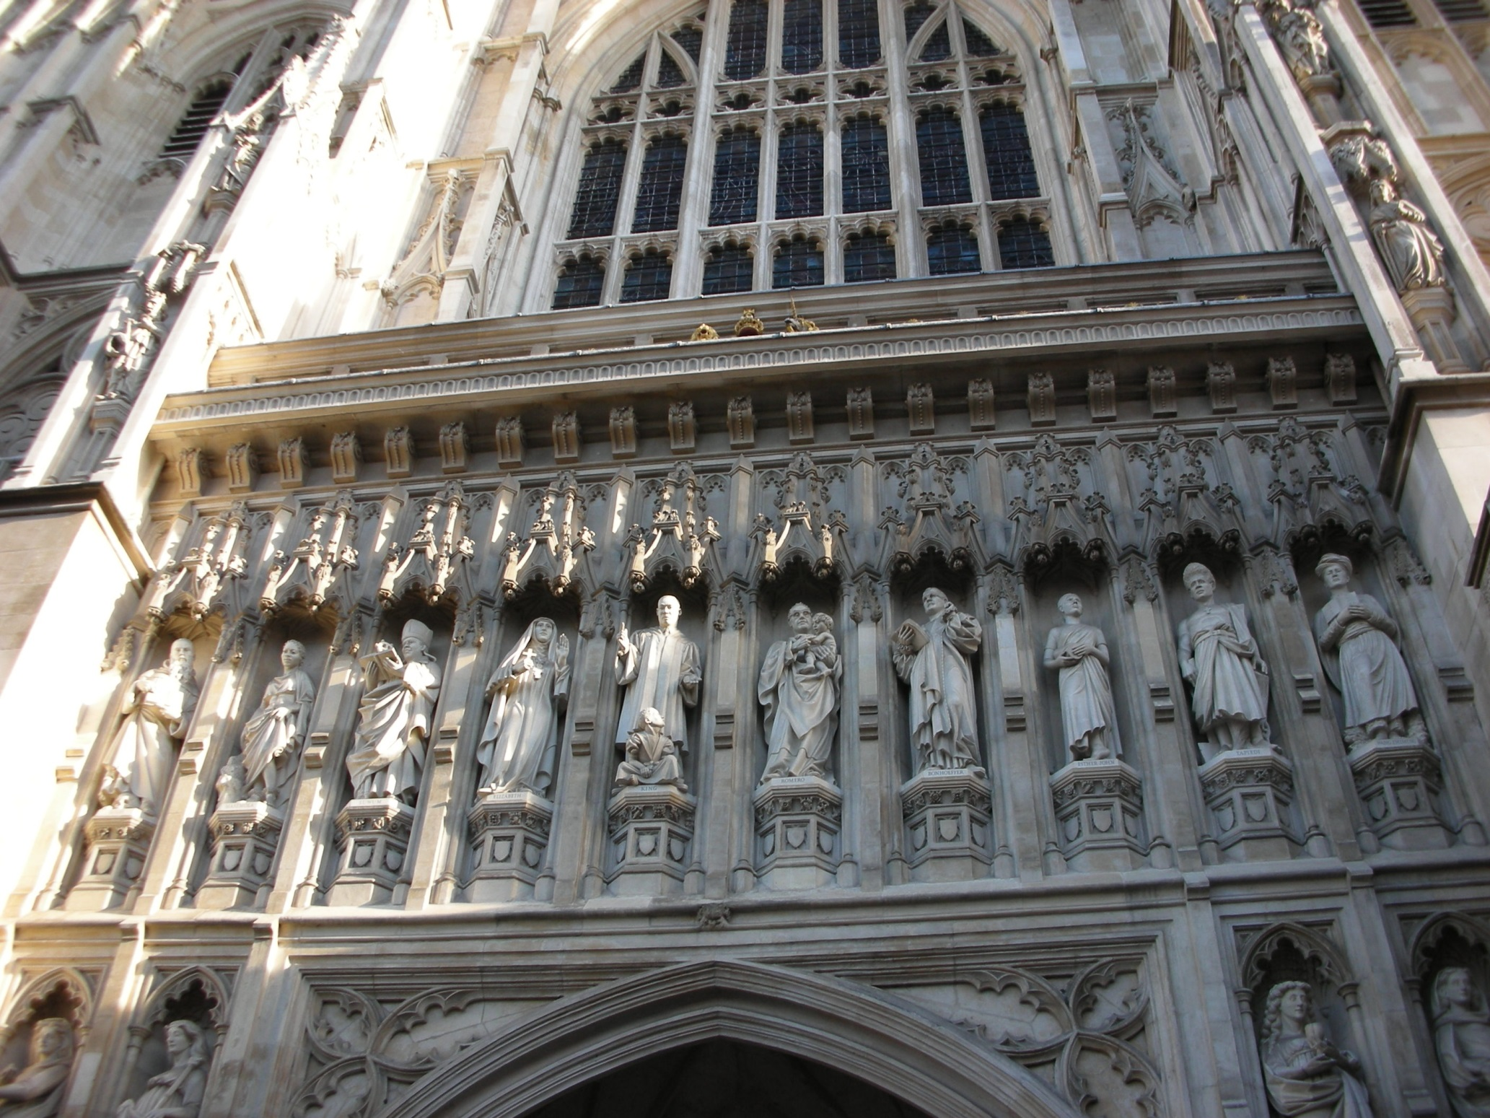

Slide 28
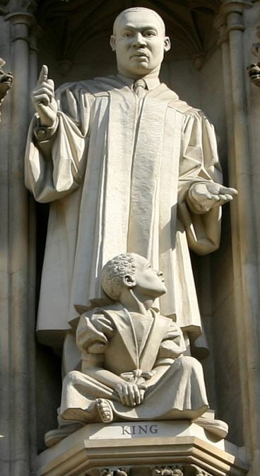

Slide 29
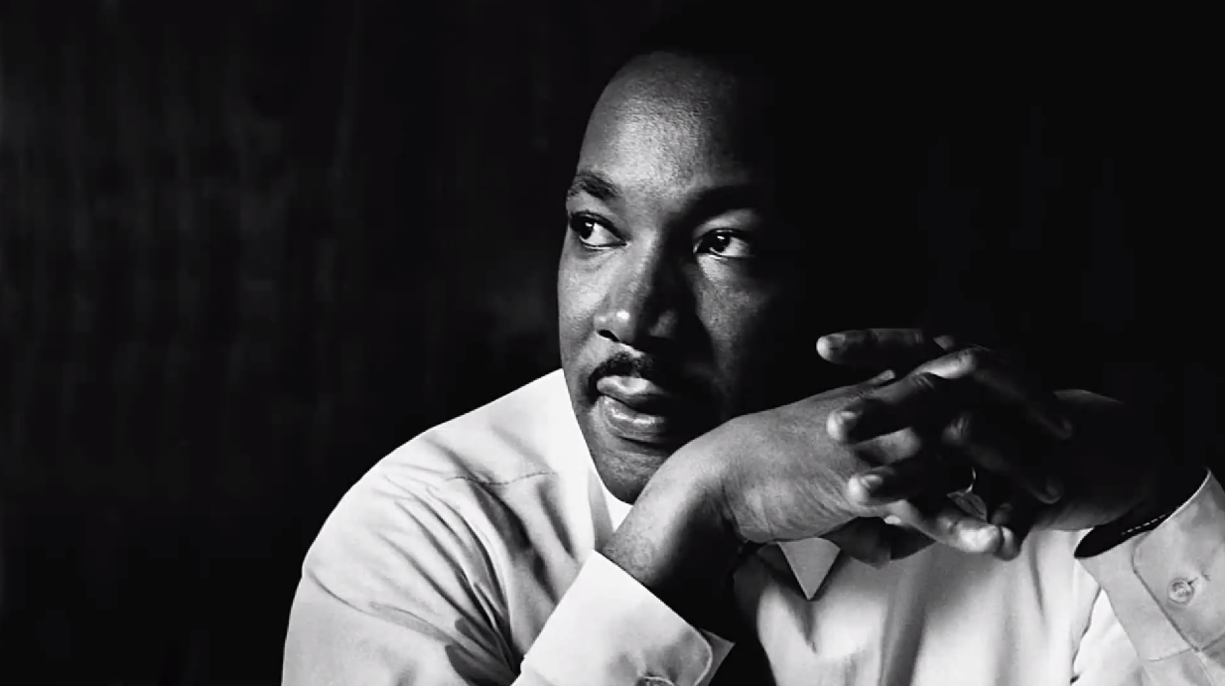
Time…
There are some surprises, such as Martin Luther King, Jr. and Anne Frank being born in 1929.

Slide 30
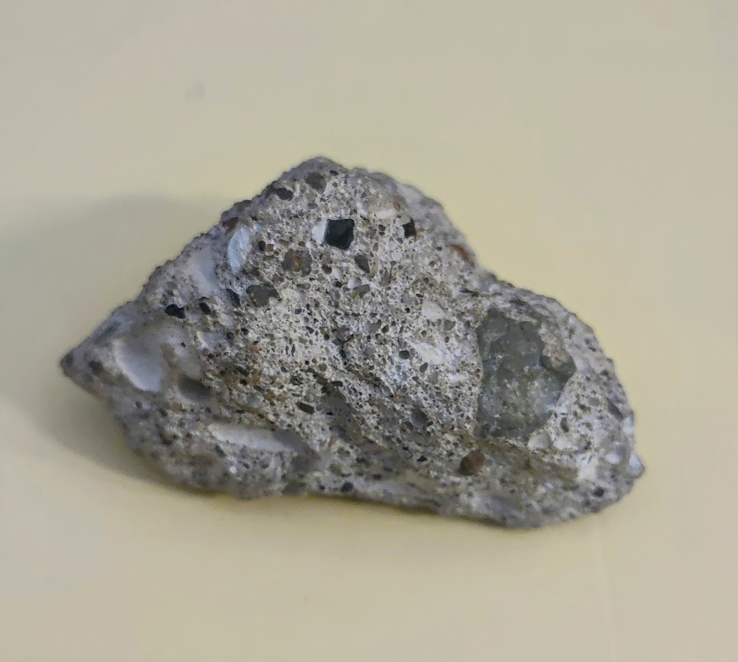

Slide 31
Time… 33 years, 2 months, 29 days

Slide 32
Time… 33 years, 2 months, 29 days
The Berlin Wall Falls and USSR Dissolves
The world was taken by surprise when, during the night of November 9, 1989, crowds of Germans began dismantling the Berlin Wall — a barrier that for almost 30 years had symbolized the Cold War division of Europe.
By October 1990, Germany was reunified, triggering the swift collapse of the other East European regimes.

Slide 33
Time… 1,000 years
Westminster Abbey
The history of Westminster Abbey can be traced back to its creation in 1050 when Edward the Confessor began building his church on the west end of Thorney Island.
The foundation was laid by King Edgar around 1090 and it became an abbey during the late 1100s under Henry II.

Slide 34
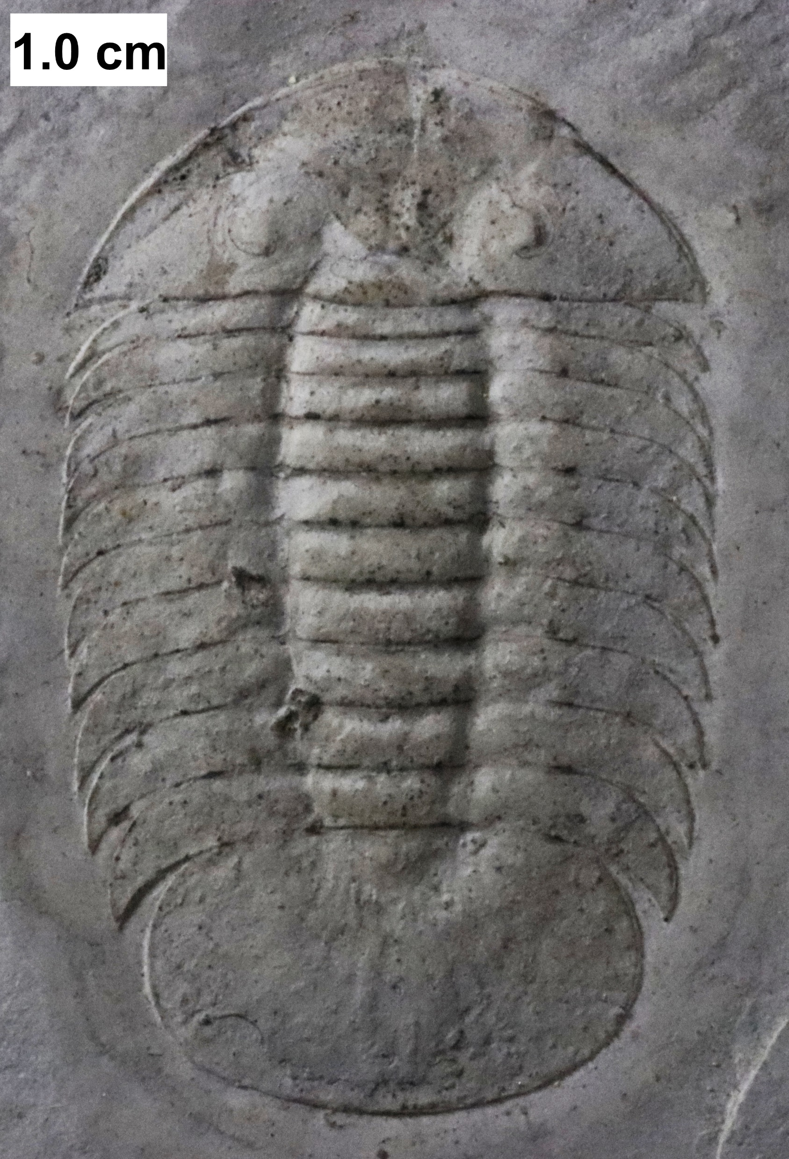

Slide 35
Time… 521 to 252 million years ago

Slide 36
Time… 521 to 252 million years ago
The first appearance of trilobites in the fossil record defines the base of the Atdabanian stage of the Early Cambrian period (521 million years ago) and they flourished throughout the lower Paleozoic before slipping into a long decline, when, during the Devonian, all trilobite orders except the Proetida died out.
The last extant trilobites finally disappeared in the mass extinction at the end of the Permian about 252 million years ago.
Trilobites were among the most successful of all early animals, existing in oceans for almost 270 million years, with over 22,000 species having been described.

Slide 37
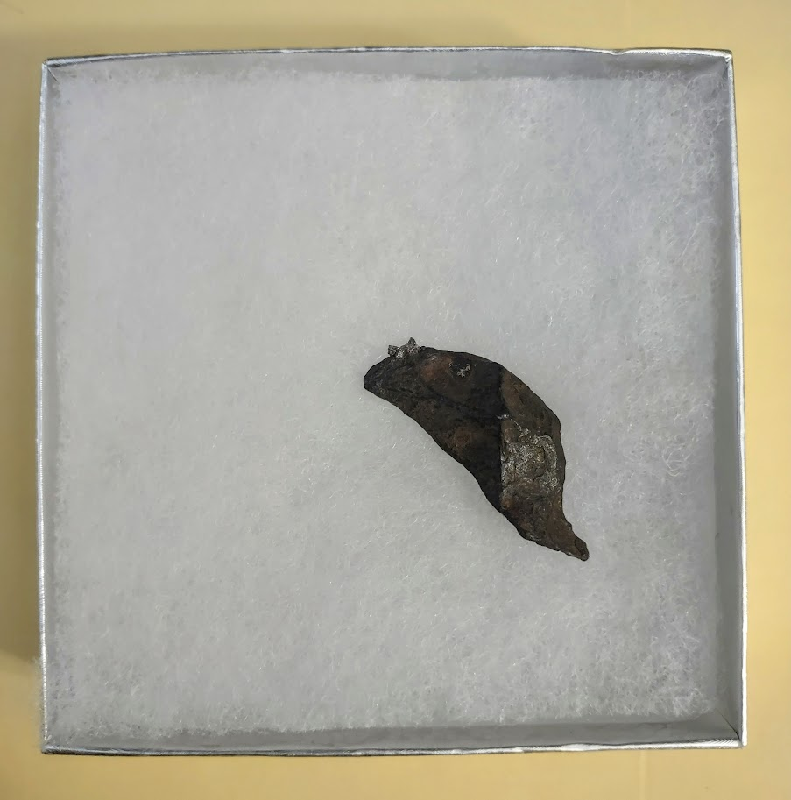

Slide 38
Time… 4.5 billion years

Slide 39
Time… 4.5 billion years
Canyon Diablo Meteorite
The Canyon Diablo meteorite refers to the many fragments of the asteroid that created Meteor Crater, Arizona 50,000 years ago.
In 1953, Clair Cameron Patterson measured ratios of the lead isotopes in samples of the meteorite. Through radiometric dating, a refined estimate of the age of the Earth was obtained: 4.550 billion years (± 70 million years).

Slide 40
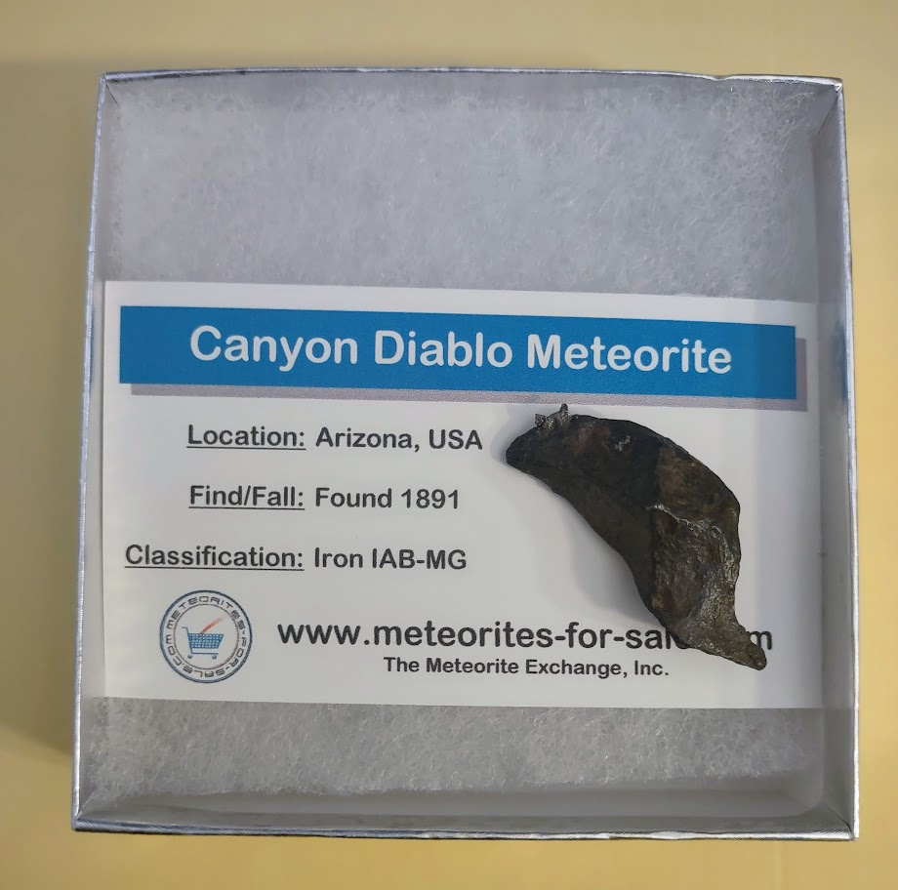
Time… 4.5 billion years
Canyon Diablo Meteorite
The Canyon Diablo meteorite refers to the many fragments of the asteroid that created Meteor Crater, Arizona 50,000 years ago.
In 1953, Clair Cameron Patterson measured ratios of the lead isotopes in samples of the meteorite. Through radiometric dating, a refined estimate of the age of the Earth was obtained: 4.550 billion years (± 70 million years).

Slide 41
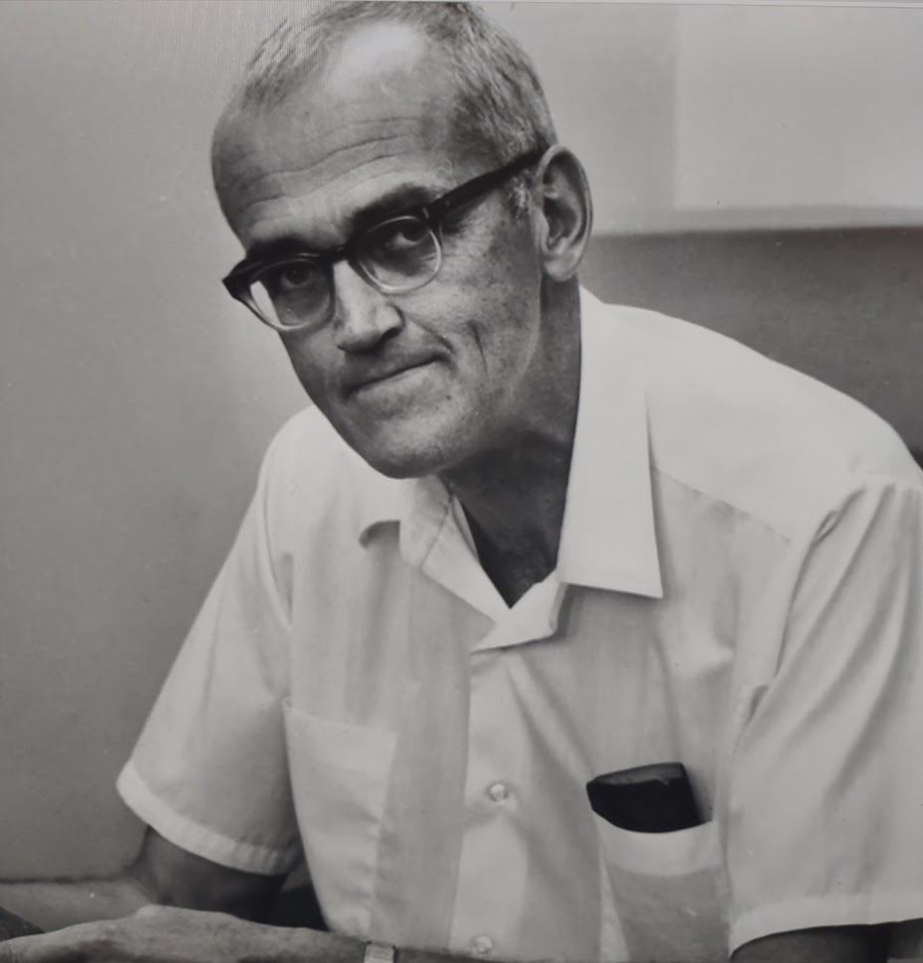
Time… 4.5 billion years
Canyon Diablo Meteorite
The Canyon Diablo meteorite refers to the many fragments of the asteroid that created Meteor Crater, Arizona 50,000 years ago.
In 1953, Clair Cameron Patterson measured ratios of the lead isotopes in samples of the meteorite. Through radiometric dating, a refined estimate of the age of the Earth was obtained: 4.550 billion years (± 70 million years).

Slide 42
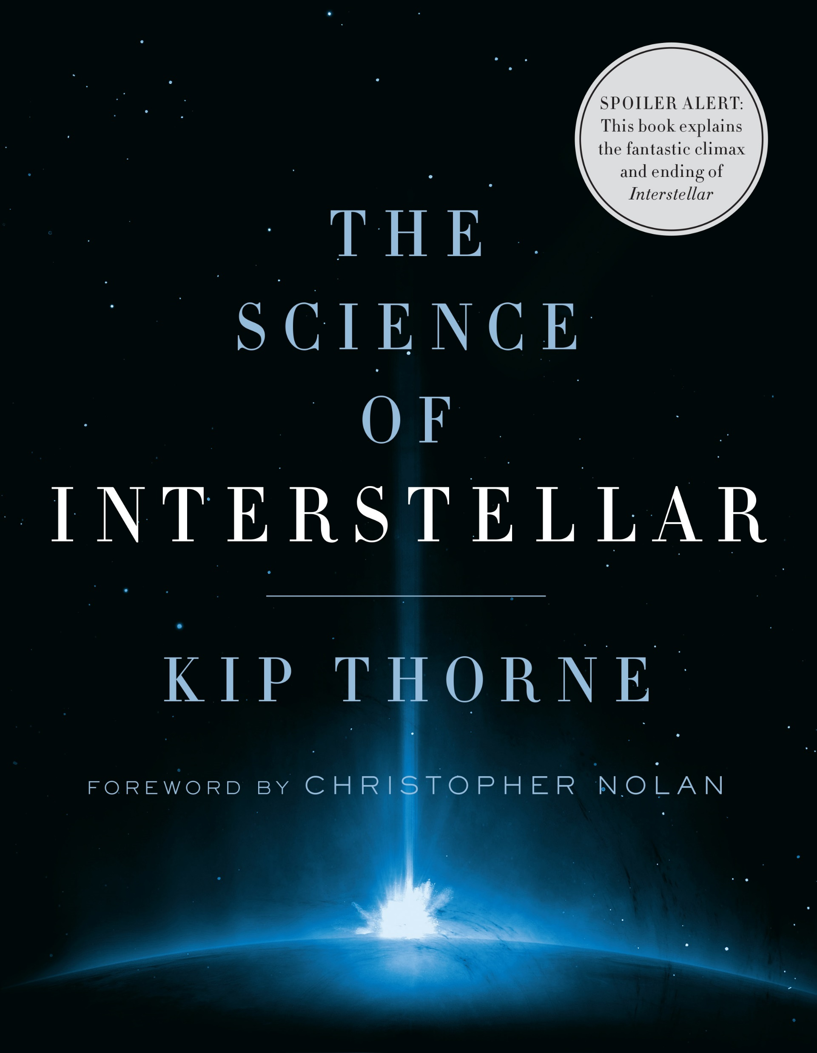
Time… Dilation
Time passes slower for our feet than for our heads.
Now, we can measure exactly how much.

Slide 43
Time… Infinity
The Apple in the Box
Infinity is not a number, but rather a philosophical concept.

Slide 44
Time… Infinity
The Apple in the Box
"Since the system has a finite entropy in thermal equilibrium and therefore a finite number of accessible states, the Poincar´e recurrence theorem guarantees that it will eventually cycle through all allowed configurations over a recurrence timescale of [infinity]."

Slide 45
Time… Infinity
The Apple in the Box
"...Among the allowed states is of course the original piano, so if we wait long enough the piano will reassemble itself through purely random fluctuations."

