Slide 1
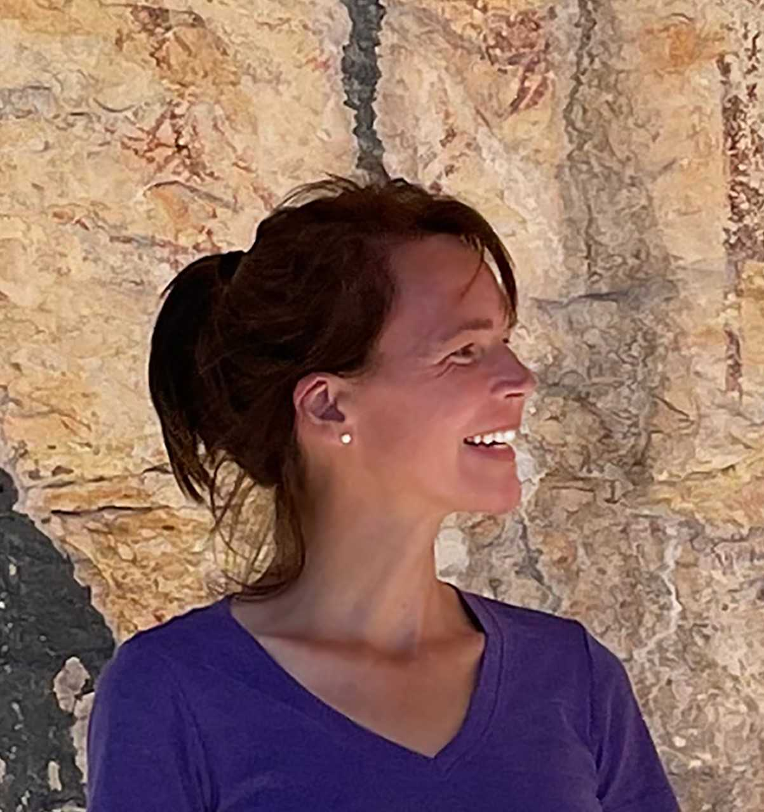
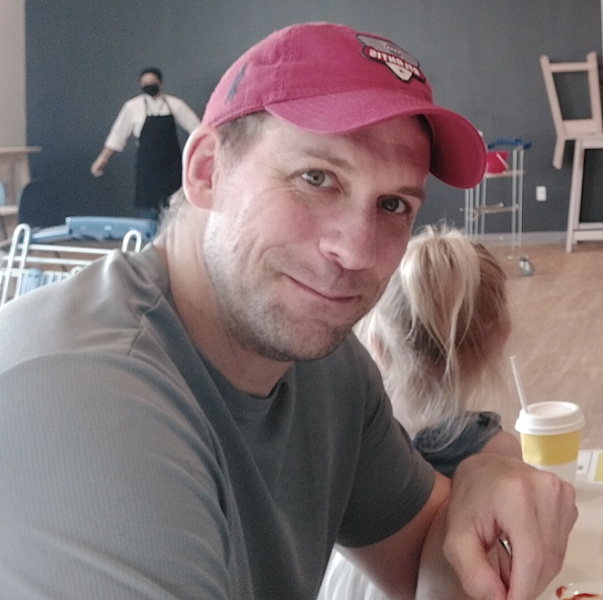
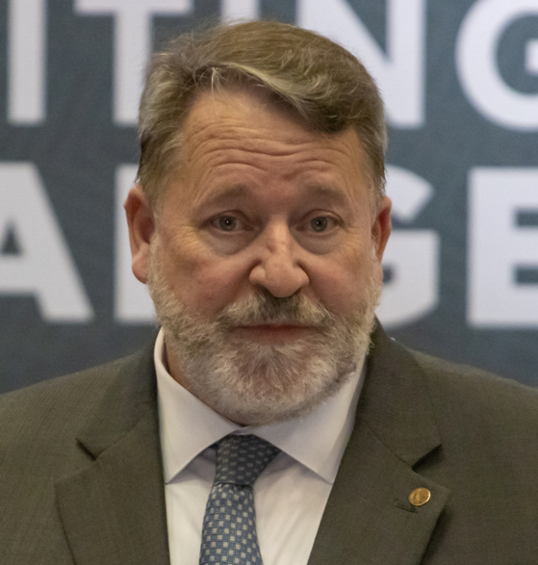
Annual Awards Ceremony The Philosophy Faculty of St. Philip’s College
THE FACULTY
Members Before 2009:
Connie Economy
Norman Kutschenreuter
Donald Castellano Hoyt
Collin Furr
Ann L. Riordan
Clinton F. Dunagan
​
2009 – 2013
Joseph Allen
John Travis
2013 – 2014
Marie Pannier Feldmeier
Andrew Hill
2014 – 2018
Matthew Fuller
Andrew Hill
2018 – 2020
Matthew Fuller
Andrew Hill
Charlie Langston
Fulbright Scholars-in-Residence:
​Richard Naylor (2016)
Yvonne Naylor (2016)
Derick Wilson (2019 - 2020)
Adjuvant Members of the
Philosophy Faculty:
Patrick J. Aspell
Jonathan Paul De Vierville
Jack Ferguson
Matthew Mangum
Marshall Naylor
Kent Slinker
fd
23 February 2022

Slide 2
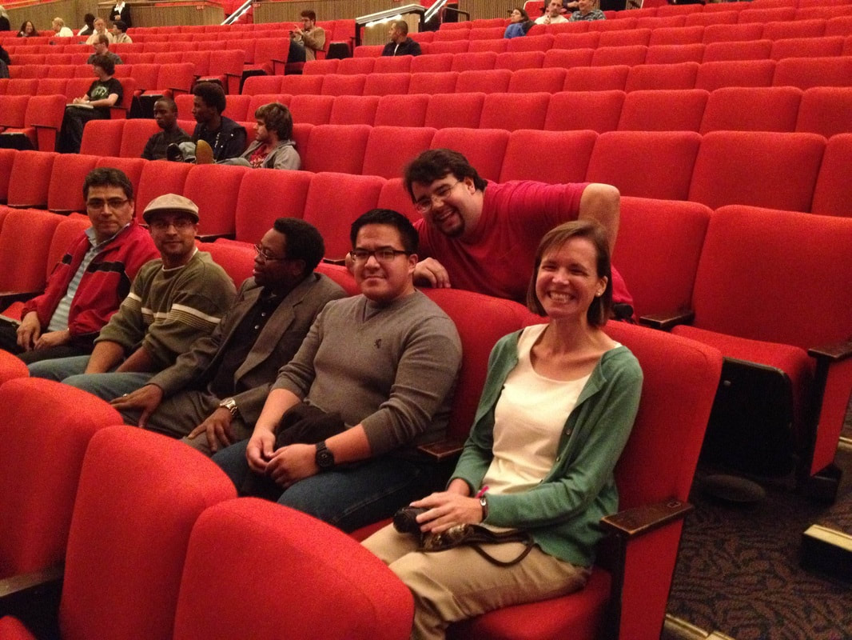
Since the fall of 2013,
the St. Philip’s College Philosophy Faculty has worked with partners from across campus to sponsor a number of groups and activities, including the
Philosophy Club
The Ethics Bowl
Field Trips
Lecture Series
The QEP Program, &
The ICDP

Slide 3
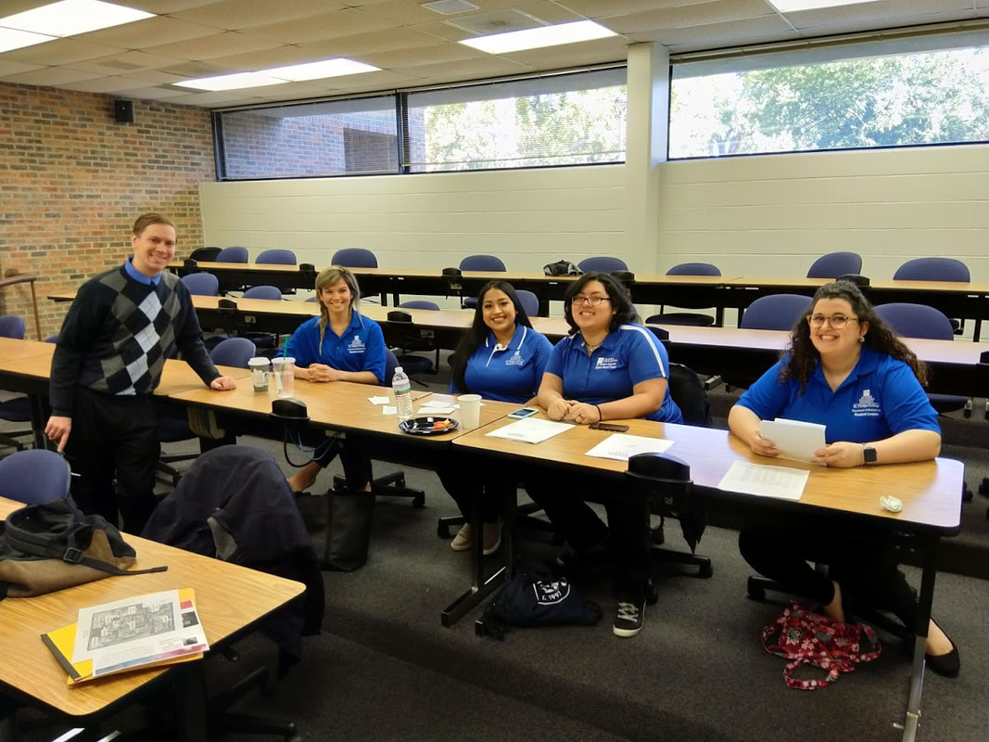
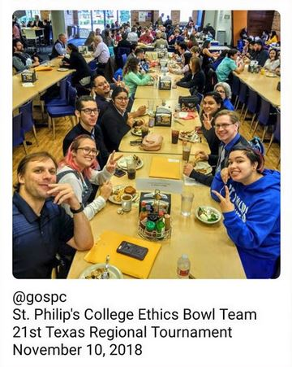
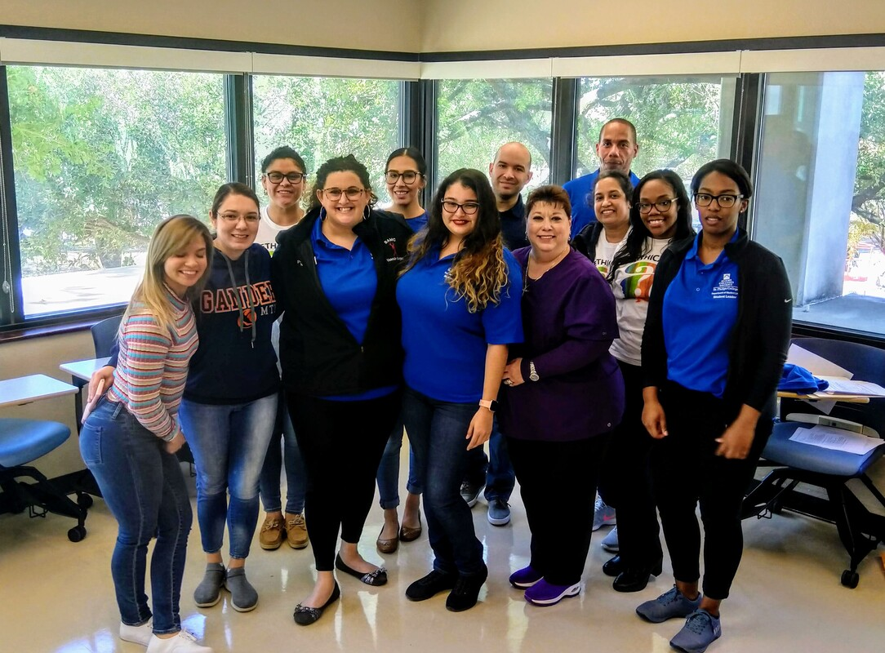
Since the fall of 2013,
the St. Philip’s College Philosophy Faculty has worked with partners from across campus to sponsor a number of groups and activities, including the
Philosophy Club
The Ethics Bowl
Field Trips
Lecture Series
The QEP Program, &
The ICDP

Slide 4
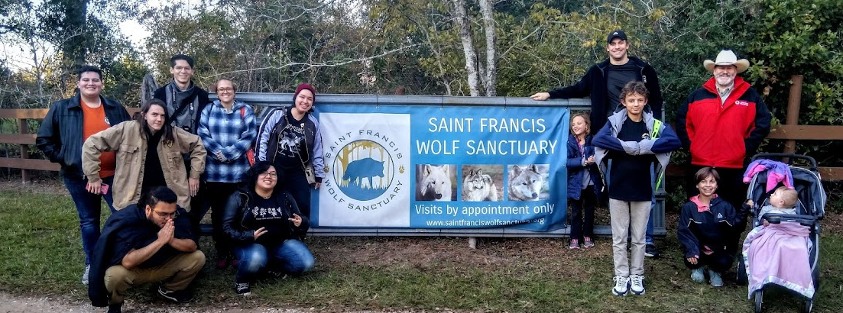
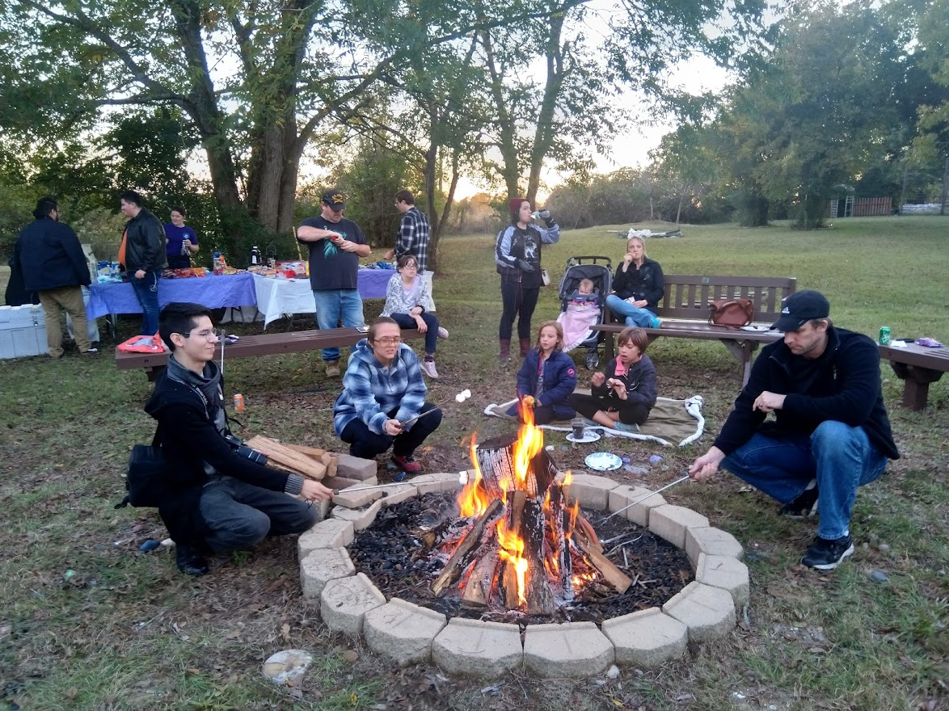
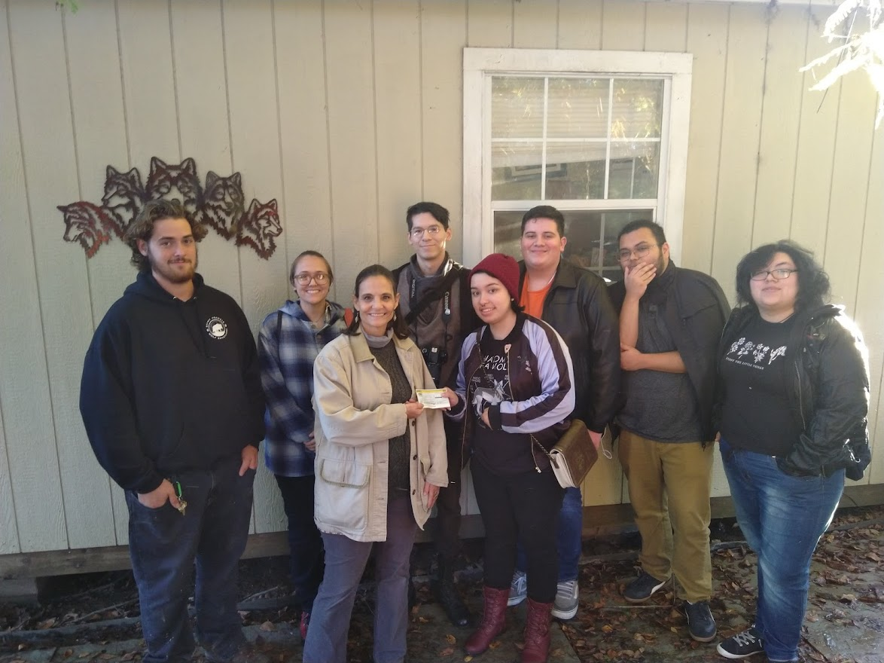
Since the fall of 2013,
the St. Philip’s College Philosophy Faculty has worked with partners from across campus to sponsor a number of groups and activities, including the
Philosophy Club
The Ethics Bowl
Field Trips
Lecture Series
The QEP Program, &
The ICDP

Slide 5
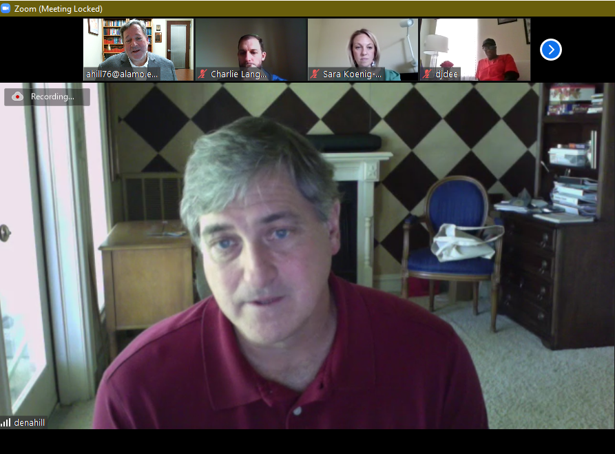
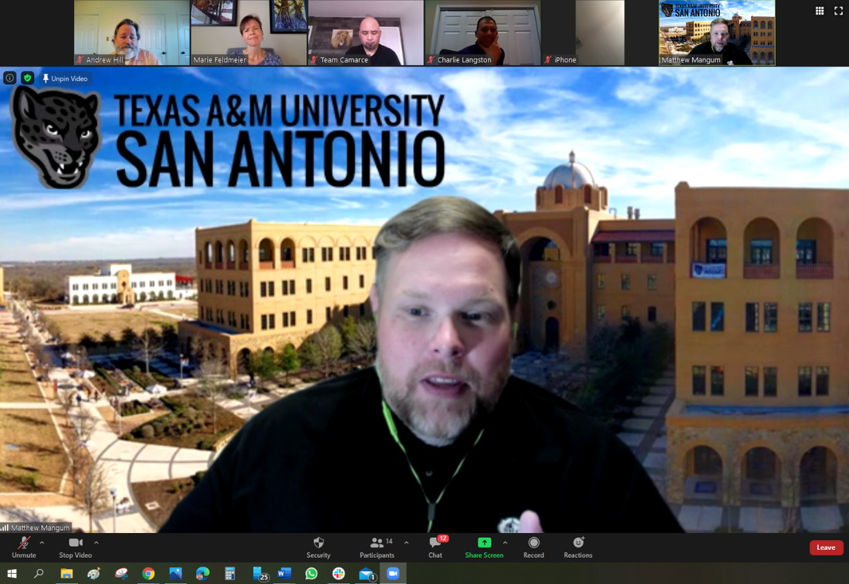
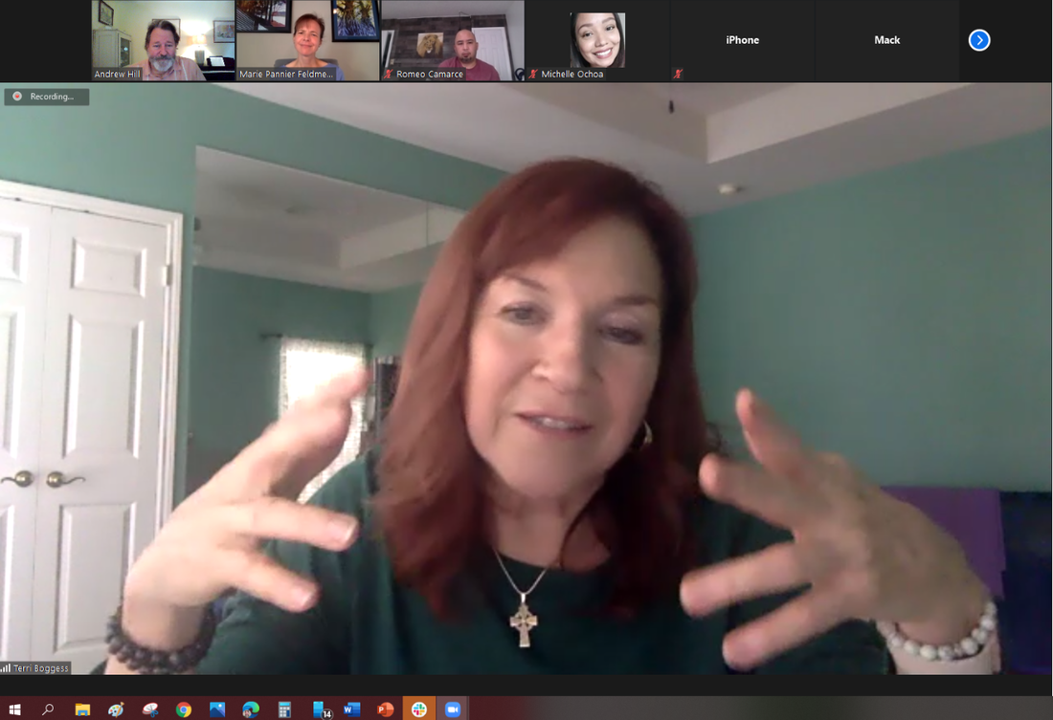
Since the fall of 2013,
the St. Philip’s College Philosophy Faculty has worked with partners from across campus to sponsor a number of groups and activities, including the
Philosophy Club
The Ethics Bowl
Field Trips
Lecture Series
The QEP Program, &
The ICDP
The Faculty Research Lecture Series

Slide 6
Since the fall of 2013,
the St. Philip’s College Philosophy Faculty has worked with partners from across campus to sponsor a number of groups and activities, including the
Philosophy Club
The Ethics Bowl
Field Trips
Lecture Series
The QEP Program, &
The ICDP

Slide 7
The Intercollegiate Civil Disagreement Partnership
Since the fall of 2013,
the St. Philip’s College Philosophy Faculty has worked with partners from across campus to sponsor a number of groups and activities, including the
Philosophy Club
The Ethics Bowl
Field Trips
Lecture Series
The QEP Program, &
The ICDP

Slide 8
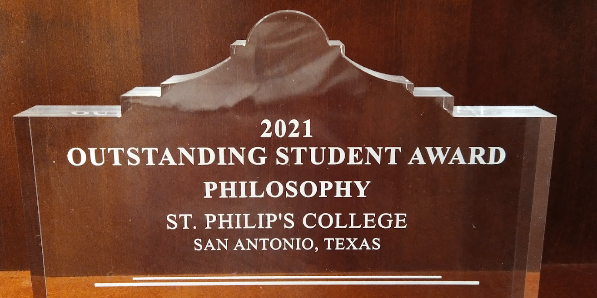
Today!
2021 Outstanding Student Award
The Outstanding Student Award

Slide 9
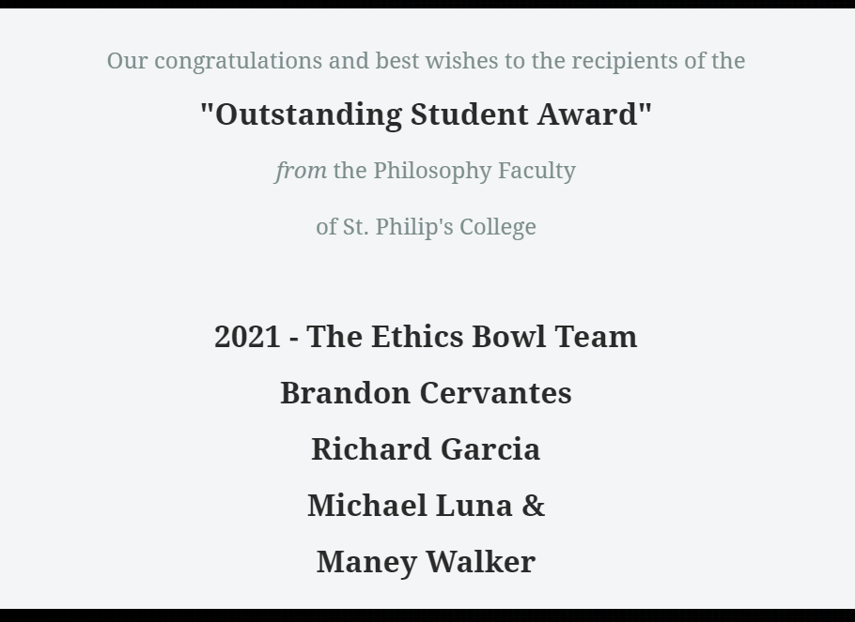
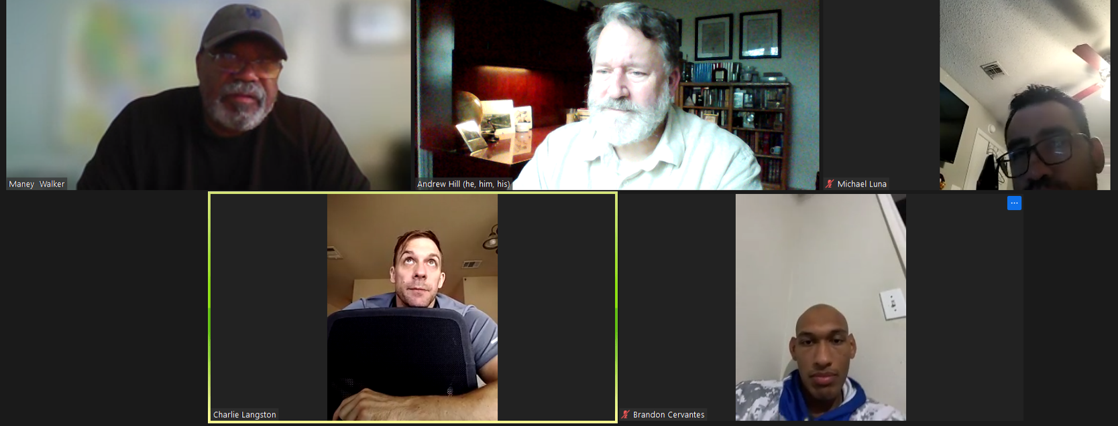
Today!
2021 Outstanding Student Award
The Ethics Bowl Team

Slide 10
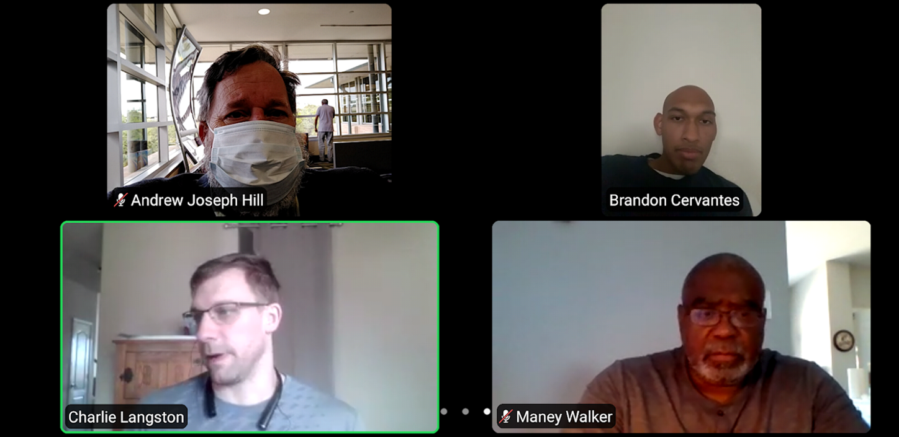
Today!
2021 Outstanding Student Award
The Ethics Bowl Team
The Outstanding Student Award

Slide 11
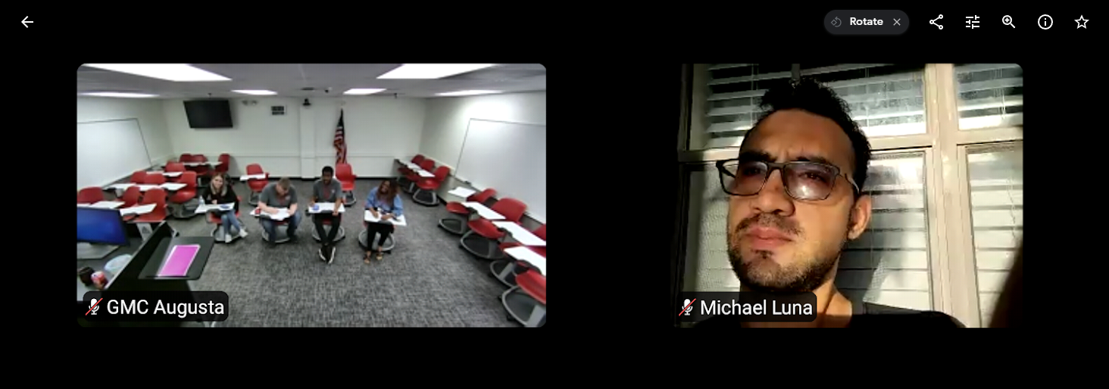
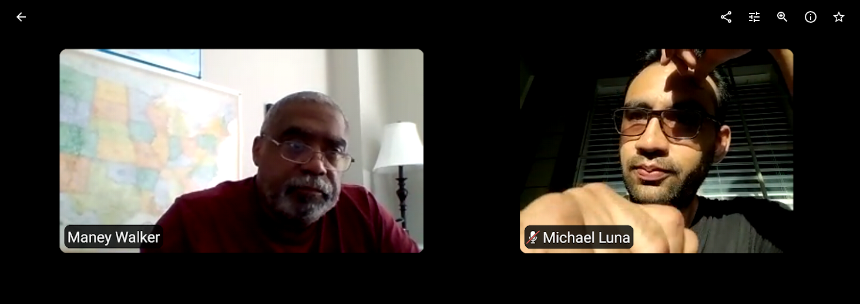
Today!
2021 Outstanding Student Award
The Ethics Bowl Team
The Outstanding Student Award

Slide 12
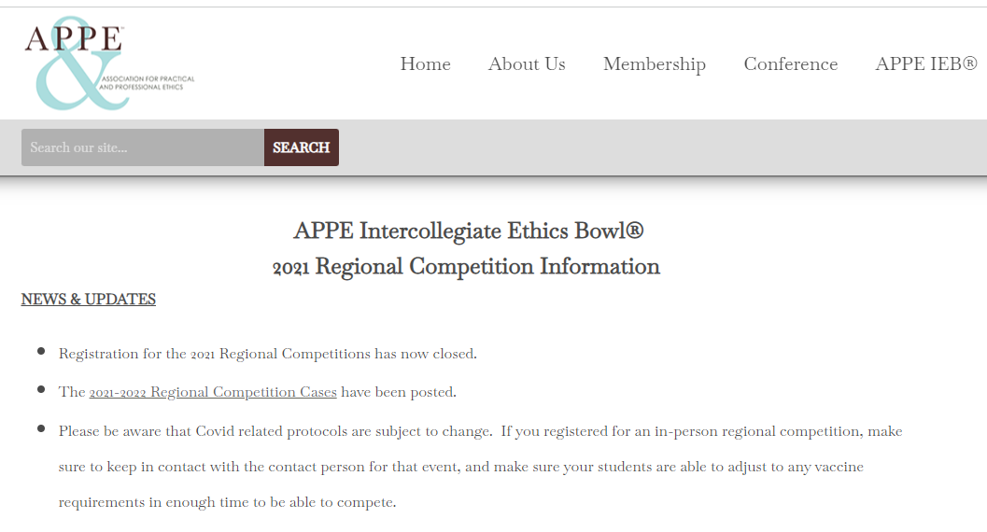
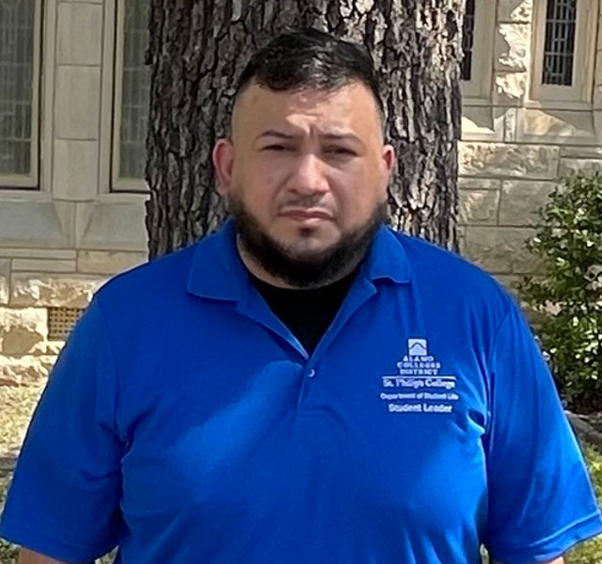
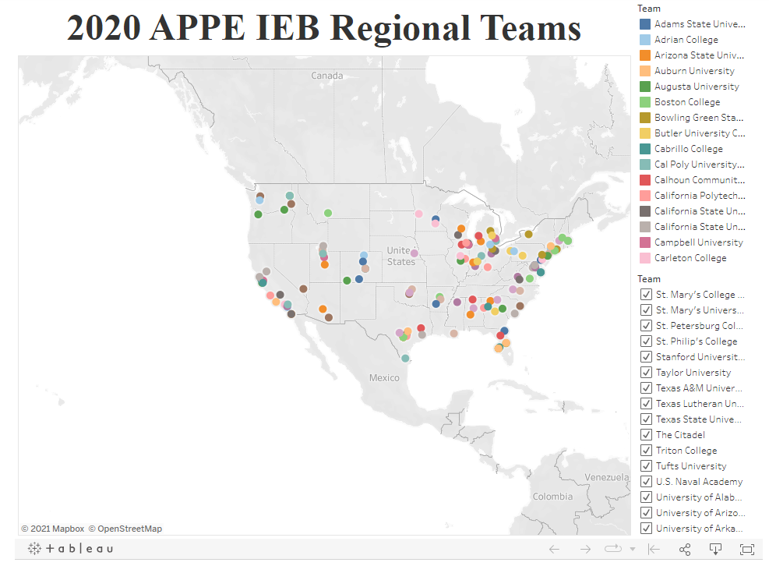
Today!
2021 Outstanding Student Award
The Ethics Bowl Team
The Outstanding Student Award

Slide 13
Today!
2021 Outstanding Student Award
The Ethics Bowl Team

Slide 14
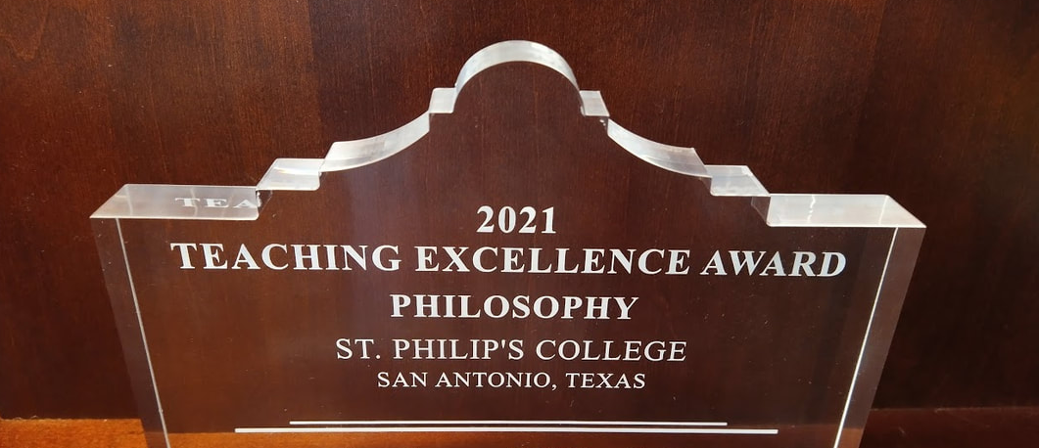
Bravo!
2021 Teaching Excellence Award
The Teaching Excellence Award

Slide 15
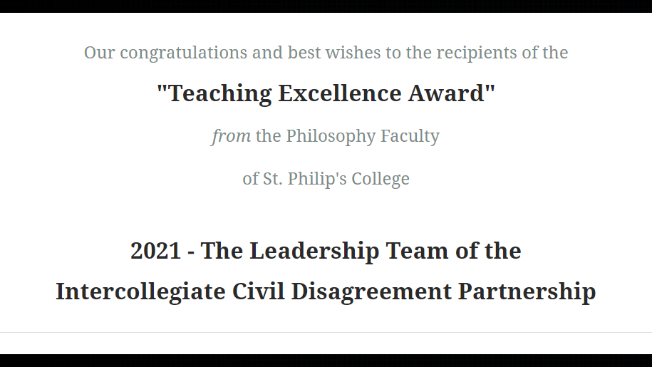
Bravo!
2021 Teaching Excellence Award
The Leadership Team of the ICDP
The Intercollegiate Civil Disagreement Partnership

Slide 16
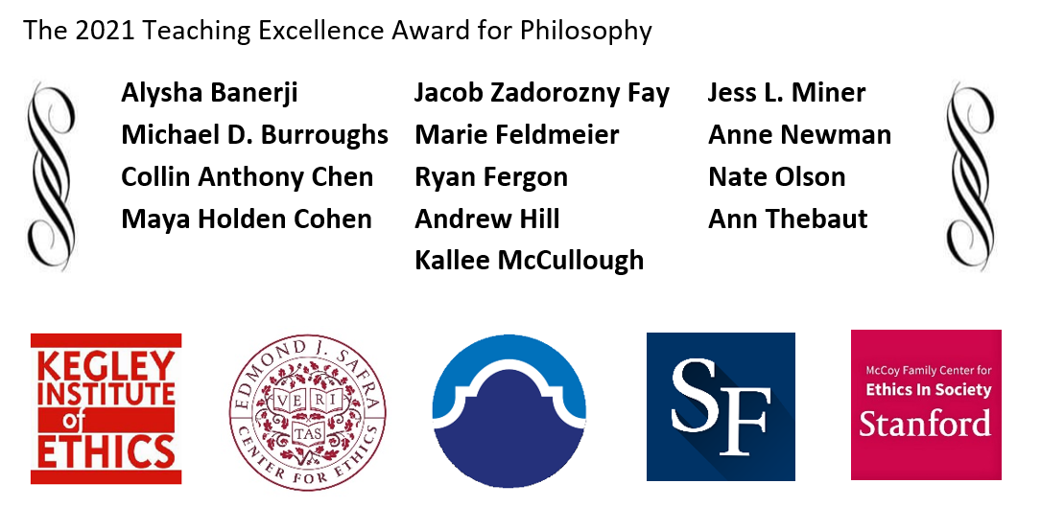
Bravo!
2021 Teaching Excellence Award
The Leadership Team of the ICDP
The Teaching Excellence Award

Slide 17
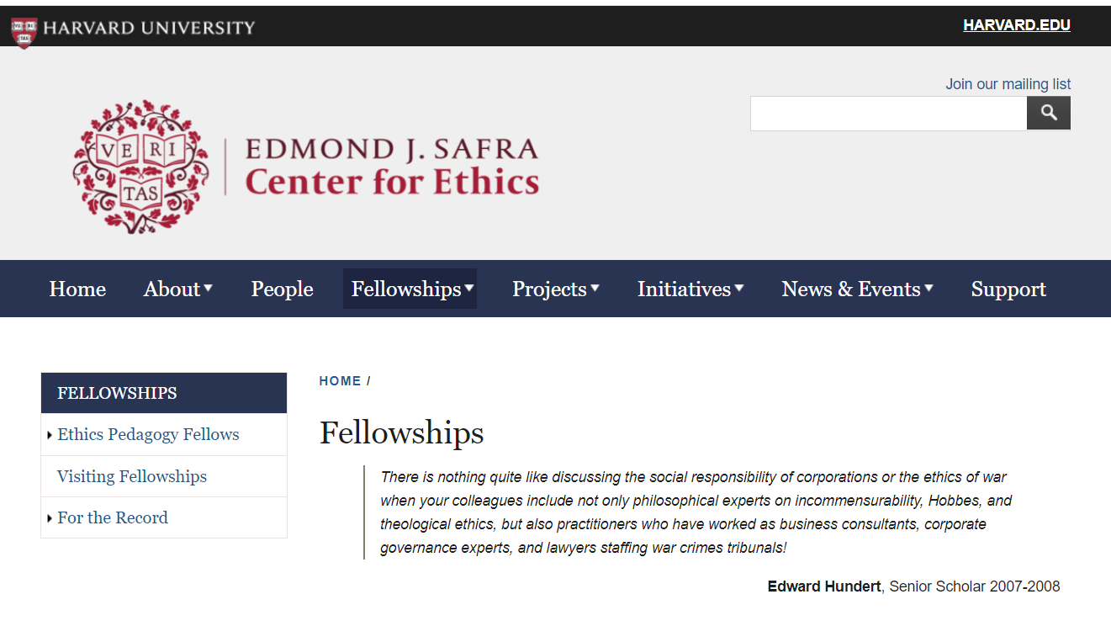
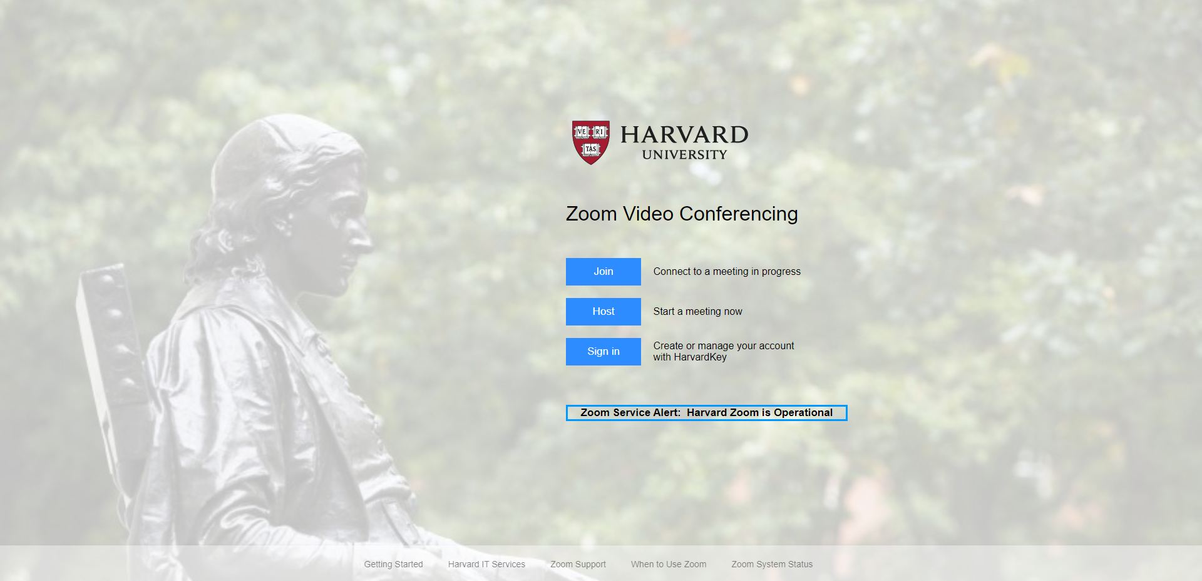
Bravo!
2021 Teaching Excellence Award
The Leadership Team of the ICDP
The Teaching Excellence Award

Slide 18
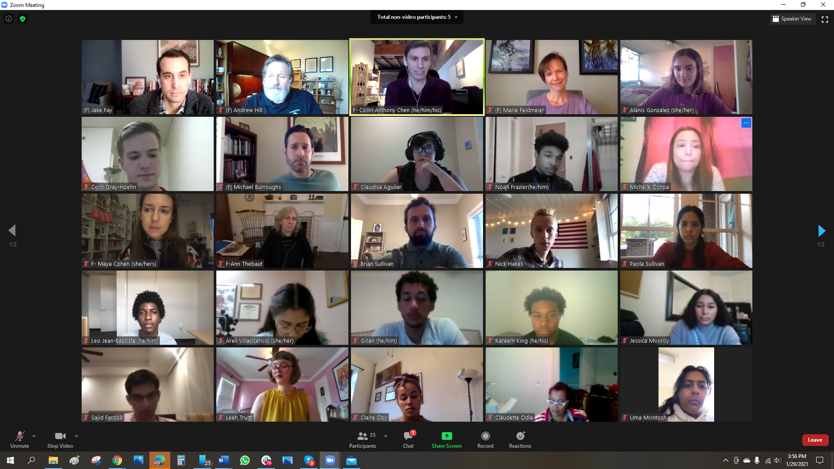
Bravo!
2021 Teaching Excellence Award
The Leadership Team of the ICDP
The Teaching Excellence Award

Slide 19
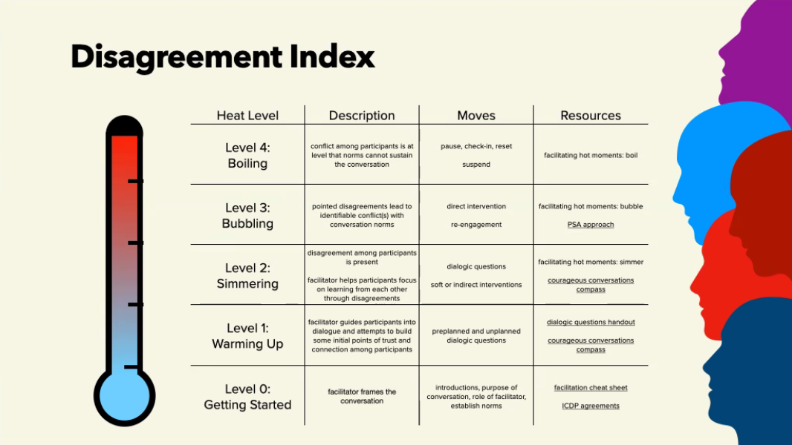
Bravo!
2021 Teaching Excellence Award
The Leadership Team of the ICDP
The Teaching Excellence Award

Slide 20
Bravo!
2021 Teaching Excellence Award
The Leadership Team of the ICDP
The Teaching Excellence Award

Slide 21
Bravo!
2021 Teaching Excellence Award
The Leadership Team of the ICDP

Slide 22
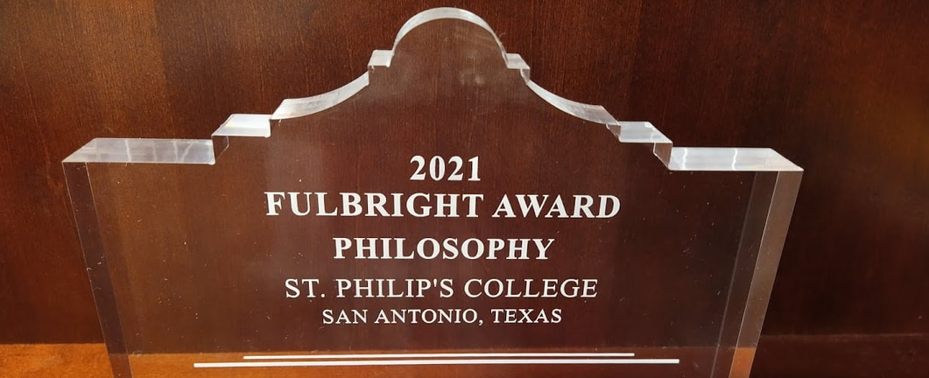
Bravo!
2021 Fulbright Award
The Fulbright Award

Slide 23
Bravo!
2021 Fulbright Award
The Corrymeela Community
The Fulbright Award
This award is presented on occasion for outstanding academic contributions to the students, faculty, and staff of St. Philip's College and for dedicated professional service to Greater San Antonio Community and the State of Texas through the Senator J. William Fulbright Scholarship Program.
This year’s recipient is The Corrymeela Community, our long-standing partner in Peace and Conflict Studies education.

Slide 24
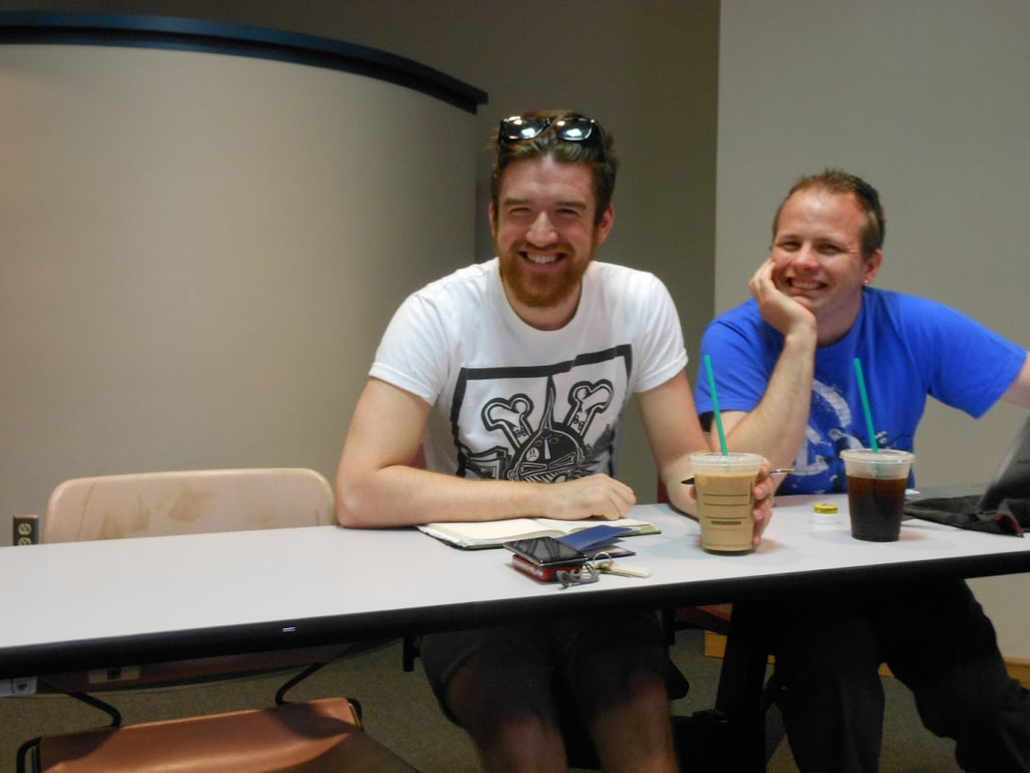
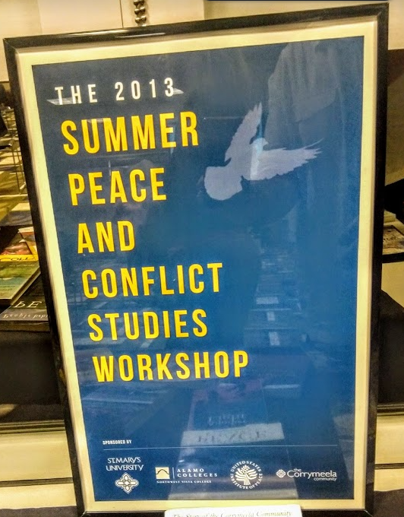
The Fulbright Award
 2013 Grant, U.S. Institute of Peace, to host the Corrymeela Community’s
Pádraig Ó Tuama for a Lecture Series with our partner, St. Mary’s University
 2013 Summer Peace and Conflict Studies Workshop, in San Antonio, with Corrymeela Members Matthew Scrimgeour and Aaron Gordon.

Slide 25
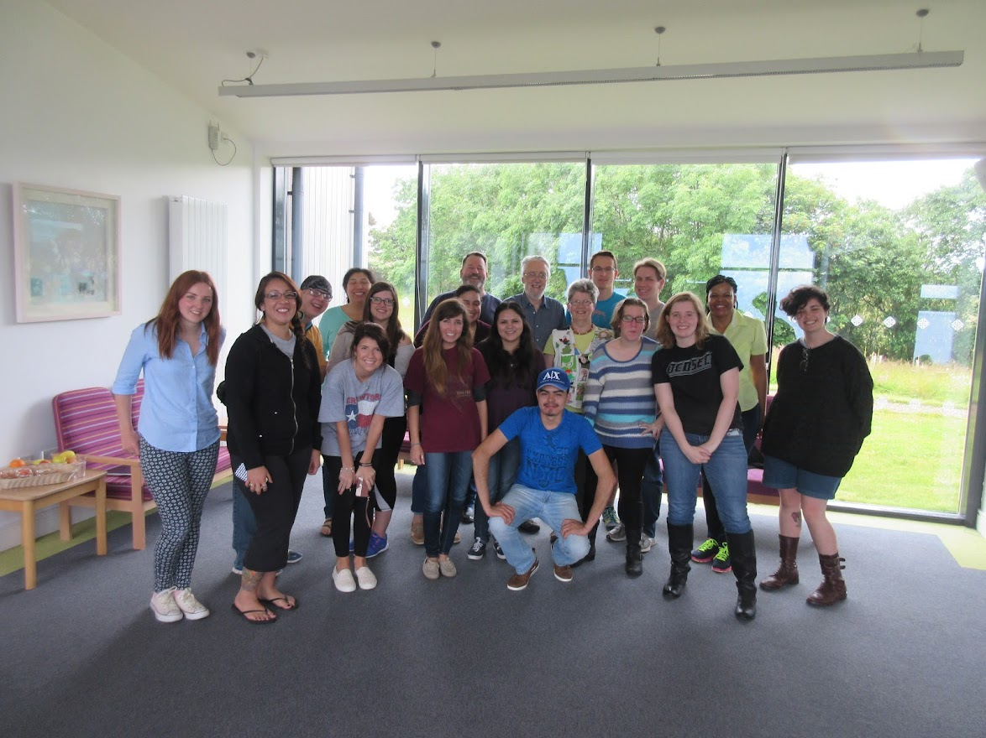
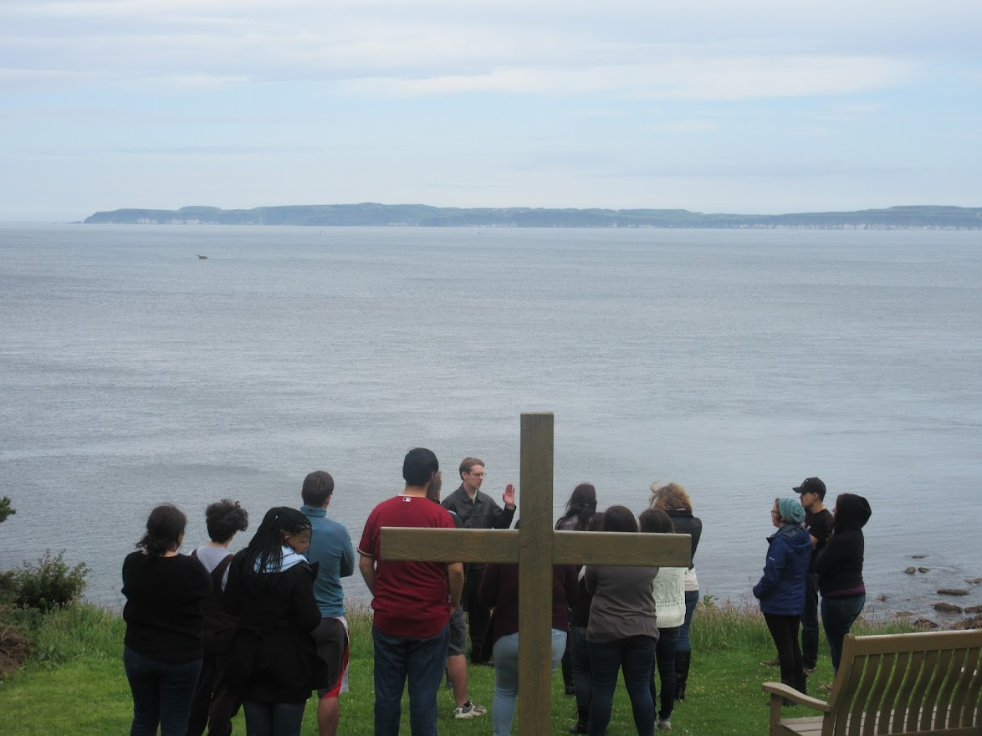
The Fulbright Award
 2015 Study Abroad Program to the Corrymeela Centre in Ballycastle. Our students were instructed by Richard & Yvonne Naylor, and also by Derick Wilson.

Slide 26
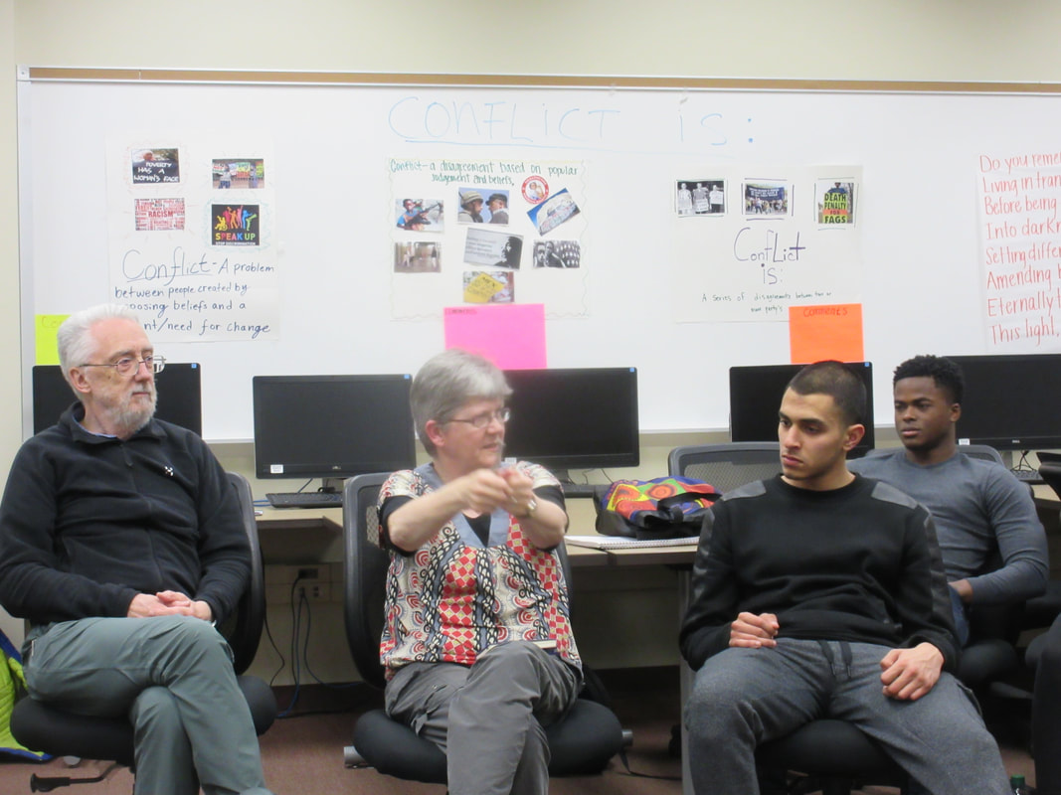
The Fulbright Award

Slide 27
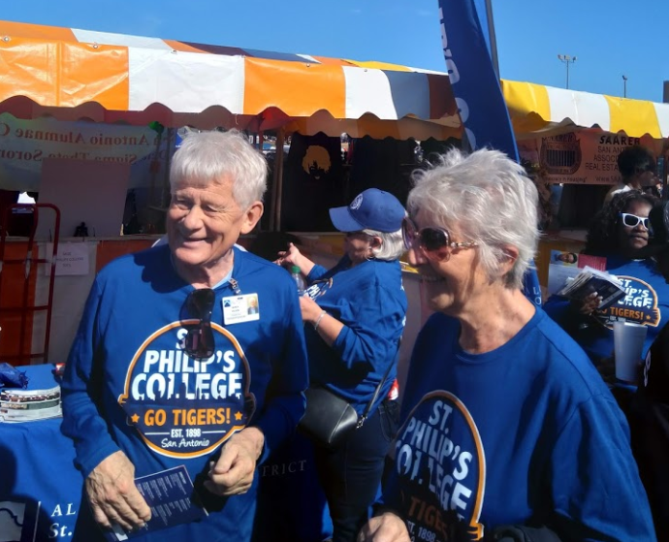
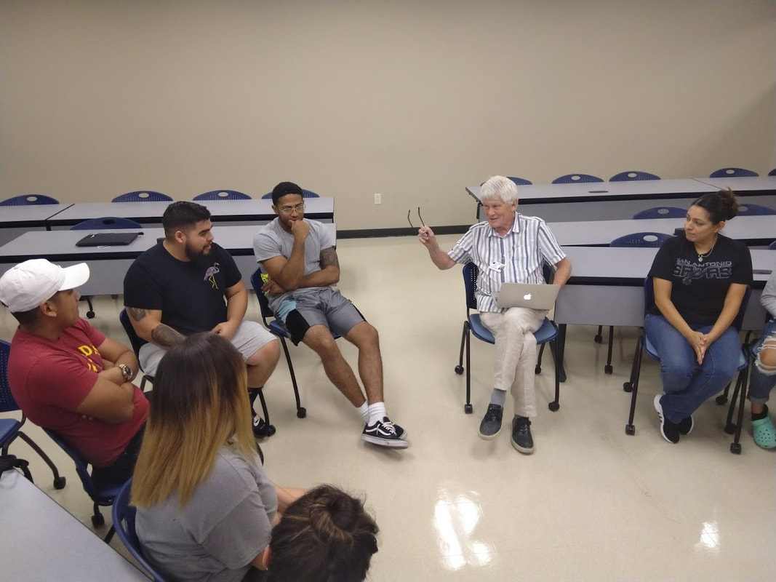
The Fulbright Award

Slide 28
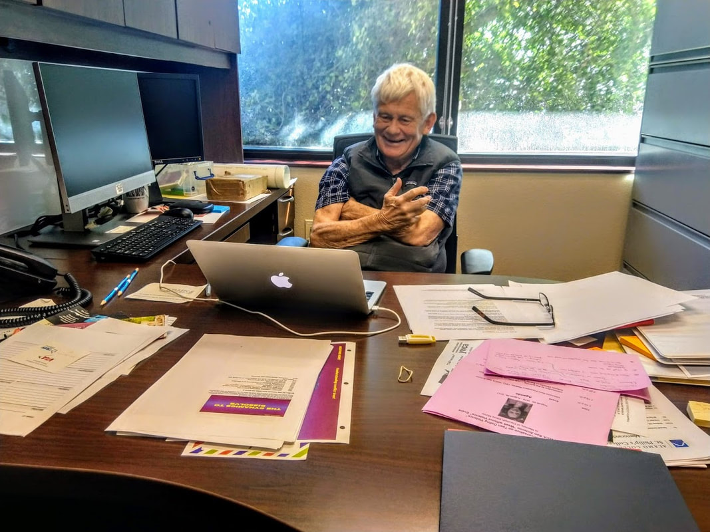
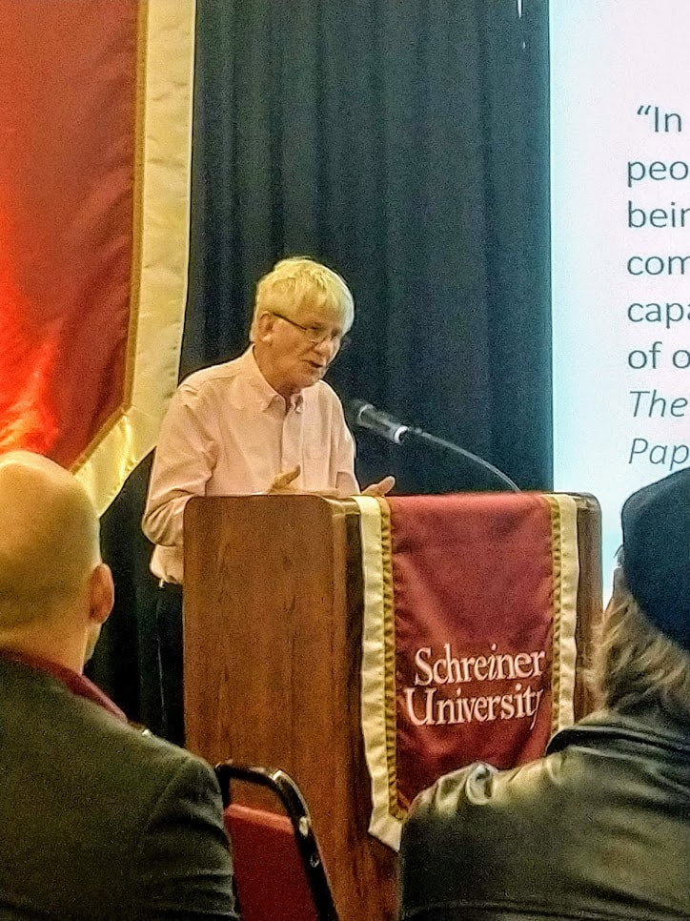
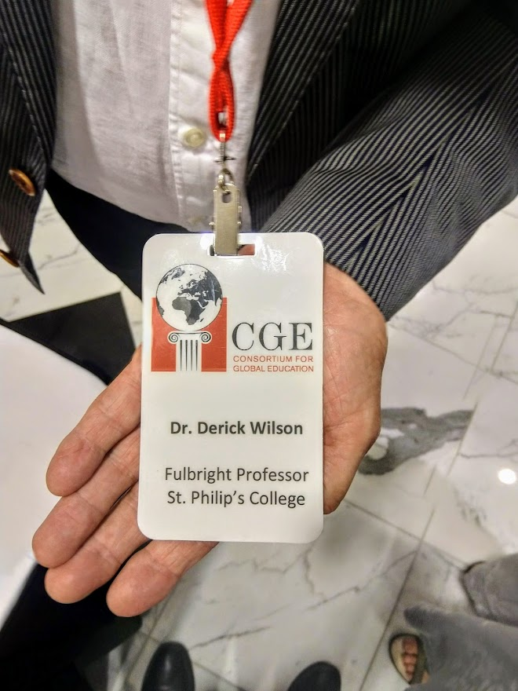
The Fulbright Award

Slide 29
The Fulbright Award

Slide 30
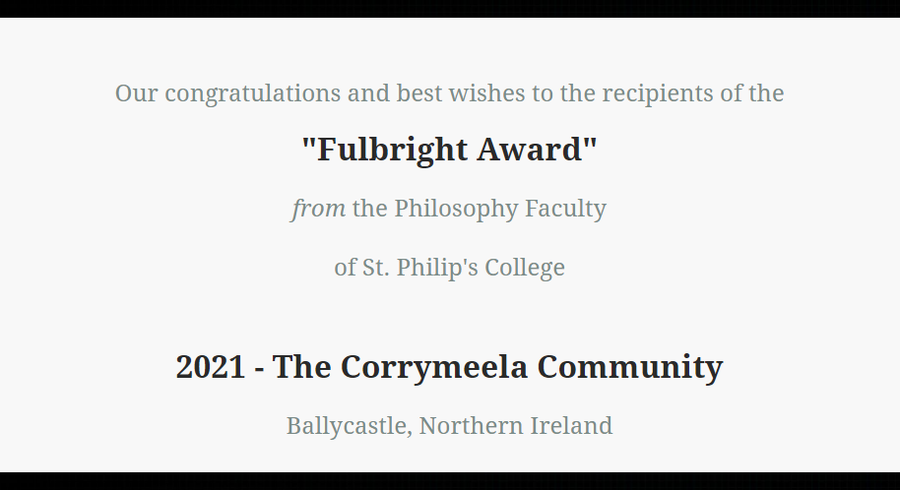
Bravo!
2021 Fulbright Award
The Corrymeela Community

Slide 31
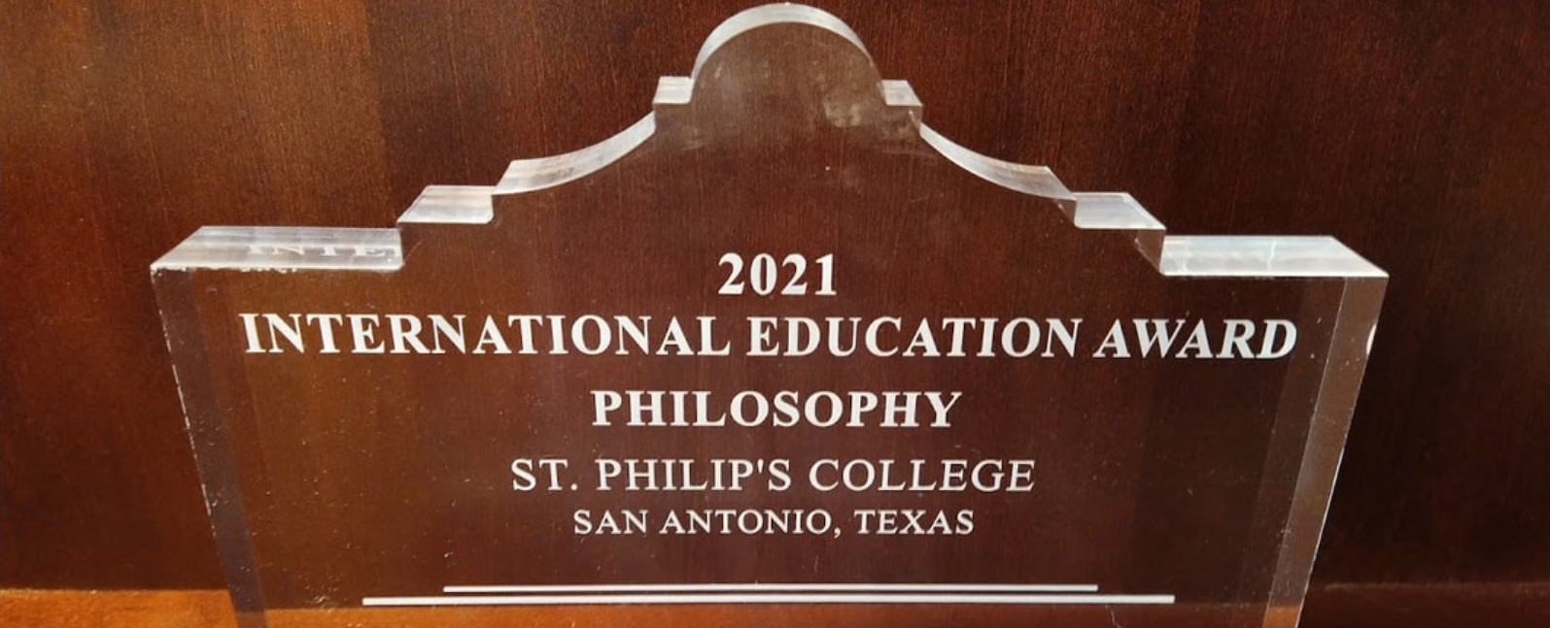
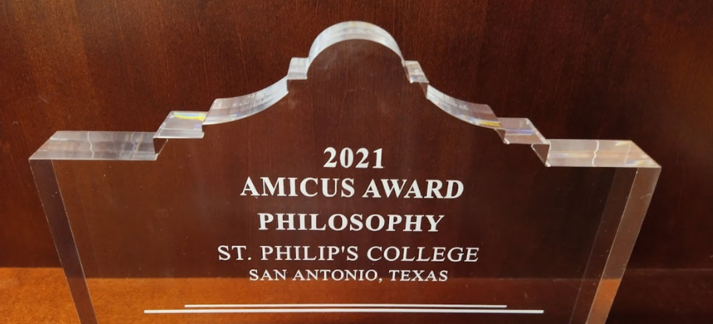
Bravo!
2021 International Education Award
The International Education Award

Slide 32
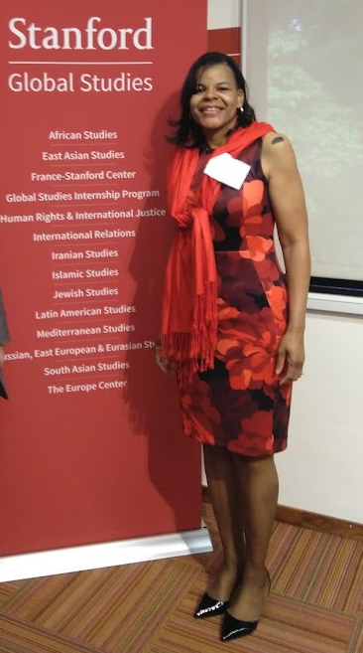
Brava!
2021 International Education Award
Irene W. Young
The International Education Award
Once a year, the Philosophy Faculty at St. Philip’s College bestows an award on a member of our community for their work supporting international education or service.
This year’s recipient is Irene W. Young, Assistant Professor of Psychology at St. Philip's College and during the academic year 2021- 2022 she is an International Faculty Fellow for Curriculum Internationalization for the Alamo Colleges District.
In AY 2018 – 2019, she was a Fellow in the Global Studies Division of Stanford University.

Slide 33
Brava!
2021 International Education Award
Irene W. Young
The International Education Award
2015 – Study Abroad
Irene taught Psychology to our students in Ireland at the Corrymeela Peace Centre in Ballycastle.

Slide 34
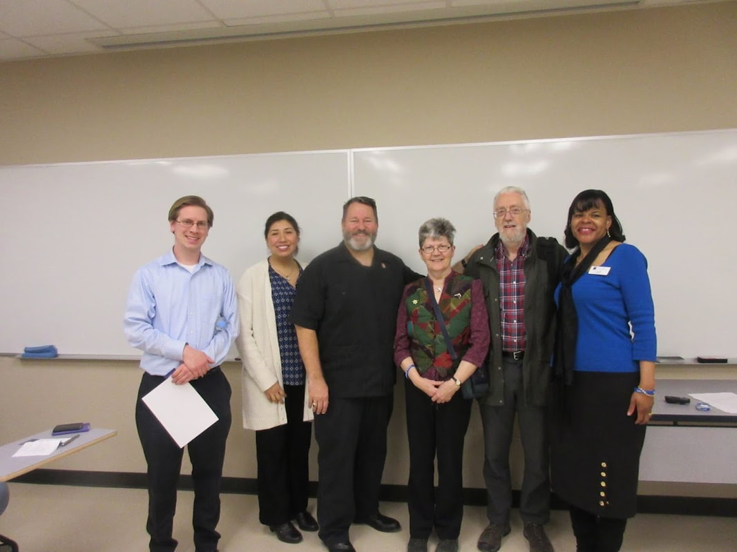
Brava!
2021 International Education Award
Irene W. Young
The International Education Award
2016 – Visiting Fulbright Scholars
Irene welcomed our Fulbright Scholars in Residence from the Corrymeela Centre to St. Philip’s College.

Slide 35
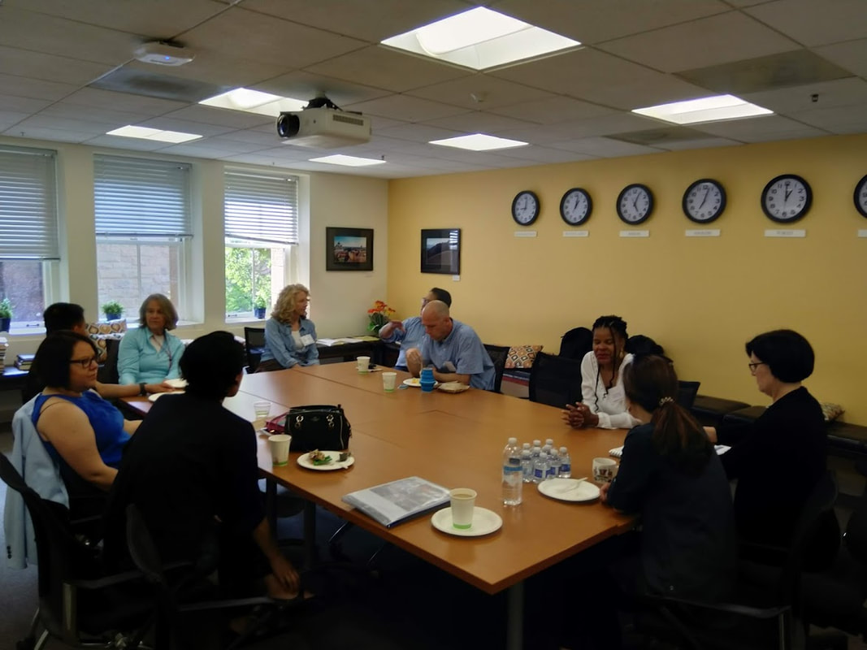
Brava!
2021 International Education Award
Irene W. Young
The International Education Award
2018 – Stanford Fellow
Irene was named a Faculty Fellow in the Global Studies Division of Stanford University.

Slide 36
Brava!
2021 International Education Award
Irene W. Young
The International Education Award
2019 – Stanford Fellow
Irene shared her work at Stanford in a Faculty Development presentation on Global Competency.

Slide 37
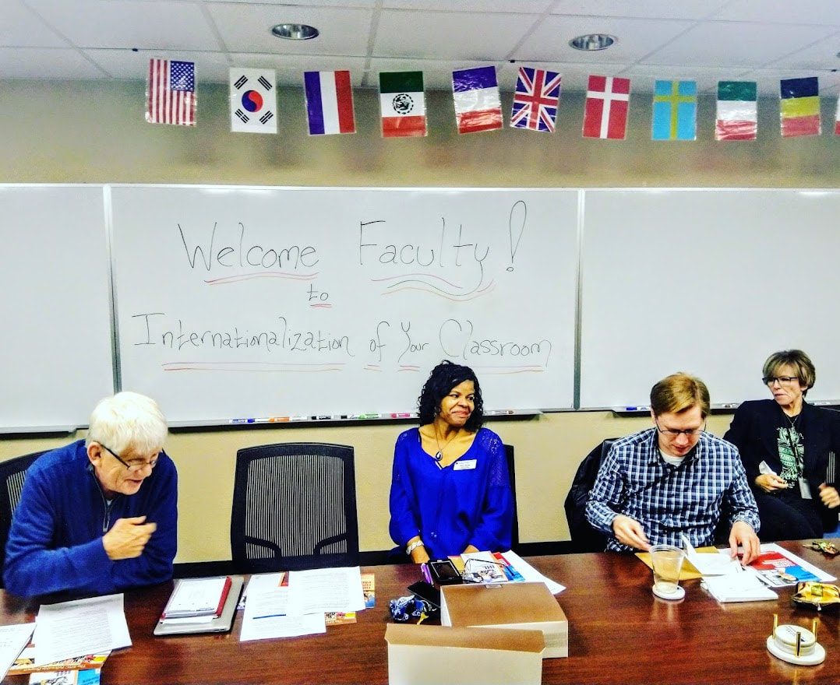
Brava!
2021 International Education Award
Irene W. Young
The International Education Award
2020 – Visiting Fulbright Scholars
Irene welcomed our Fulbright Scholar in Residence from the Corrymeela Centre to St. Philip’s College.

Slide 38
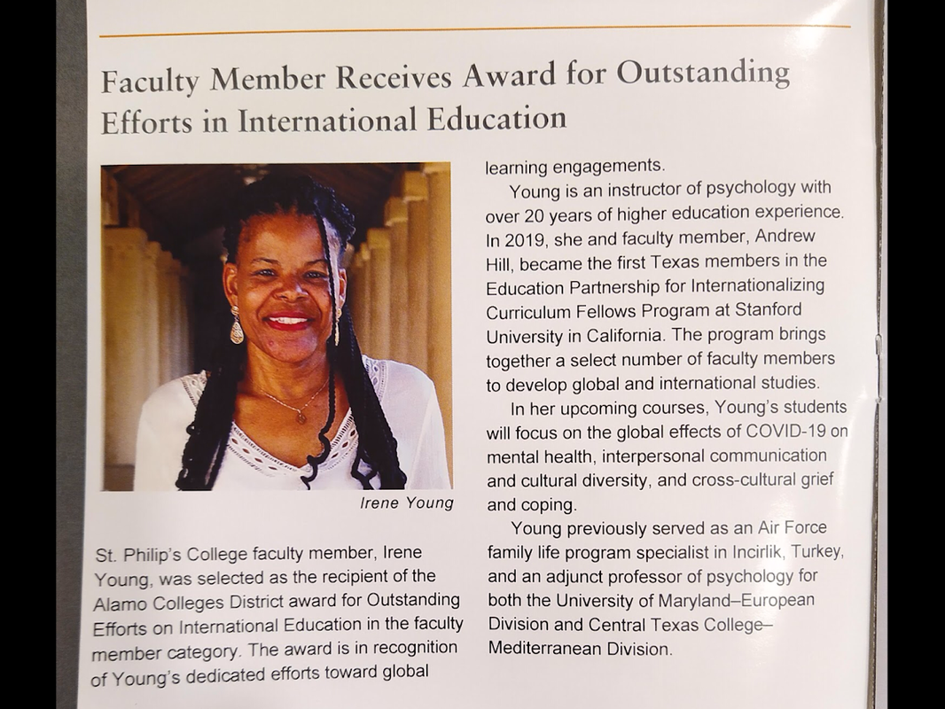
Brava!
2021 International Education Award
Irene W. Young
The International Education Award
2021 – Fellow
Irene was named an International Faculty Fellow for Curriculum Internationalization for the Alamo Colleges District.

Slide 39
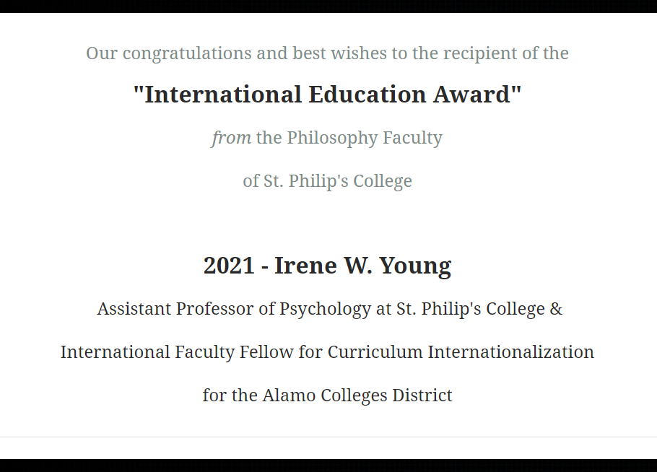
Brava!
2021 International Education Award
Irene W. Young

Slide 40
Bravo!
2021 Amicus Award
The Amicus Award

Slide 41
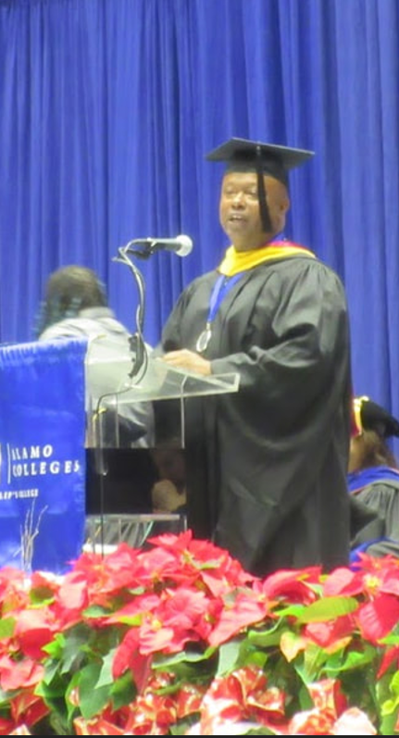
Bravo!
2021 Amicus Award
George H. Johnson, III
Once a year, the Philosophy Faculty at St. Philip’s College bestows an award that recognizes outstanding contributions to the shared work of our extended faculty, our colleagues, or our local partners in the Greater San Antonio Community in the teaching of Philosophy inside and outside the classroom.
Our students benefit when our partnerships come together to share expertise, knowledge, and resources.
This year’s recipient is George H. Johnson, III, Professor of Mathematics, and Interim Vice President of College Services at St. Philip's College.
The Amicus Award

Slide 42
Bravo!
2021 Amicus Award
George H. Johnson, III
The Amicus Award
Prof. Johnson, pictured with Matthew Fuller, received the 2017 NISOD Excellence Award from the College of Education at the University of Texas at Austin for his teaching and leadership at St. Philip’s College. This is a national distinction for distinguished service.
Prof. Johnson is a committed educator and is seen here with the thousands of people who filled the streets of San Antonio’s historically black East Side for a march celebrating Martin Luther King Jr. Day, on Monday, January 21, 2019.

Slide 43
Bravo!
2021 Amicus Award
George H. Johnson, III
The Amicus Award
Prof. Johnson has been a long-standing support of the Philosophy Club, having attended the first-ever dinner sponsored by the Club when we attended the Trinity University DeCoursey Lecture on October 16, 2013.
George H. Johnson, III and Marie Feldmeier, when St. Philip’s College hosted the Association for Practical and Professional Ethics (APPE) Eighth Annual Two-Year College Ethics Bowl National Competition on Saturday, November 23, 2019.

Slide 44
Bravo!
2021 Amicus Award
George H. Johnson, III

Slide 45
Save the Date! October 13, 2023 50th Anniversary Celebration The Philosophy Faculty of St. Philip’s College
THE FACULTY
Members Before 2009:
Connie Economy
Norman Kutschenreuter
Donald Castellano Hoyt
Collin Furr
Ann L. Riordan
Clinton F. Dunagan
​
2009 – 2013
Joseph Allen
John Travis
2013 – 2014
Marie Pannier Feldmeier
Andrew Hill
2014 – 2018
Matthew Fuller
Andrew Hill
2018 – 2020
Matthew Fuller
Andrew Hill
Charlie Langston
Fulbright Scholars-in-Residence:
​Richard Naylor (2016)
Yvonne Naylor (2016)
Derick Wilson (2019 - 2020)
Adjuvant Members of the
Philosophy Faculty:
Patrick J. Aspell
Jonathan Paul De Vierville
Jack Ferguson
Matthew Mangum
Marshall Naylor
Kent Slinker
fd

Slide 46
Annual Awards Ceremony The Philosophy Faculty of St. Philip’s College
THE FACULTY
Members Before 2009:
Connie Economy
Norman Kutschenreuter
Donald Castellano Hoyt
Collin Furr
Ann L. Riordan
Clinton F. Dunagan
​
2009 – 2013
Joseph Allen
John Travis
2013 – 2014
Marie Pannier Feldmeier
Andrew Hill
2014 – 2018
Matthew Fuller
Andrew Hill
2018 – 2020
Matthew Fuller
Andrew Hill
Charlie Langston
Fulbright Scholars-in-Residence:
​Richard Naylor (2016)
Yvonne Naylor (2016)
Derick Wilson (2019 - 2020)
Adjuvant Members of the
Philosophy Faculty:
Patrick J. Aspell
Jonathan Paul De Vierville
Jack Ferguson
Matthew Mangum
Marshall Naylor
Kent Slinker
fd
23 feb 2022

