Slide 1
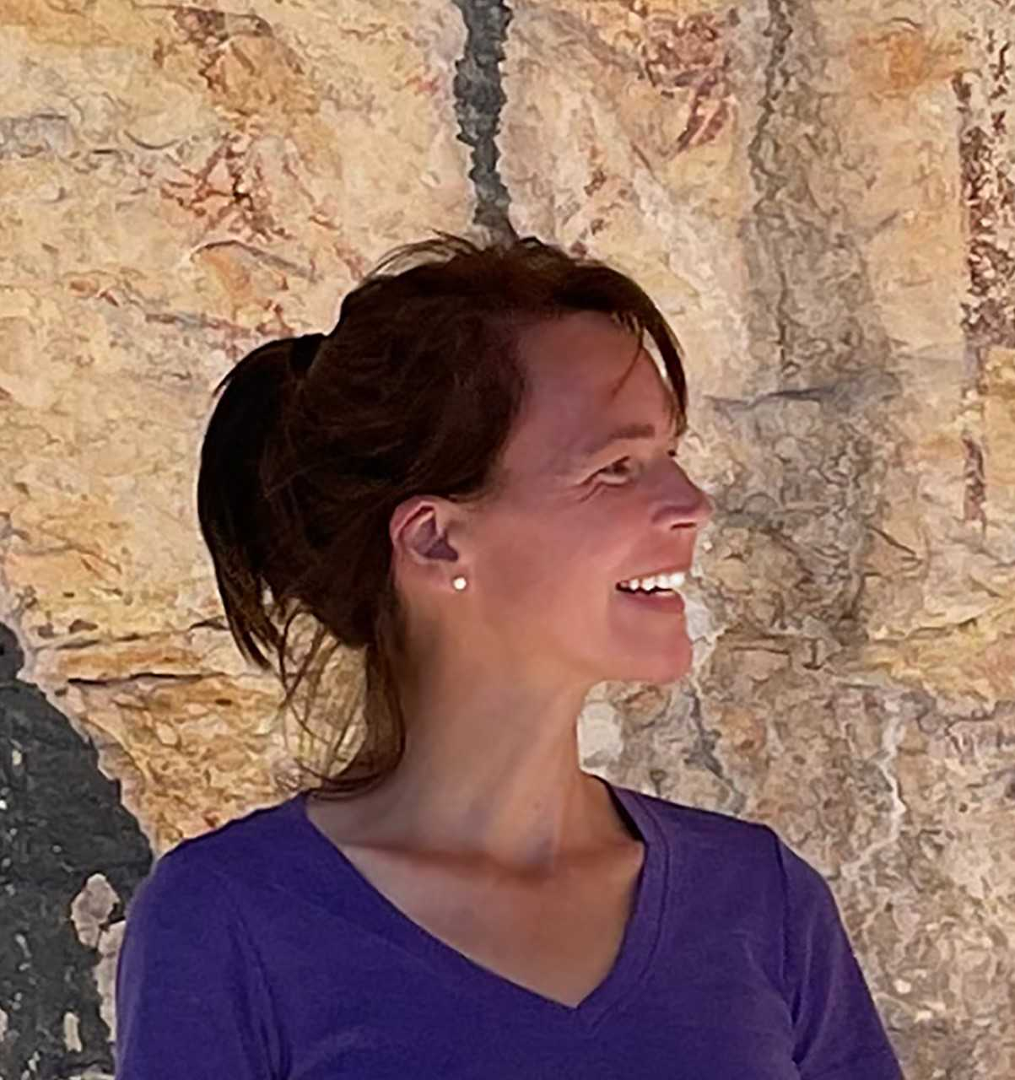
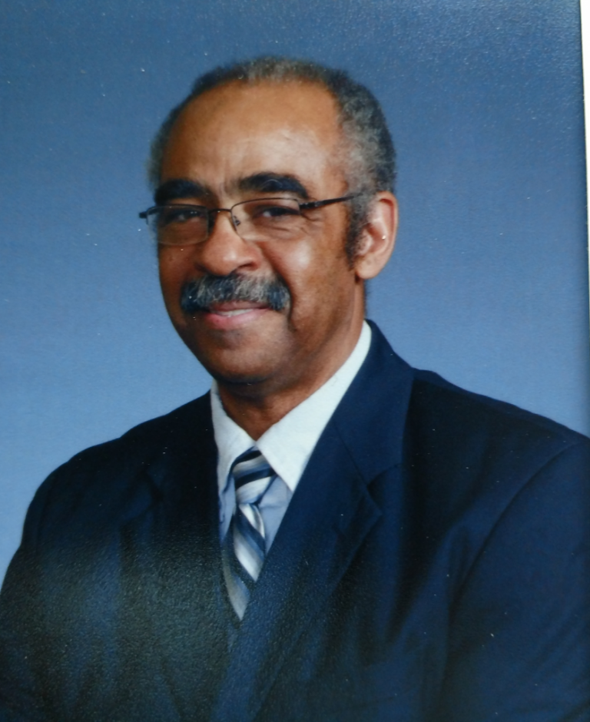
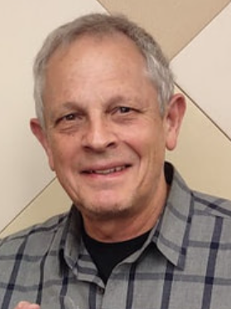
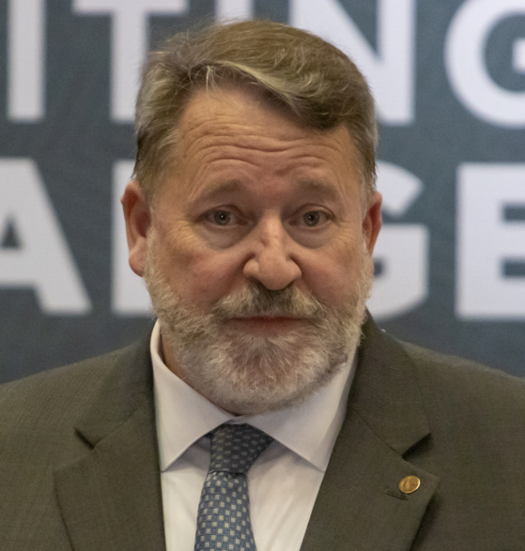
Annual Awards Ceremony The Philosophy Faculty of St. Philip’s College
07
December 2022

Slide 3
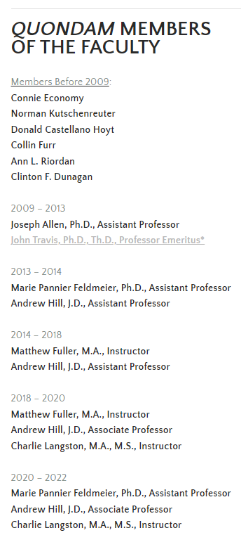
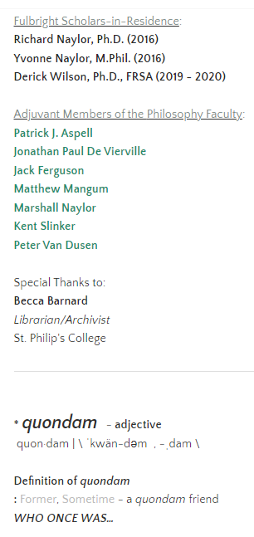

Slide 4
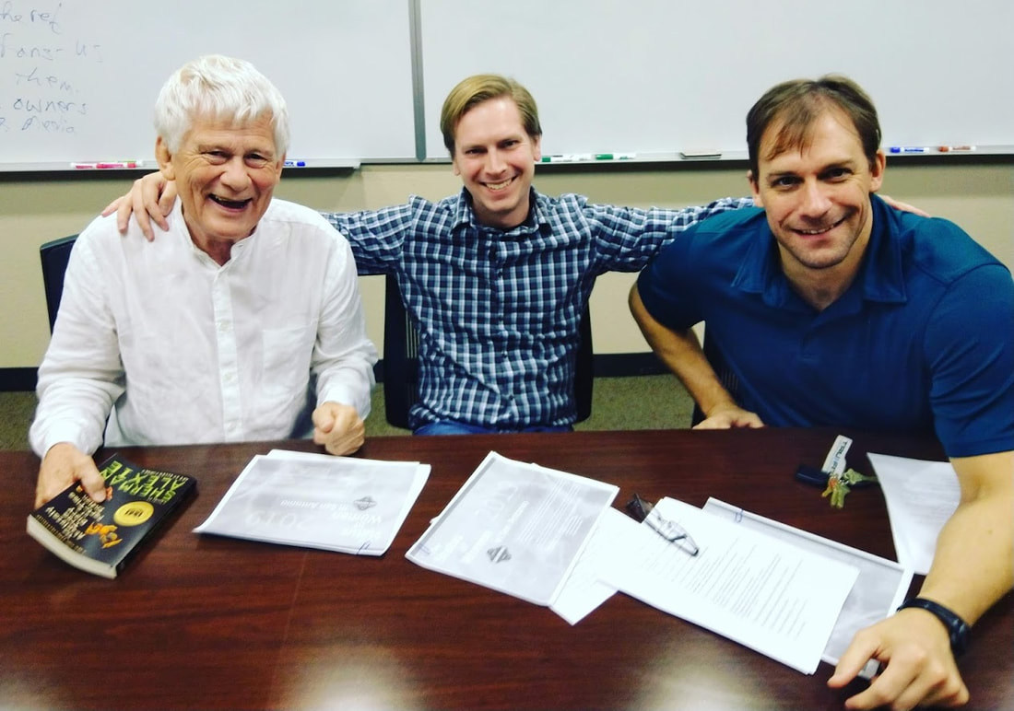
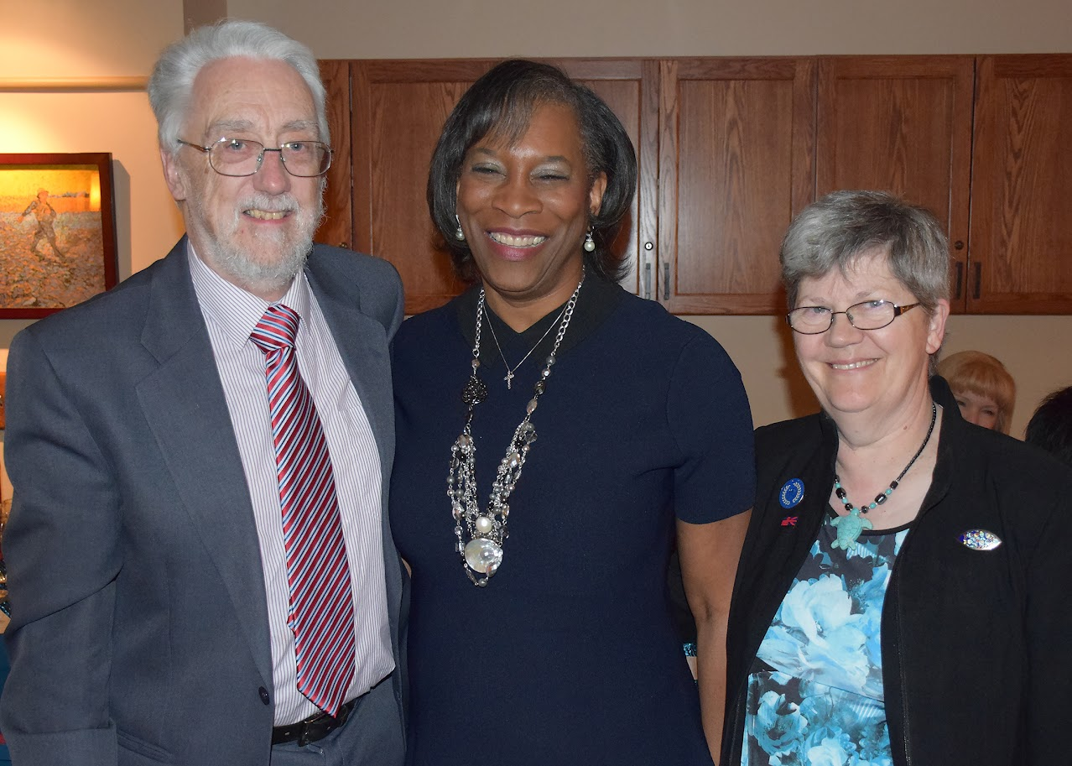

Slide 5
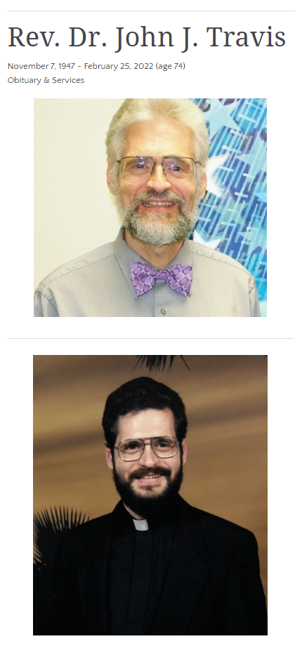

Slide 6
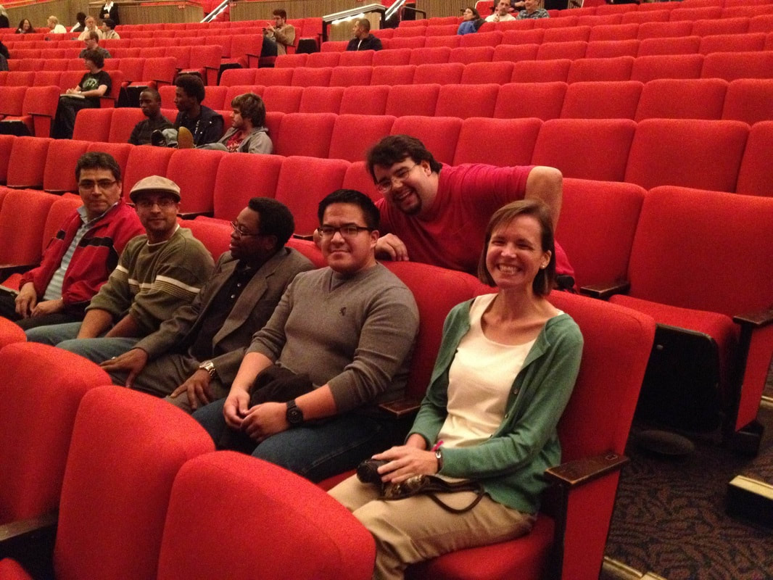
Since the fall of 2013,
the St. Philip’s College Philosophy Faculty has worked with partners from across campus to sponsor a number of groups and activities, including the
Philosophy Club
The Ethics Bowl
Field Trips
Lecture Series
The QEP Program, &
The ICDP

Slide 7
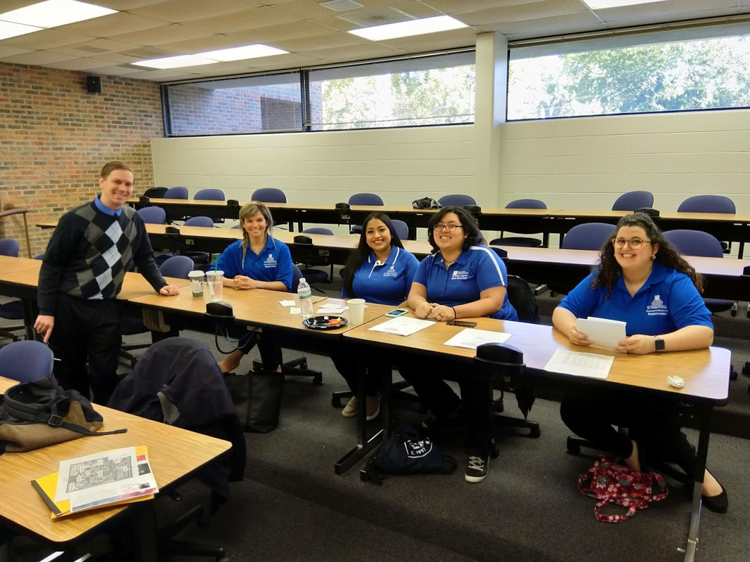
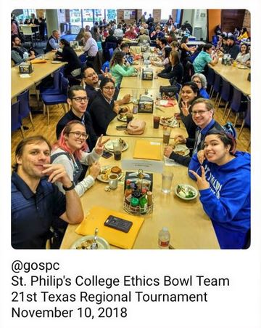
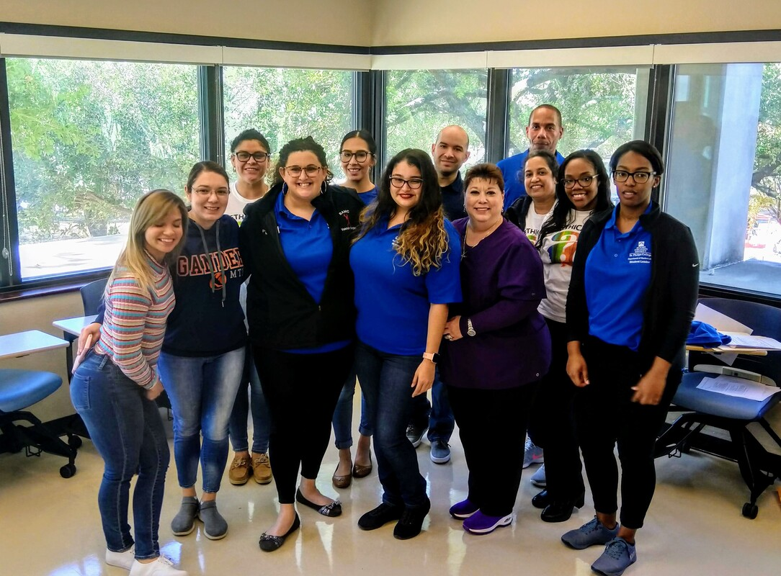
Since the fall of 2013,
the St. Philip’s College Philosophy Faculty has worked with partners from across campus to sponsor a number of groups and activities, including the
Philosophy Club
The Ethics Bowl
Field Trips
Lecture Series
The QEP Program, &
The ICDP

Slide 8
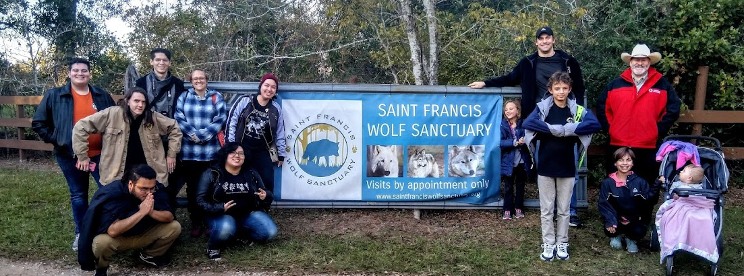
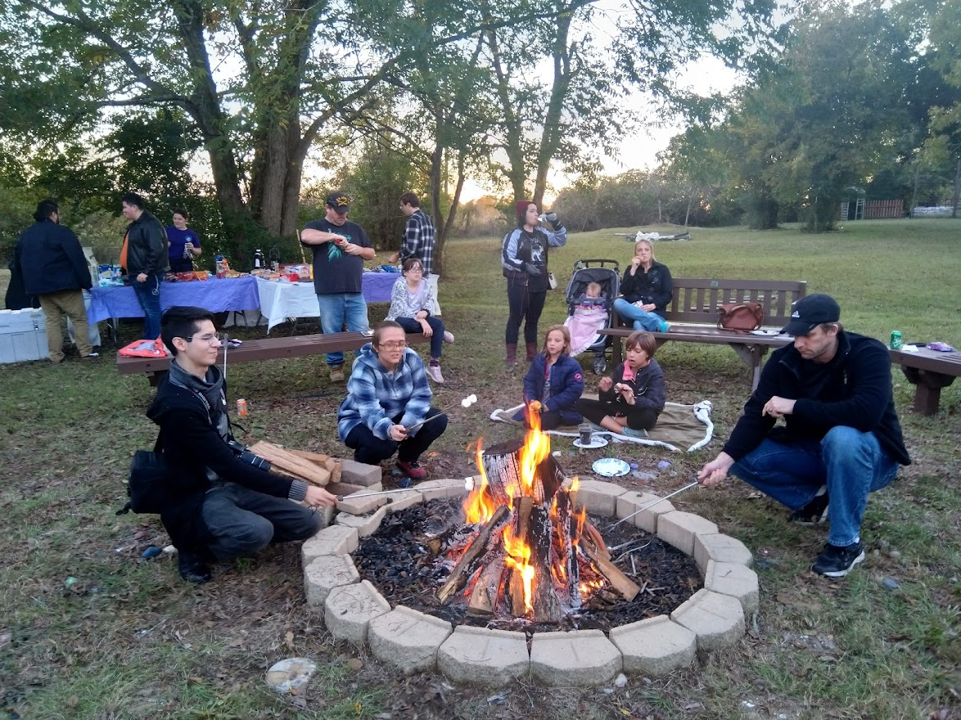
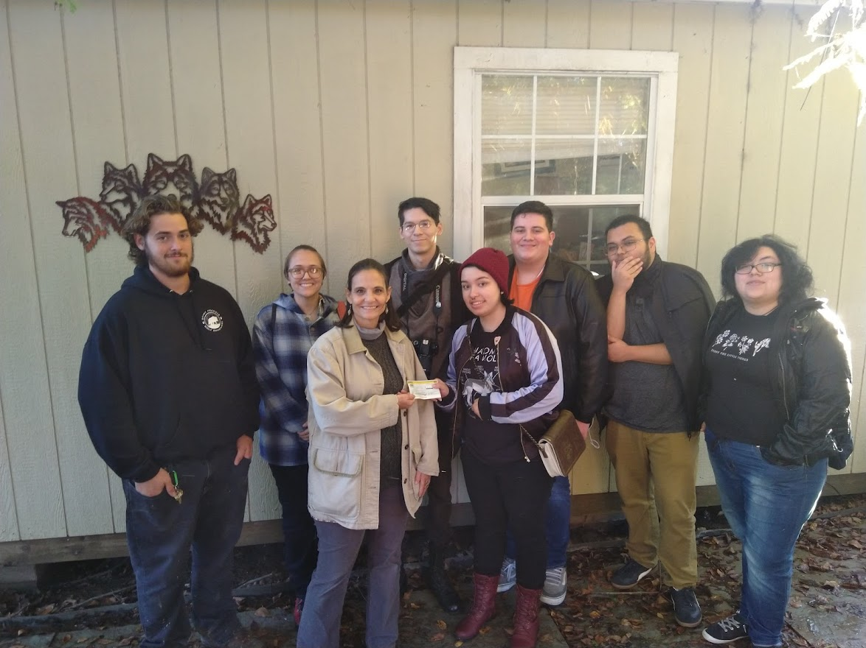
Since the fall of 2013,
the St. Philip’s College Philosophy Faculty has worked with partners from across campus to sponsor a number of groups and activities, including the
Philosophy Club
The Ethics Bowl
Field Trips
Lecture Series
The QEP Program, &
The ICDP

Slide 9
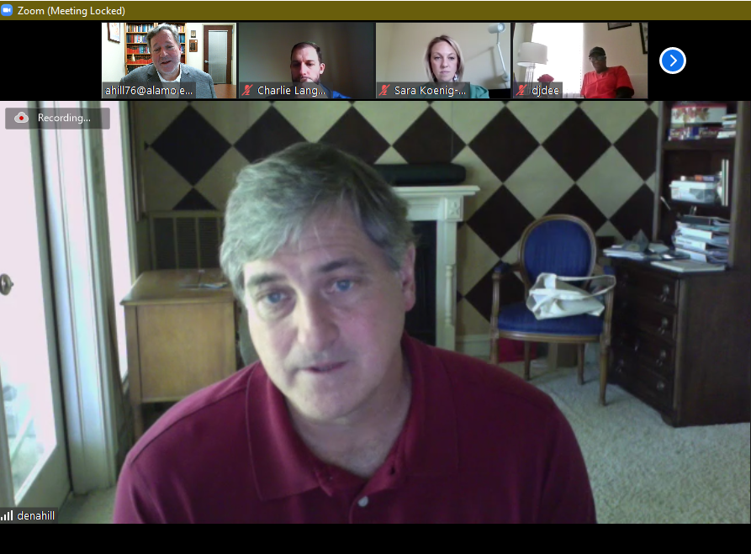
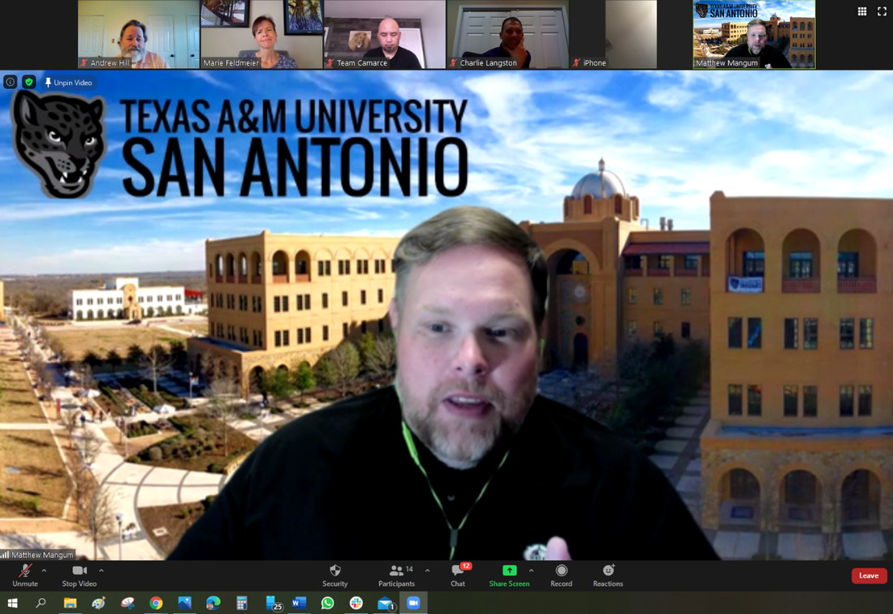
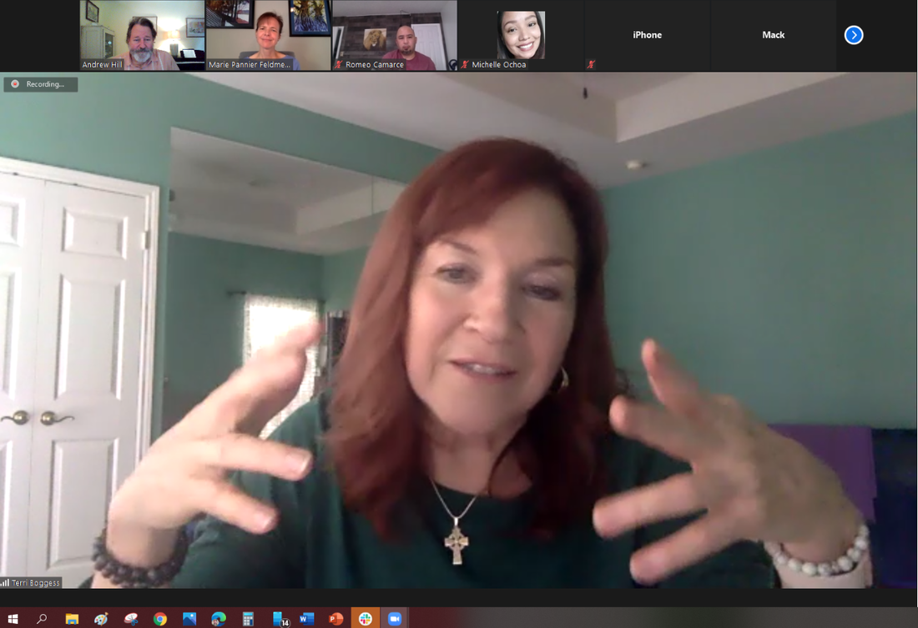
Since the fall of 2013,
the St. Philip’s College Philosophy Faculty has worked with partners from across campus to sponsor a number of groups and activities, including the
Philosophy Club
The Ethics Bowl
Field Trips
Lecture Series
The QEP Program, &
The ICDP
The Faculty Research Lecture Series

Slide 10
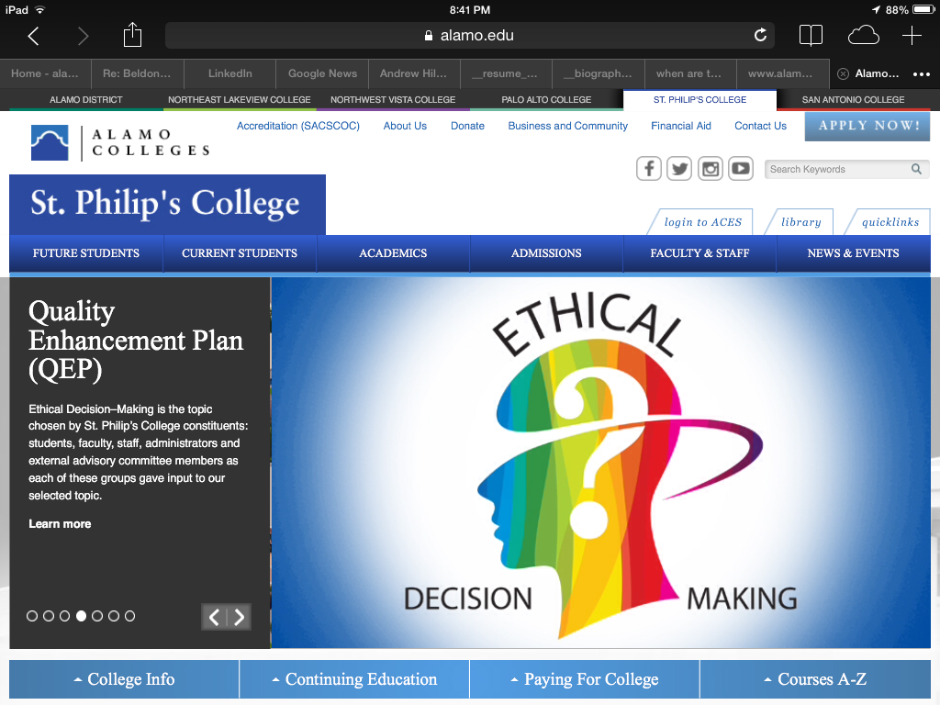
Since the fall of 2013,
the St. Philip’s College Philosophy Faculty has worked with partners from across campus to sponsor a number of groups and activities, including the
Philosophy Club
The Ethics Bowl
Field Trips
Lecture Series
The QEP Program, &
The ICDP

Slide 11
The Intercollegiate Civil Disagreement Partnership
Since the fall of 2013,
the St. Philip’s College Philosophy Faculty has worked with partners from across campus to sponsor a number of groups and activities, including the
Philosophy Club
The Ethics Bowl
Field Trips
Lecture Series
The QEP Program, &
The ICDP

Slide 12
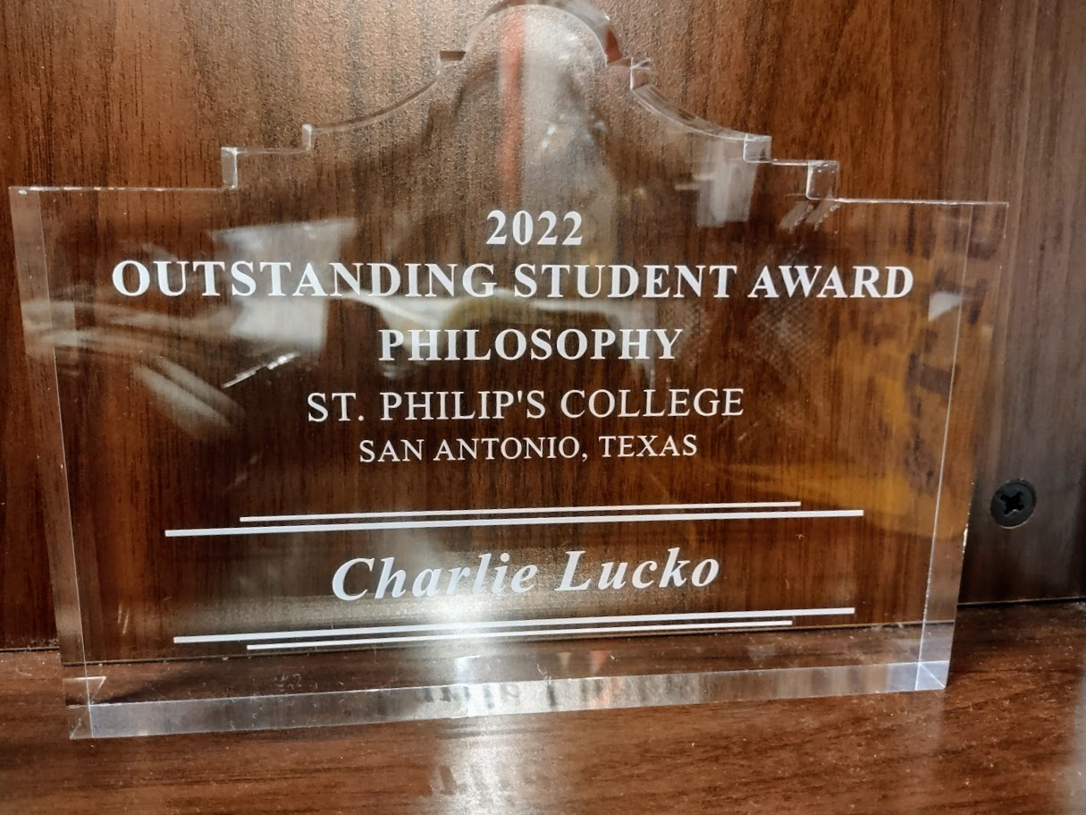
Today!
2022 Outstanding Student Award
The Outstanding Student Award

Slide 13
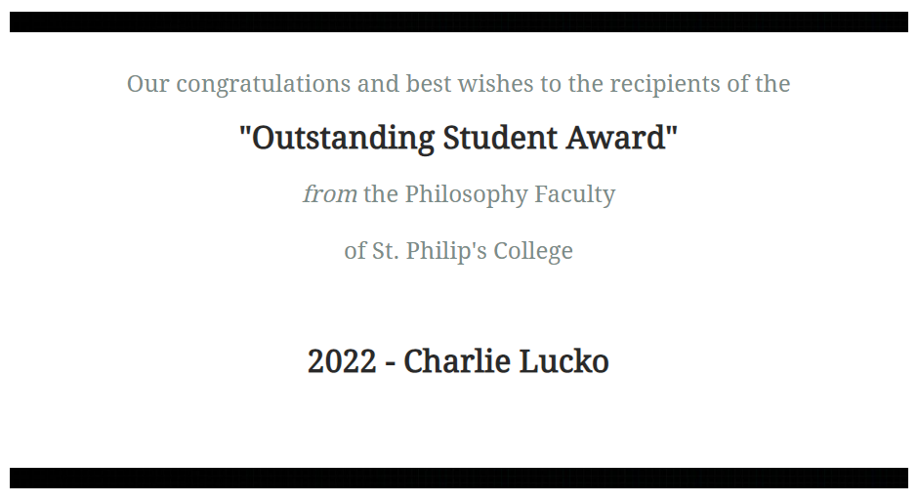
Bravo!
2022 Outstanding Student Award
The Outstanding Student Award

Slide 14
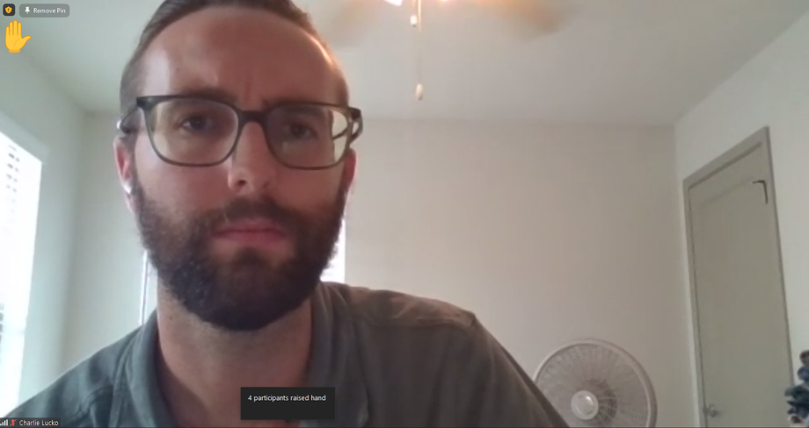
Bravo!
2022 Outstanding Student Award
The Outstanding Student Award

Slide 15
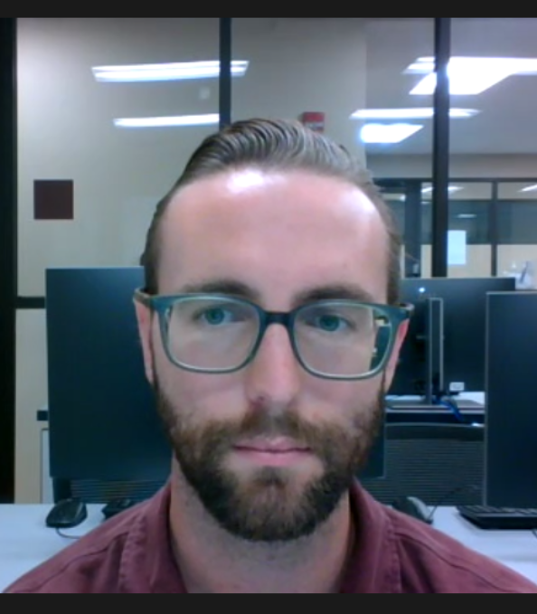
Bravo!
2022 Outstanding Student Award
The Outstanding Student Award

Slide 16
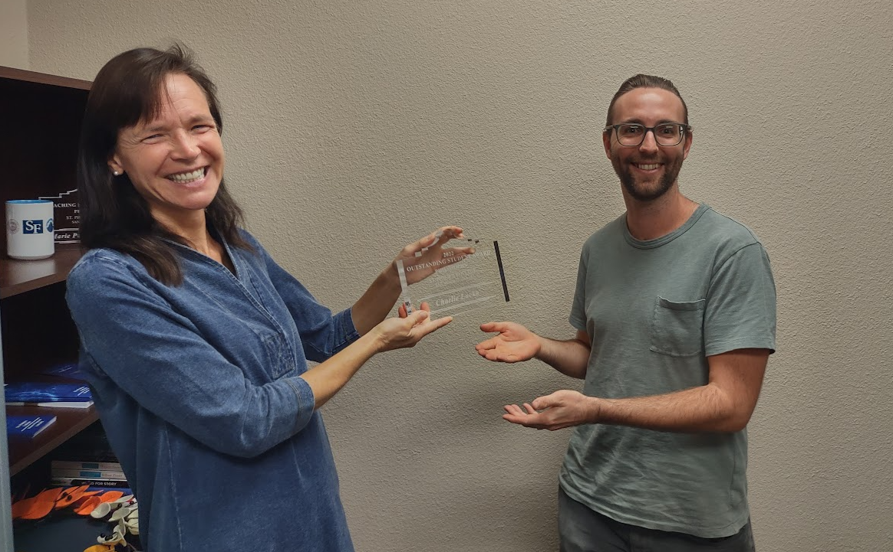
Bravo!
2022 Outstanding Student Award
The Outstanding Student Award

Slide 17
Bravo!
2022 Outstanding Student Award
The Outstanding Student Award

Slide 18
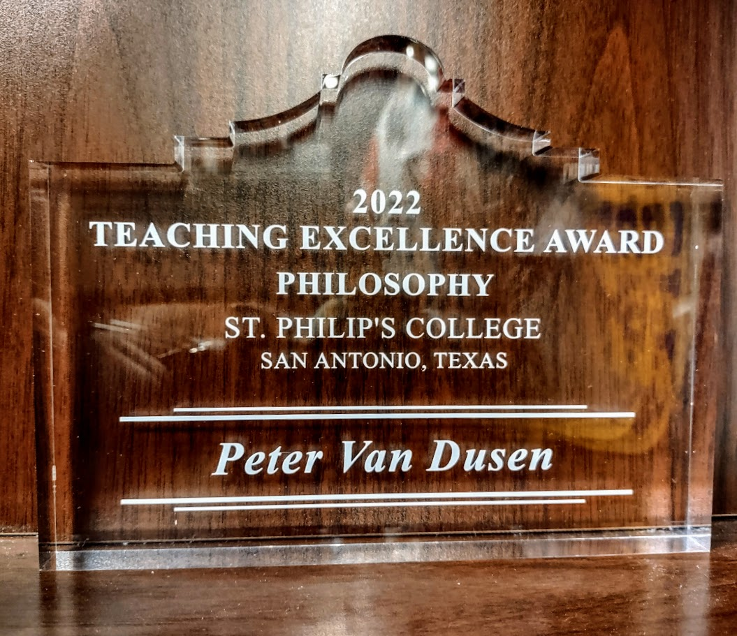
Bravo!
2022 Teaching Excellence Award
The Teaching Excellence Award

Slide 19
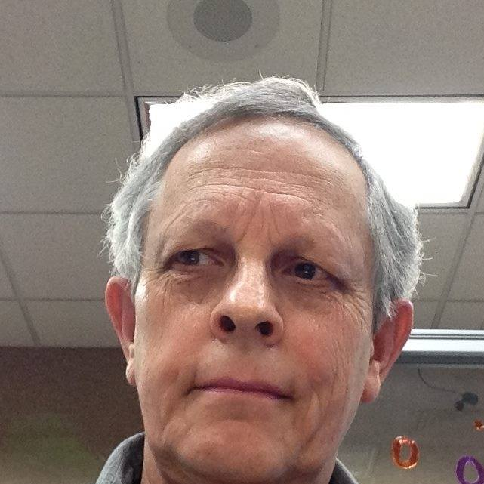
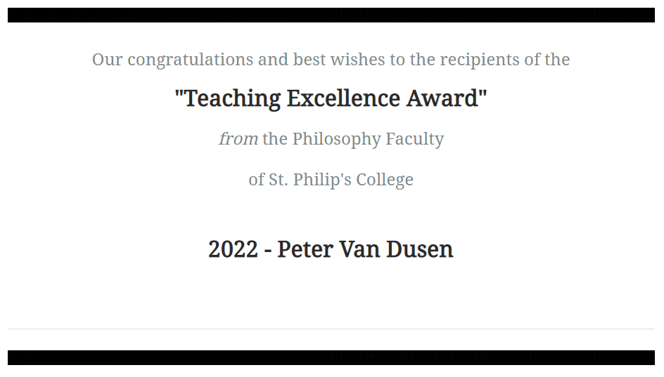
Bravo!
2022 Teaching Excellence Award
Peter Van Dusen
The First Professor of Philosophy at St. Philip’s College
The Teaching Excellence Award

Slide 20
Bravo!
2022 Teaching Excellence Award
The Teaching Excellence Award

Slide 21
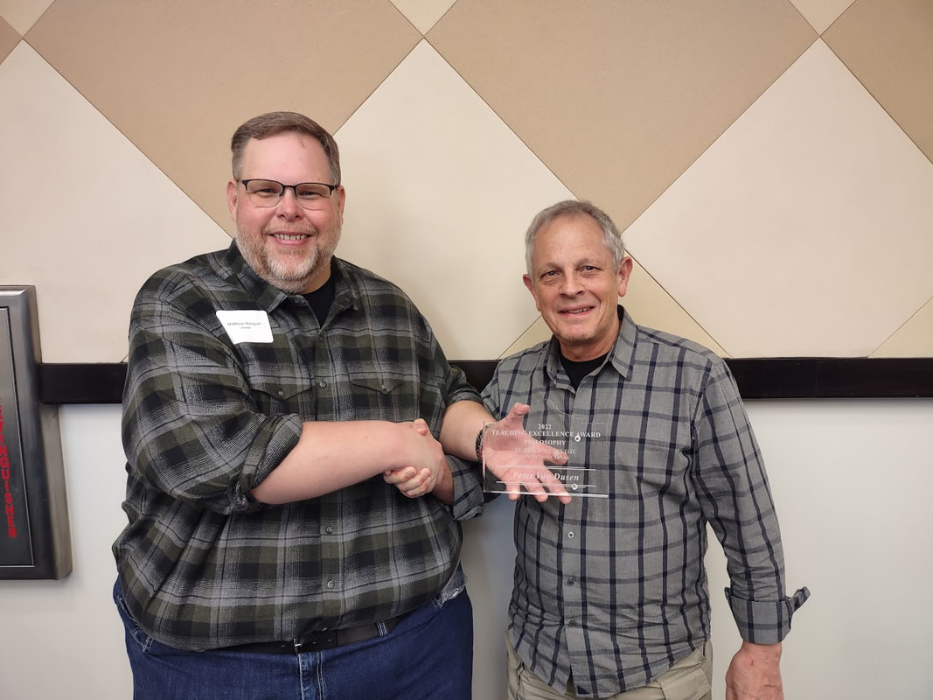
Bravo!
2022 Teaching Excellence Award
The Teaching Excellence Award

Slide 22
Bravo!
2022 Teaching Excellence Award
The Teaching Excellence Award

Slide 23
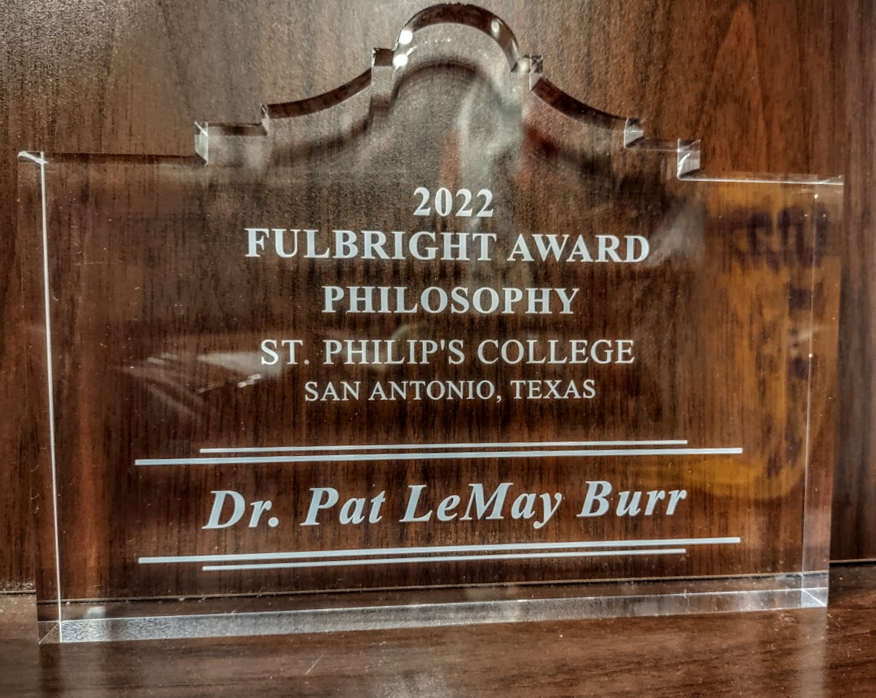
Bravo!
2022 Fulbright Award
The Fulbright Award

Slide 24
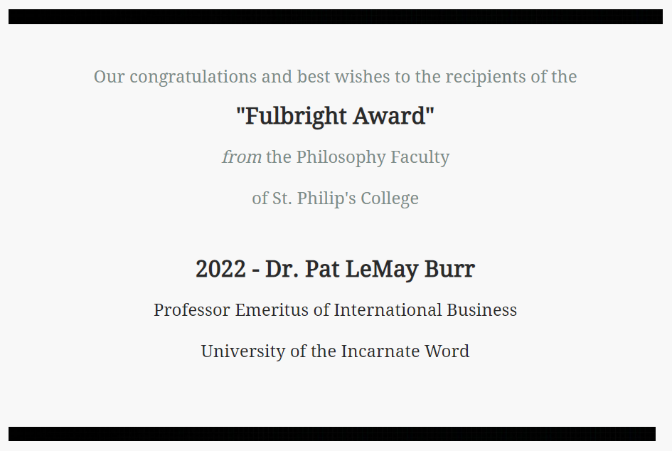
Brava!
2022 Fulbright Award
Dr. Pat LeMay Burr
The Fulbright Award

Slide 25
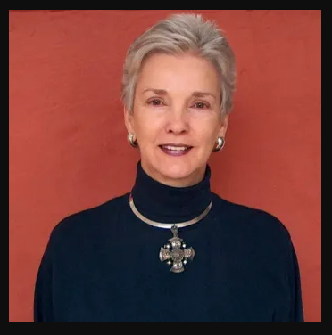
Brava!
2022 Fulbright Award
Dr. Pat LeMay Burr
The Fulbright Award
This award is presented on occasion for outstanding academic contributions to the students, faculty, and staff of St. Philip's College and for dedicated professional service to Greater San Antonio Community and the State of Texas through the Senator J. William Fulbright Scholarship Program.
This year’s recipient is Dr. Pat LeMay Burr, the founding and long-standing President of the San Antonio Chapter of the Fulbright Association.

Slide 26
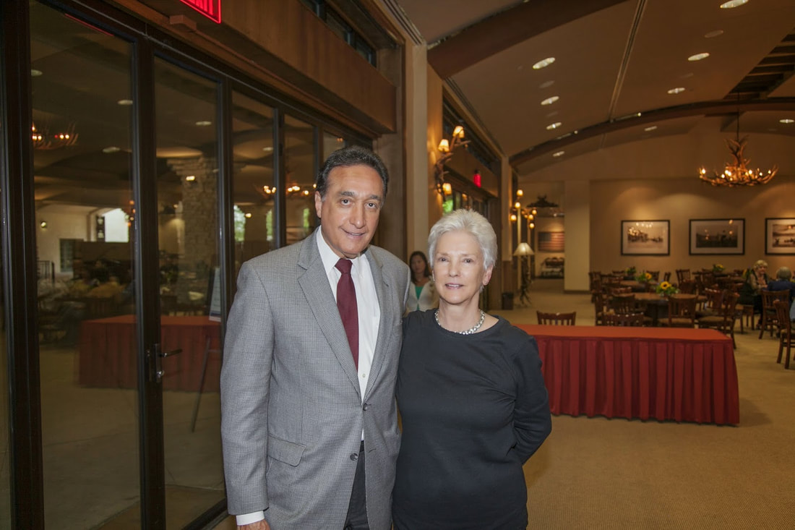
Brava!
2022 Fulbright Award
Dr. Pat LeMay Burr
The Fulbright Award

Slide 27
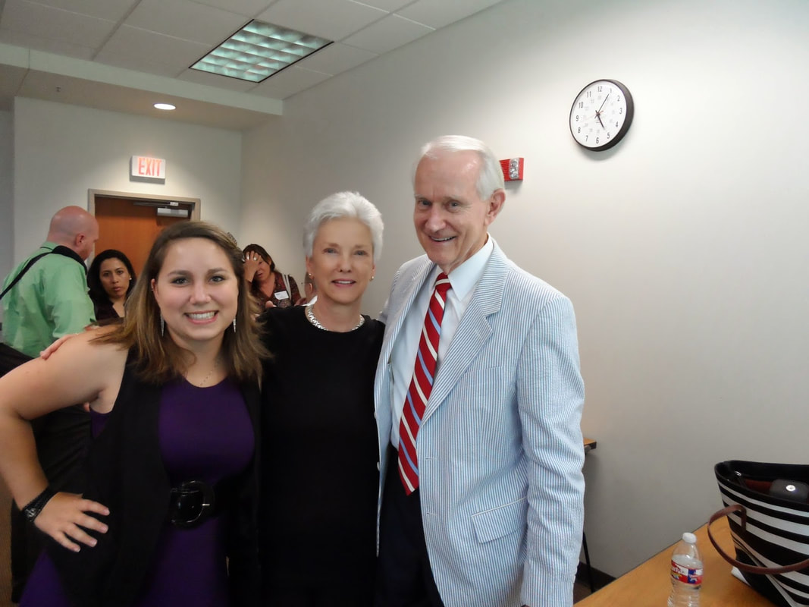
Brava!
2022 Fulbright Award
Dr. Pat LeMay Burr
The Fulbright Award

Slide 28
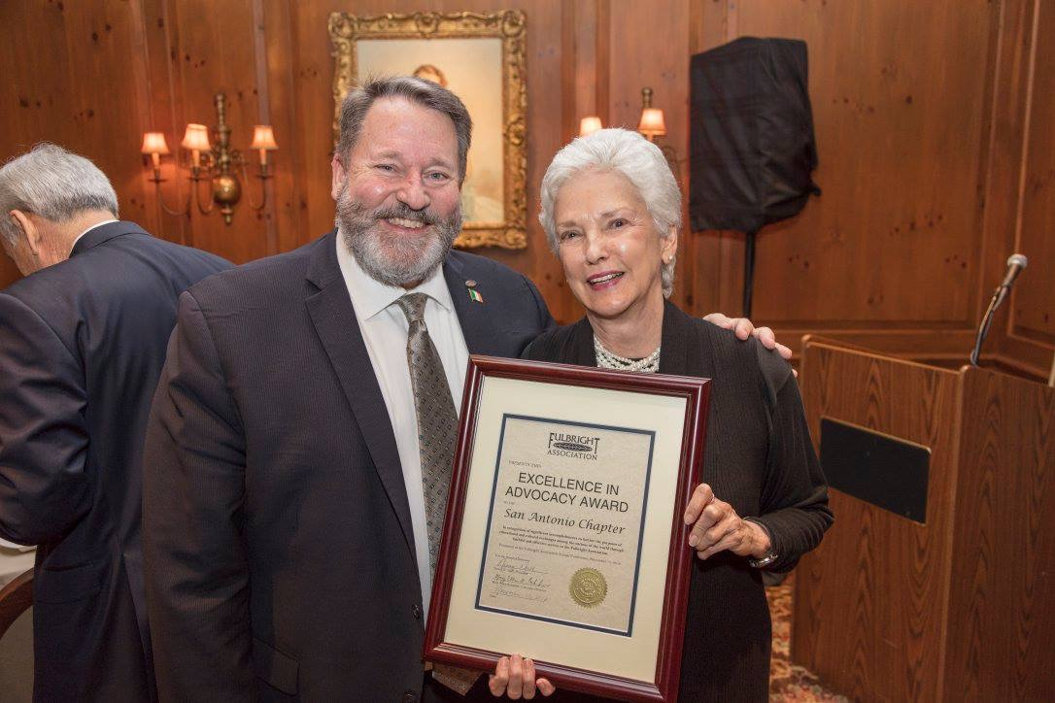
Brava!
2022 Fulbright Award
Dr. Pat LeMay Burr
The Fulbright Award

Slide 29
Brava!
2022 Fulbright Award
Dr. Pat LeMay Burr
The Fulbright Award

Slide 30
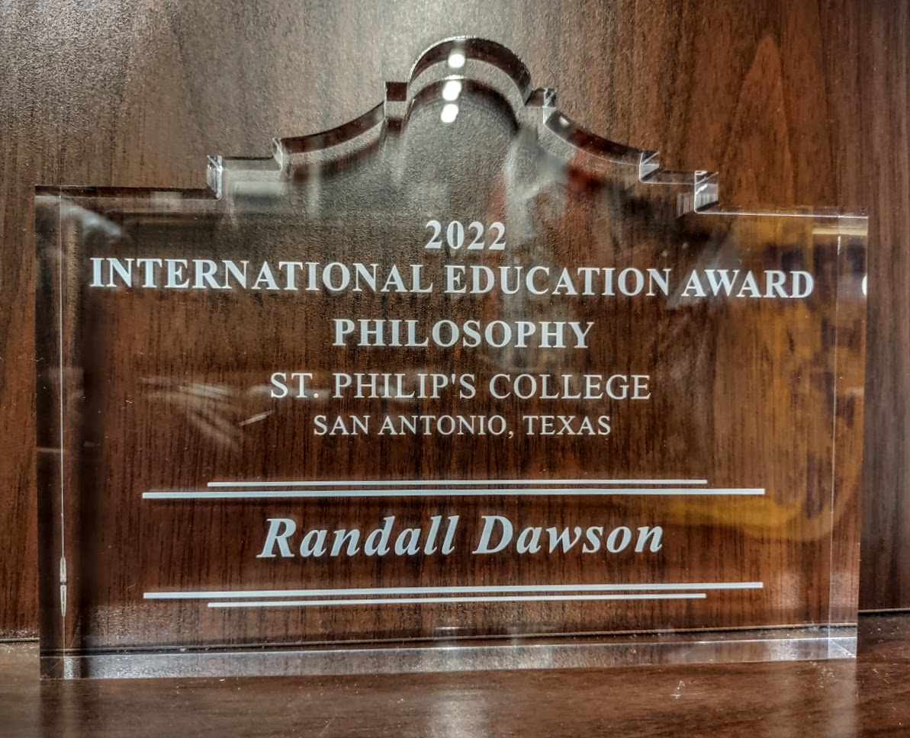
Bravo!
2022 International Education Award
The International Education Award

Slide 31
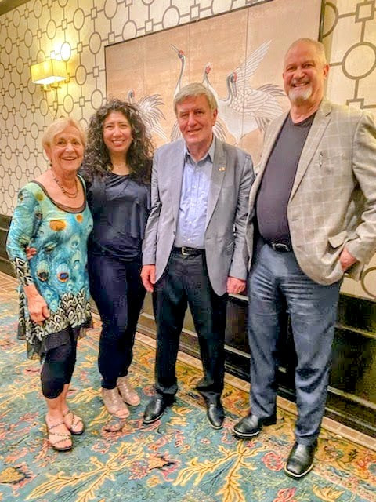
Brava!
2022 International Education Award
Randall Dawson
The International Education Award
Once a year, the Philosophy Faculty at St. Philip’s College bestows an award on a member of our community for their work supporting international education or service.
This year’s recipient is Randall Dawson, the Vice President for Academic Success at St. Philip's College.
​Mr. Dawson regularly represent St. Philip's College at community events and has been recognized for his outreach efforts to build collaborations with Community organizations local government and other colleges and universities.

Slide 32
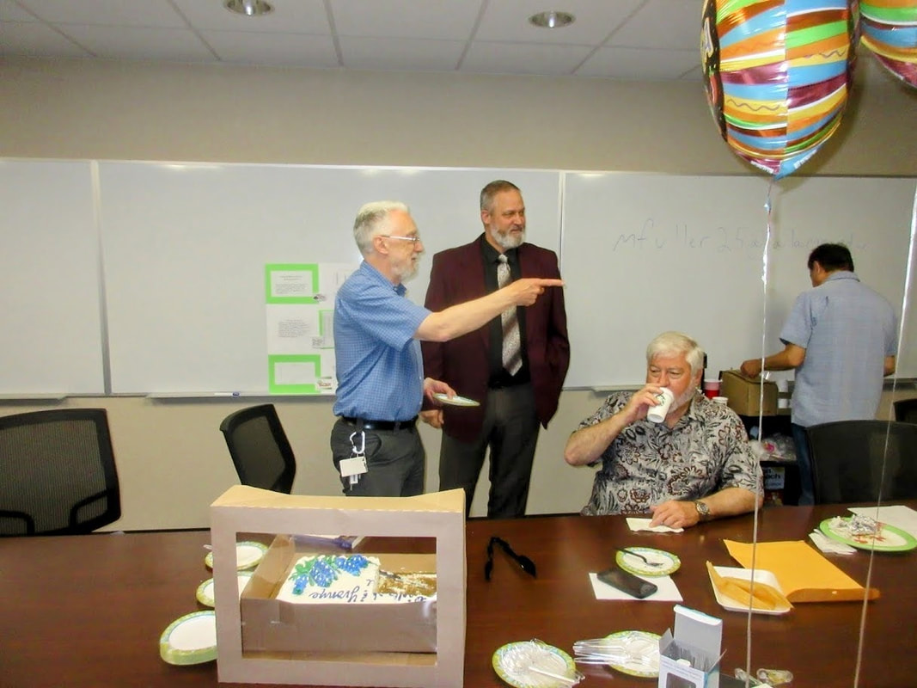
Brava!
2022 International Education Award
Randall Dawson
The International Education Award
Randall actively supports our participation in the Fulbright Scholar Program and was the Fulbright Program Responsible Administrative Officer for St. Philip's College.
Here is Randall with Dr. Richard Naylor, one of our two Fulbright Scholars-in-Residence during their farewell party in April 2016.

Slide 33
Brava!
2022 International Education Award
Randall Dawson
The International Education Award
Randall actively supports our participation in the Fulbright Scholar Program and was the Fulbright Program Responsible Administrative Officer for St. Philip's College.
Here is Randall with Dr. Richard Naylor, one of our two Fulbright Scholars-in-Residence during their farewell party in April 2016.
Randall has also supported our faculty in other internationalization efforts, including the Education Partnership for Internationalizing Curriculum through Stanford University in 2018 – 2019.

Slide 34
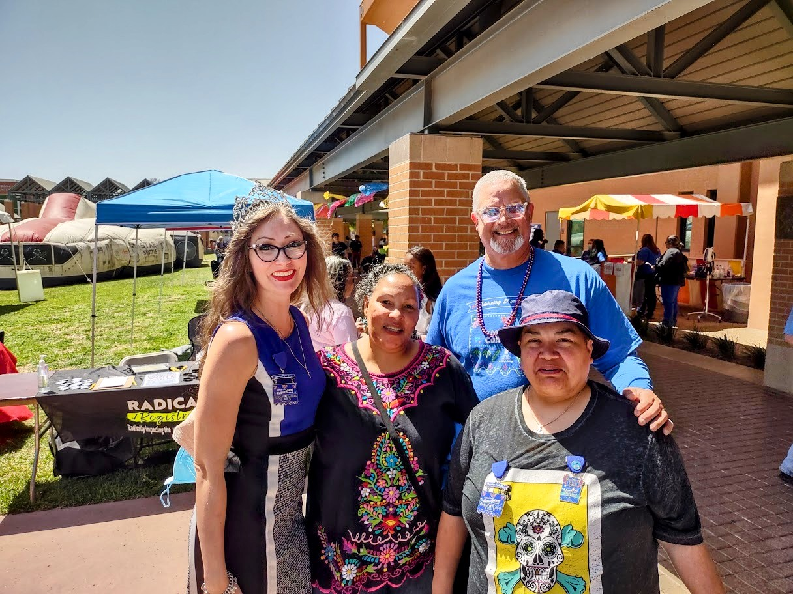
Brava!
2022 International Education Award
Randall Dawson
The International Education Award

Slide 35
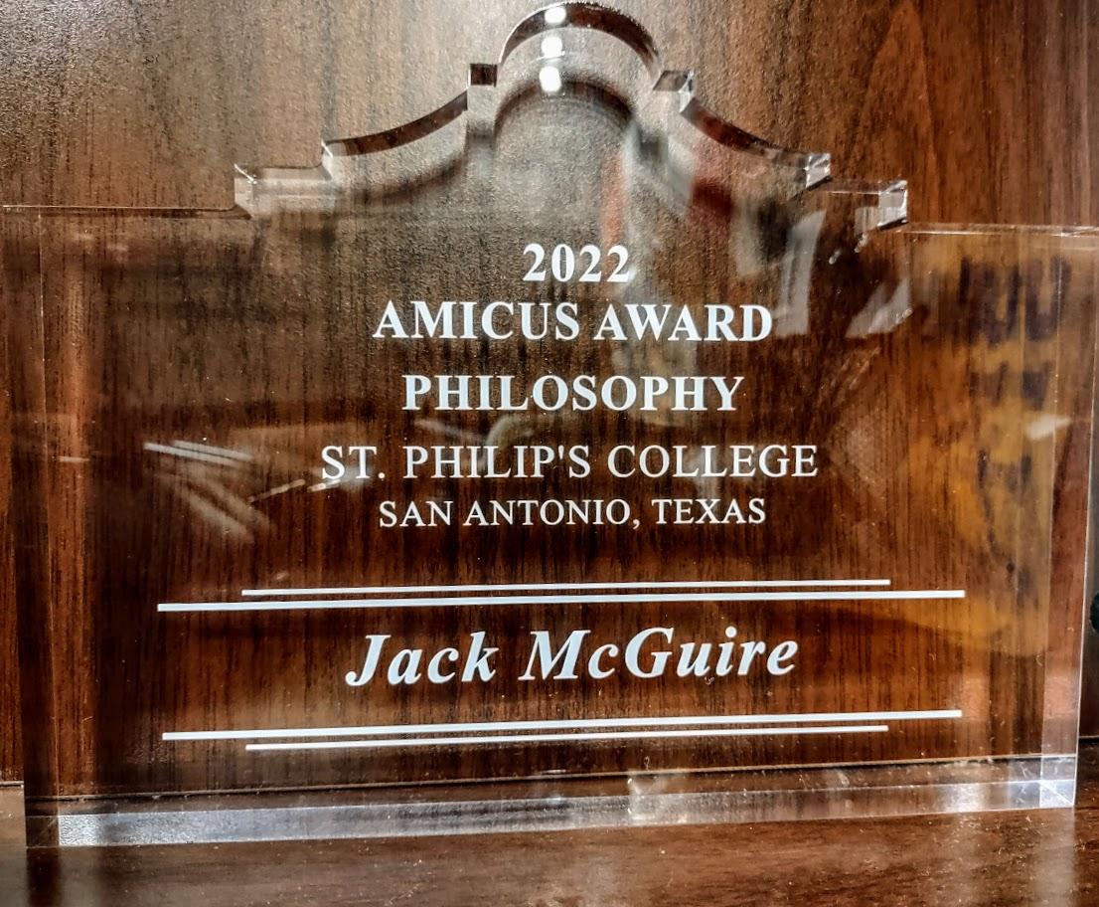
Bravo!
2022 Amicus Award
The Amicus Award

Slide 36
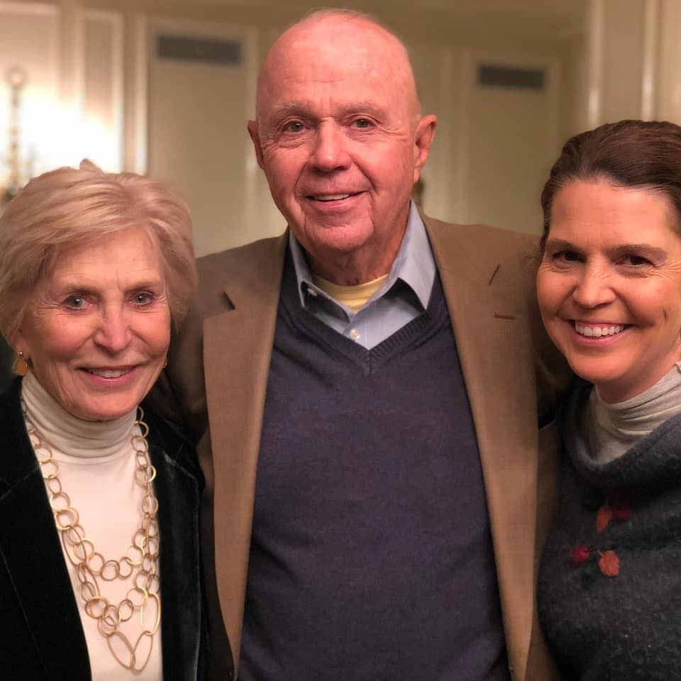
Bravo!
The Amicus Award
2022 Amicus Award
Jack McGuire
Once a year, the Philosophy Faculty at St. Philip’s College bestows an award that recognizes outstanding contributions to the shared work of our extended faculty, our colleagues, or our local partners in the Greater San Antonio Community in the teaching of Philosophy inside and outside the classroom.
Our students benefit when our partnerships come together to share expertise, knowledge, and resources.
This year’s recipient is Jack McGuire, business executive, Rotarian, and devoted citizen.

Slide 37
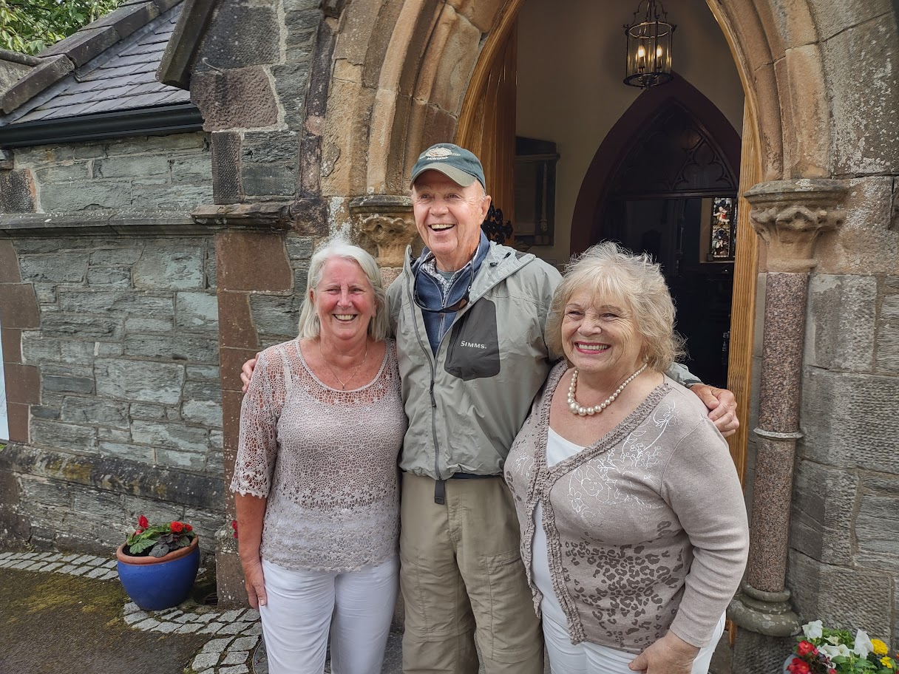
Bravo!
The Amicus Award
2022 Amicus Award
Jack McGuire

Slide 38
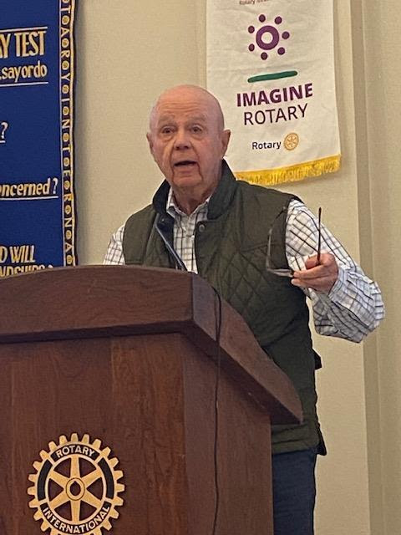
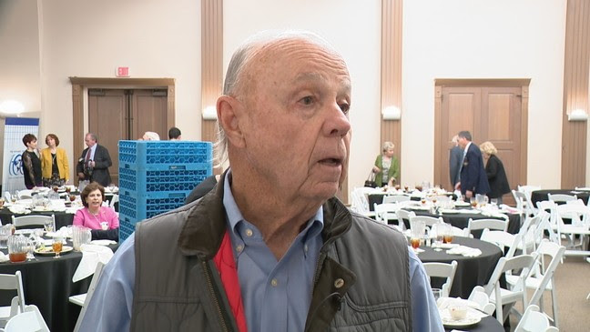
Bravo!
The Amicus Award
2022 Amicus Award
Jack McGuire

Slide 39
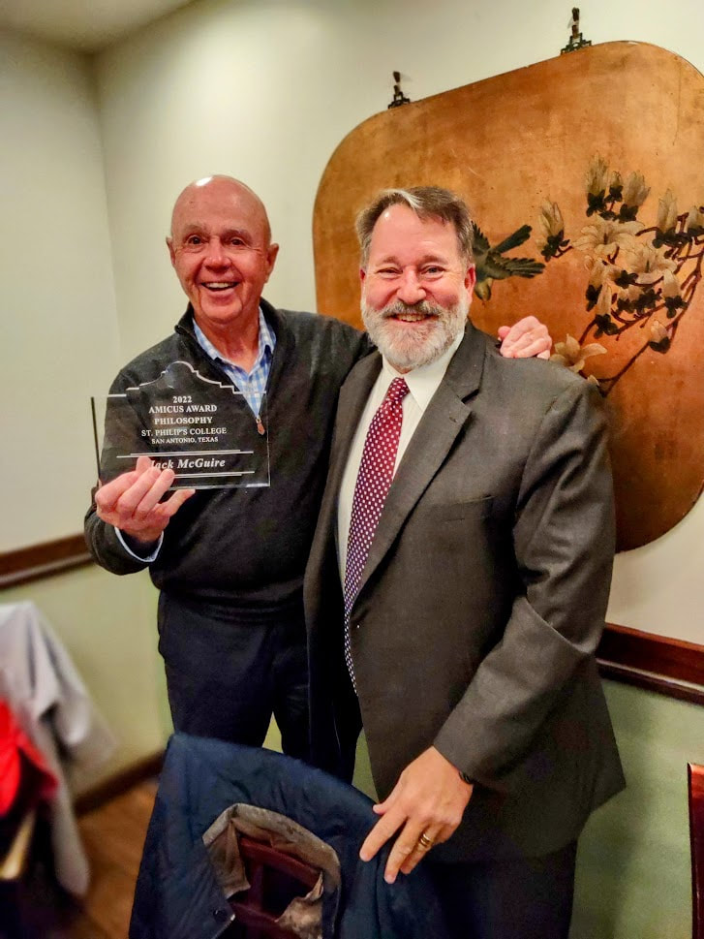
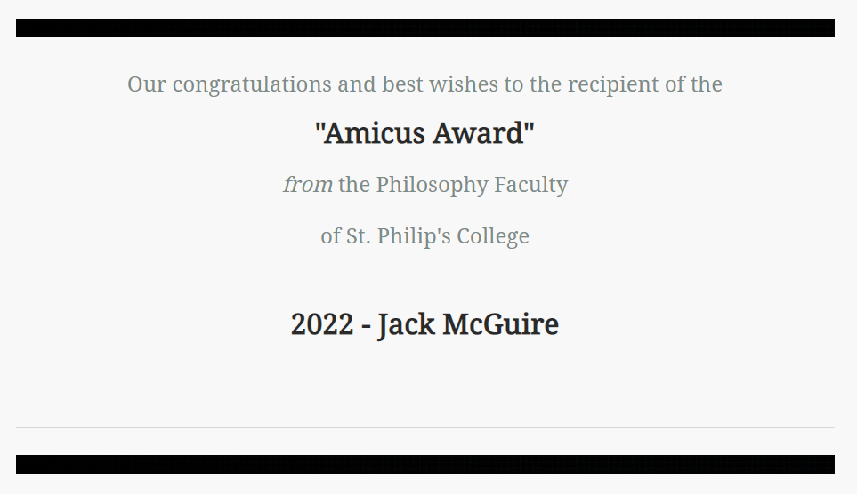
Bravo!
2022 Amicus Award
Jack McGuire

Slide 40
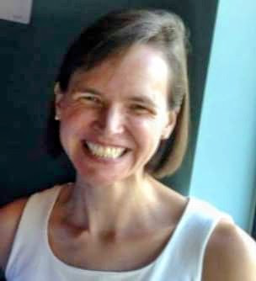
Save the Date! October 13, 2023 50th Anniversary Celebration The Philosophy Faculty of St. Philip’s College
fd

Slide 41
Annual Awards Ceremony The Philosophy Faculty of St. Philip’s College
fd
07 December 2022

