Slide 1
Annual Awards Ceremony The Philosophy Faculty of St. Philip’s College
fd
DECEMBER 13, 2023

Slide 2
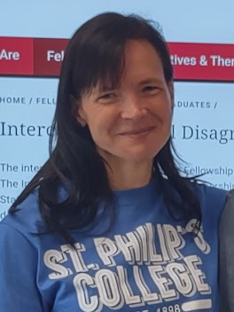
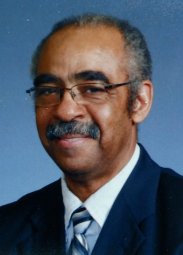
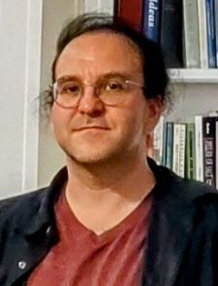
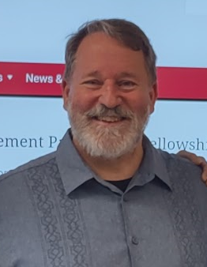
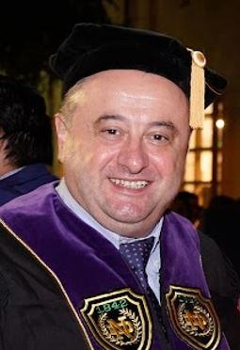
Annual Awards Ceremony The Philosophy Faculty of St. Philip’s College
13 DEC 2023

Slide 4
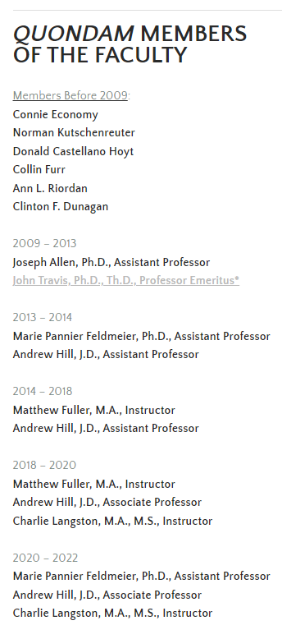
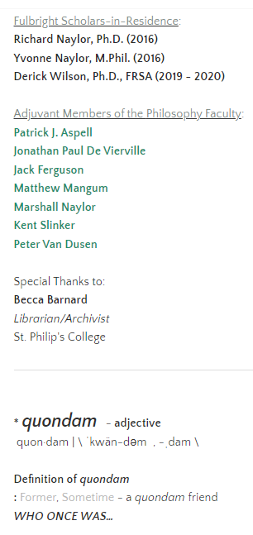

Slide 5
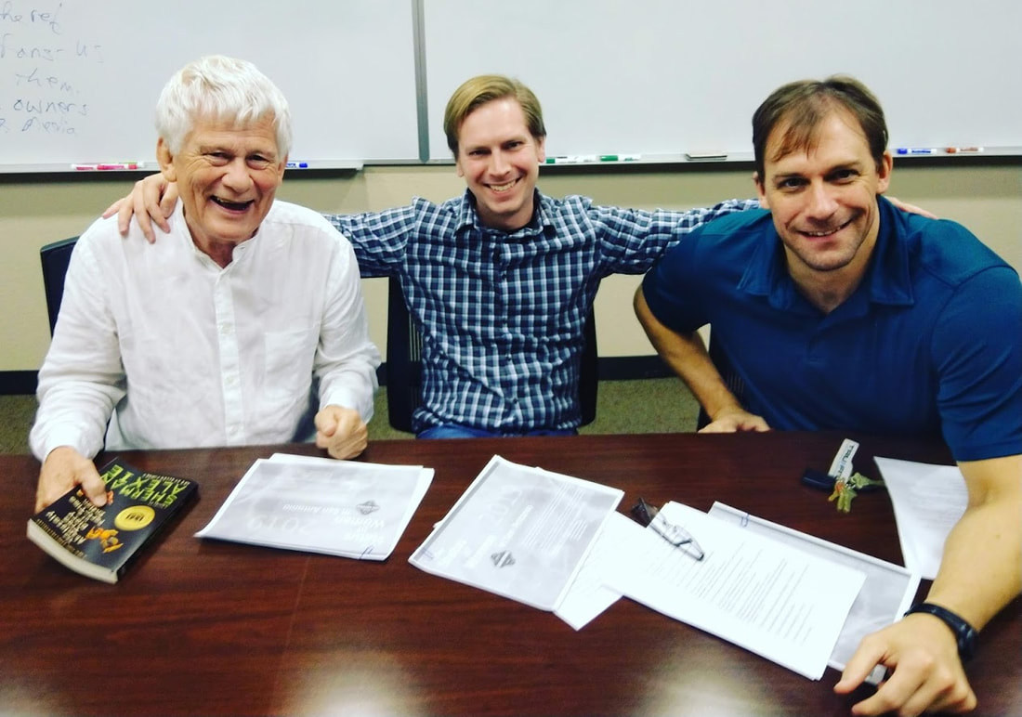
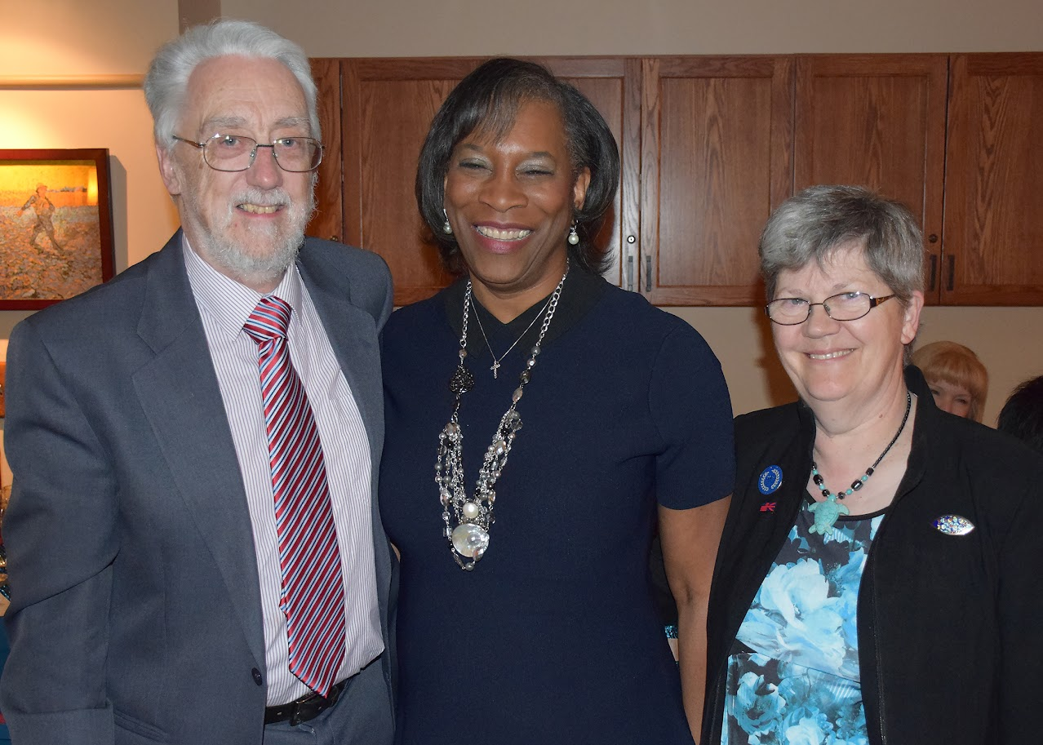

Slide 7
Since the fall of 2013,
the St. Philip’s College Philosophy Faculty has worked with partners from across campus to sponsor a number of groups and activities, including the
Philosophy Club
The Ethics Bowl
Field Trips
Lecture Series
The QEP Program, &
The ICDP

Slide 8
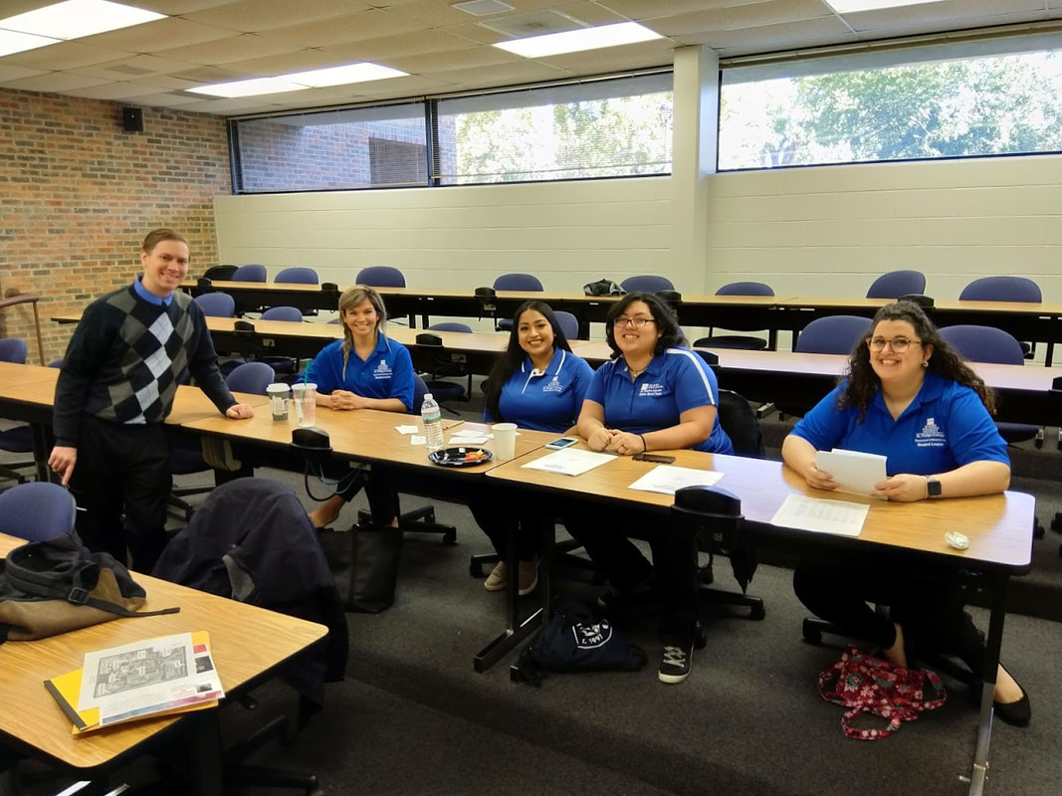
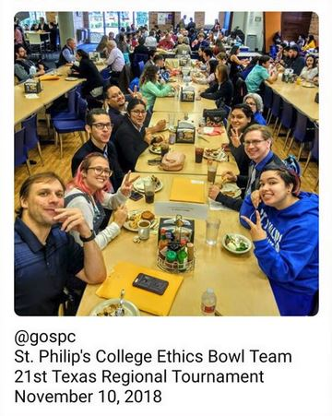
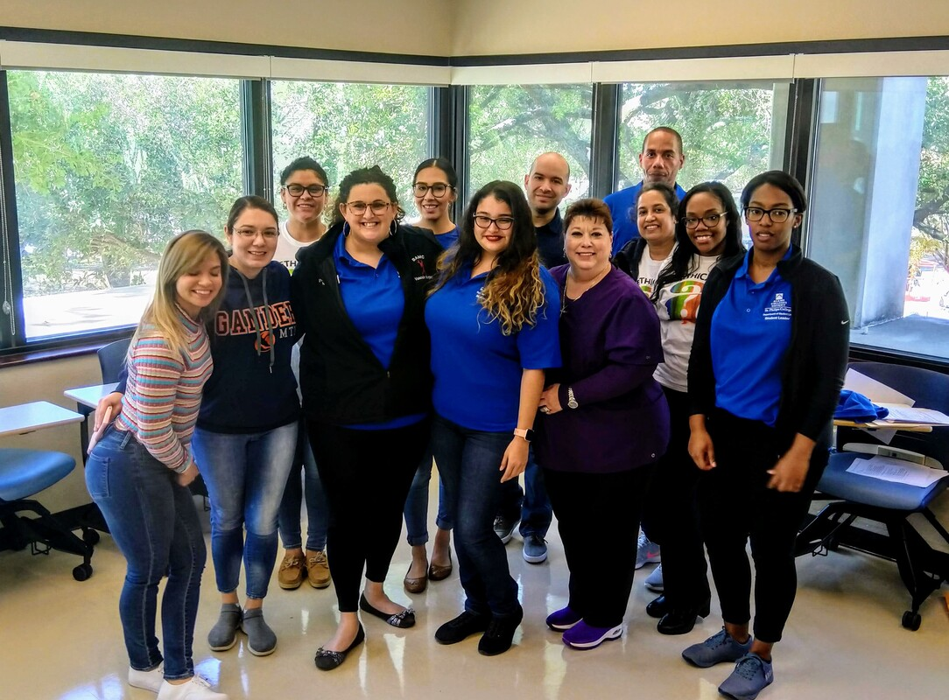
Since the fall of 2013,
the St. Philip’s College Philosophy Faculty has worked with partners from across campus to sponsor a number of groups and activities, including the
Philosophy Club
The Ethics Bowl
Field Trips
Lecture Series
The QEP Program, &
The ICDP

Slide 9
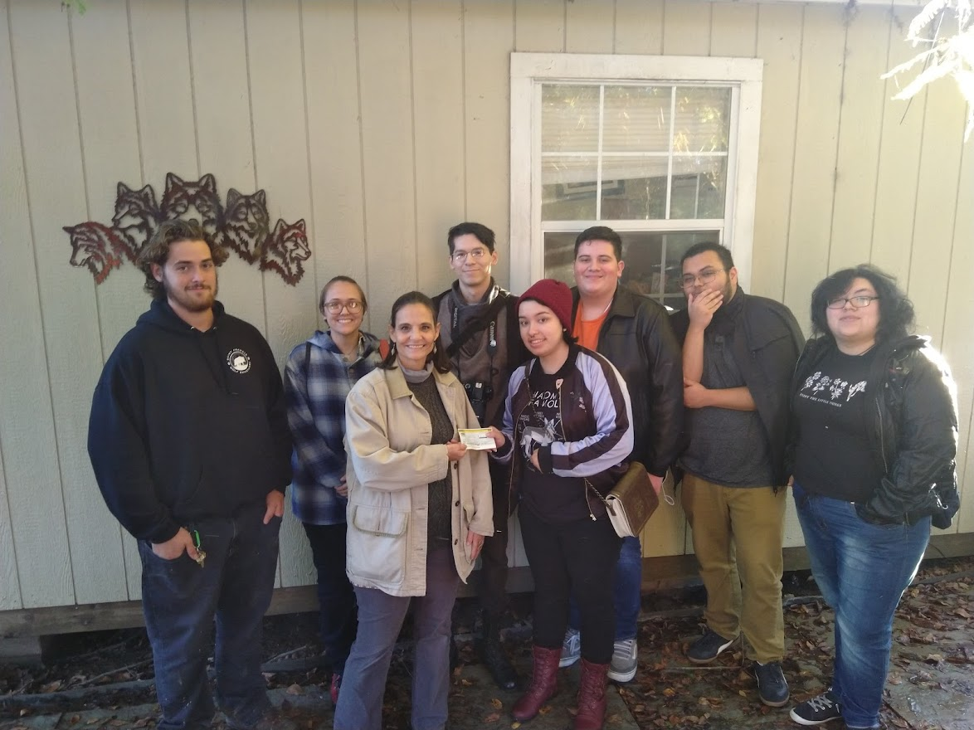
Since the fall of 2013,
the St. Philip’s College Philosophy Faculty has worked with partners from across campus to sponsor a number of groups and activities, including the
Philosophy Club
The Ethics Bowl
Field Trips
Lecture Series
The QEP Program, &
The ICDP

Slide 10
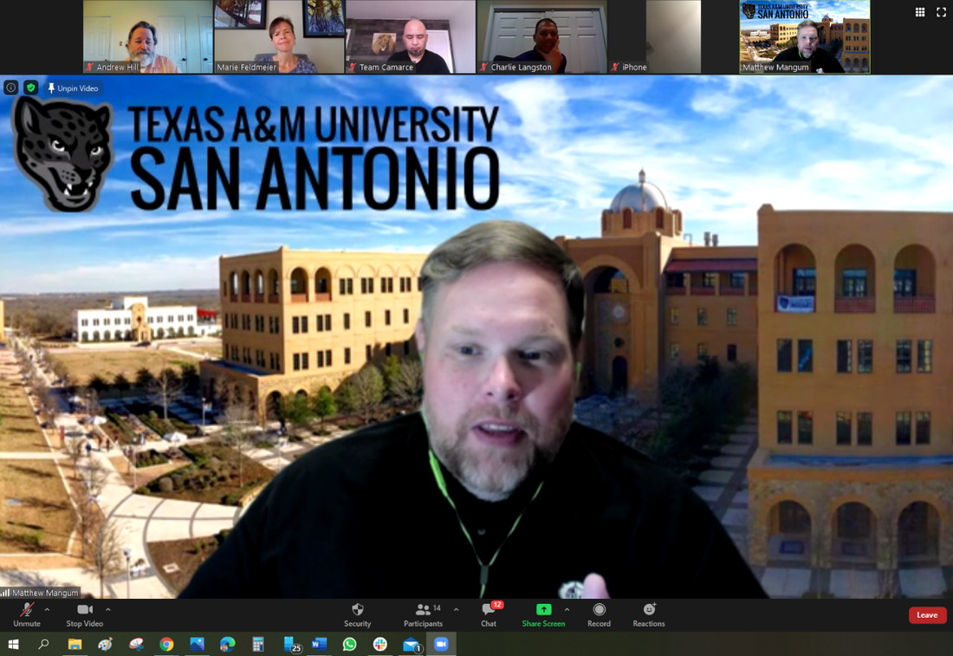
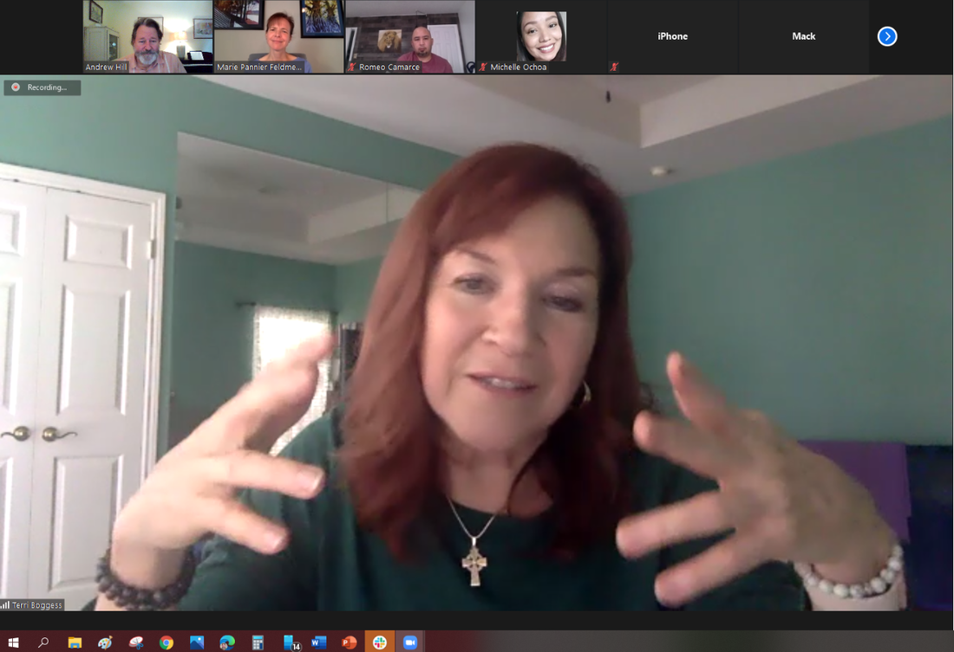
Since the fall of 2013,
the St. Philip’s College Philosophy Faculty has worked with partners from across campus to sponsor a number of groups and activities, including the
Philosophy Club
The Ethics Bowl
Field Trips
Lecture Series
The QEP Program, &
The ICDP
The Faculty Research Lecture Series

Slide 11
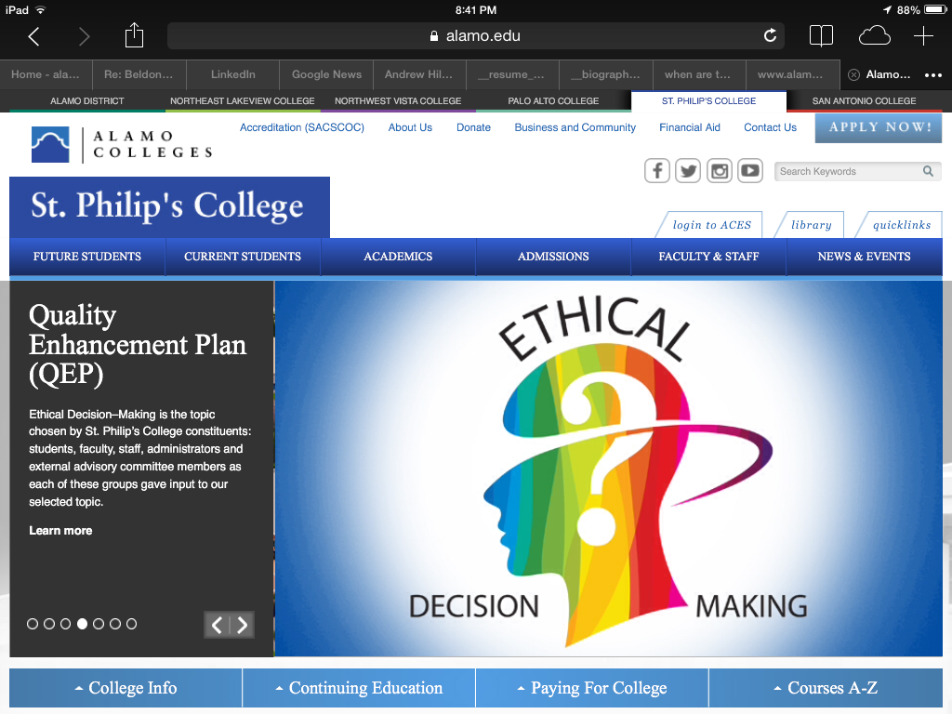
Since the fall of 2013,
the St. Philip’s College Philosophy Faculty has worked with partners from across campus to sponsor a number of groups and activities, including the
Philosophy Club
The Ethics Bowl
Field Trips
Lecture Series
The QEP Program, &
The ICDP

Slide 12
The Intercollegiate Civil Disagreement Partnership
Since the fall of 2013,
the St. Philip’s College Philosophy Faculty has worked with partners from across campus to sponsor a number of groups and activities, including the
Philosophy Club
The Ethics Bowl
Field Trips
Lecture Series
The QEP Program, &
The ICDP

Slide 13
Bravo!
2023 Outstanding Student Award
The Outstanding Student Award

Slide 14
Bravo!
2023 Outstanding Student Award
The Outstanding Student Award

Slide 15
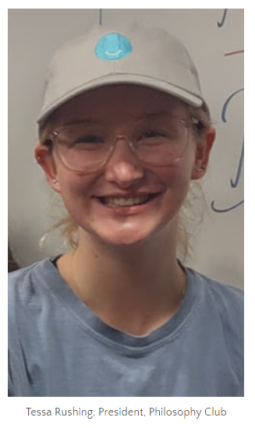
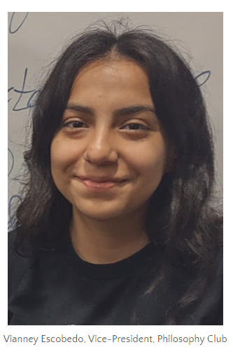
Bravo!
2023 Outstanding Student Award
The Outstanding Student Award

Slide 16
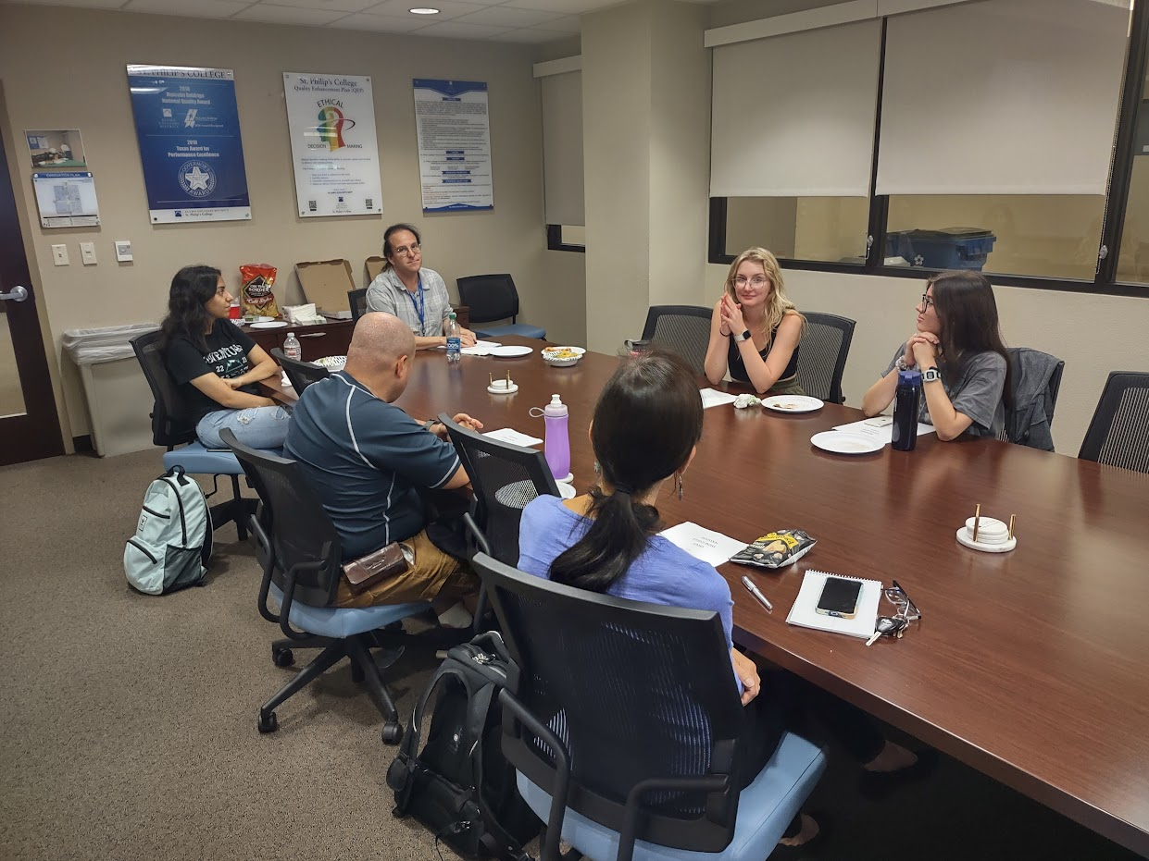
Bravo!
2023 Outstanding Student Award
The Outstanding Student Award

Slide 17
Bravo!
2023 Teaching Excellence Award
The Teaching Excellence Award

Slide 18
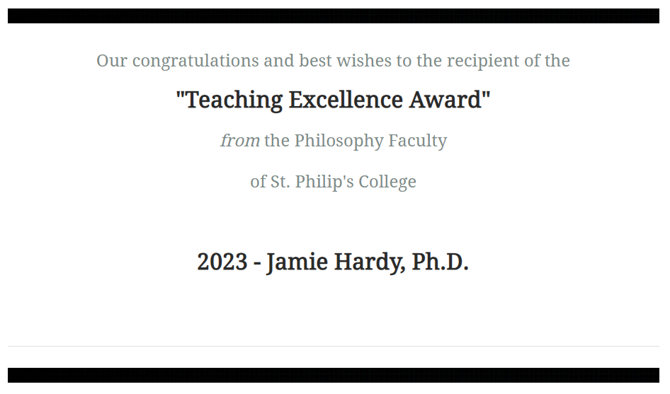
Bravo!
2023 Teaching Excellence Award
The Teaching Excellence Award

Slide 19
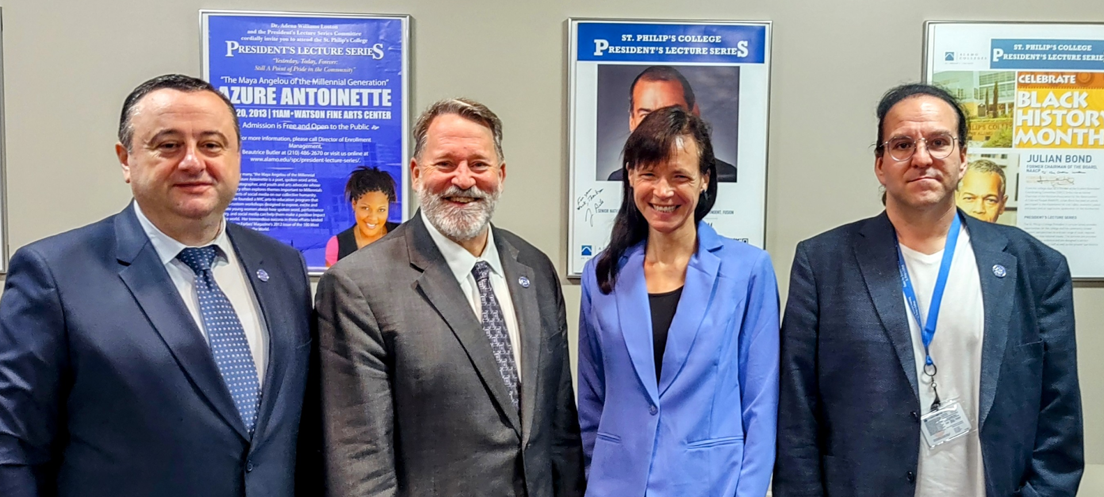
Bravo!
2023 Teaching Excellence Award
The Teaching Excellence Award

Slide 20
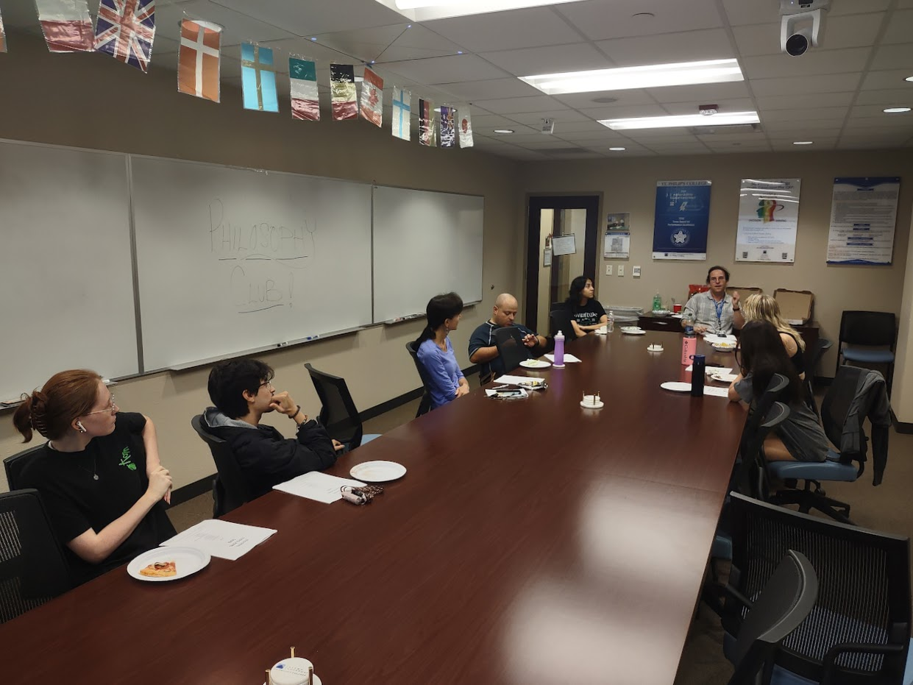
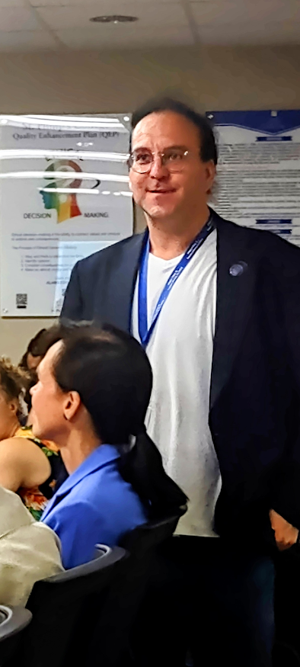
Bravo!
2023 Teaching Excellence Award
The Teaching Excellence Award

Slide 21
Brava!
2023 Fulbright Award
The Fulbright Award

Slide 22
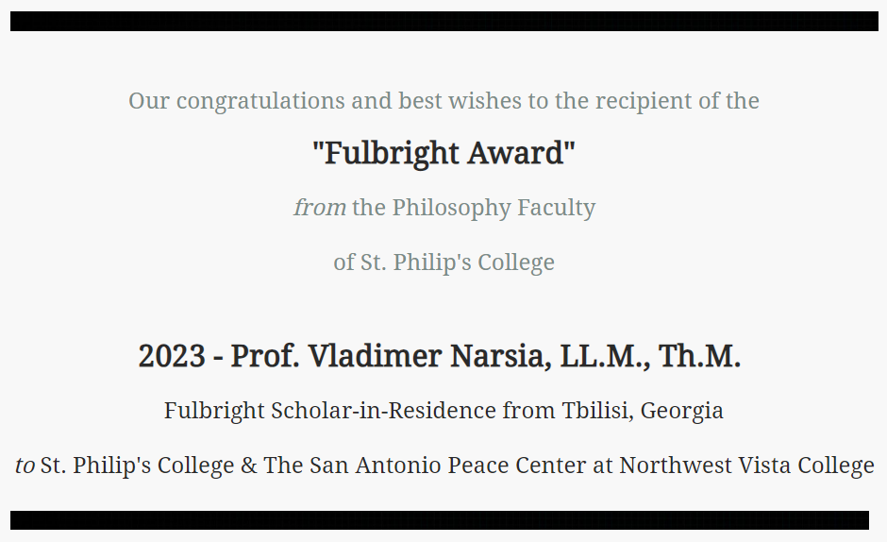
Brava!
2023 Fulbright Award
The Fulbright Award

Slide 23
Brava!
2023 Fulbright Award
The Fulbright Award

Slide 24
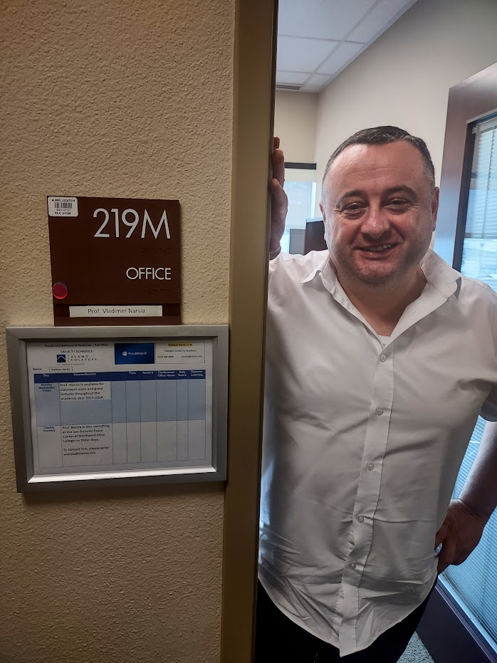
Brava!
2023 Fulbright Award
The Fulbright Award
This award is presented on occasion for outstanding academic contributions to the students, faculty, and staff of St. Philip's College and for dedicated professional service to Greater San Antonio Community and the State of Texas through the Senator J. William Fulbright Scholarship Program.
This year’s recipient is Vladimer Narsia, the Fulbright Scholar-in-Residence here at St. Philip’s College and the Peace Center at Northwest Vista College.

Slide 25
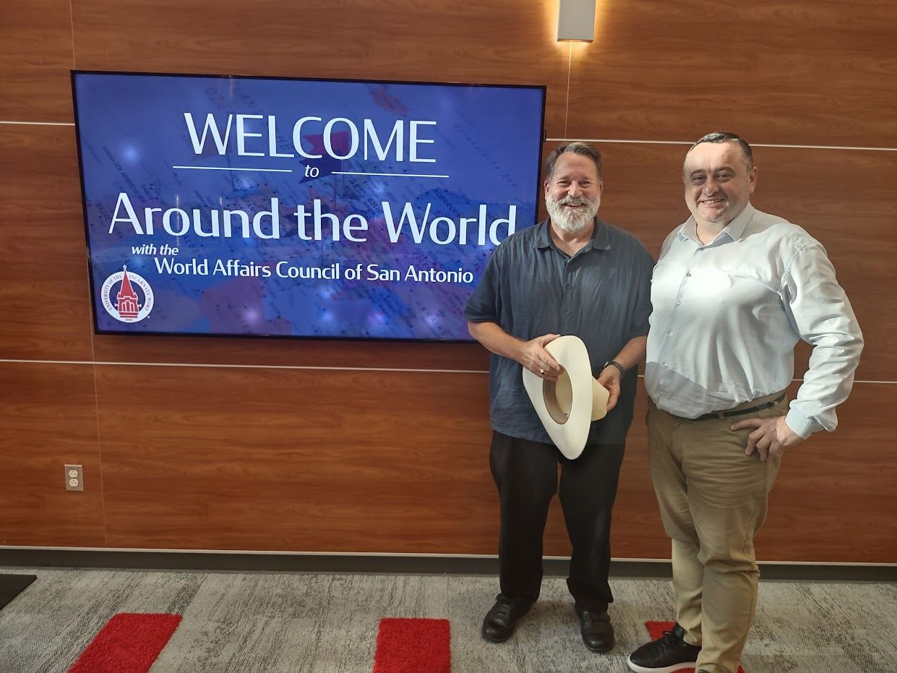
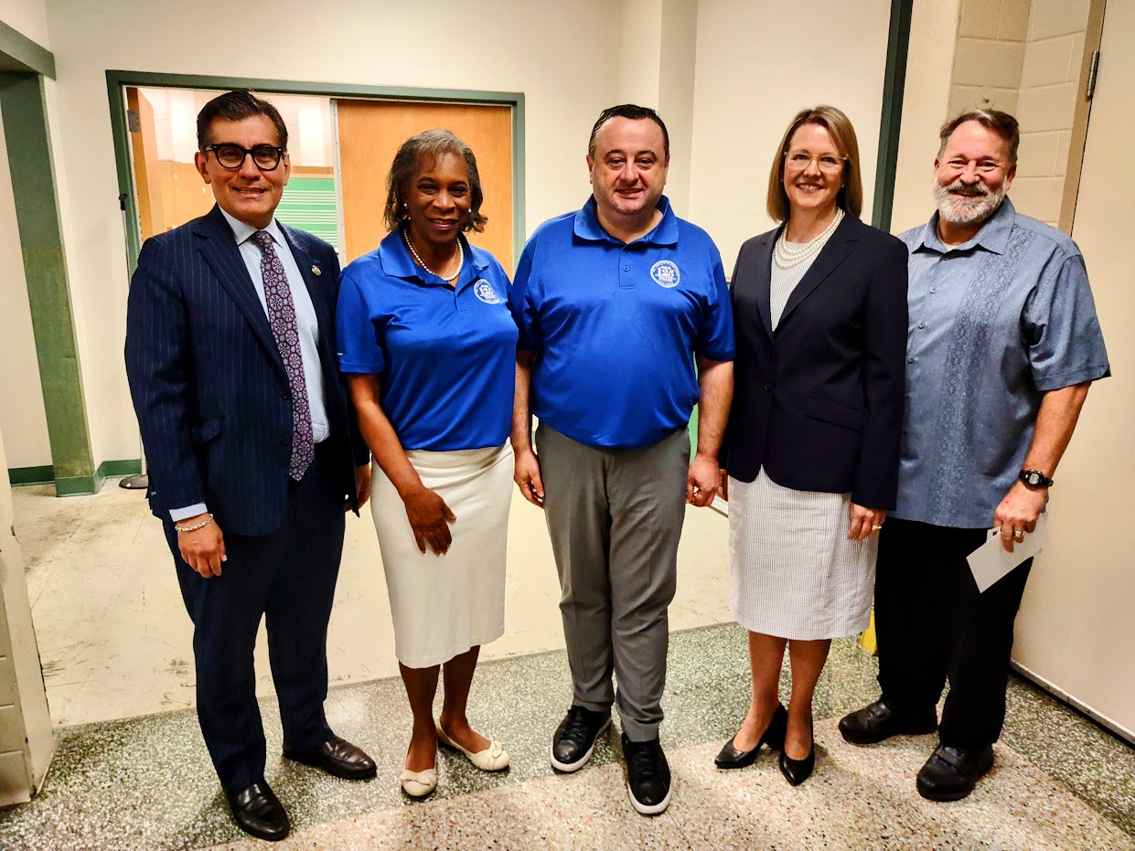
Brava!
2023 Fulbright Award
The Fulbright Award

Slide 26
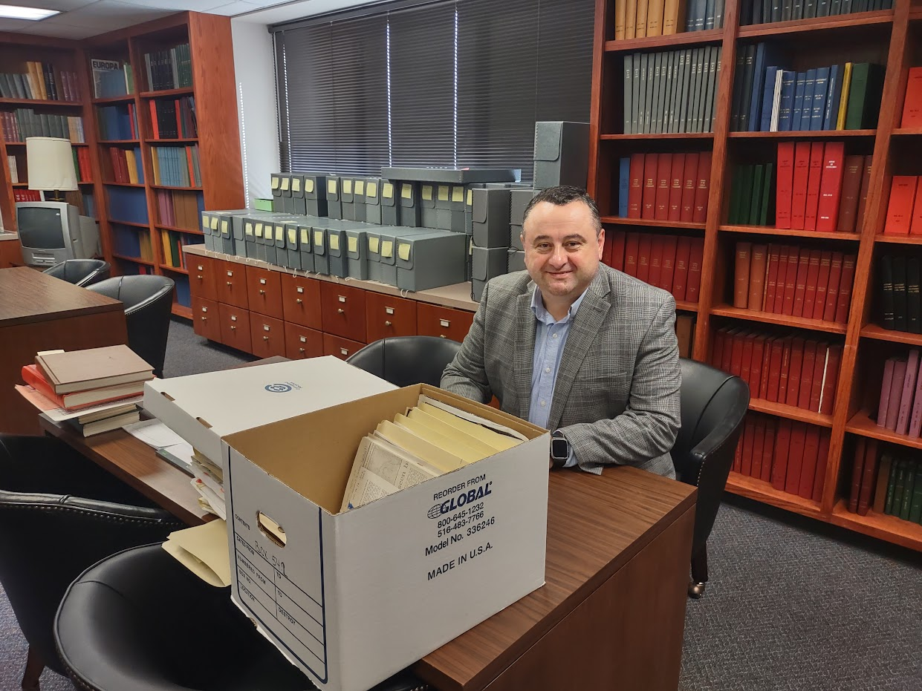
Brava!
2023 Fulbright Award
The Fulbright Award

Slide 27
Bravo!
2023 International Education Award
The International Education Award

Slide 28
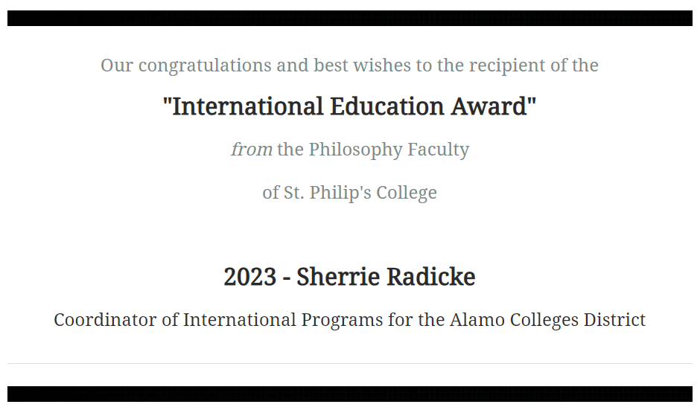
Bravo!
2023 International Education Award
The International Education Award

Slide 29
Brava!
2023 International Education Award
Once a year, the Philosophy Faculty at St. Philip’s College bestows an award on a member of our community for their work supporting international education or service.
This year’s recipient is Sherrie Radicke, M.A., the Coordinator of International Programs for the Alamo Colleges District.
She is a compassionate higher education professional with an unwavering work ethic and passion for elevating others to their full potential. Innovative and critical thinker who strongly values and supports educational equity, diversity and inclusion for all individuals.

Slide 30
Brava!
2023 International Education Award
She possesses a deep interest and passion for global awareness and consciousness, and she is an international educator who is deeply interested in advancing academia and scholarly research in the following areas:
• comprehensive & inclusive internationalization;
• globalization efforts at Alamo District Colleges;
• culturally responsive leadership & pedagogy;
and
• contemporary circumstances in Diaspora communities.

Slide 31
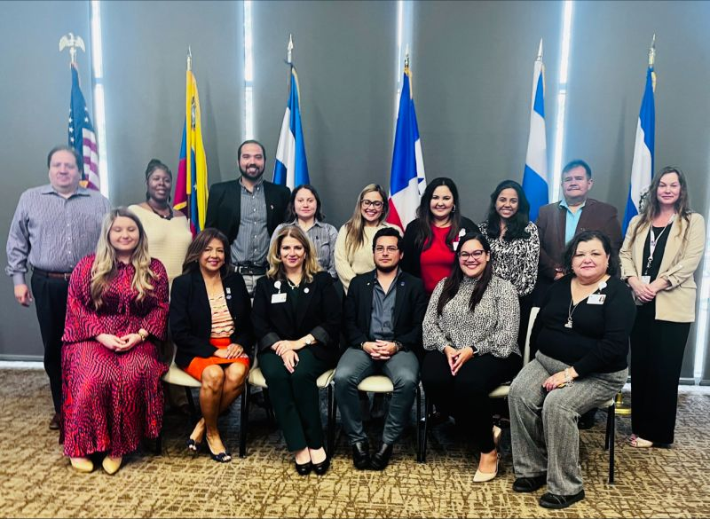
Brava!
2023 International Education Award
The International Education Award

Slide 32
Bravo!
2023 Amicus Award
The Amicus Award

Slide 33
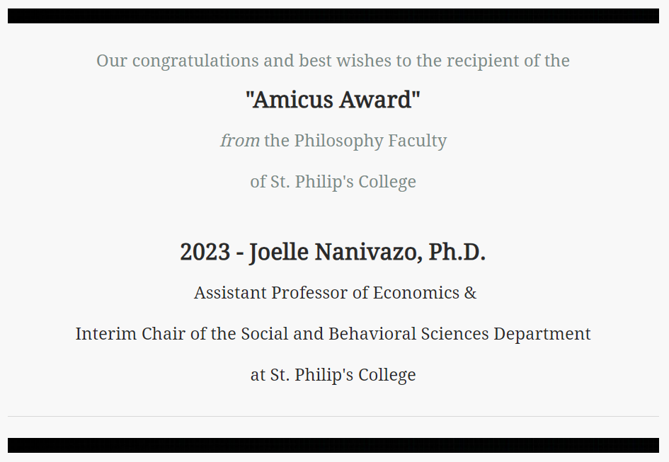
Bravo!
2023 Amicus Award
The Amicus Award

Slide 34
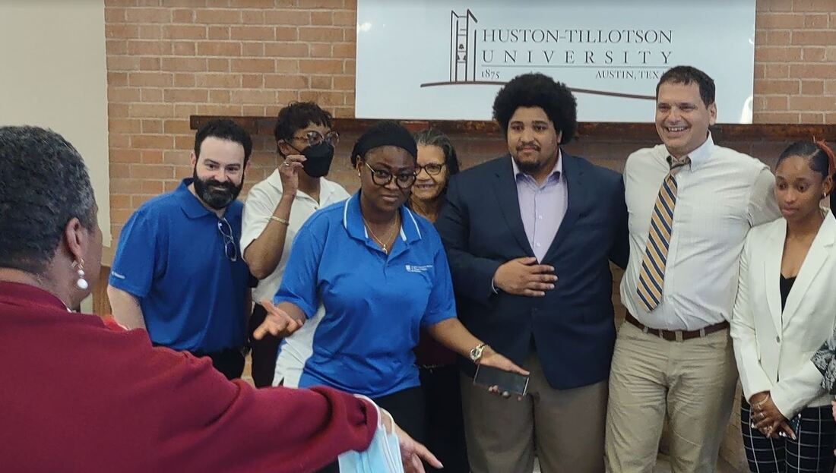
Bravo!
The Amicus Award
2023 Amicus Award
Once a year, the Philosophy Faculty at St. Philip’s College bestows an award that recognizes outstanding contributions to the shared work of our extended faculty, our colleagues, or our local partners in the teaching of Philosophy inside and outside the classroom.
Our students benefit when our partnerships come together to share expertise, knowledge, and resources.
This year’s recipient is Dr. Joelle Nanivazo, Assistant Professor of Economics & Interim Chair of the Social and Behavioral Sciences Department at St. Philip's College.

Slide 35
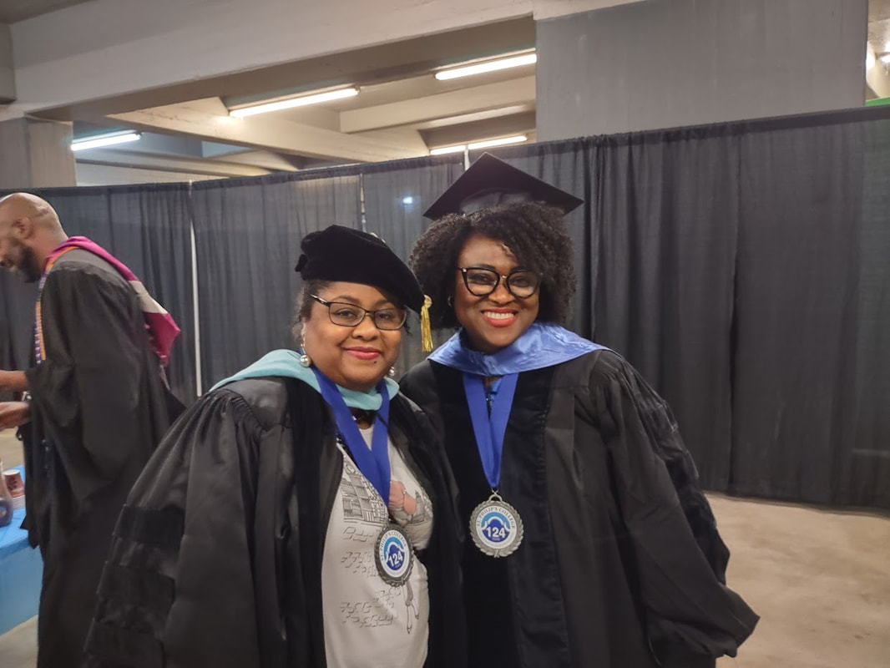
Bravo!
The Amicus Award
2023 Amicus Award

Slide 36
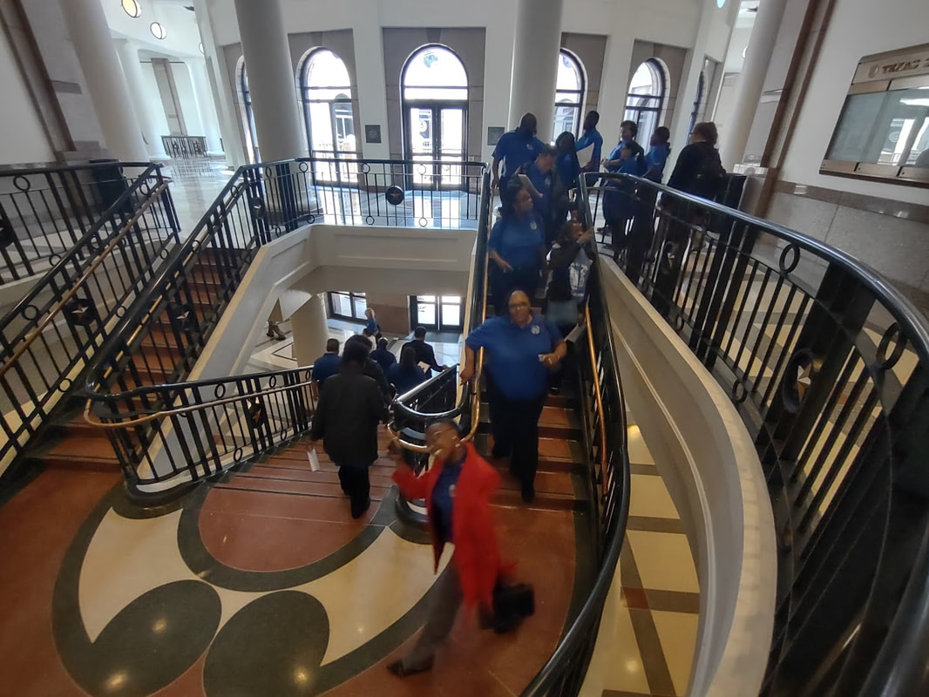
Bravo!
The Amicus Award
2023 Amicus Award

Slide 37
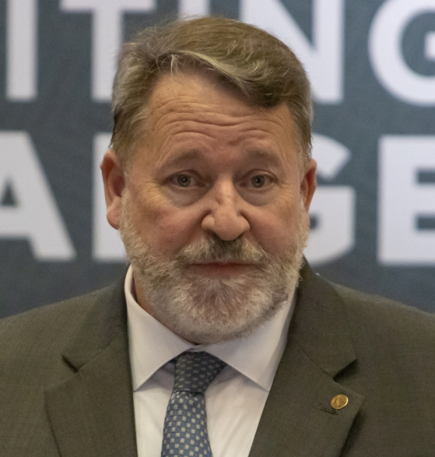
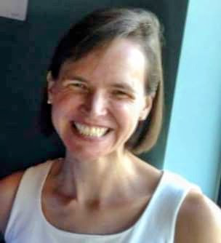
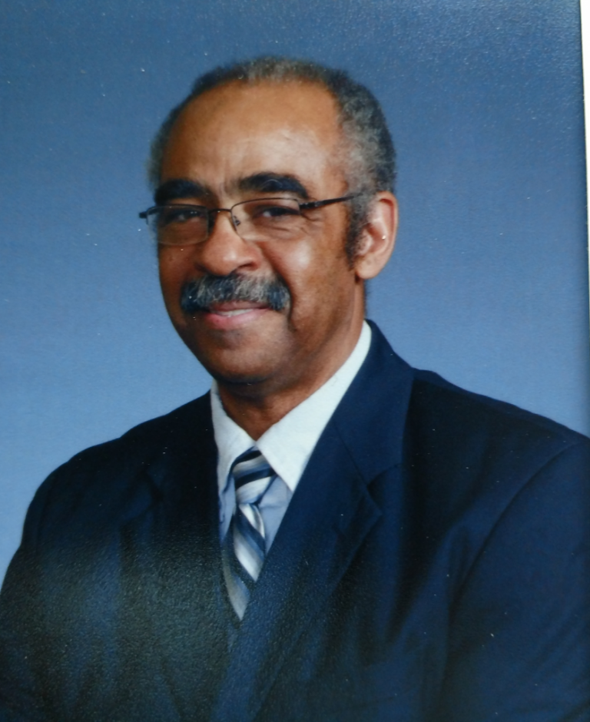
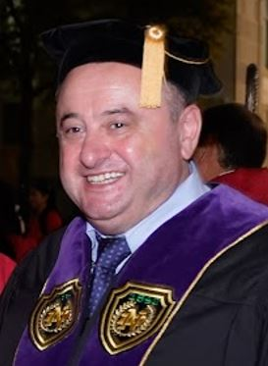
Save the Date! May 26, 2024 50th Anniversary Celebration The Philosophy Faculty of St. Philip’s College
fd

Slide 38
Annual Awards Ceremony The Philosophy Faculty of St. Philip’s College
fd
DECEMBER 13, 2023

Slide 39
Annual Awards Ceremony The Philosophy Faculty of St. Philip’s College
fd
DECEMBER 13, 2023

