Slide 1
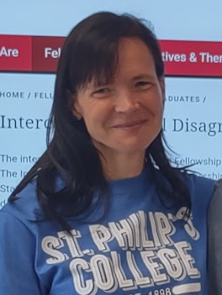
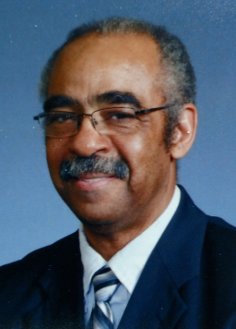
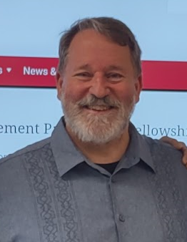
Annual Awards Ceremony The Philosophy Faculty of St. Philip’s College
11 May 2023

Slide 3
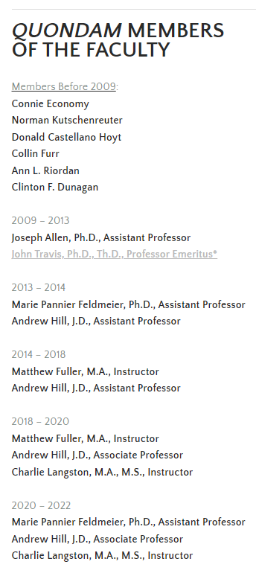
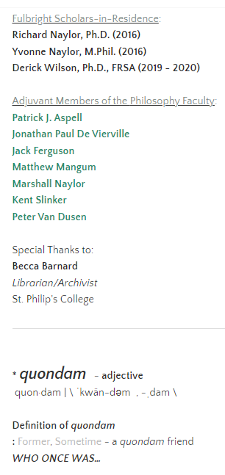

Slide 4
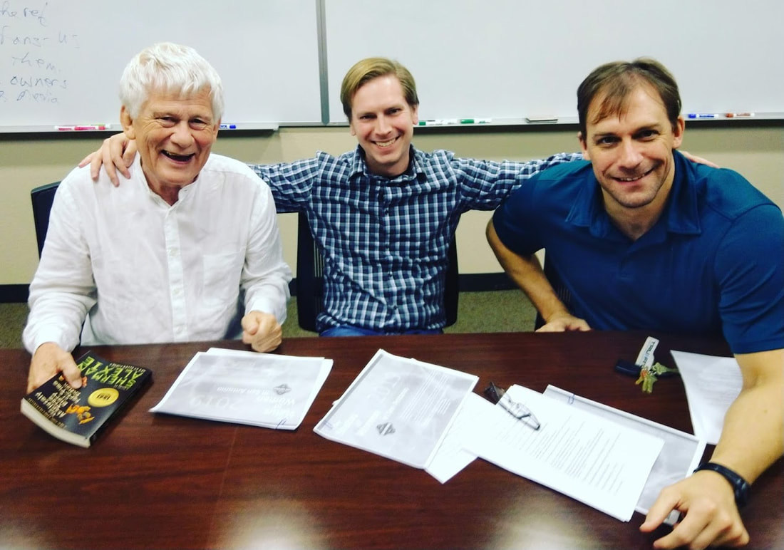
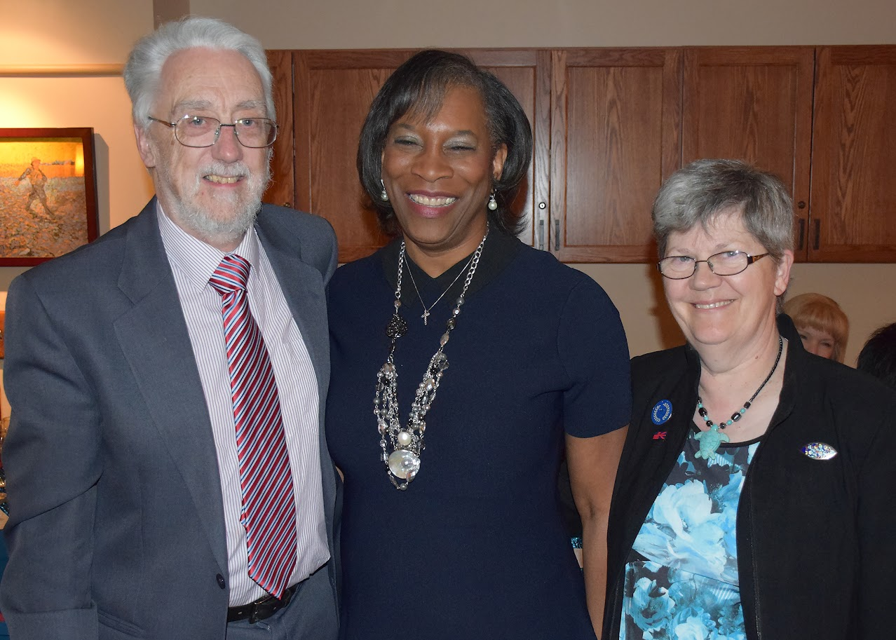

Slide 5
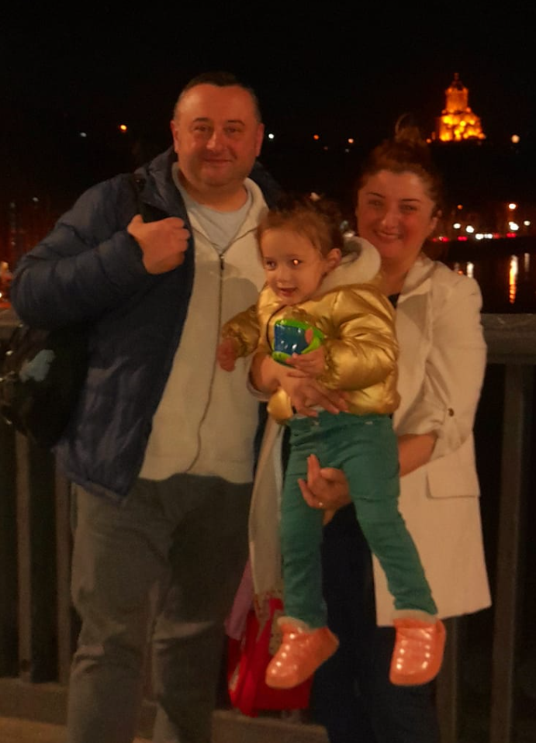

Slide 6
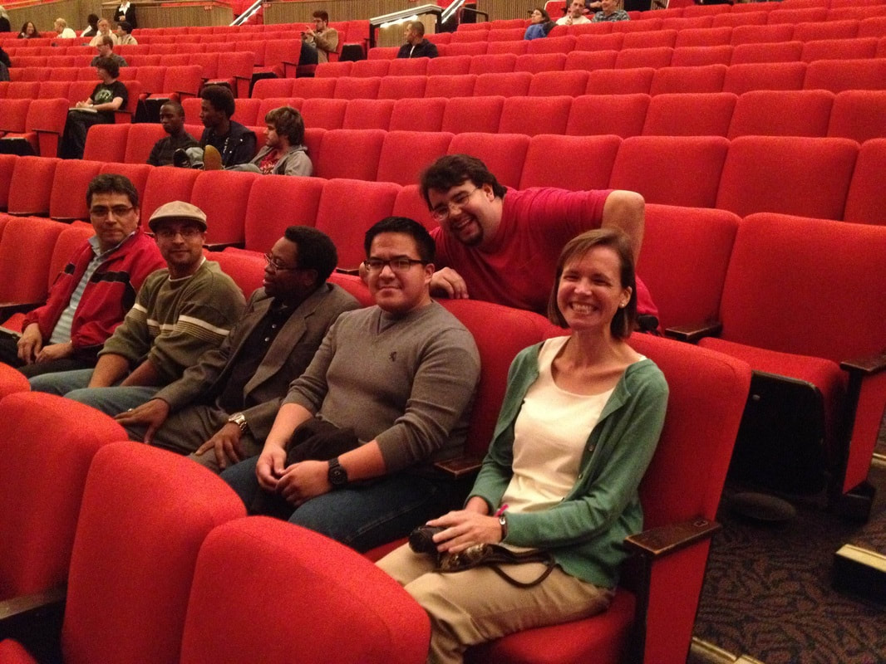
Since the fall of 2013,
the St. Philip’s College Philosophy Faculty has worked with partners from across campus to sponsor a number of groups and activities, including the
Philosophy Club
The Ethics Bowl
Field Trips
Lecture Series
The QEP Program, &
The ICDP

Slide 7
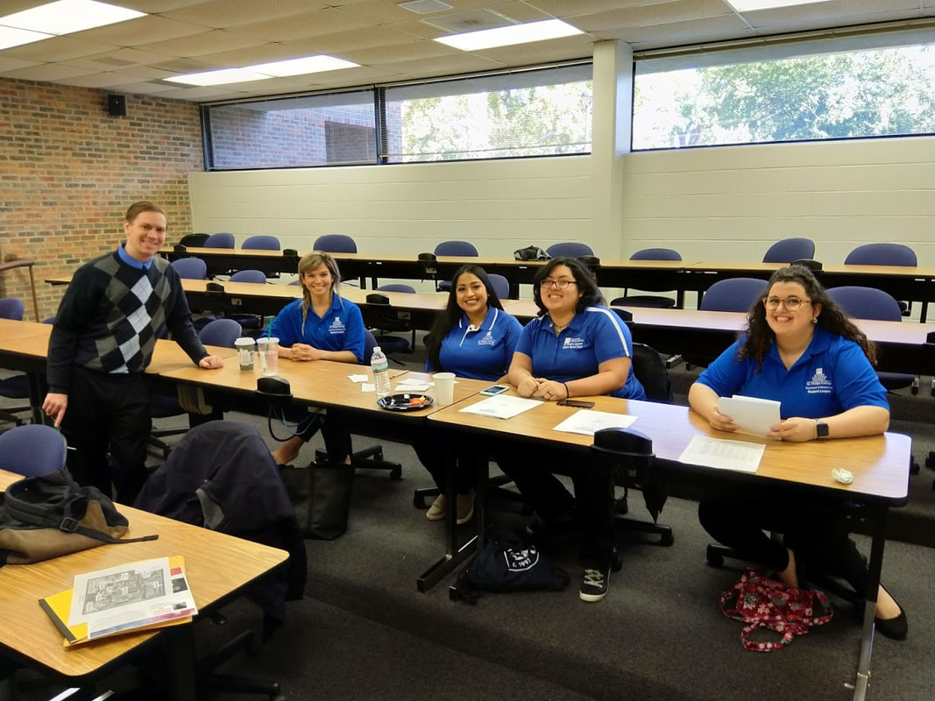
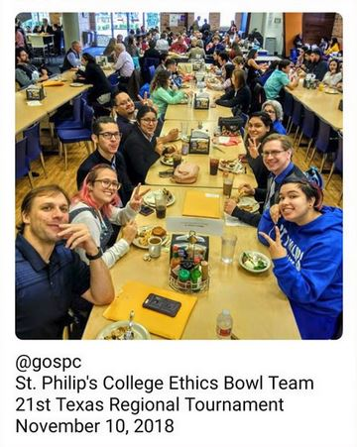
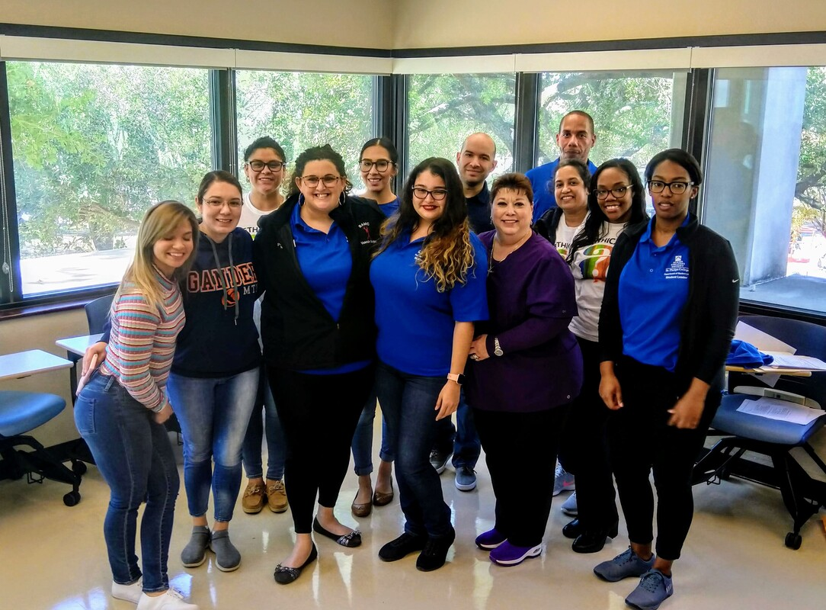
Since the fall of 2013,
the St. Philip’s College Philosophy Faculty has worked with partners from across campus to sponsor a number of groups and activities, including the
Philosophy Club
The Ethics Bowl
Field Trips
Lecture Series
The QEP Program, &
The ICDP

Slide 8
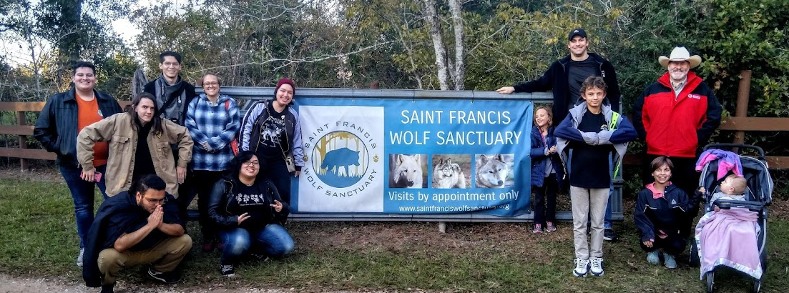
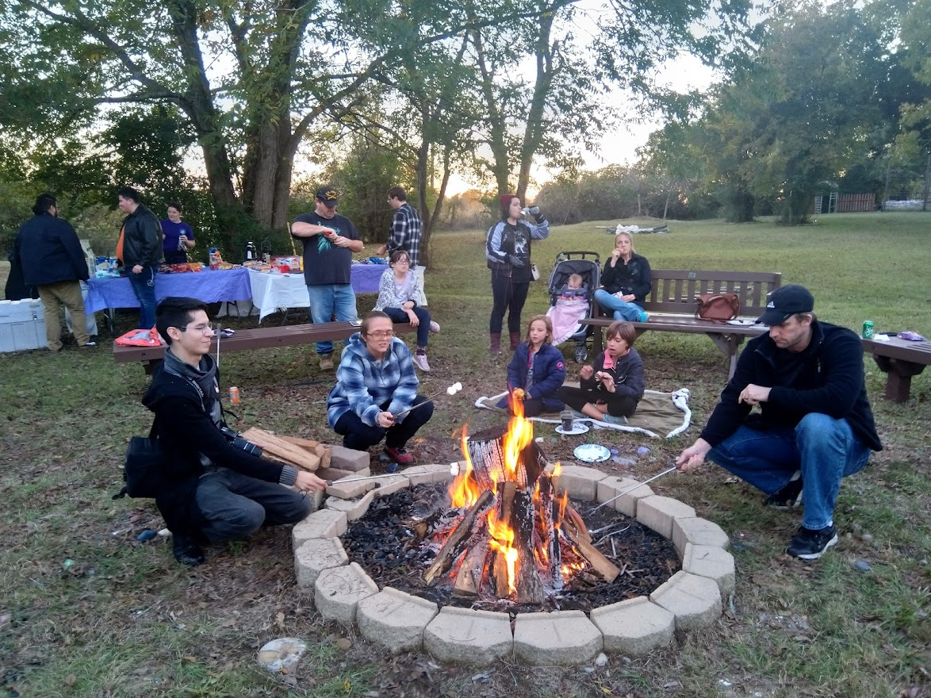
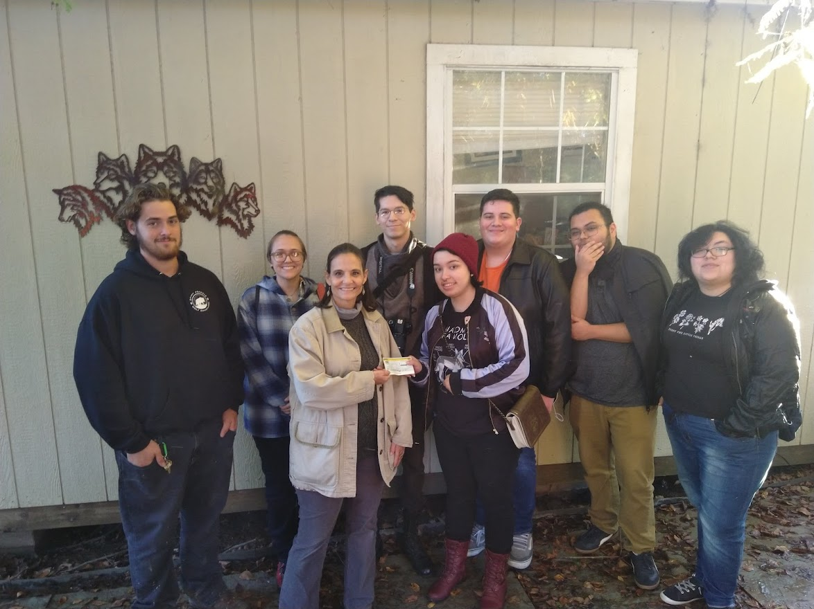
Since the fall of 2013,
the St. Philip’s College Philosophy Faculty has worked with partners from across campus to sponsor a number of groups and activities, including the
Philosophy Club
The Ethics Bowl
Field Trips
Lecture Series
The QEP Program, &
The ICDP

Slide 9
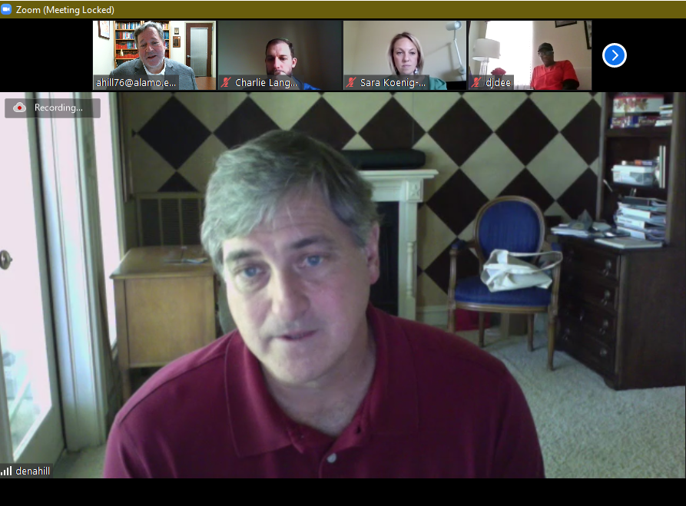
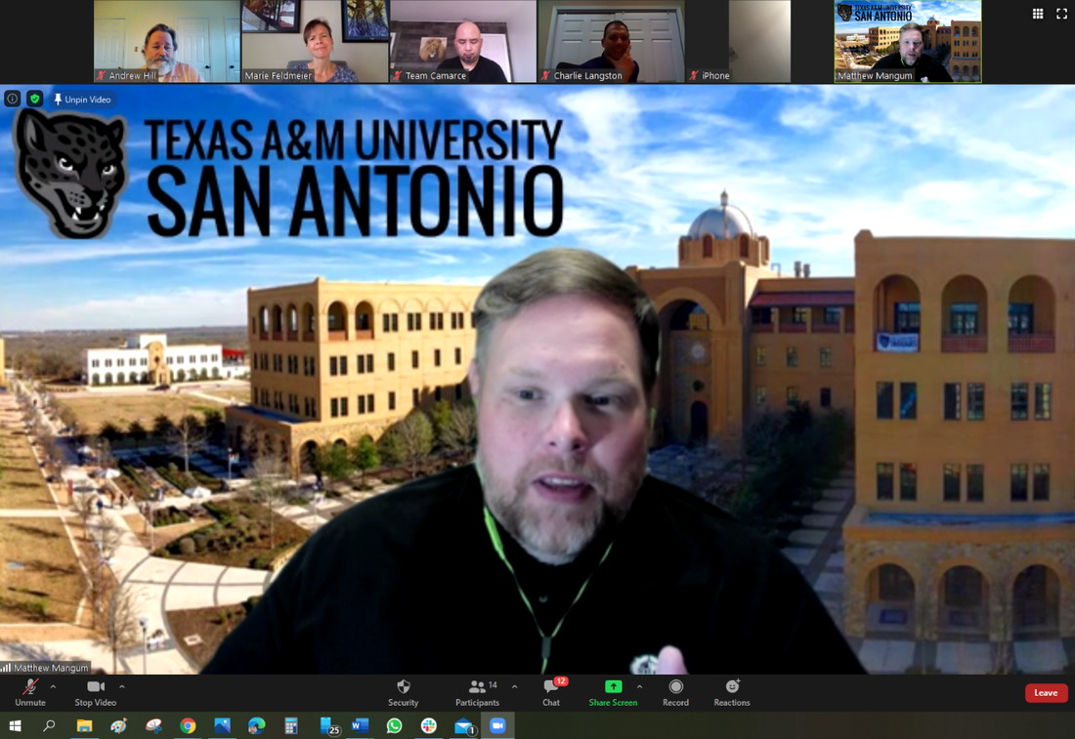
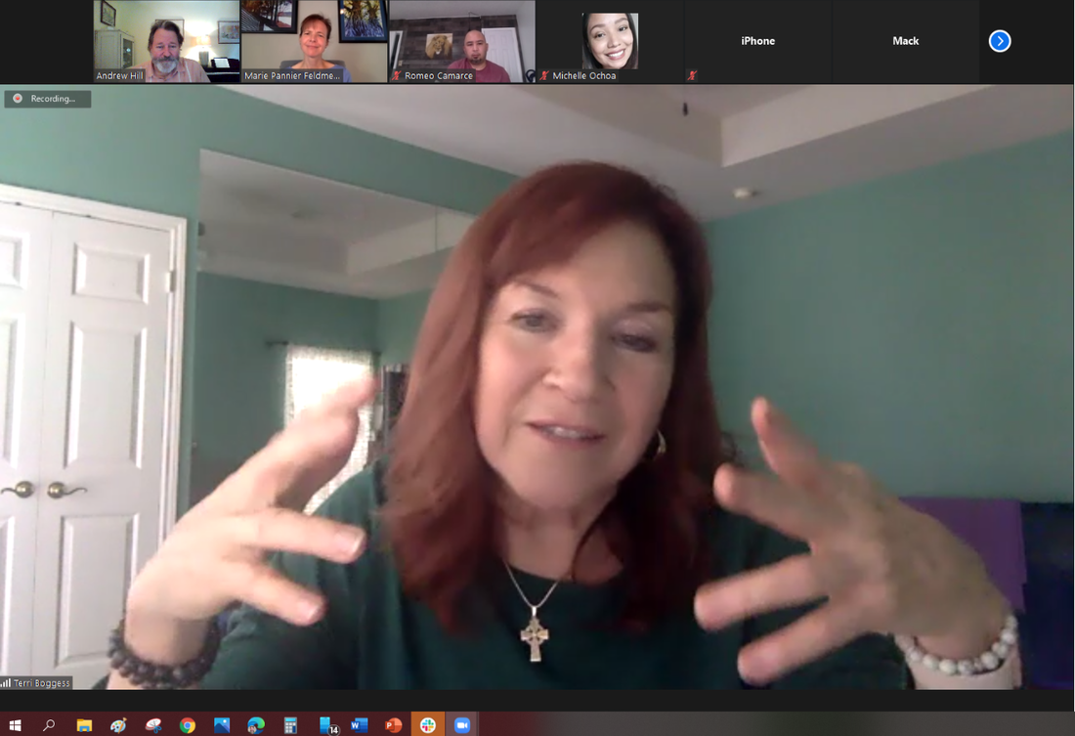
Since the fall of 2013,
the St. Philip’s College Philosophy Faculty has worked with partners from across campus to sponsor a number of groups and activities, including the
Philosophy Club
The Ethics Bowl
Field Trips
Lecture Series
The QEP Program, &
The ICDP
The Faculty Research Lecture Series

Slide 10
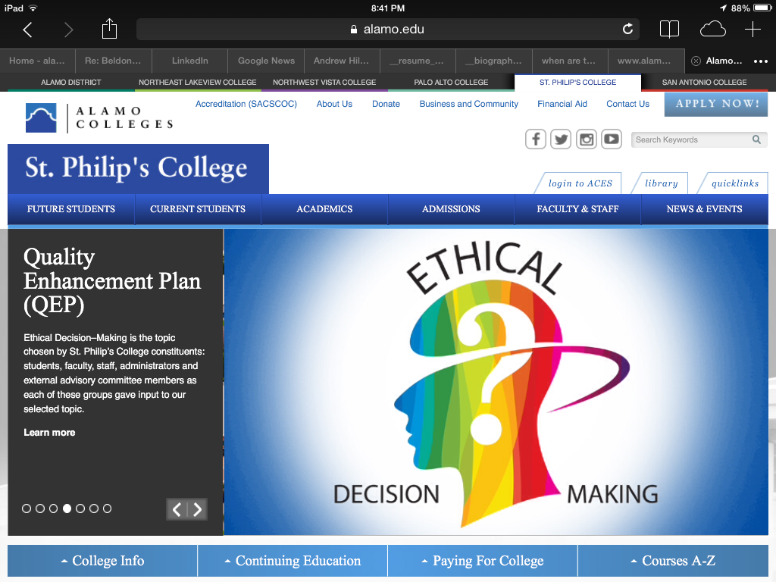
Since the fall of 2013,
the St. Philip’s College Philosophy Faculty has worked with partners from across campus to sponsor a number of groups and activities, including the
Philosophy Club
The Ethics Bowl
Field Trips
Lecture Series
The QEP Program, &
The ICDP

Slide 11
The Intercollegiate Civil Disagreement Partnership
Since the fall of 2013,
the St. Philip’s College Philosophy Faculty has worked with partners from across campus to sponsor a number of groups and activities, including the
Philosophy Club
The Ethics Bowl
Field Trips
Lecture Series
The QEP Program, &
The ICDP

Slide 12
Bravo!
2023 Outstanding Student Award
The Outstanding Student Award

Slide 13
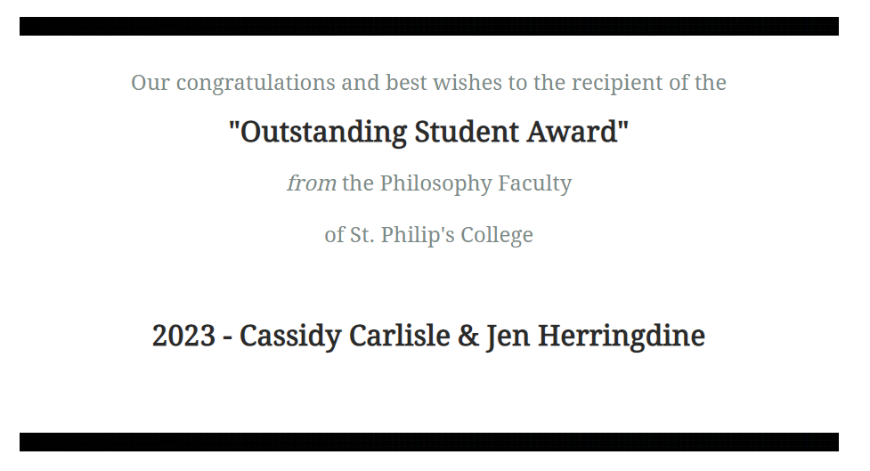
Bravo!
2023 Outstanding Student Award
The Outstanding Student Award

Slide 14
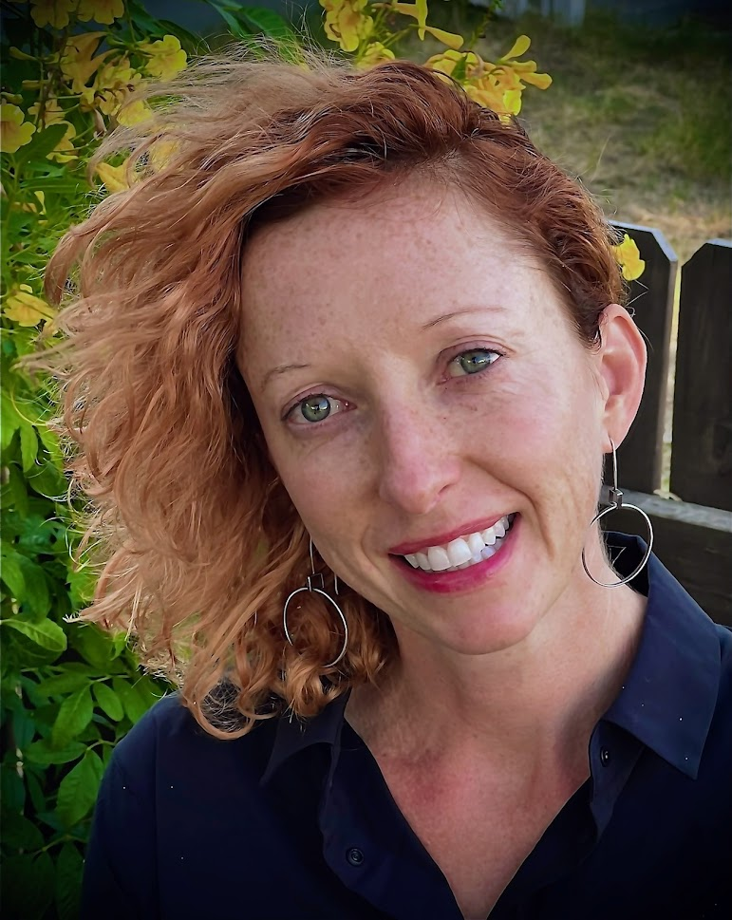
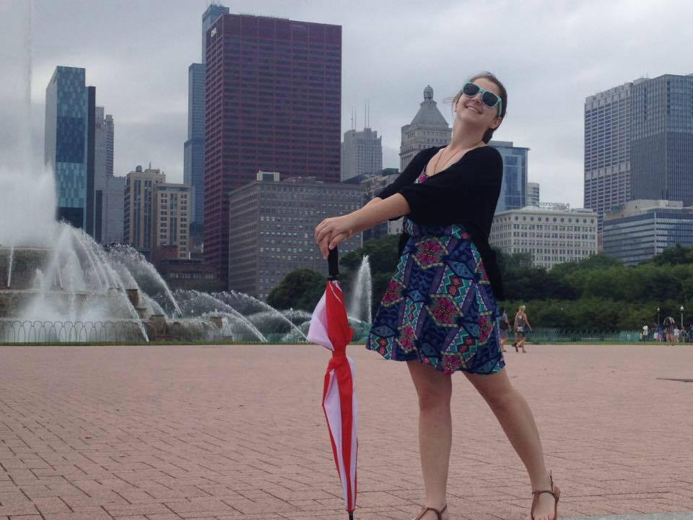
Bravo!
2023 Outstanding Student Award
The Outstanding Student Award

Slide 15
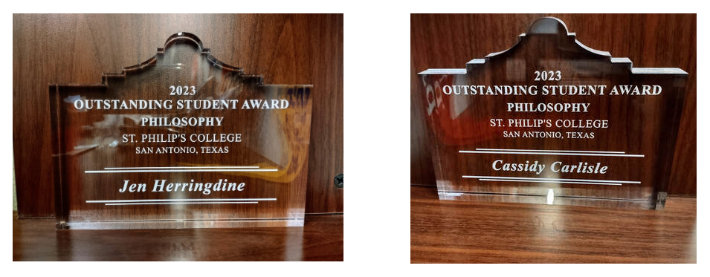
Bravo!
2023 Outstanding Student Award
The Outstanding Student Award

Slide 16
Bravo!
2023 Teaching Excellence Award
The Teaching Excellence Award

Slide 17
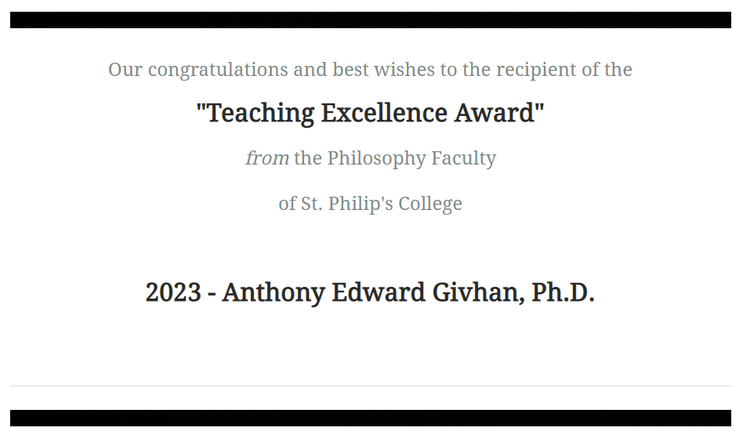
Bravo!
2023 Teaching Excellence Award
The Teaching Excellence Award

Slide 18
Bravo!
2023 Teaching Excellence Award
The Teaching Excellence Award

Slide 19
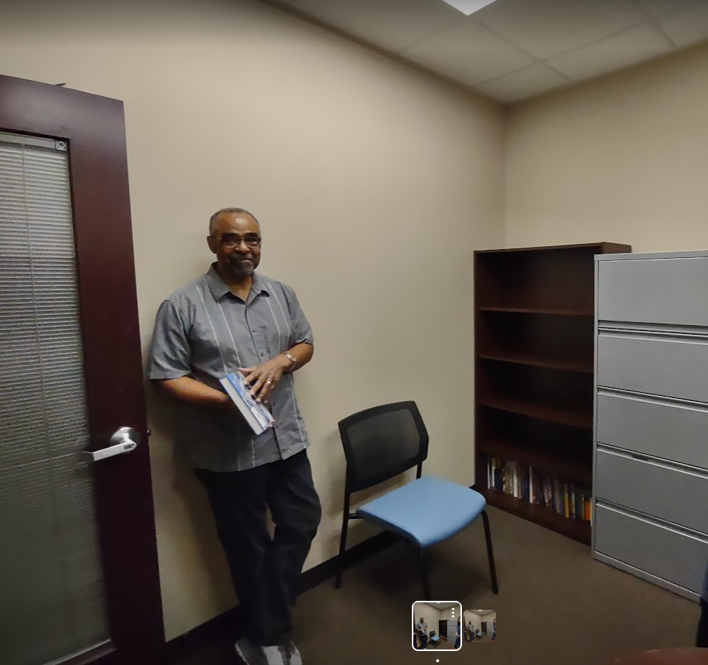
Bravo!
2023 Teaching Excellence Award
The Teaching Excellence Award

Slide 20
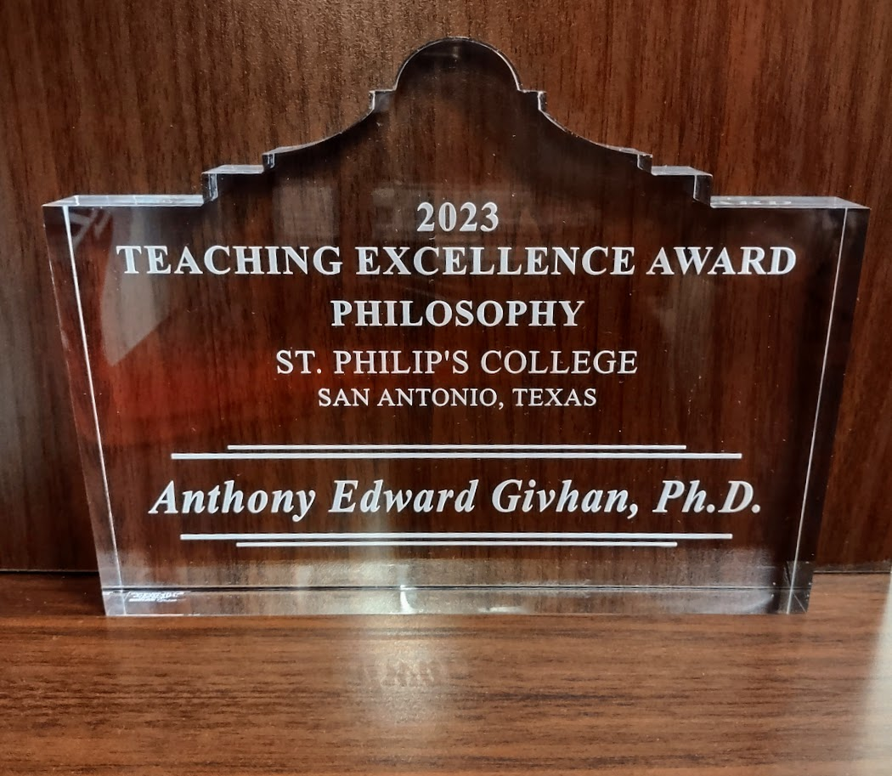
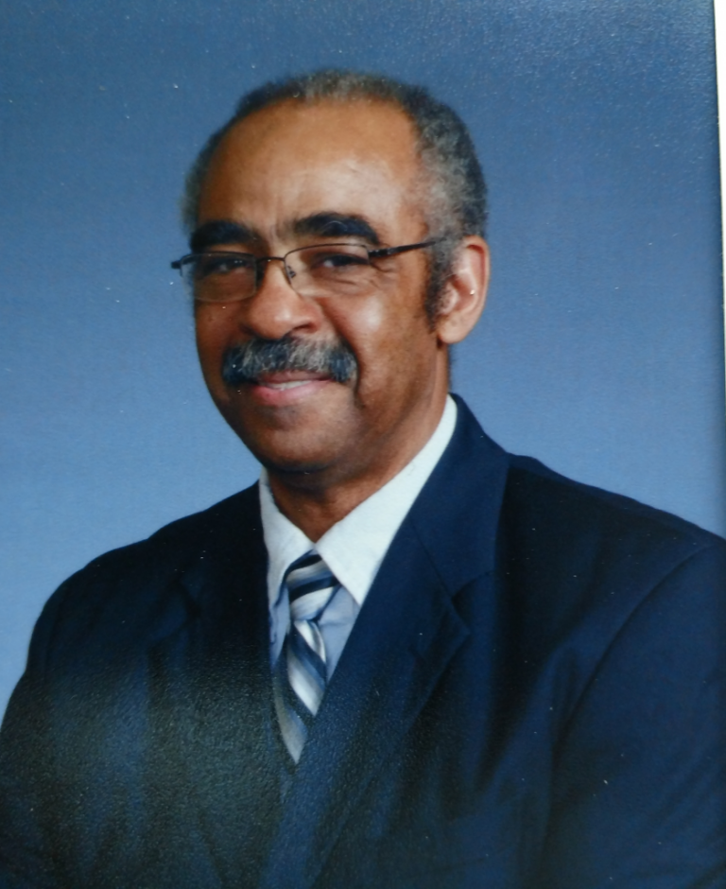
Bravo!
2023 Teaching Excellence Award

Slide 21
Brava!
2023 Fulbright Award
The Fulbright Award

Slide 22
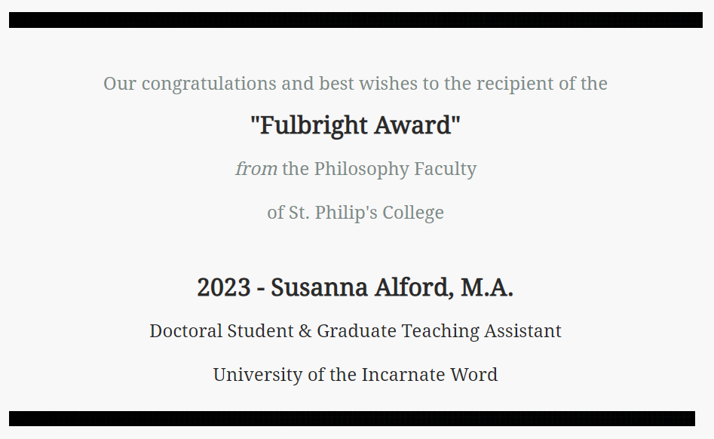
Brava!
2023 Fulbright Award
The Fulbright Award

Slide 23
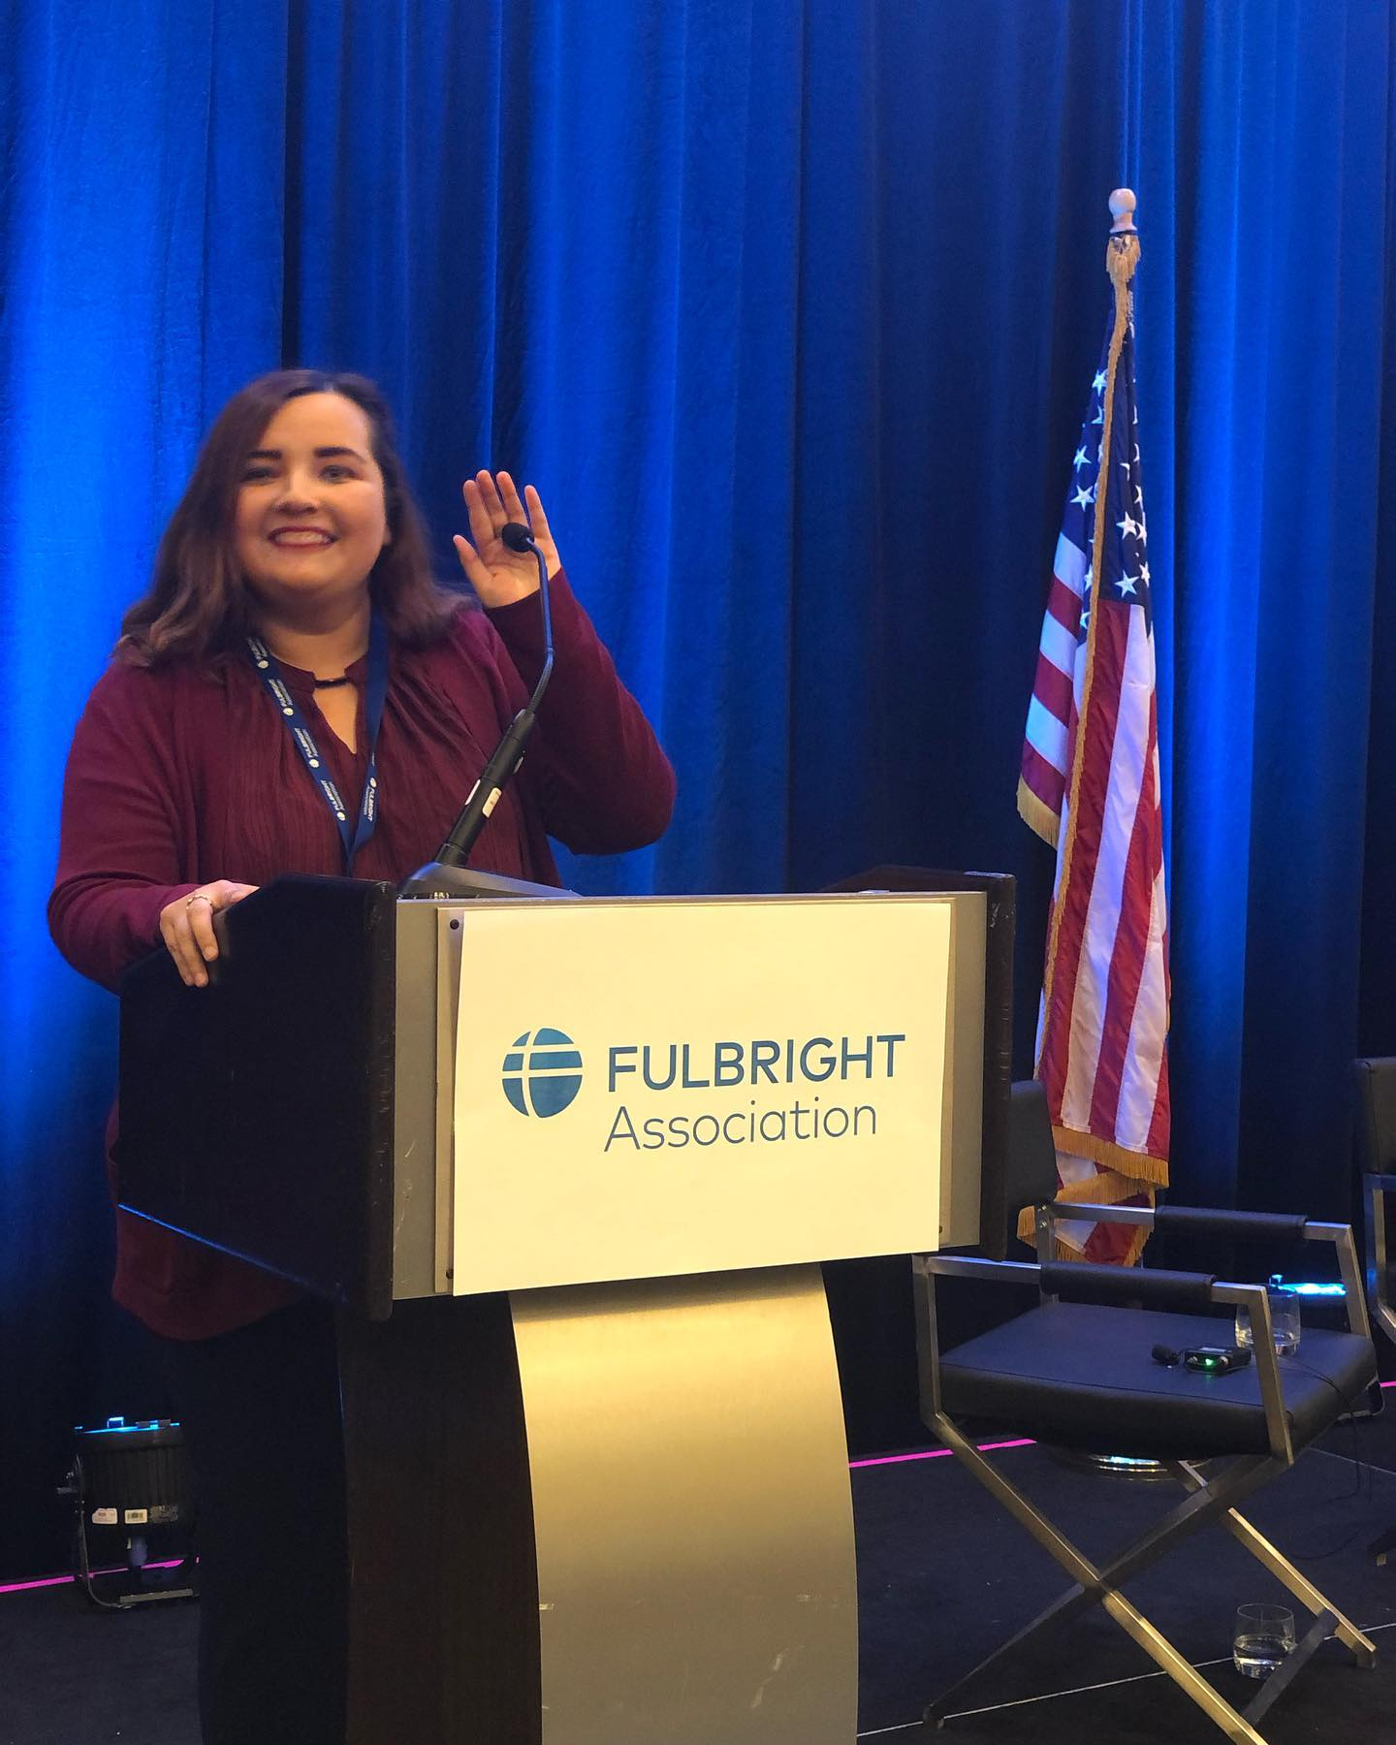
Brava!
2023 Fulbright Award
The Fulbright Award

Slide 24
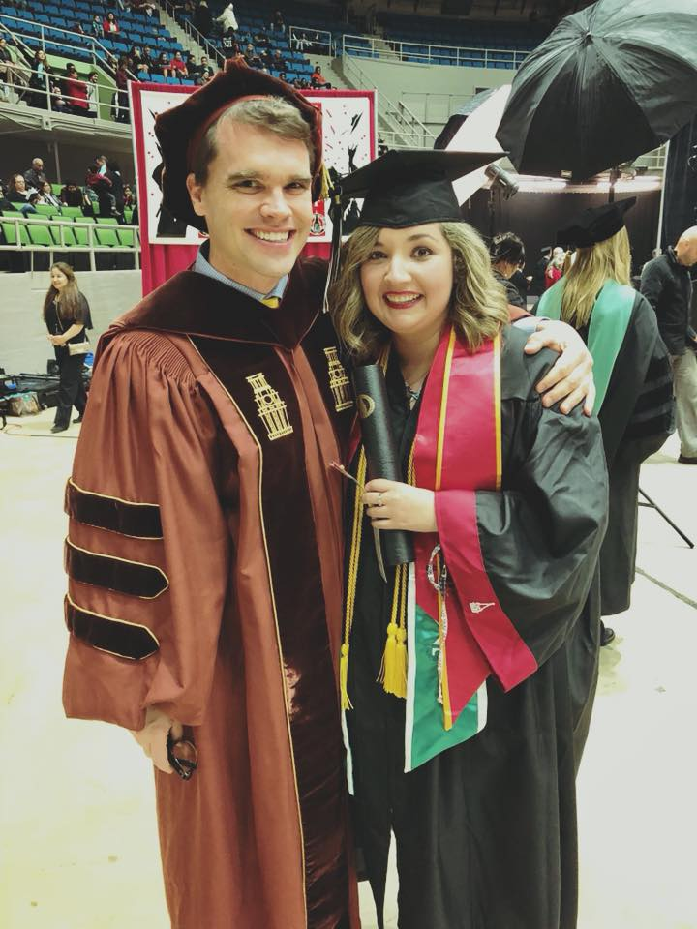
Brava!
2023 Fulbright Award
The Fulbright Award
This award is presented on occasion for outstanding academic contributions to the students, faculty, and staff of St. Philip's College and for dedicated professional service to Greater San Antonio Community and the State of Texas through the Senator J. William Fulbright Scholarship Program.
This year’s recipient is Susanna Alford, the long-standing student volunteer behind the San Antonio Chapter of the Fulbright Association.

Slide 25
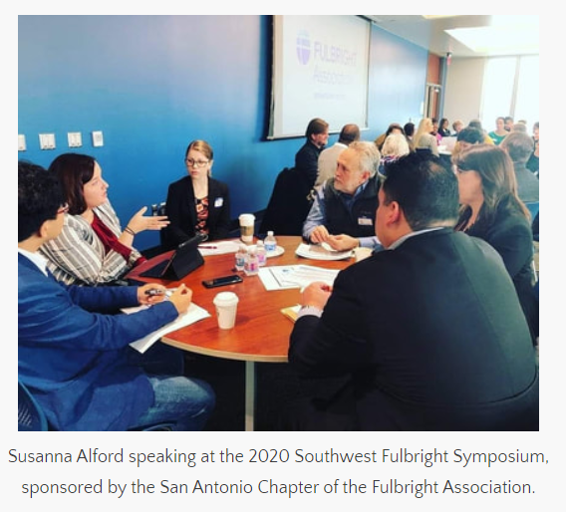
Brava!
2023 Fulbright Award
The Fulbright Award

Slide 26
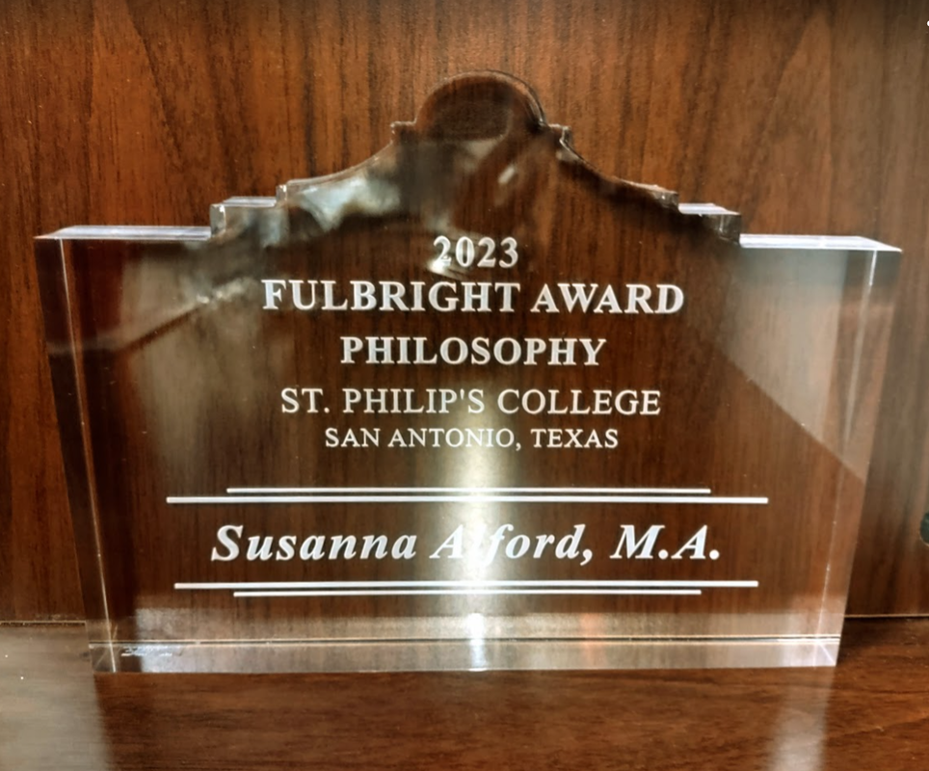
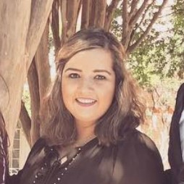
Brava!
2023 Fulbright Award
The Fulbright Award

Slide 27
Bravo!
2023 International Education Award
The International Education Award

Slide 28
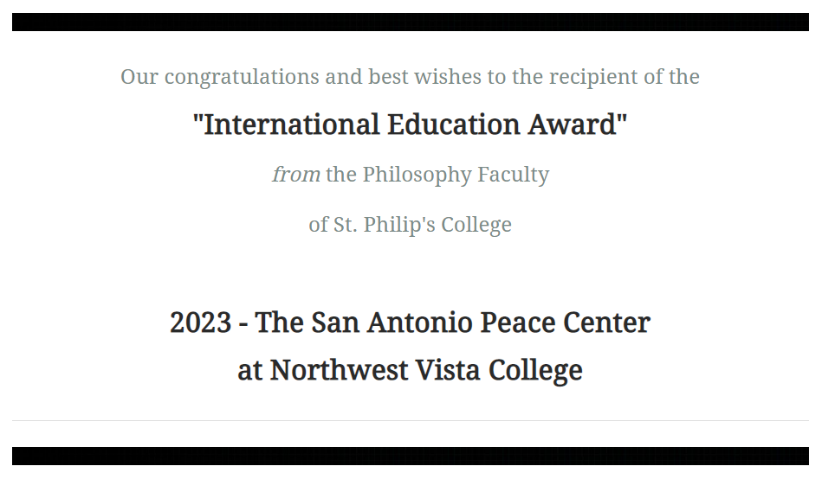
Bravo!
2023 International Education Award
The International Education Award

Slide 29
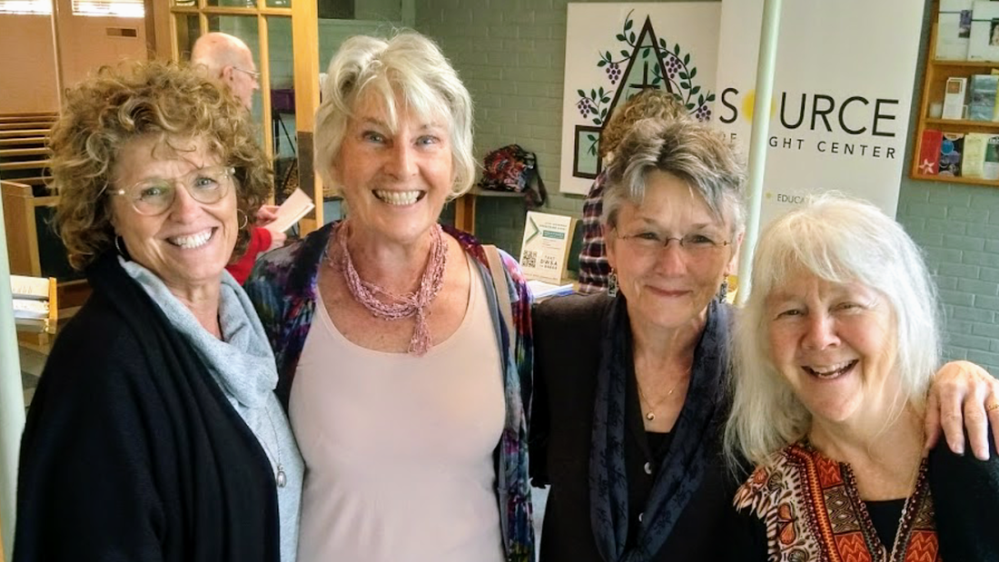
Brava!
2023 International Education Award
Once a year, the Philosophy Faculty at St. Philip’s College bestows an award on a member of our community for their work supporting international education or service.
This year’s recipient is The San Antonio Peace Center, our longstanding partner in international education.
Over the last 30 years, the San Antonio Peace Center has been at the forefront of peace and compassion advocacy and activism. The volunteers have been at the center of protests, marches, demonstrations, seminars, workshops, and direct service actions with a wide range of community partners.

Slide 30
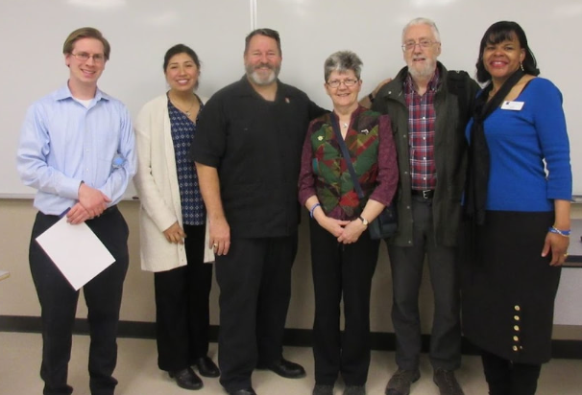
Brava!
2023 International Education Award
The Peace Center has also worked closely with the Fulbright Scholars-in-Residence who have come to St. Philip’s College, integrating them into their local work.
The first couple from the Corrymeela Peace Center was Richard and Yvonne Naylor (2016), and they were followed by Derick and Dot Wilson (2019-2020).

Slide 31
Brava!
2023 International Education Award
The Peace Center has also worked closely with the Fulbright Scholars-in-Residence who have come to St. Philip’s College, integrating them into their local work.
The first couple from the Corrymeela Peace Center was Richard and Yvonne Naylor (2016), and they were followed by Derick and Dot Wilson (2019-2020).

Slide 32
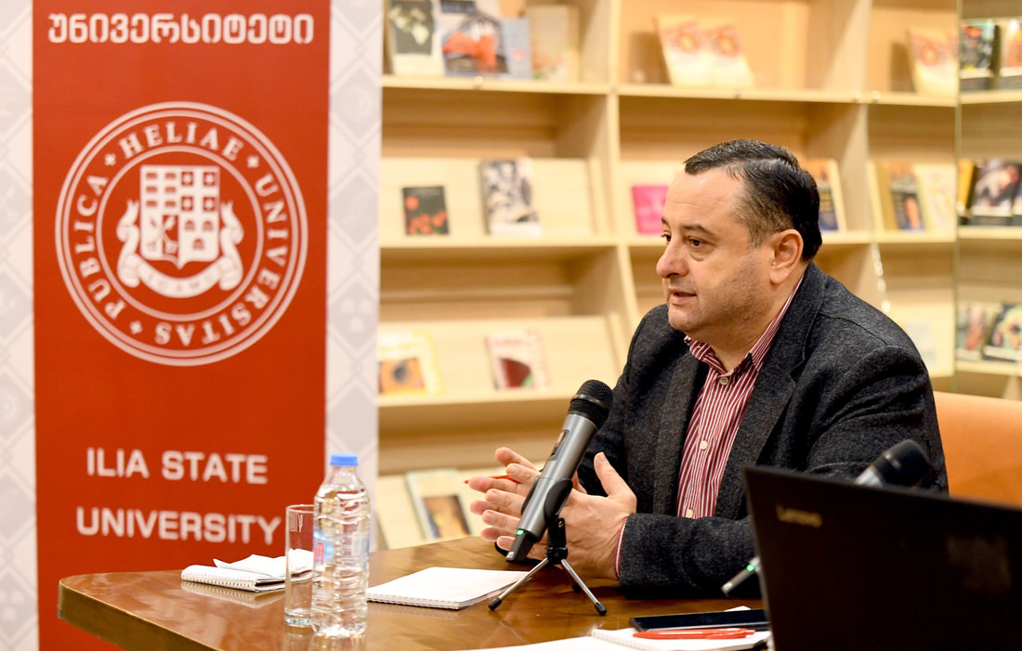
Brava!
2023 International Education Award
In fact, we look forward to working with the Peace Center and Northwest Vista College, as we have partnered again to bring in a new Fulbright Scholar-in-Residence who is an expert on interreligious dialogue and peace and conflict studies.
Prof. Vladimer Narsia, a professor at Ilia State University in Tbilisi, Georgia will be co-hosted by the San Antonio Peace Center and St. Philip’s College during the next academic year, 2023-2024.

Slide 33
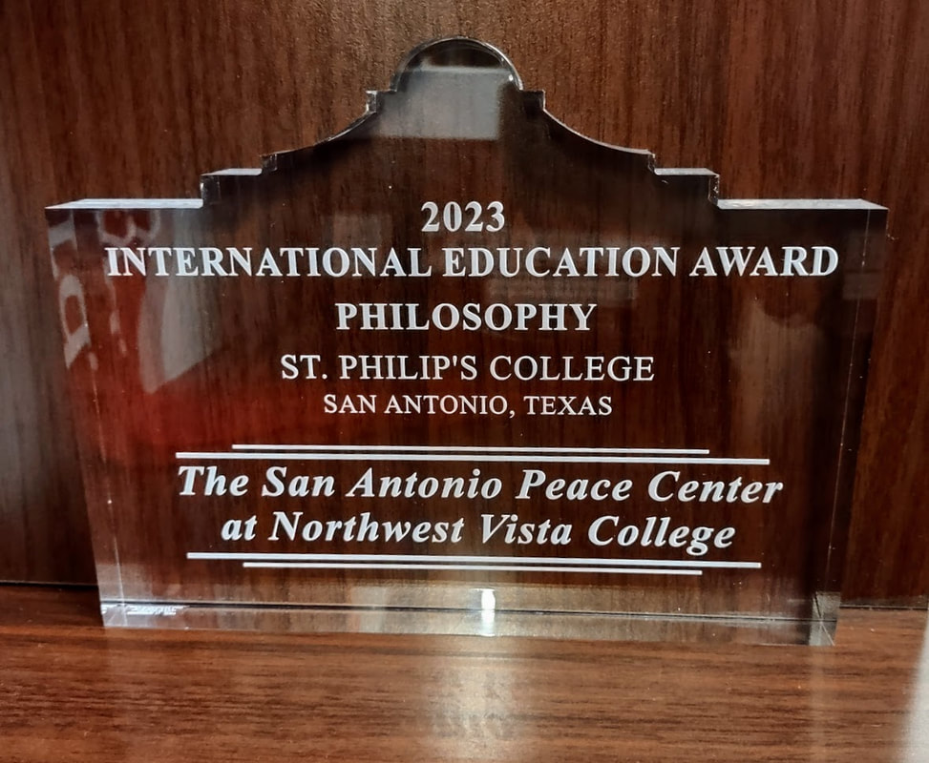
Brava!
2023 International Education Award
The International Education Award

Slide 34
Bravo!
2023 Amicus Award
The Amicus Award

Slide 35
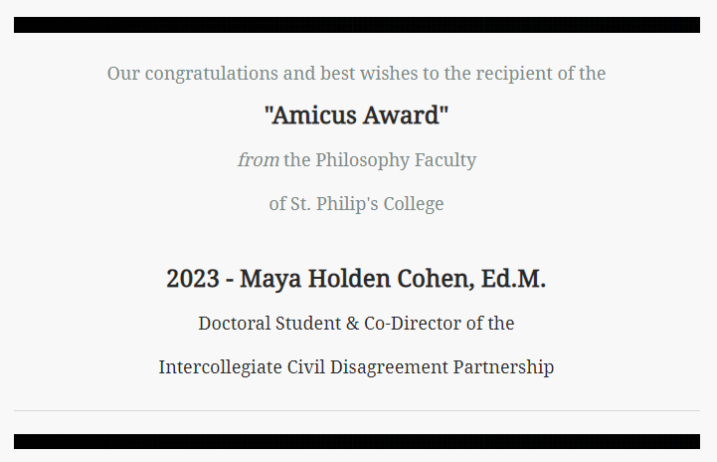
Bravo!
2023 Amicus Award
The Amicus Award

Slide 36
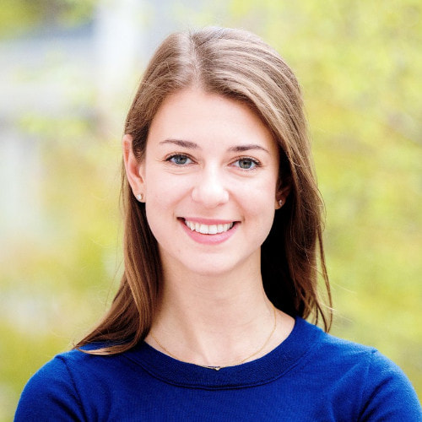
Bravo!
The Amicus Award
2023 Amicus Award
Once a year, the Philosophy Faculty at St. Philip’s College bestows an award that recognizes outstanding contributions to the shared work of our extended faculty, our colleagues, or our local partners in the teaching of Philosophy inside and outside the classroom.
Our students benefit when our partnerships come together to share expertise, knowledge, and resources.
This year’s recipient is Maya Holden Cohen, doctoral student & co-director of the Intercollegiate Civil Disagreement Partnership.

Slide 37
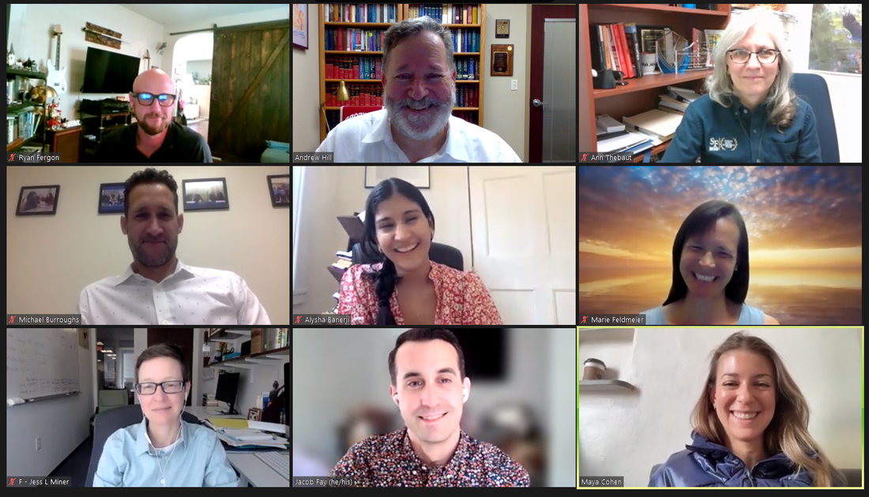
Bravo!
The Amicus Award
2023 Amicus Award

Slide 38
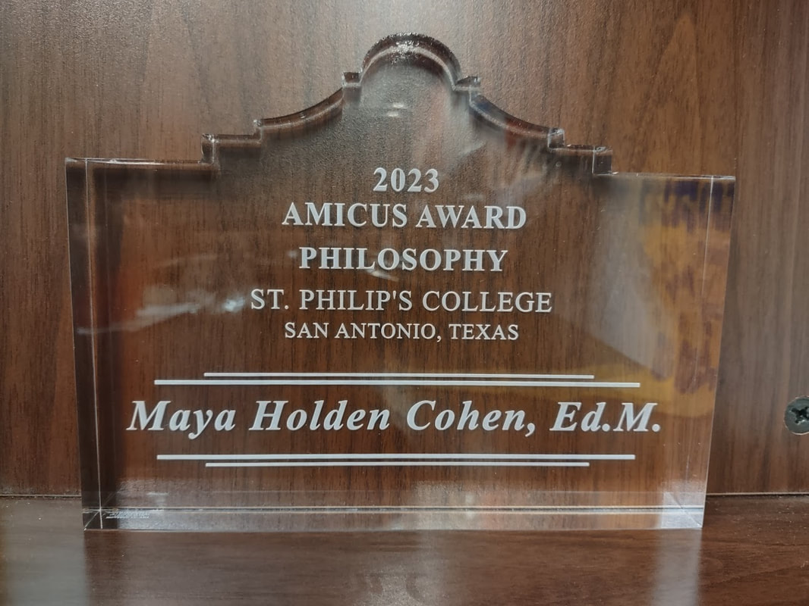
Bravo!
The Amicus Award
2023 Amicus Award

Slide 39
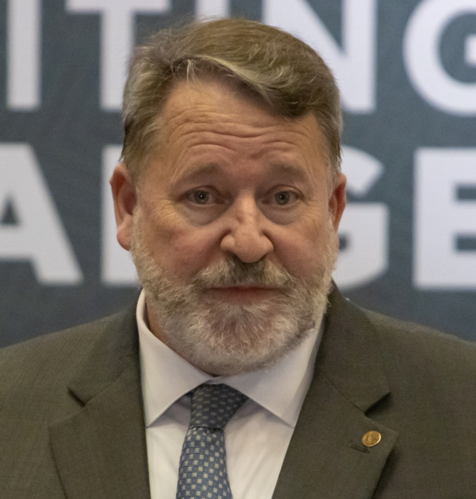
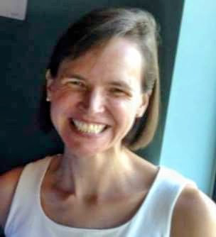
Save the Date! October 13, 2023 50th Anniversary Celebration The Philosophy Faculty of St. Philip’s College
fd

Slide 40
Annual Awards Ceremony The Philosophy Faculty of St. Philip’s College
fd
11 may 2023

