Slide 2
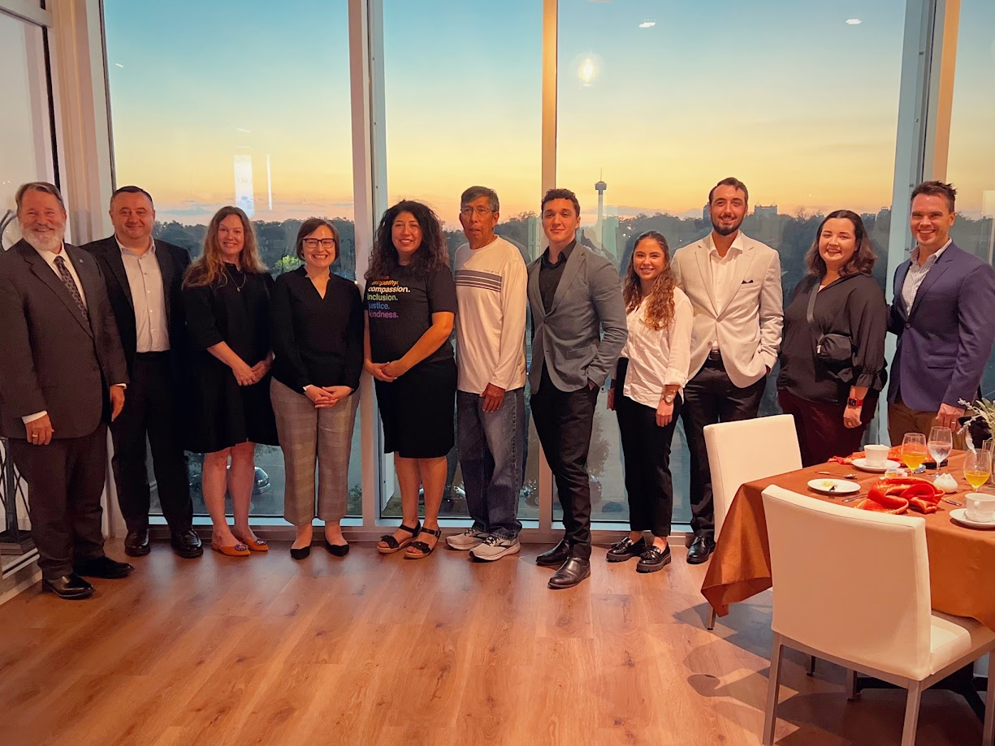

Slide 3
Fulbright Scholars in San Antonio:
Inspiring Our Community
How You can Advance Internationalization of Your Curriculum with a Fulbright Scholar-in-Residence
Andrew J. Hill
Philosophy
St. Philip’s College
San Antonio, Texas
24 January 2024

Slide 4
The San Antonio Chapter of the Fulbright Association has
partnered with SPC & NVC to bring Fulbright Scholars from around the world to contribute to the growth and development of our students and our larger community.
We will also be discussing the traditional Fulbright Scholars program which takes faculty members around the world to teach and conduct research in 160 countries.

Slide 5
Fulbright alumni have achieved distinction in government, science, the arts, business, philanthropy, education, and athletics:
40 Fulbright alumni have served as heads of state or government
62 Fulbright alumni from 15 countries have been awarded the Nobel Prize
76 Fulbright alumni are MacArthur Foundation Fellows
89 Fulbright alumni have received Pulitzer Prizes

Slide 6
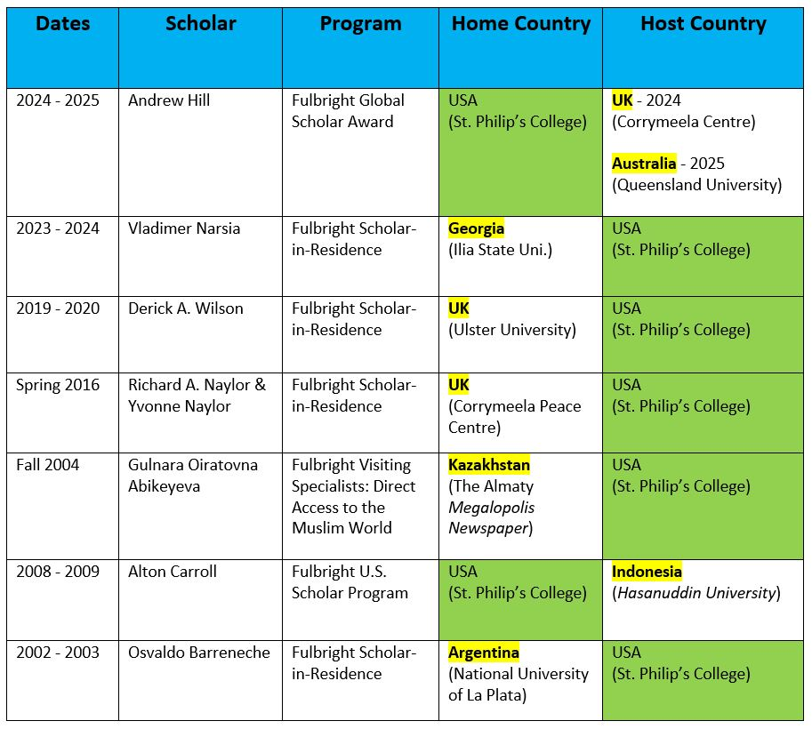

Slide 9
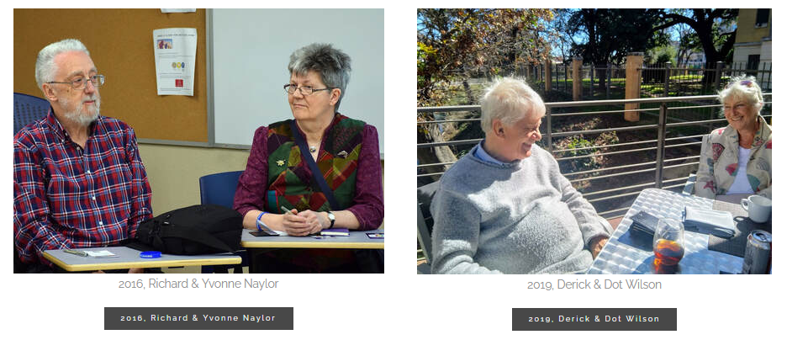
The program provides approximately 8,000 grants annually – roughly 1,600 to U.S. students, 1,200 to U.S. scholars, 4,000 to foreign students, 900 to foreign visiting scholars, and several hundred to teachers and professionals.

Slide 10
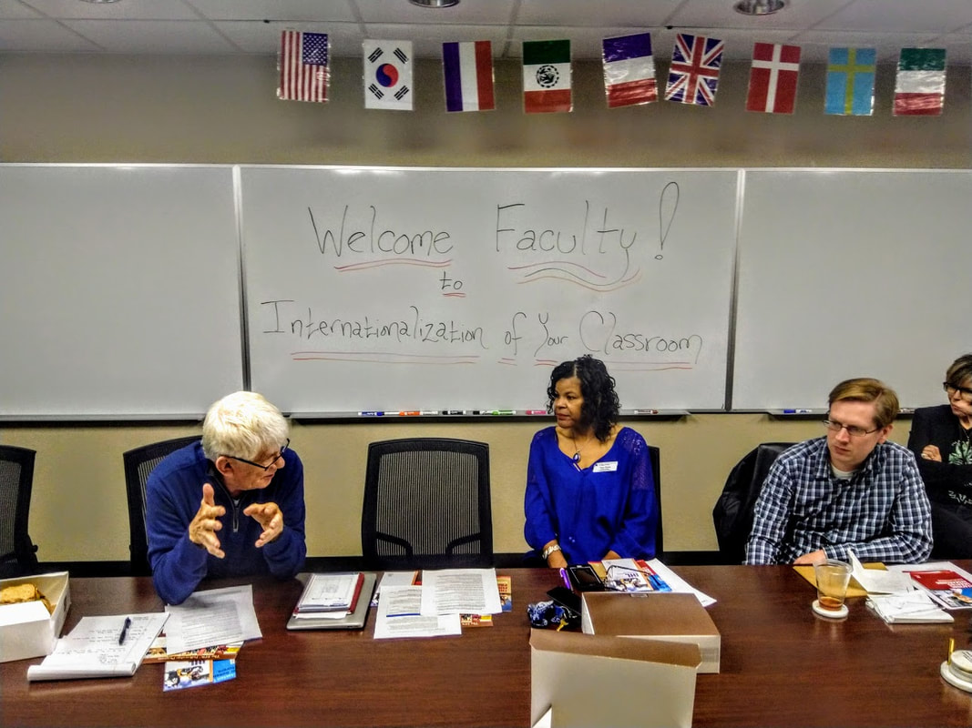
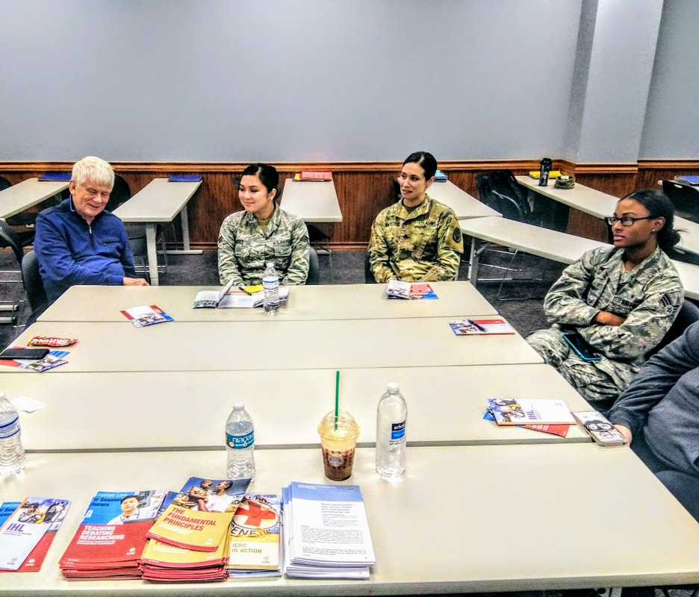

Slide 11
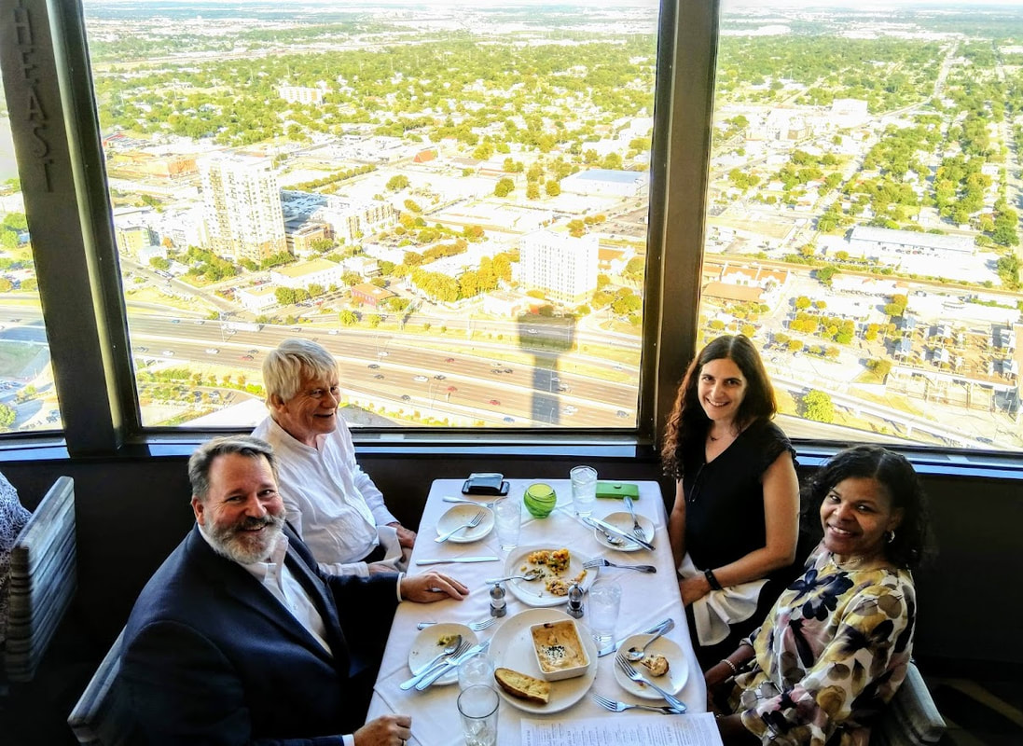

Slide 12
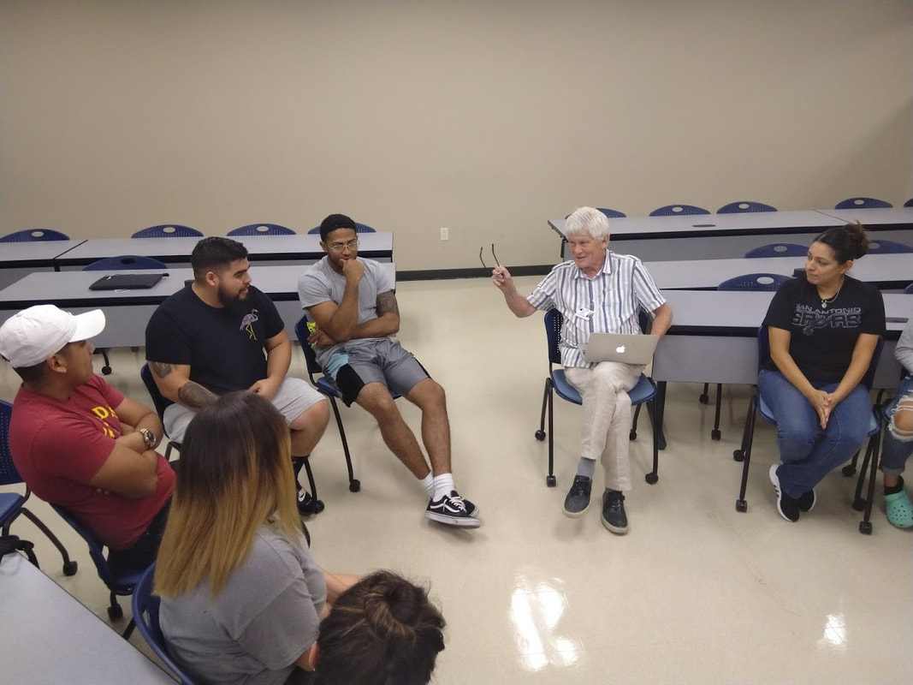
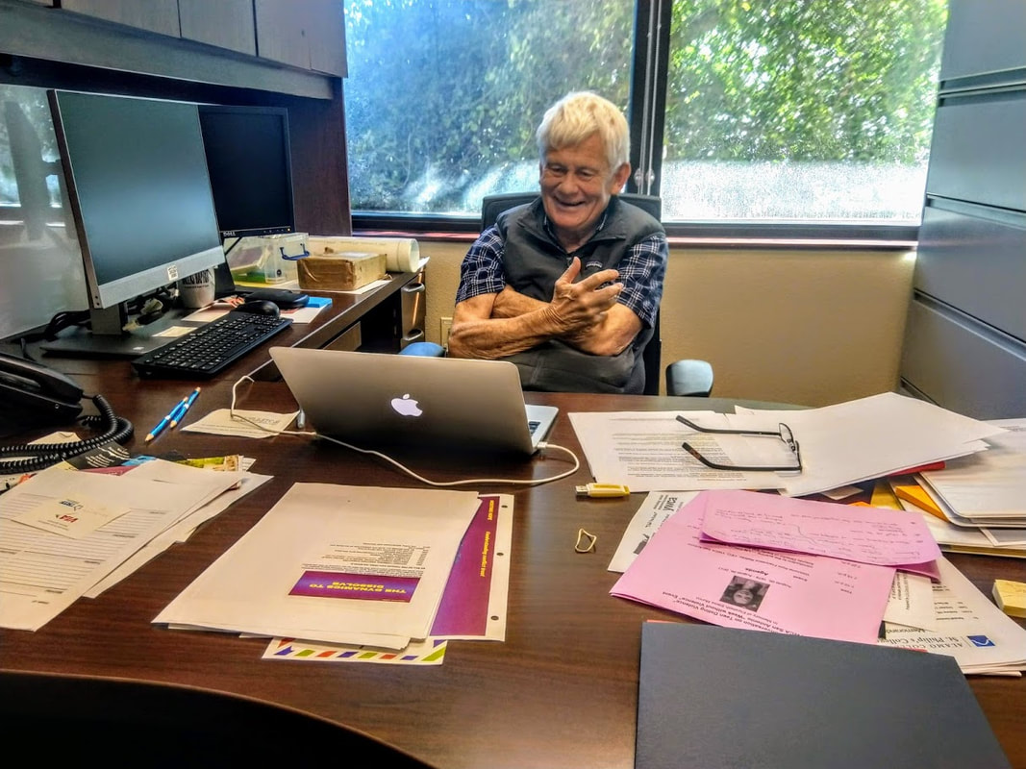

Slide 13
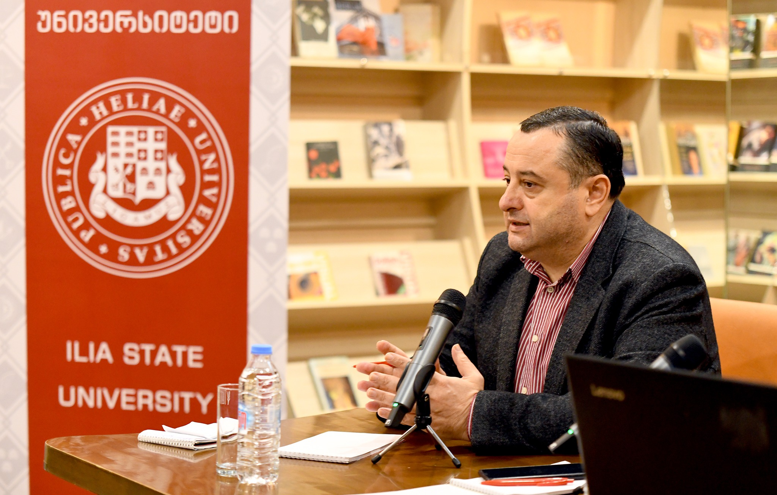
St. Philip’s College has now partnered with Northwest Vista College and the San Antonio Chapter of the Fulbright Association to bring a Fulbright Scholar-in-Residence to our city for the current academic year, 2023-2024.
Our scholar in residence is Professor Vladimer Narsia of Ilia State University in Tbilisi, Georgia.

Slide 14
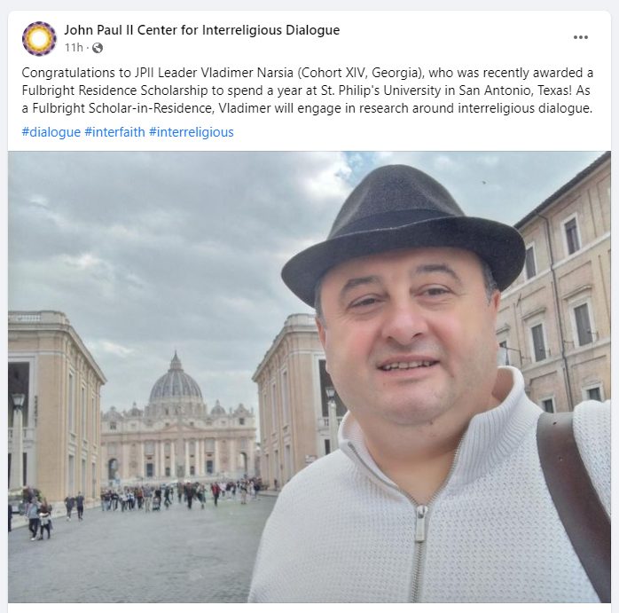
Our scholar, Prof. Vladimer Narsia of Ilia State University in Tbilisi, Georgia, served as a Russell Berrie Fellow at the John Pall II Center for Interreligious Dialogue at the Angelicum in Rome.

Slide 15
St. Philip’s College San Antonio, Texas

Slide 16
Northwest Vista College San Antonio, Texas

Slide 17
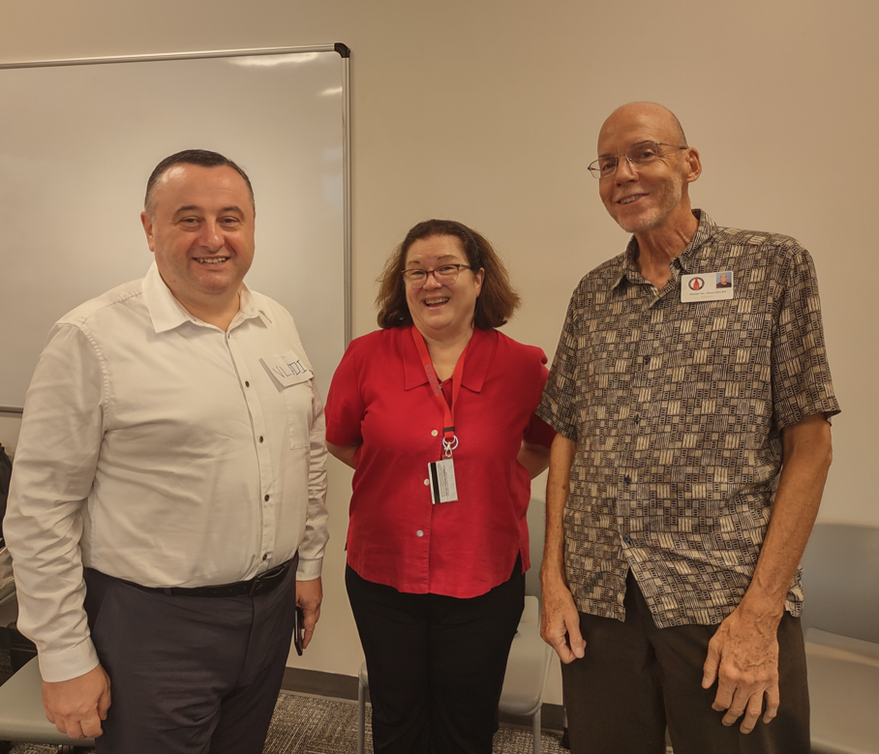
University of the Incarnate Word San Antonio

Slide 18
Little Flower Basilica Elementary School San Antonio, Texas

Slide 19
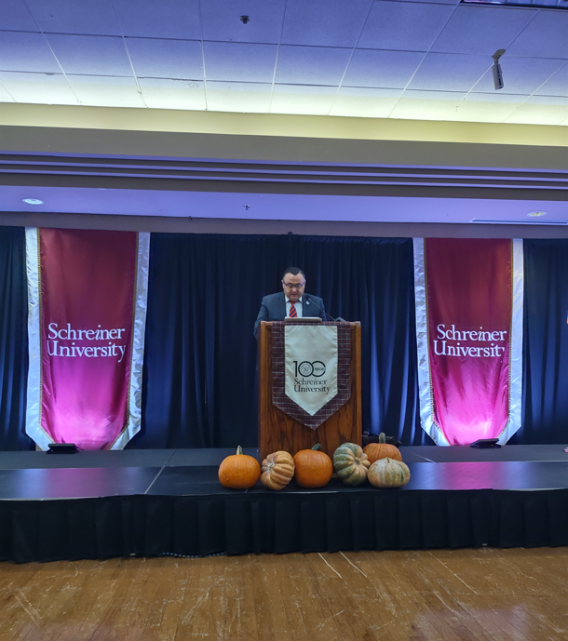
Schreiner University Kerrville, Texas

Slide 20
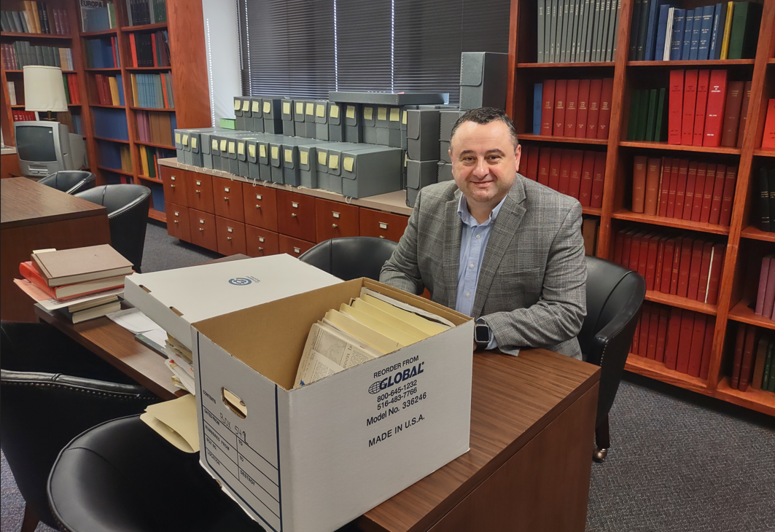
Baylor University Waco, Texas

Slide 21
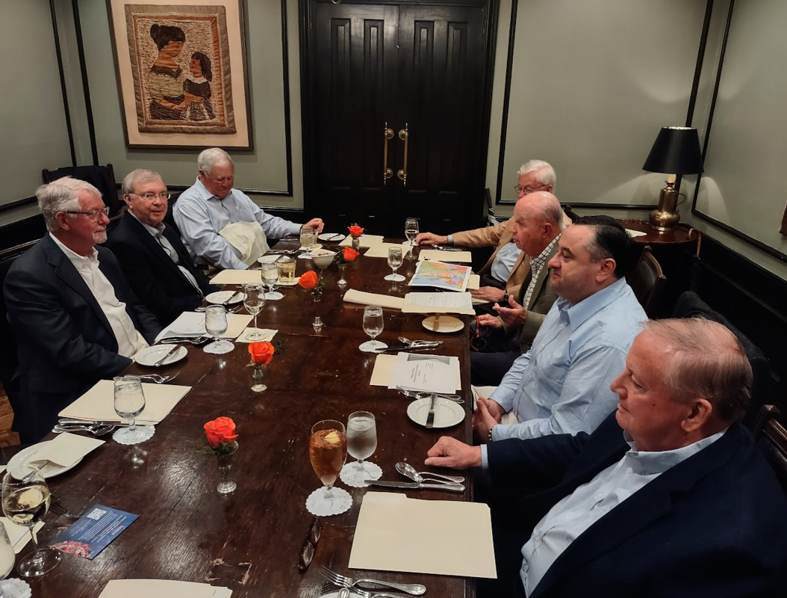
Rotary Club and Peace Center San Antonio

Slide 22
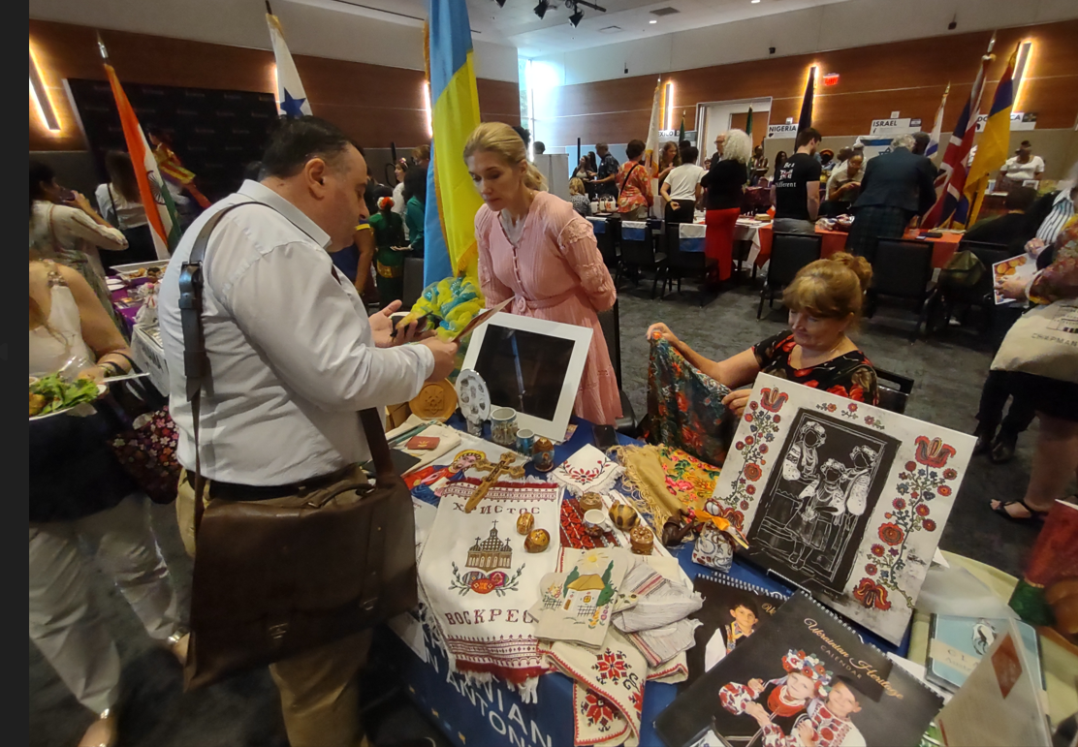
The World Affairs Council San Antonio, Texas

Slide 25
Andrew J. Hill
Philosophy
St. Philip’s College
San Antonio, Texas
24 January 2024
Questions?

