Slide 2
Fulbright Scholars in San Antonio:
Inspiring Our Community
How You can Advance the Mission and Purpose of the GCUE
with a Fulbright Scholar-in-Residence (SIR)
Andrew Hill
Fellow, San Antonio Peace Center
Northwest Vista College
Vladimer Narsia
Fulbright SIR, San Antonio Peace Center
Northwest Vista College
Northwest Vista College
San Antonio, Texas
14 October 2023

Slide 3
The San Antonio Chapter of the Fulbright Association and
the Alamo Colleges have partnered to bring Fulbright Scholars from around the world to contribute to the growth and development of our students and our larger community.
We will also be discussing the traditional Fulbright Scholars program which takes our members around the world to learn, consult, teach and conduct research in 160 countries.

Slide 4
Fulbright alumni have achieved distinction in government, science, the arts, business, philanthropy, education, and athletics:
40 Fulbright alumni have served as heads of state or government
62 Fulbright alumni from 15 countries have been awarded the Nobel Prize
76 Fulbright alumni are MacArthur Foundation Fellows
89 Fulbright alumni have received Pulitzer Prizes

Slide 5
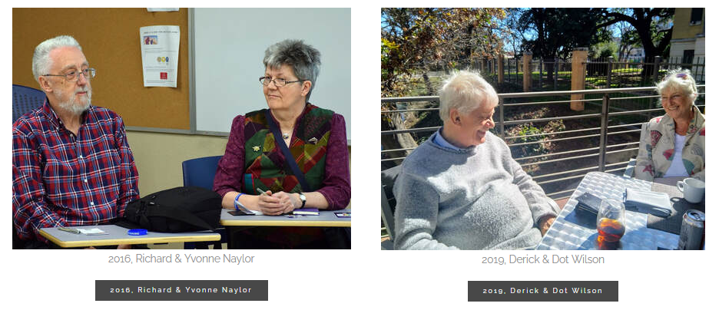
The program provides approximately 8,000 grants annually – roughly 1,600 to U.S. students, 1,200 to U.S. scholars, 4,000 to foreign students, 900 to foreign visiting scholars, and several hundred to teachers and professionals.

Slide 6
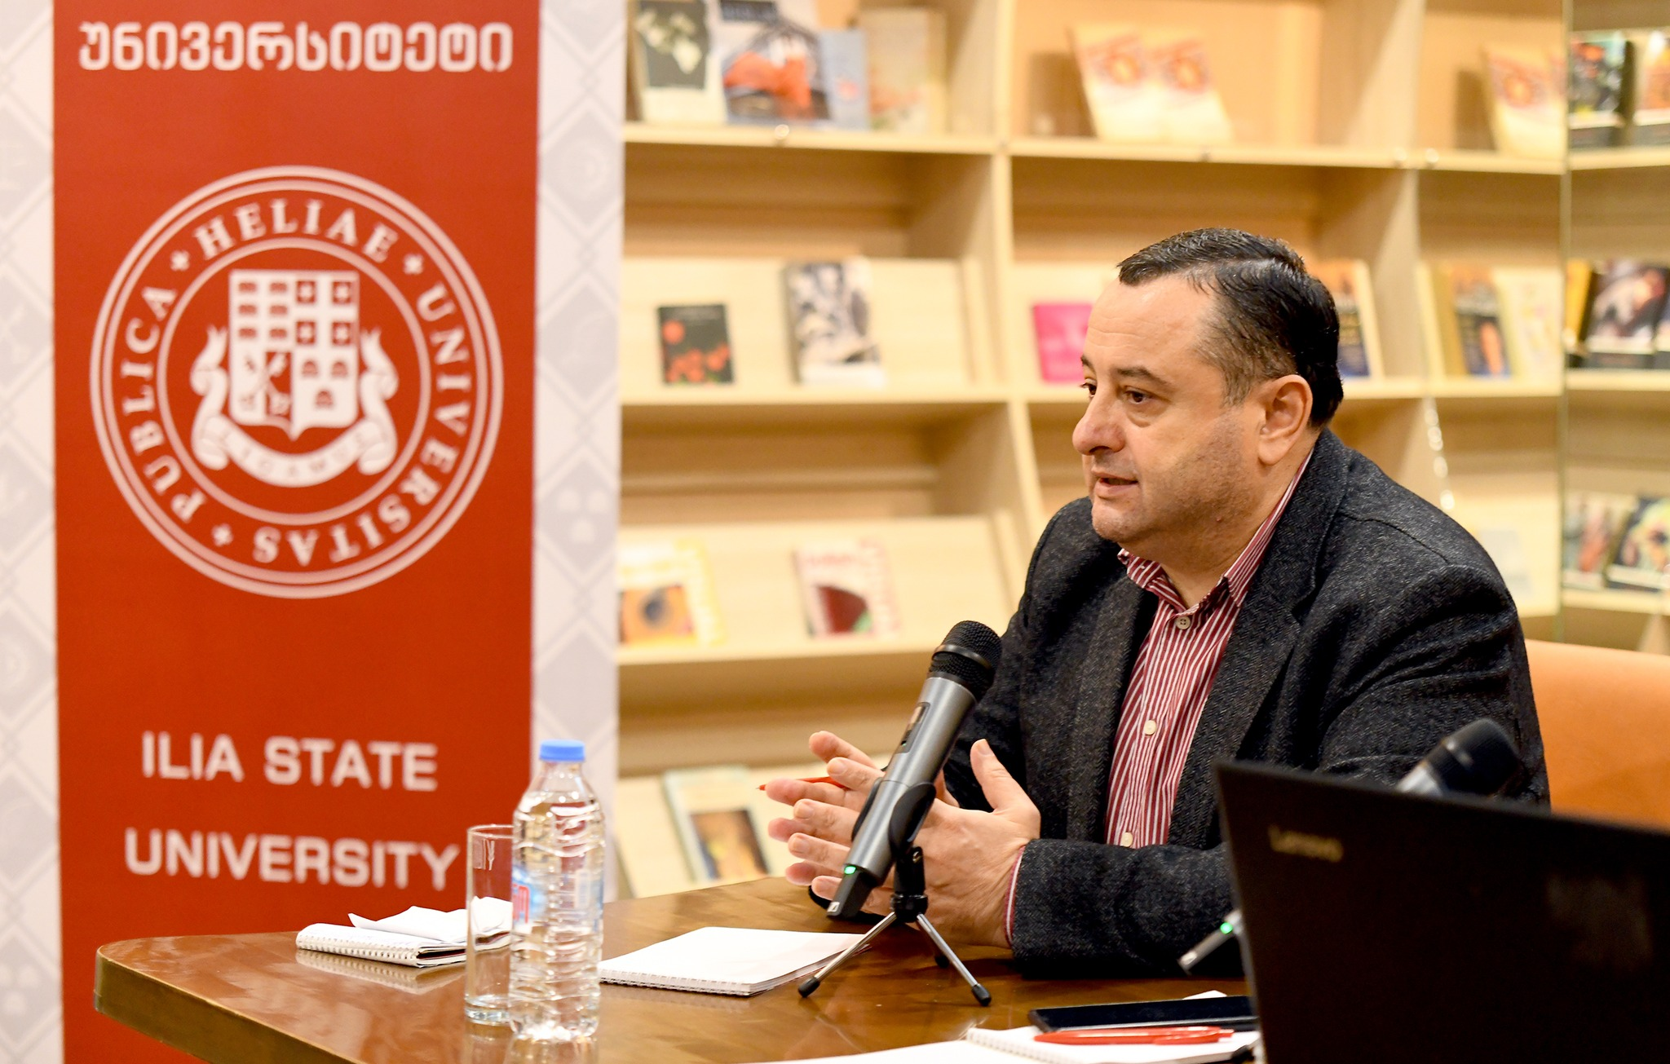
Northwest Vista College has partnered with St. Philip’s College and the San Antonio Chapter of the Fulbright Association to bring a Fulbright Scholar-in-Residence to our city for the current academic year, 2023-2024.
Our visiting scholar is Professor Vladimer Narsia of Ilia State University in Tbilisi, Georgia.

Slide 7
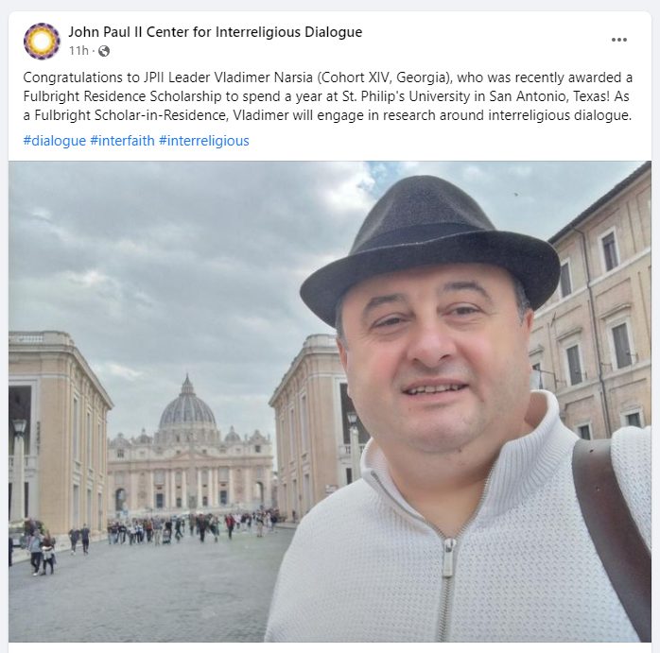
Professor Vladimer Narsia is a scholar of interreligious dialogue, and who previously served as a Russell Berrie Fellow at the John Paul II Center for Interreligious Dialogue at the Angelicum in Rome.

Slide 8
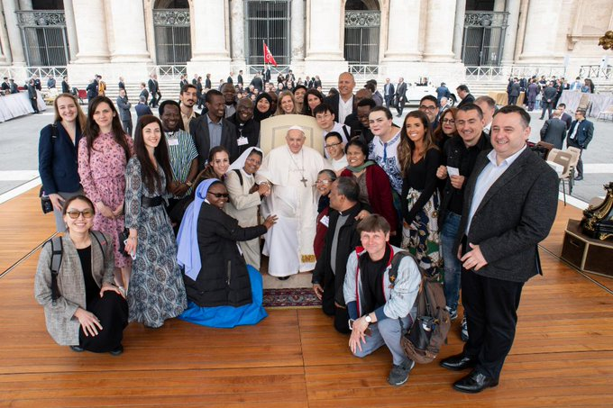
Professor Narsia studied, conducted research, and taught as part of his fellowship in Rome with colleagues from around the globe.
Here he is with Pope Francis (Vladimer, far right, in suit coat):

Slide 11
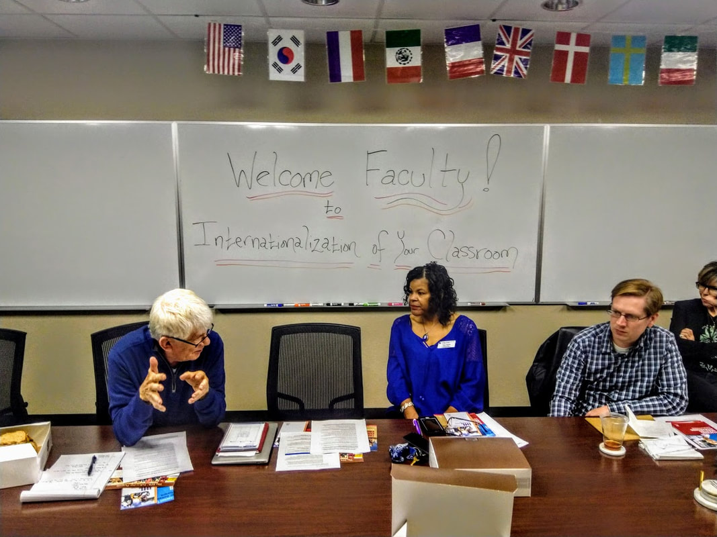
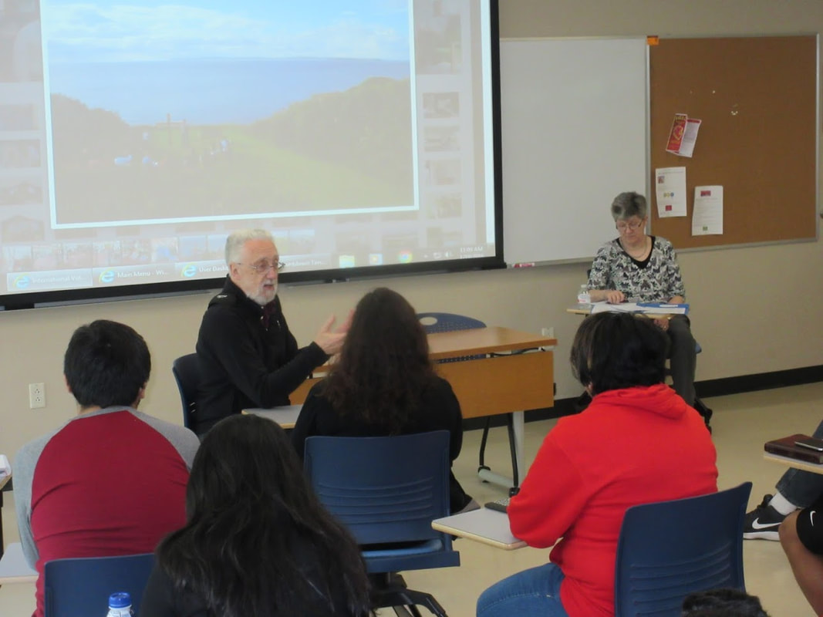

Slide 12
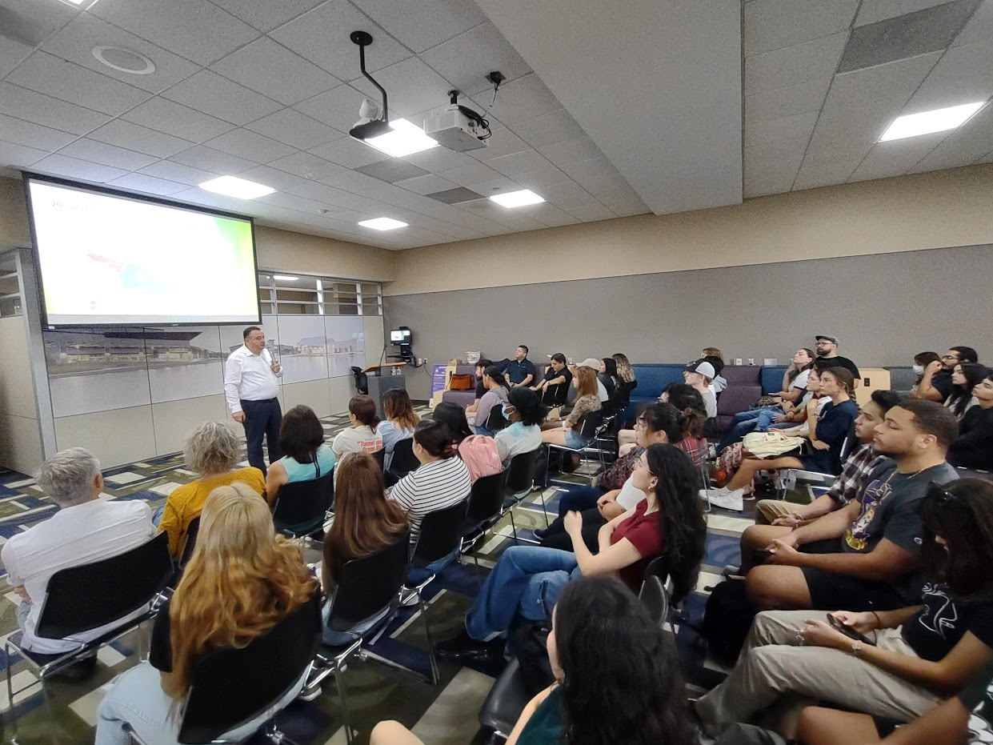

Slide 13
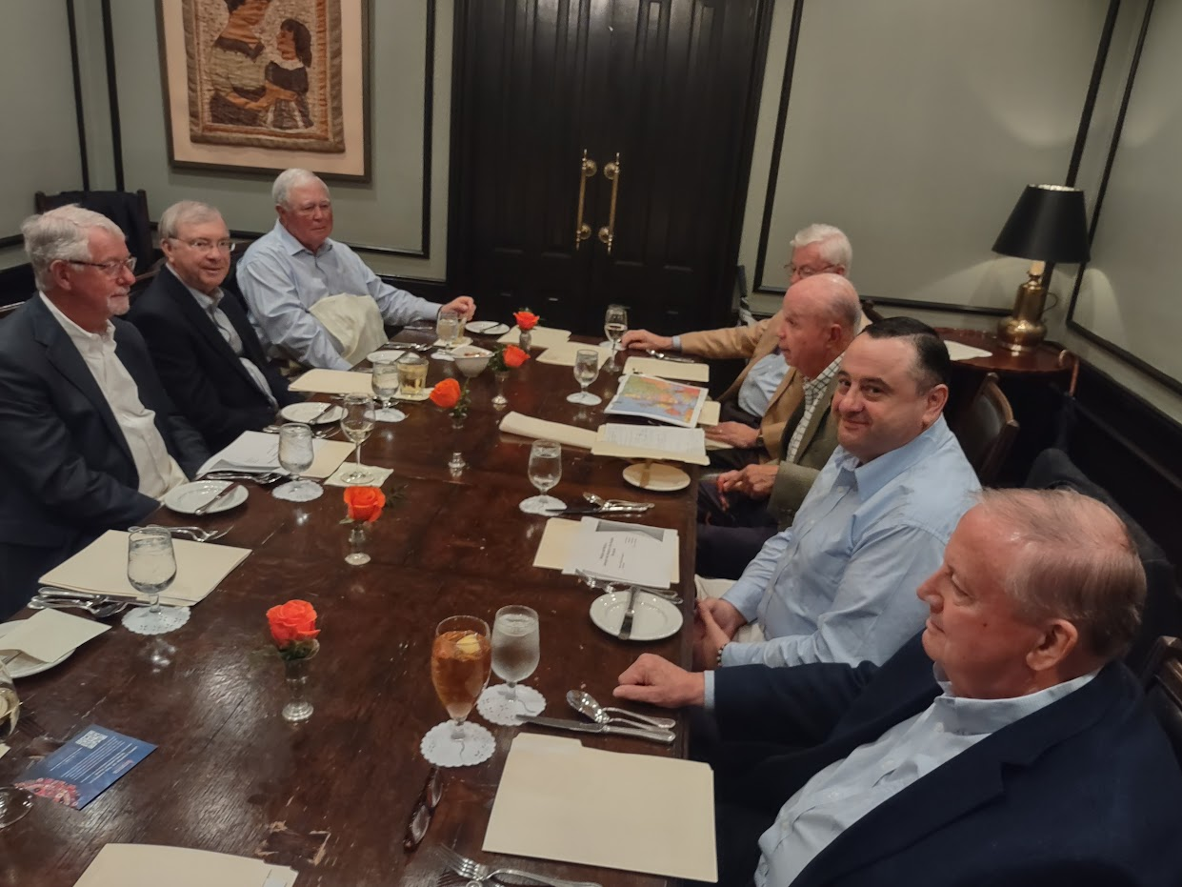
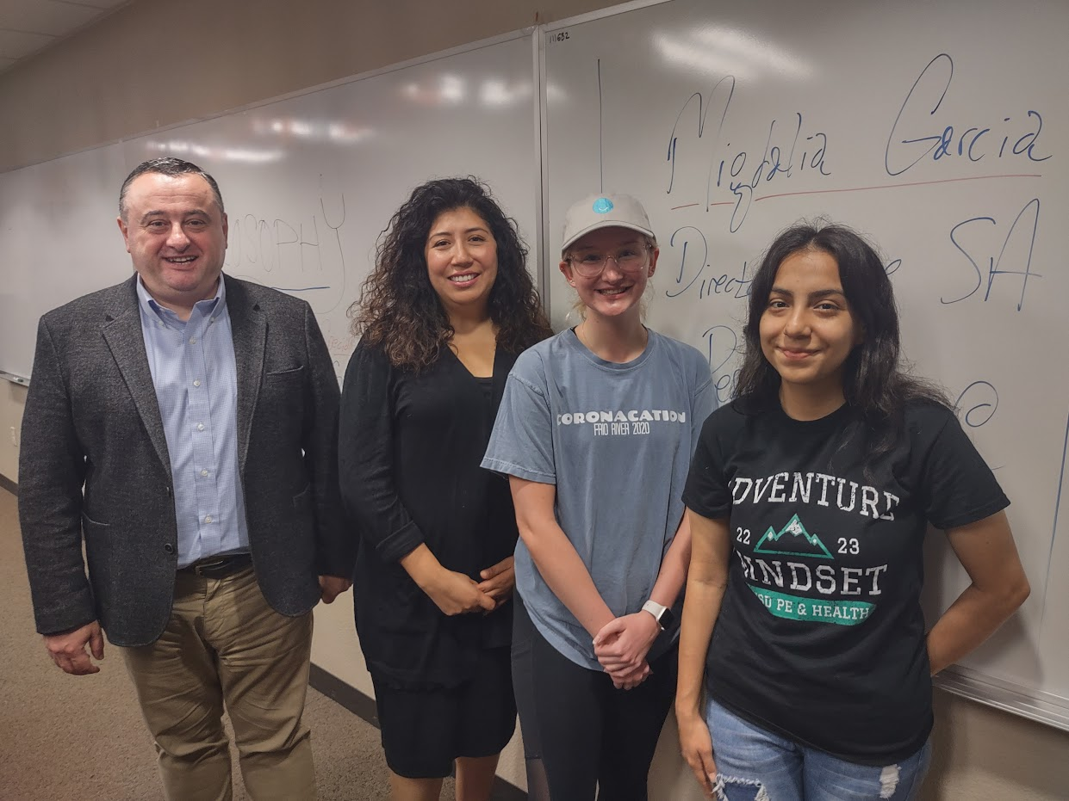

Slide 14
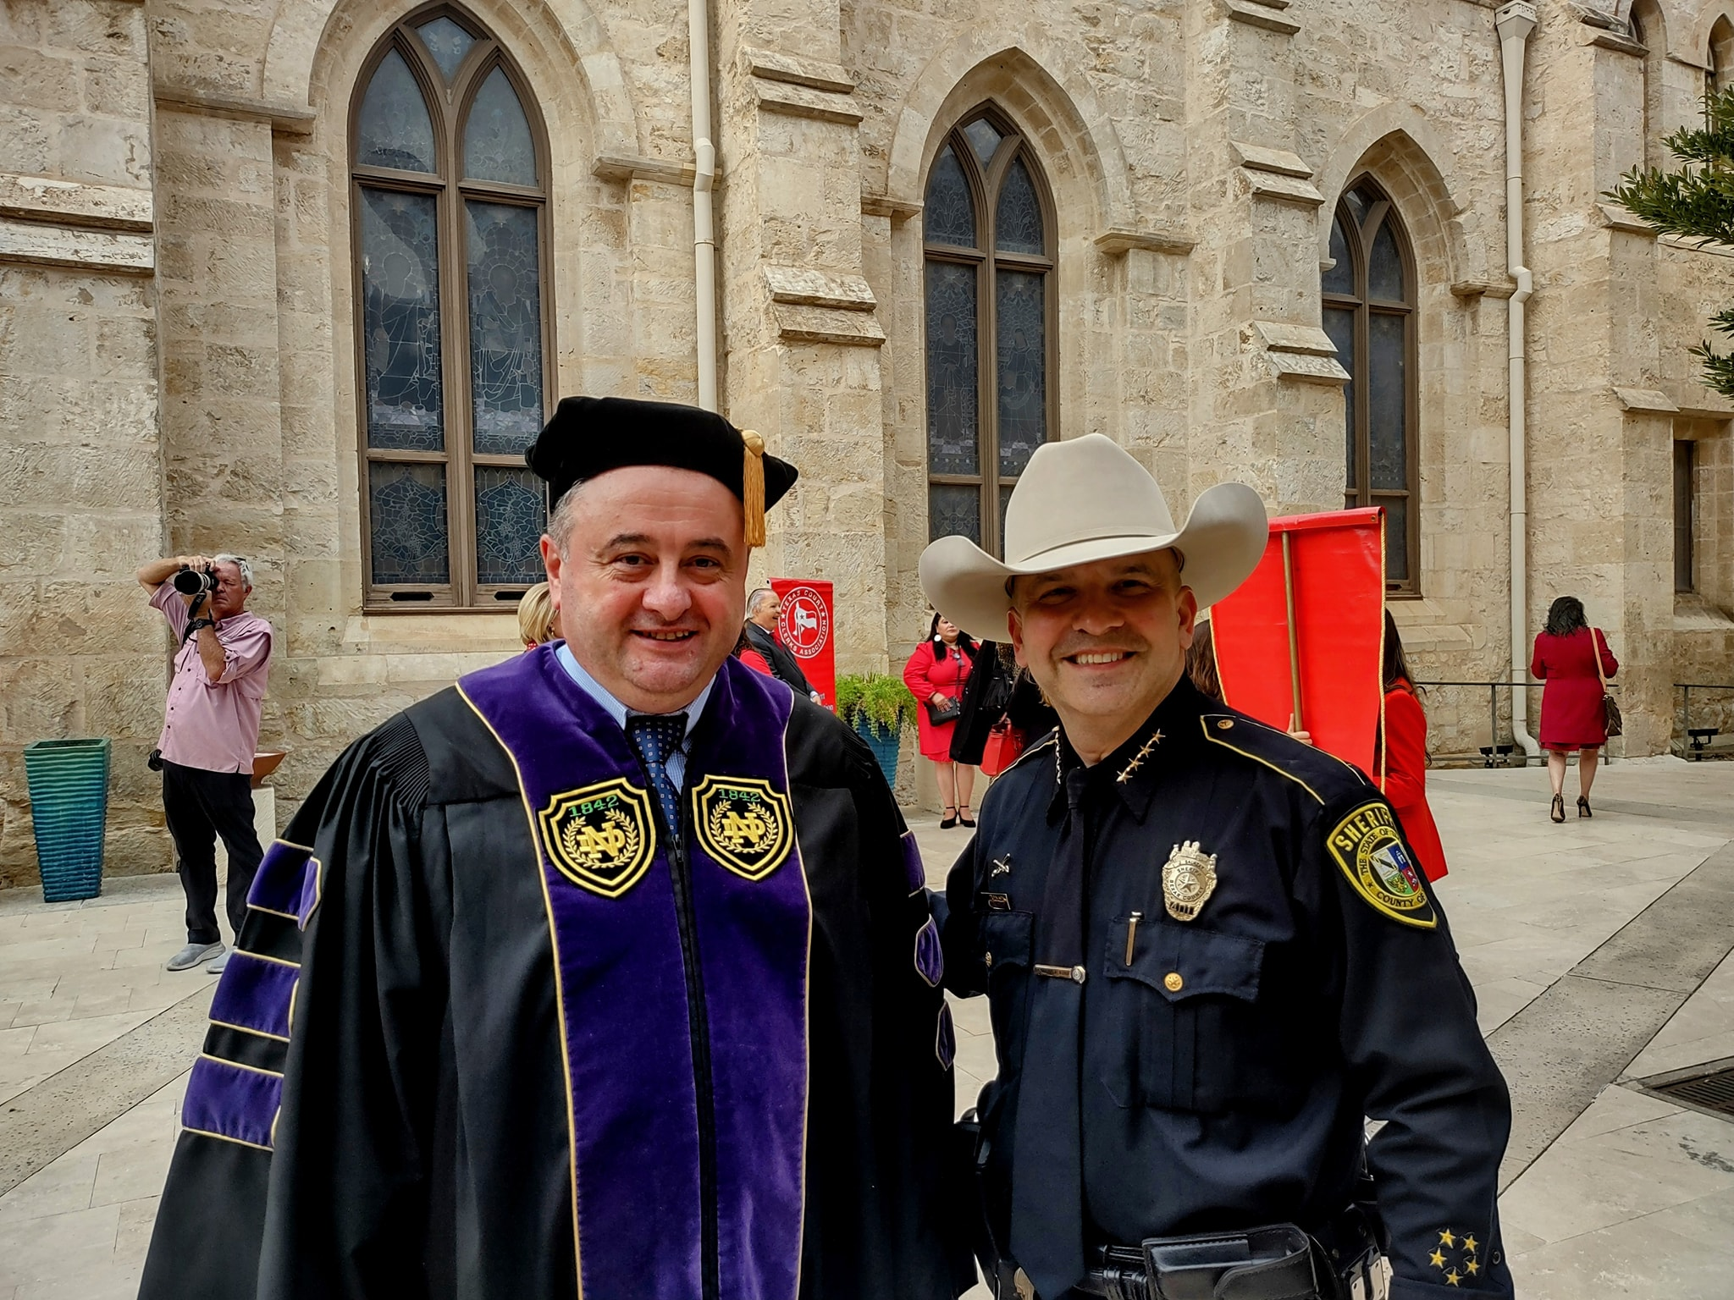
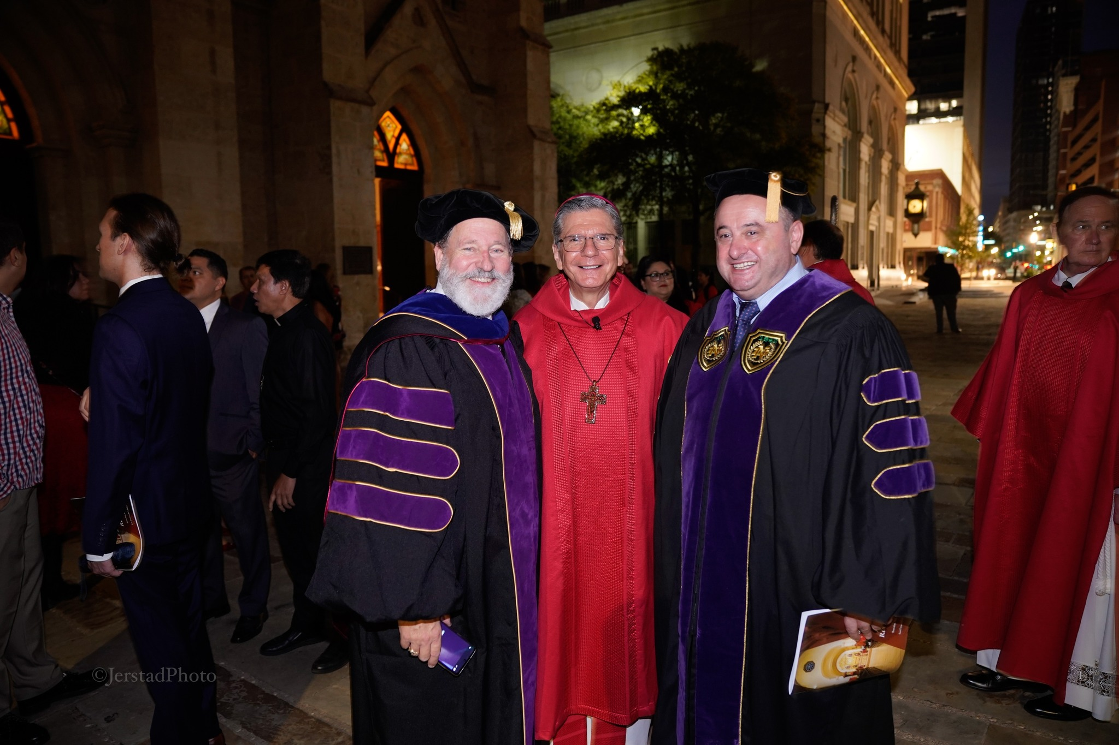

Slide 19
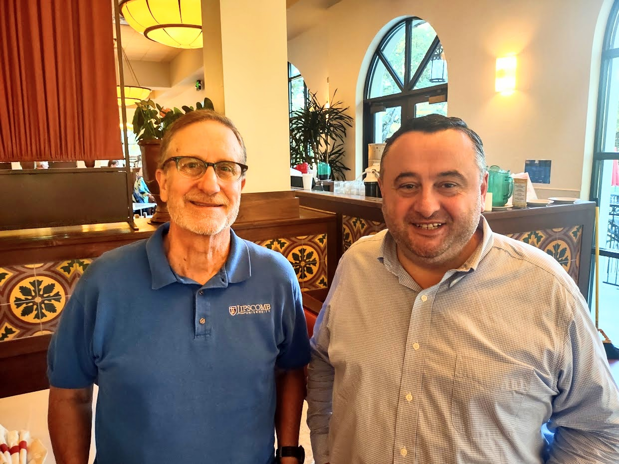
Roger Wiemers
Lipscomb University
Fulbright, India, 2007-2008
Vladimer Narsia
Fulbright SIR, San Antonio Peace Center
Northwest Vista College, 2023-2024
12 October 2023
Viola’s Ventanas Restaurant

Slide 20
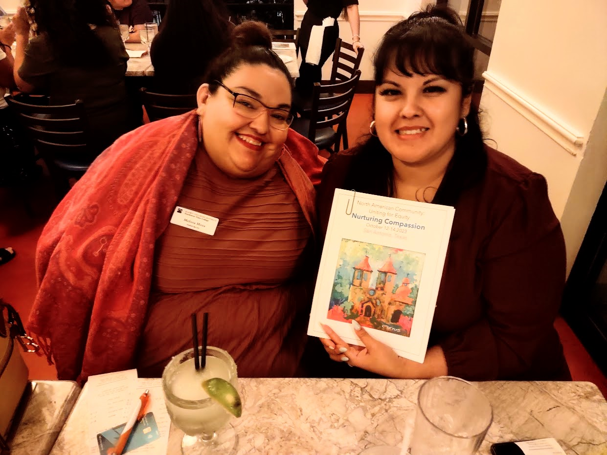
Melissa Moya
Northwest Vista Colleg
Fulbright, Peru, 2013
Magdalena Yznaga
Palo Alto College
Fulbright, Peru, 2013
12 October 2023
Viola’s Ventanas Restaurant

Slide 21
Andrew Hill
Fellow, San Antonio Peace Center
Northwest Vista College
Vladimer Narsia
Fulbright SIR, San Antonio Peace Center
Northwest Vista College
Northwest Vista College
San Antonio, Texas
14 October 2023
Questions?

