Slide 1
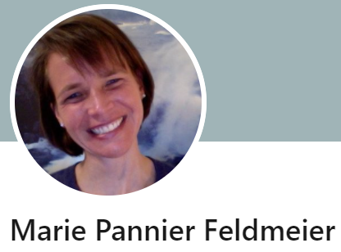
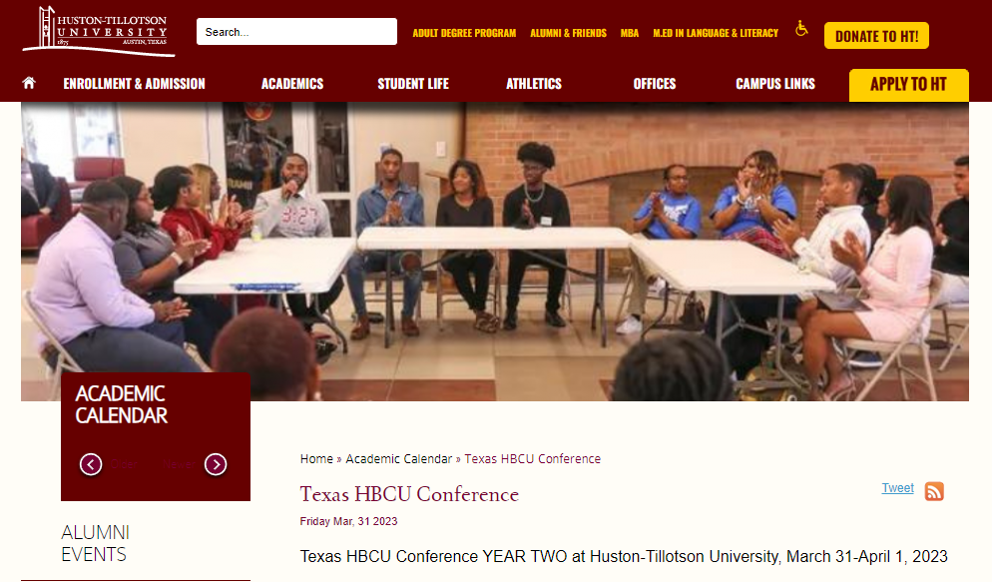

Slide 2
The Intercollegiate Civil Disagreement Partnership
Community-Centered Public Policy, Civically Engaged Higher Education Institutions and the HBCU: A Conference of Texas HBCUs
The Texas HBCU Conference at Huston-Tillotson University
March 31 - April 01, 2023

Slide 3
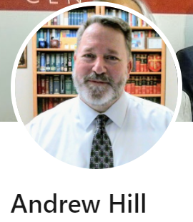
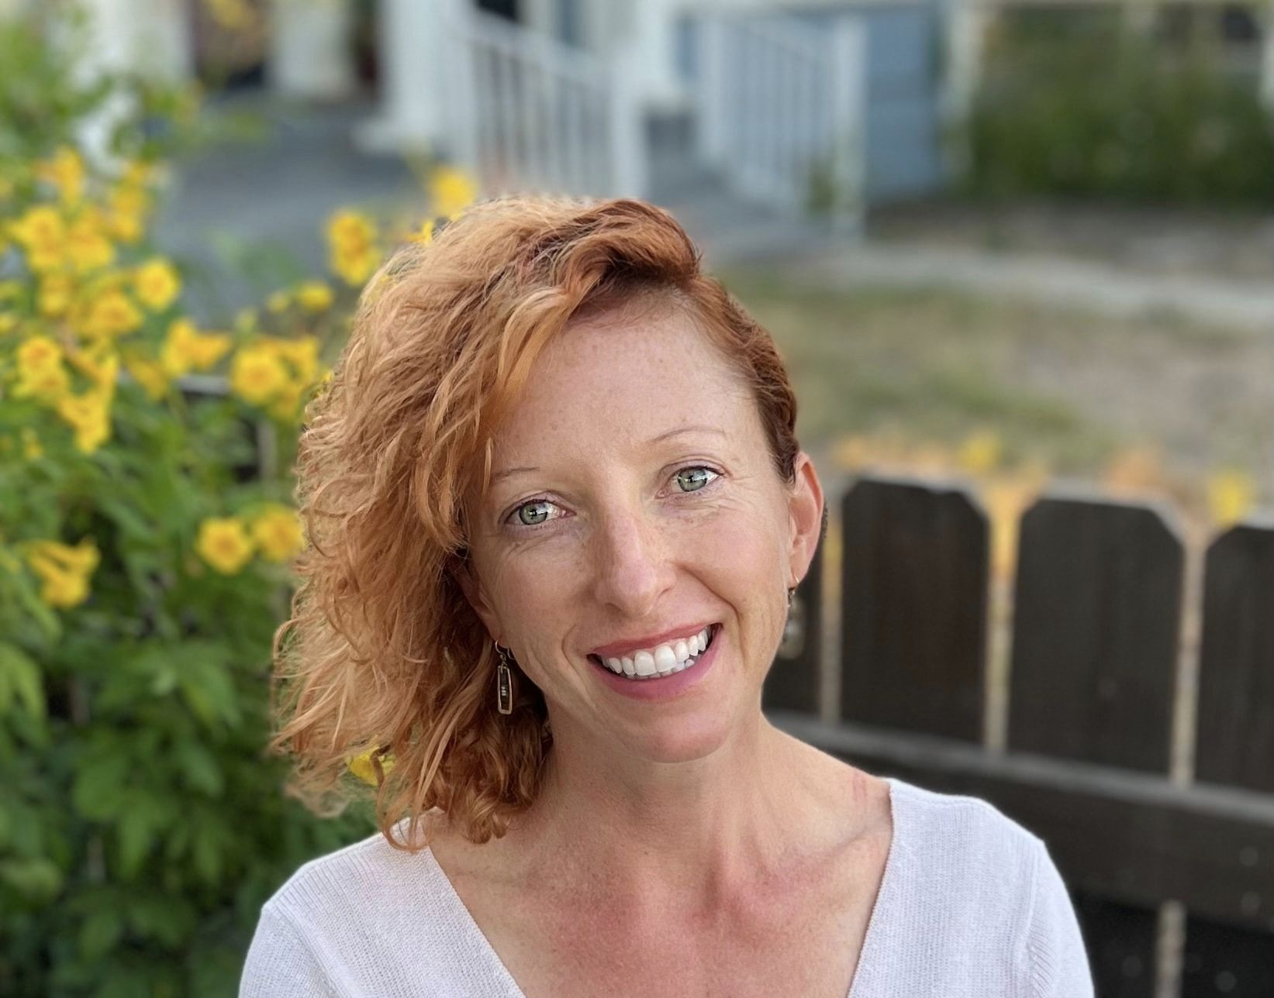
The Intercollegiate Civil Disagreement Partnership
Marie Pannier Feldmeier, Ph.D., Assistant Professor of Philosophy
Andrew Hill, J.D., Associate Professor of Philosophy
Jen Herringdine, Fellow
St. Philip’s College
March 31 - April 1, 2023

Slide 4
ICDP: Program Overview
ICDP is a consortium of five colleges and universities in the U.S. committed to reducing polarization by teaching students how to connect across political difference.
Goals
To bring together students from a range of public, private, two-year, and four-year institutions in order to develop their abilities to engage in and lead conversations about difficult, important topics across political difference;
To strengthen student-led initiatives seeking to reduce polarization on partner institutions’ campuses;
To contribute to research on important civic indicators like efficacy and engagement by documenting and measuring the effects of the program’s efforts

Slide 5
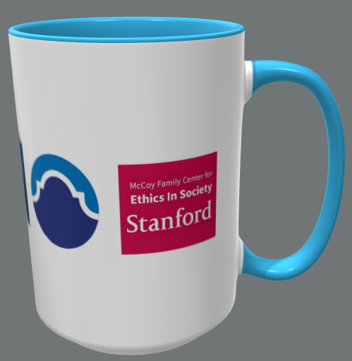
Participating Institutions
St. Philip’s College, San Antonio, TX
California State University, Bakersfield, CA
Santa Fe College, Gainesville, FL
Stanford University, Stanford, CA
Harvard University, Cambridge, MA
Schools & Leadership Team
Notes:
The partner institutions are intentionally and purposefully diverse. They include a mix of public and private institutions; two-year and four-year institutions; a historically Black college with a strong focus on education for military veterans; Hispanic-serving institutions; and two institutions research universities.

Slide 6
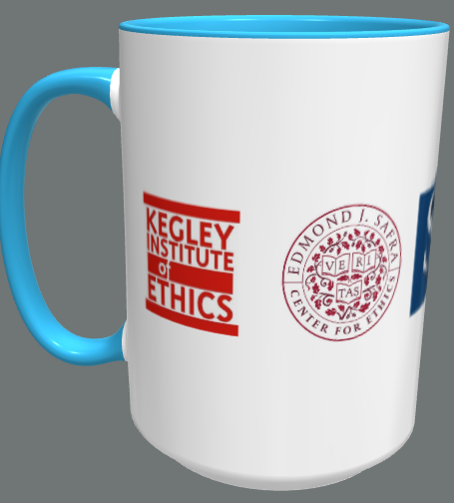
Program Model
8 students selected by application process (40 fellows total)
Year-long fellowship program
Zoom sessions: 2 hrs ~every 1-3 weeks
Slide presentations, facilitation skill tutorials, practice facilitation sessions & lectures
Closing capstone lectures with students facilitating post-event discussions

Slide 7
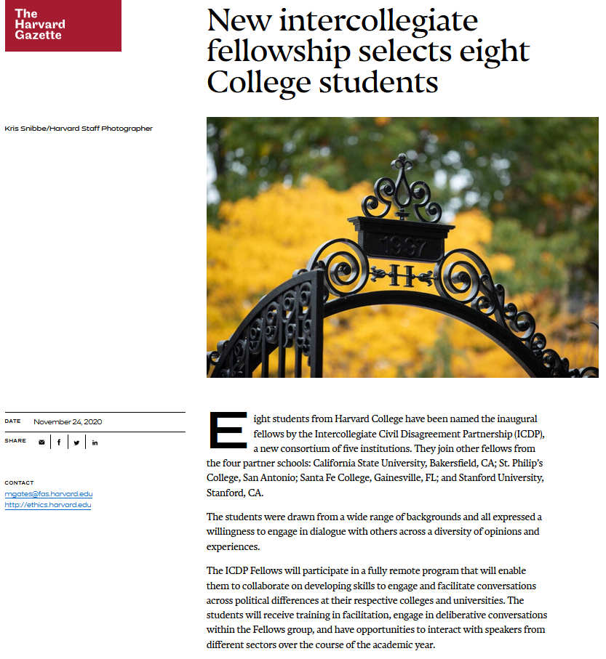
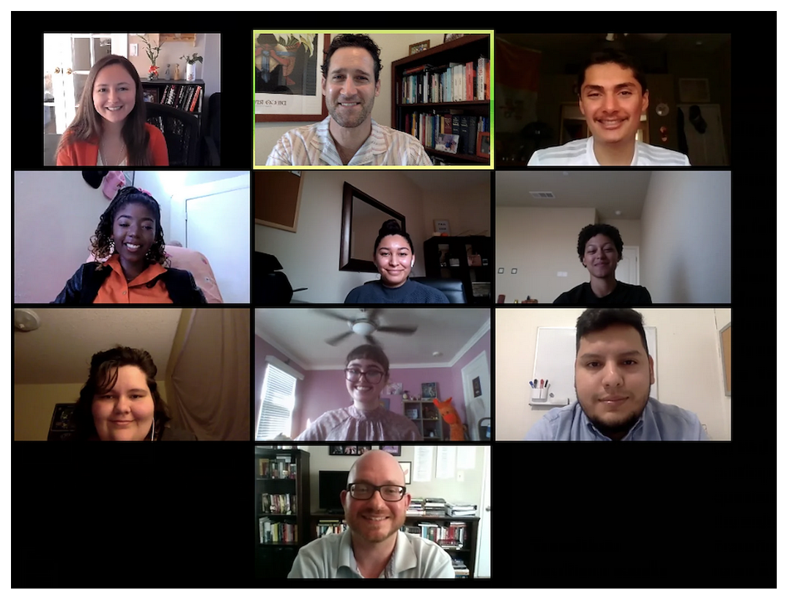
The Eight ICDP Fellows from
California State University - Bakersfield for AY 2020-2021

Slide 8
Program Development
Leadership team
1-3 faculty members from each institution
Met weekly to coordinate program management, brainstorm and provide feedback on pedagogy, address emerging challenges or issues
Highly collaborative!
Pedagogy Team
1-3 faculty members from each institution
Design pedagogy and programming with input and feedback from the leadership team and fellows
Building the plane while we were flying it! Sometimes scramble-y but also allowed for quick iteration, adaption, integration of student feedback

Slide 9
Program Calendar
Fall: Building community & foundational skills
Session 1: Orientation & Civic Self-Portraits
Session 2: Intentions, Agreements, Identities
Session 3: Triggers & Effective Questions
Session 4: Designing Effective Questions cont’d
Session 5: Institutional Group Reflections
Spring: Deepening skills & applying in practice
Session 6: Practice Facilitated Discussion
Session 7: Responding to Norm Violations
Session 8: Planning & Framing Difficult Conversations
Session 9: Practicing Facilitator Moves
Session 10: Misinformation
Session 11: Guest lecture, Lilliana Mason
Capstone Events: Climate change & Ibram X. Kendi
Session 12: Closing!
Notes:
https://drive.google.com/drive/folders/1MgiL5bbZ1yLzEQKhdhfKXXLzs0fxxGeQ?usp=sharing

Slide 10
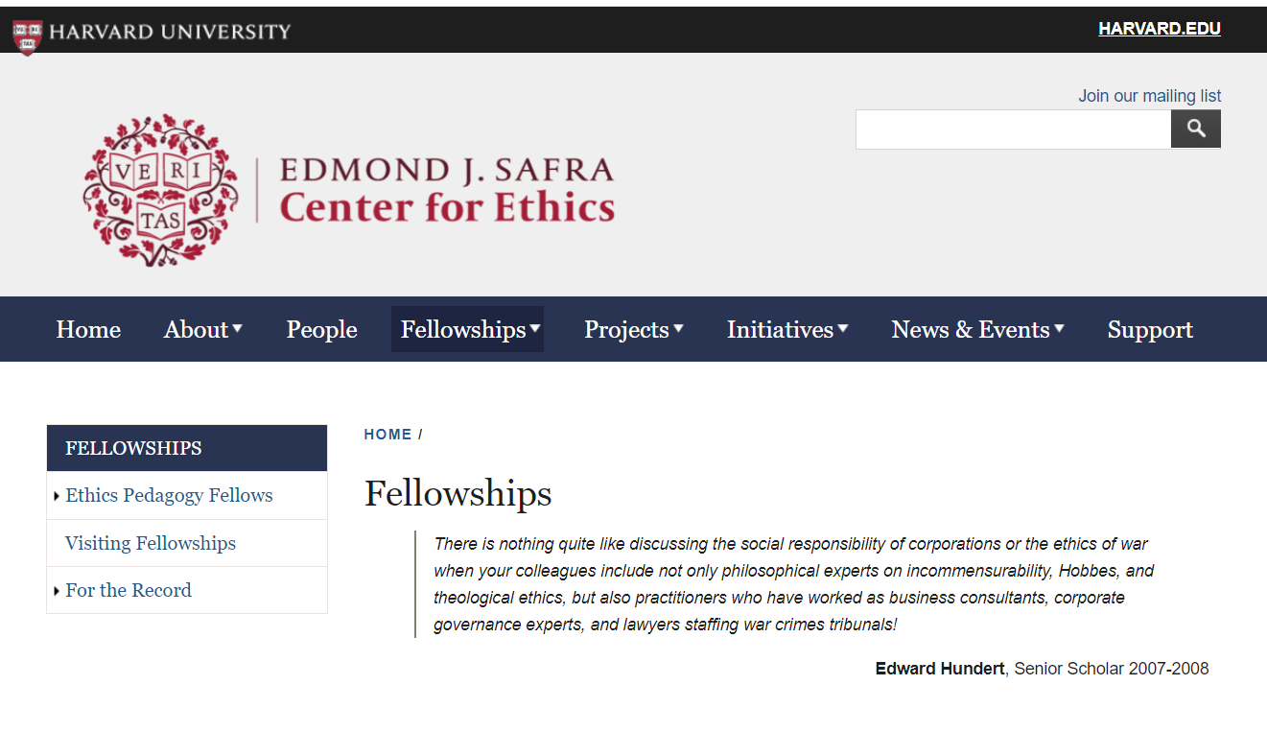
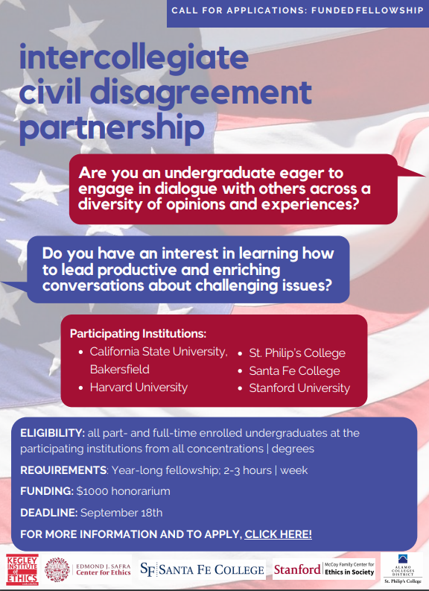
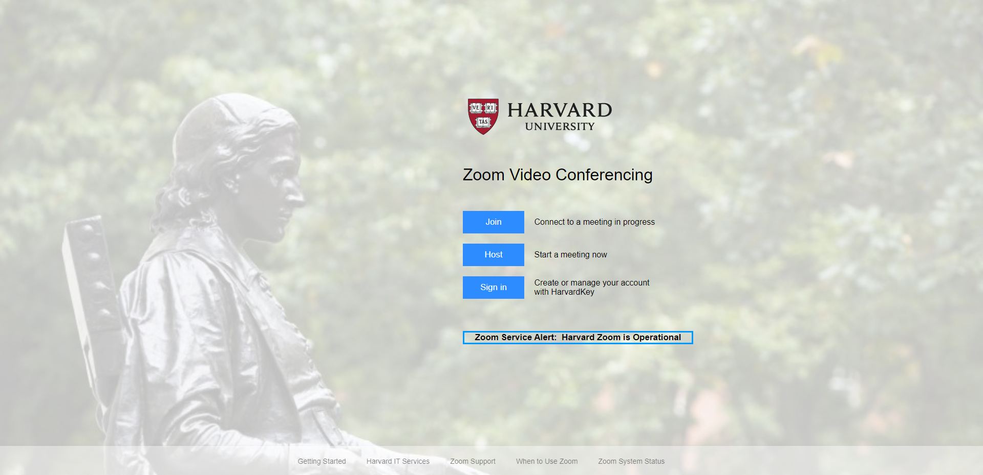

Slide 11
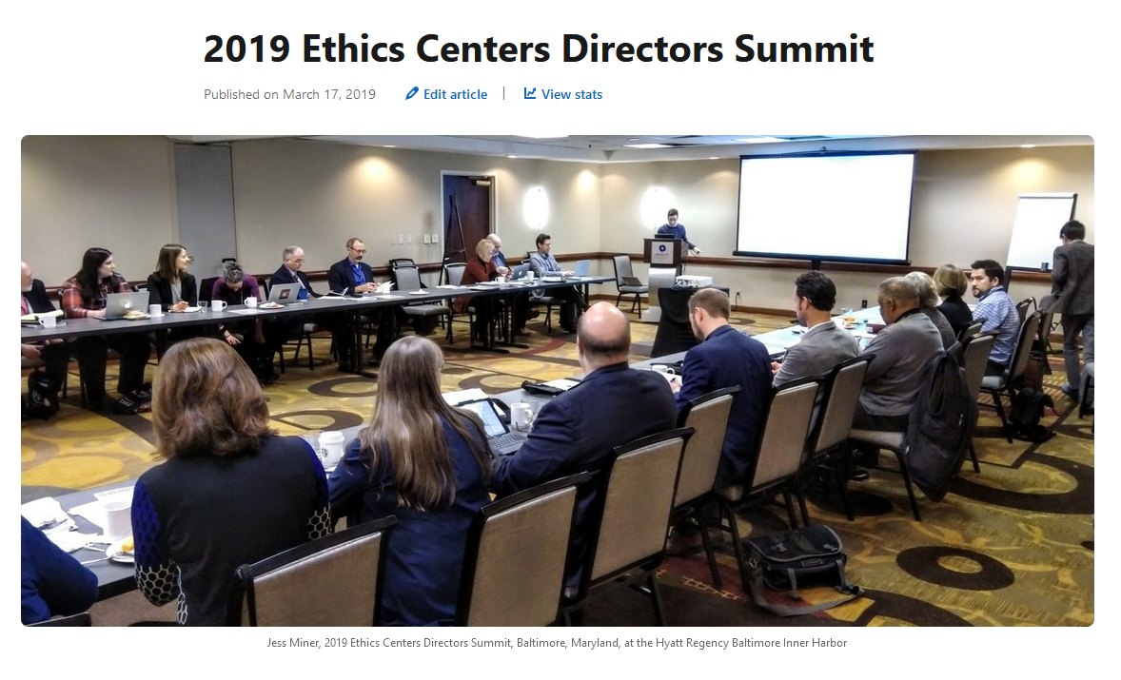

Slide 12
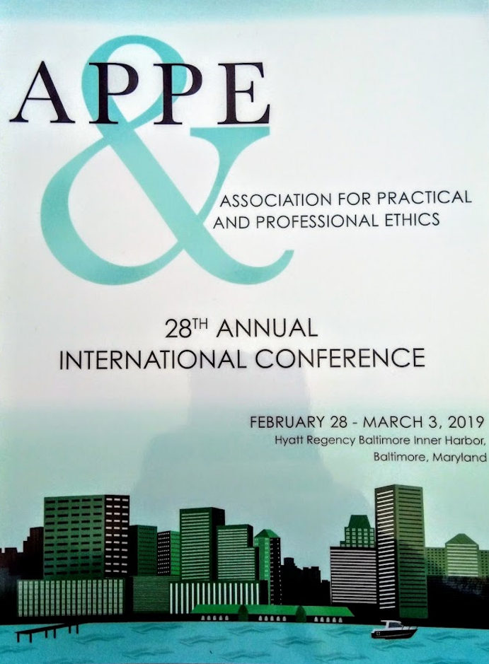
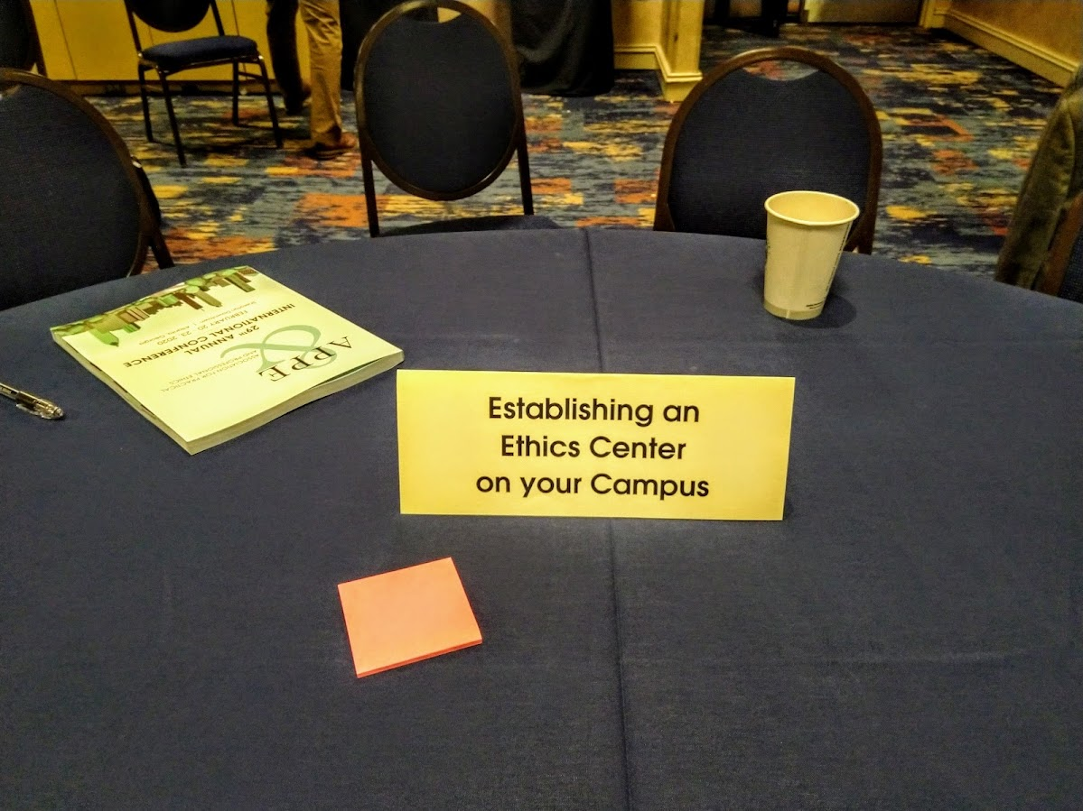

Slide 13
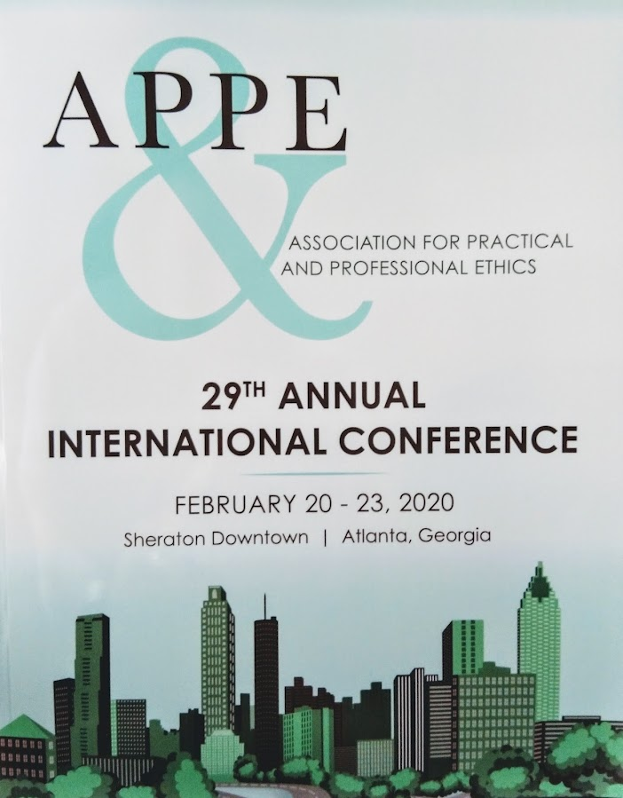

Slide 14
The Intercollegiate Civil Disagreement Partnership
(ICDP)

Slide 15
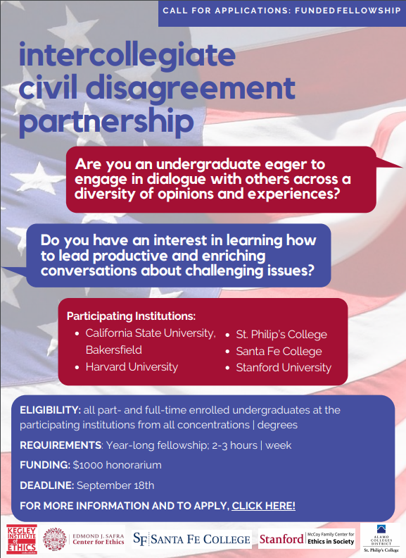
The Intercollegiate Civil Disagreement Partnership
(ICDP)

Slide 25
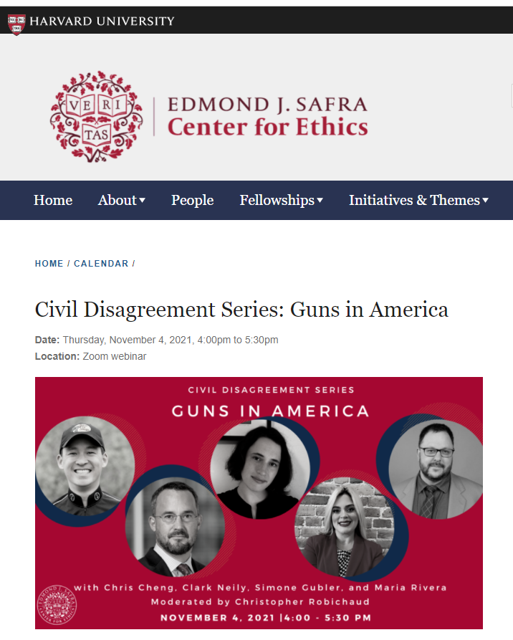
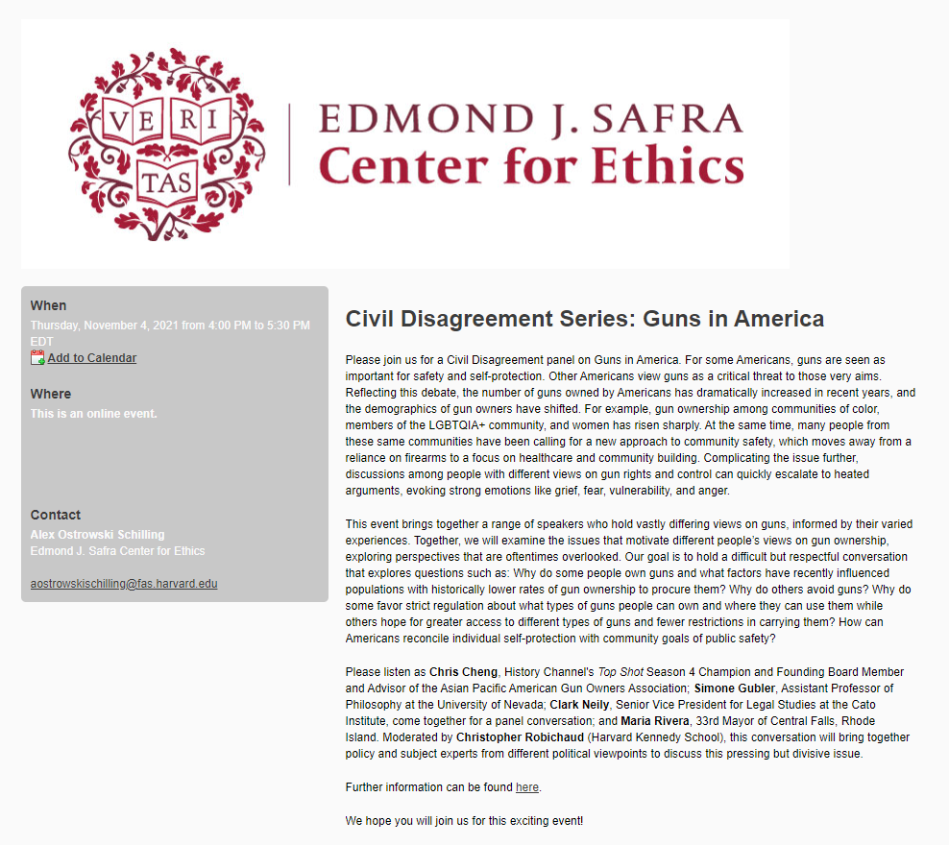

Slide 26
Reflecting on your fellowship experience as a whole, what do you feel you've gained or learned from your involvement this year? What do you feel worked well?
“I've learned to approach conversations from a point of wanting to understand a person's motivations and background for their viewpoints, rather than wanting to change their mind. I've also become more conscious of pushing back against my own views, trying to find scenarios that might cause me to add nuance to my perspective or evaluate why I think the way I do about certain issues. Finally, I've learned how to frame longer and planned conversations by starting from accessible questions that help define the problem and personal experiences, before getting into more normative/empirical evaluations of a polarizing topic.”

Slide 27
Reflecting on your fellowship experience as a whole, what do you feel you've gained or learned from your involvement this year? What do you feel worked well?
“It was wonderful to connect with students from other parts of the countries and with more diverse backgrounds than I usually interact with (more part-time, parents, veterans, etc.) - I hope that I may have gained some humility regarding the value of my own opinions, some wisdom from their thoughts, and some optimism from their example and our common work!”

Slide 28
Reflecting on your fellowship experience as a whole, what do you feel you've gained or learned from your involvement this year? What do you feel worked well?
“I feel equipped with more tools to approach heated conversations of all kinds--facilitated or others. In facilitated conversation, I have the opportunity for group norms, time, and (usually more) open minds to explore challenging topics. In other conversations, I have the opportunity to trust longer pauses, ask for clarity, or asking more questions as opposed to always feeling the need to have a response/come-back.”

Slide 29
Are there any specific examples you'd like to share of ways or times you've used skills, tools, or insights from the fellowship in your everyday life?
“1/6/2021 made this work seem incredibly important. Leaning on the empathy and processing skills I've learned in this fellowship has been helpful in processing the events and being hopeful moving forward.”

Slide 30
Are there any specific examples you'd like to share of ways or times you've used skills, tools, or insights from the fellowship in your everyday life?
“I live in a liberal town in the heart of a right-wing county. I work for an essential service provider, and at one point we were the only of our kind open during the pandemic. The residual tensions of the last year's events (masks vs anti-masks, race-based tensions) are still affecting my day to day at work, and removing my hat as a participator and learning how to be a facilitator has helped me navigate charged conversations with patients. These are conversations that are thrust upon me, without my explicit consent to engage. Approaching these conversations in a facilitator mindset has helped ease the mental struggle.”

Slide 31
Are there any specific examples you'd like to share of ways or times you've used skills, tools, or insights from the fellowship in your everyday life?
“Interestingly I found a lot of parallels between this fellowship and private conversations with friends/groups of friends about personal issues as well as in arguments. In general, any emotion interaction/communication allowed me to use facilitation skills to slow down a discussion and look at things more objectively and ensure that everyone's input is valued and heard.”

Slide 32
Questions?

Slide 33
The Intercollegiate Civil Disagreement Partnership
Marie Pannier Feldmeier, Ph.D., Assistant Professor of Philosophy
Andrew Hill, J.D., Associate Professor of Philosophy
Jen Herringdine, Fellow
St. Philip’s College
March 31 - April 1, 2023

