Slide 1
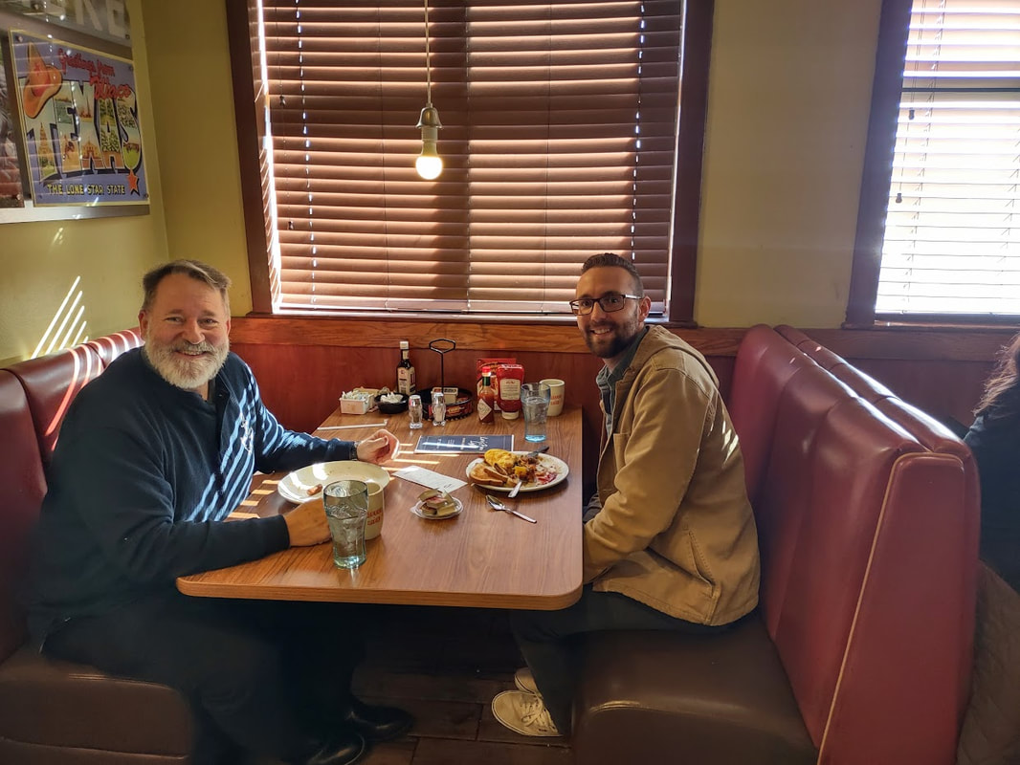
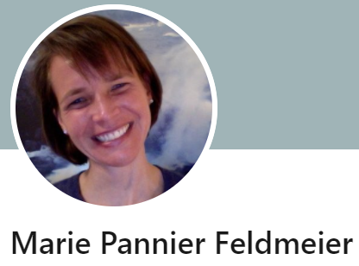
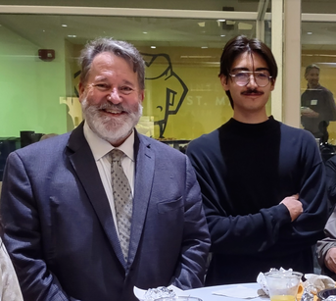
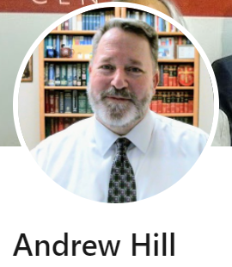
The Intercollegiate Civil Disagreement Partnership
Campus Connection Fellows:
Charlie Lucko (above) and
Ian Aguirre
AY 2022 – 2023 St. Philip’s College Fellows

Slide 2
ICDP: Three key Characteristics
What key characteristics do we need to know?
St. Philip’s College is a public, community college of 14, 000 students, but is also part of a large district that has a single chancellor and a single board of trustees for all five colleges.
It is the only college in the USA that is both a historically black (HBCU) and a hispanic serving institution (HSI).
It is located on the east side of San Antonio, which is historically the most economically distressed part of San Antonio and the center of the African American community.

Slide 3
The Speech Climate
Chilled (Currently)
Active (Historically)
Promising
Three Words
Notes:
The partner institutions are intentionally and purposefully diverse. They include a mix of public and private institutions; two-year and four-year institutions; a historically Black college with a strong focus on education for military veterans; Hispanic-serving institutions; and two institutions research universities.

Slide 4
Biggest Needs
Protections (No Tenure)
The ICDP (Needs Expansion)
More Outlets (Across the Campus)

Slide 5
Biggest Strengths & Opportunities
Our College History
The ICDP Program
The District Structure

Slide 6
Key Questions
Short Term: How do we resume our evaluation given our current “Paused” status?
Medium Term: How do we scale up or expand ICDP?
Long Term: How do sustain a permanent environment?

