Slide 1
Community Engagement in San Antonio, Texas
Vladimer Narsia
Fulbright Scholar-in-Residence
St. Philip’s College, Northwest Vista College
San Antonio, Texas.

Slide 2
St. Philip’s College San Antonio, Texas

Slide 3
Northwest Vista College San Antonio, Texas

Slide 4
St. Philip’s College and Northwest Vista College S-I-R Engagement

Slide 5
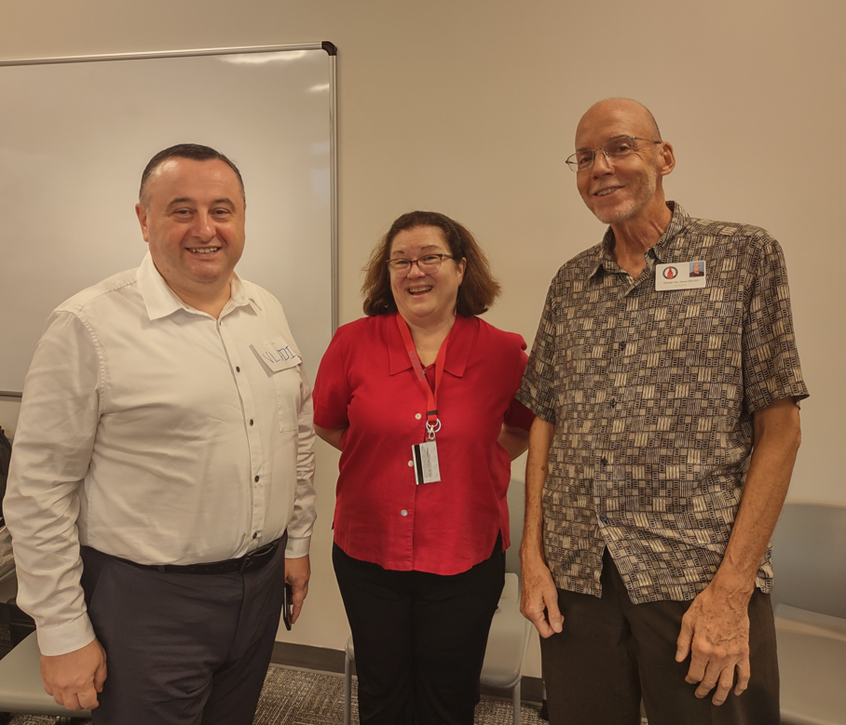
University of the Incarnate Word San Antonio

Slide 6
Little Flower Basilica Elementary School San Antonio, Texas

Slide 7
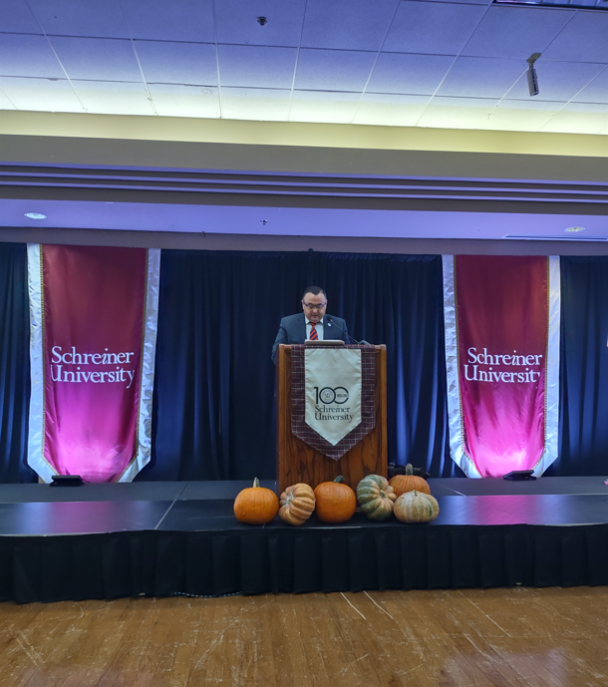
Schreiner University Kerrville, Texas

Slide 8
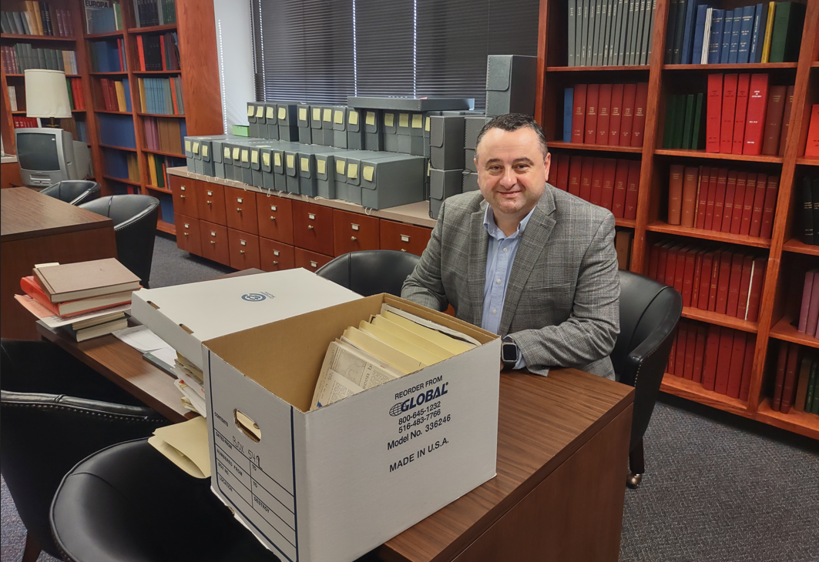
Baylor University Waco, Texas

Slide 9
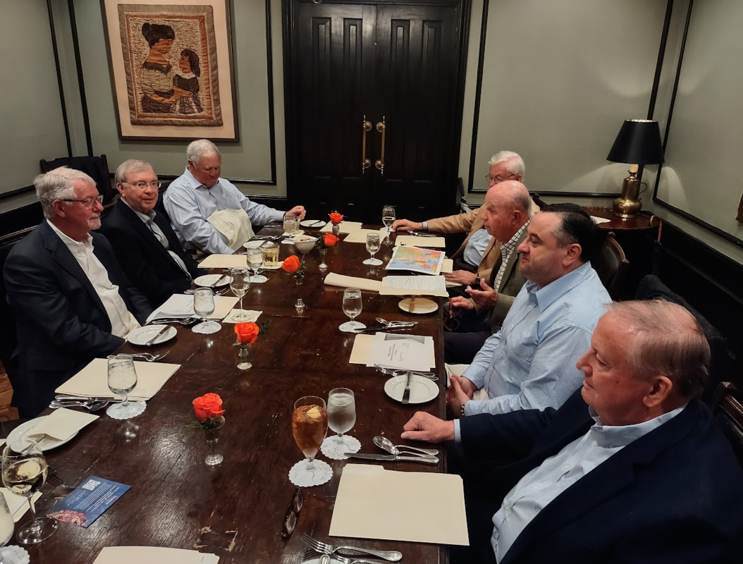
Rotary Club and Peace Center San Antonio

Slide 10
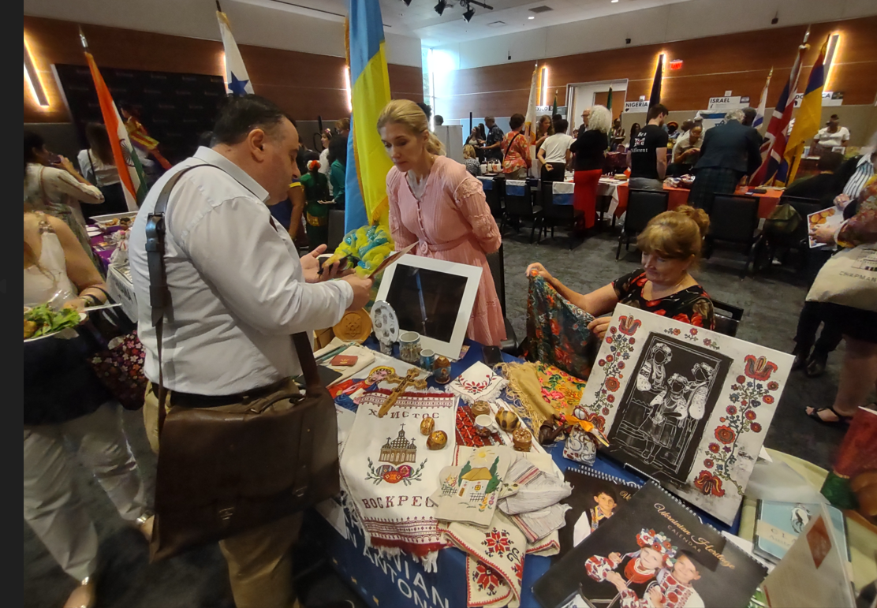
The World Affairs Council San Antonio, Texas

Slide 11
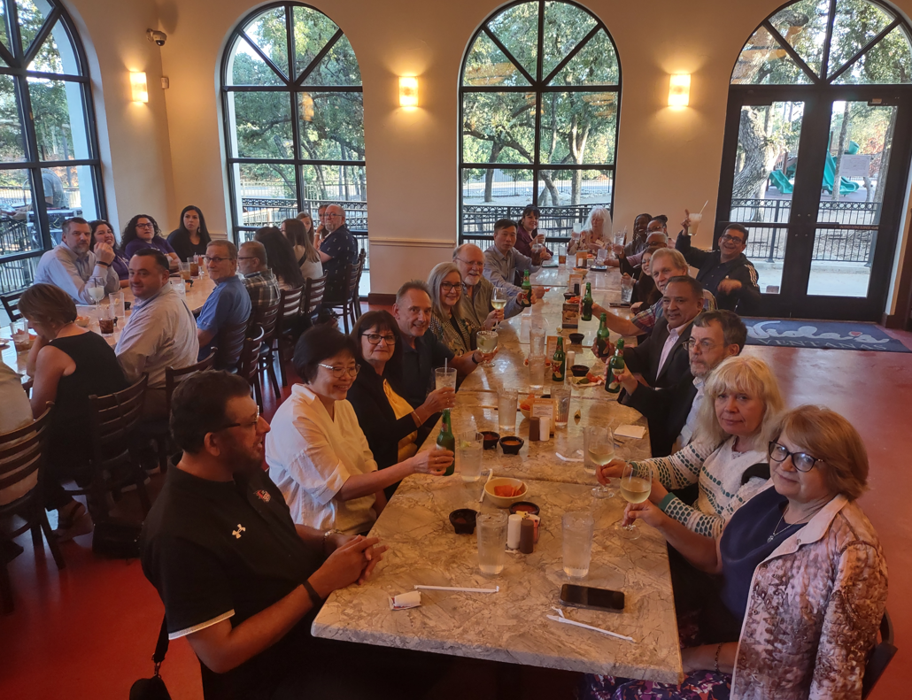
San Antonio Chapter of the Fulbright Association President of the Chapter: Prof. Andrew J. Hill

Slide 12
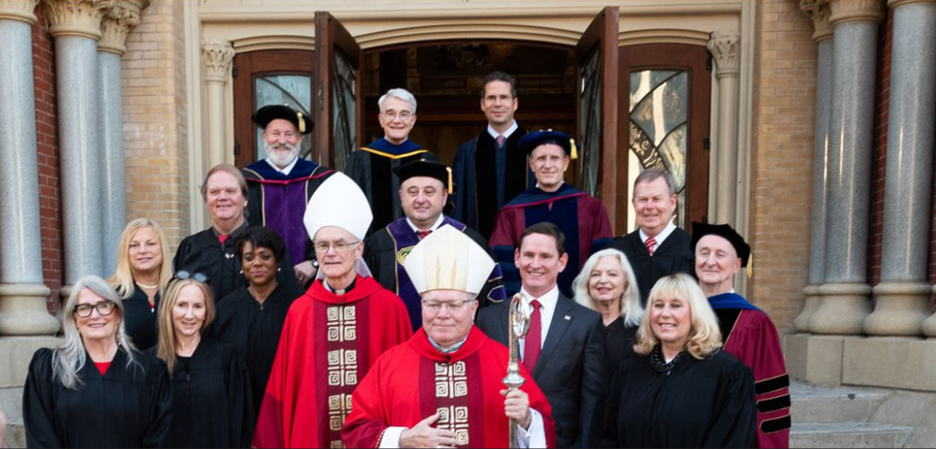
Red Mass Dallas, Texas

Slide 13
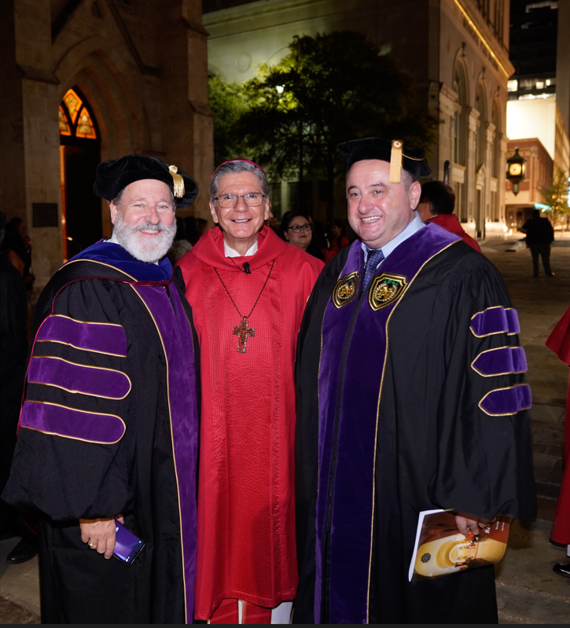
Red Mass San Antonio

Slide 14
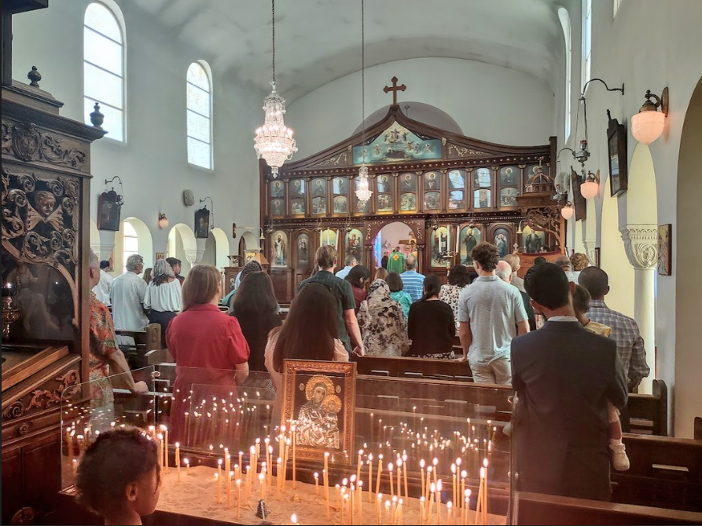
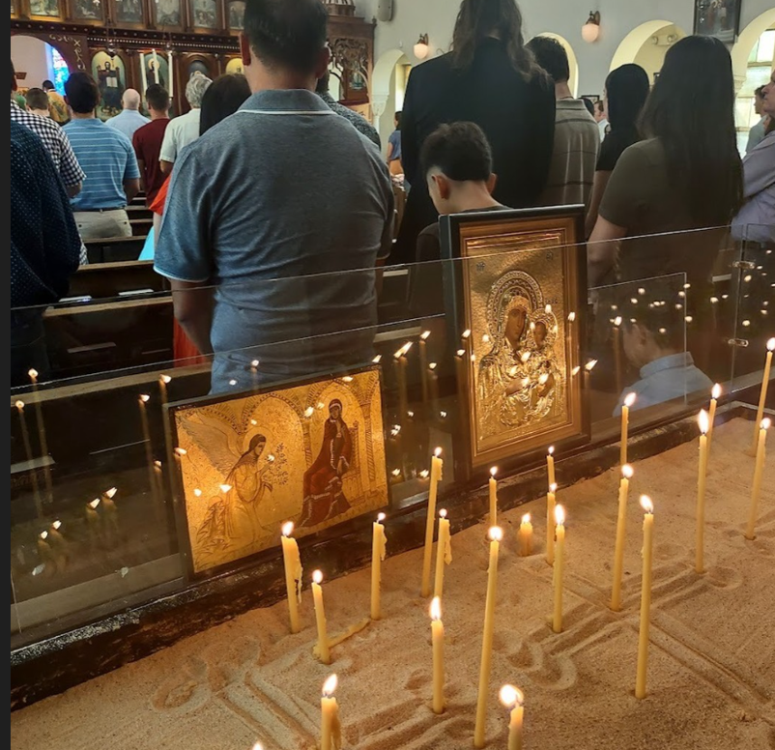
St. Sophia’s Greek Orthodox Church San Antonio, Texas

Slide 15
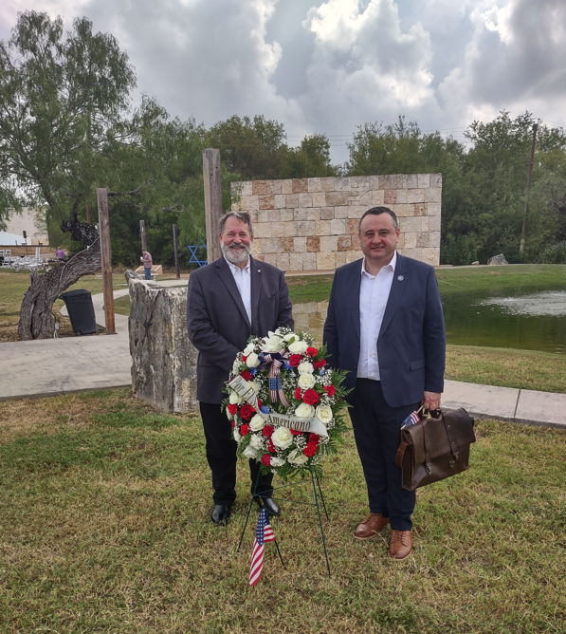
New Life Christian Church

Slide 16
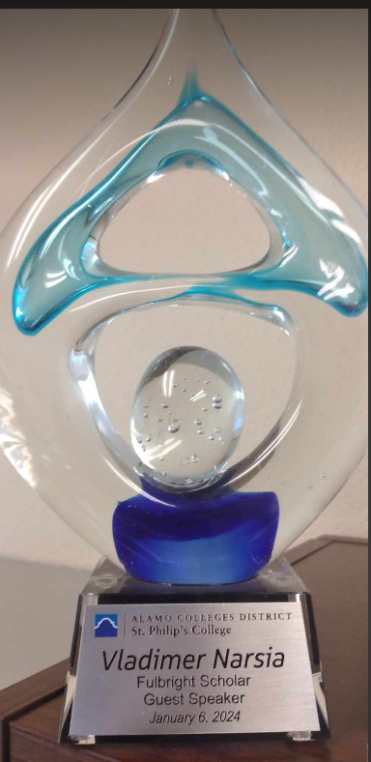
Prizes Awarded

Slide 17
Prof. Vladimer Narsia
vladimer.narsia@fulbrightmail.org

